Slide 1
ITI – Intake 39 – Embedded Systems Track
Digital Hearing Aid
Graduation Project
Team Members:-
Hanna Nabil.
Bishoy Medhat.
Under the supervision of:-
1) Eng.\ Ahmed Al-Ashmawy.
2) Eng.\ Yousef Nofel.

Slide 2
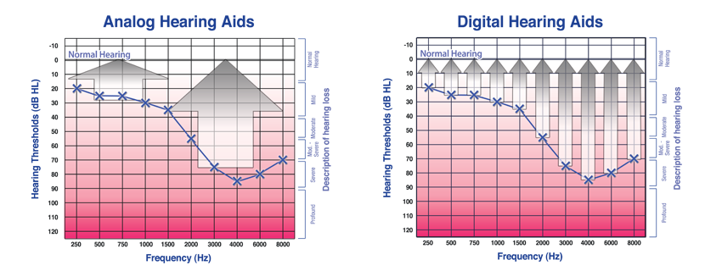
Why digital hearing aid?
- Analog vs digital

Slide 3
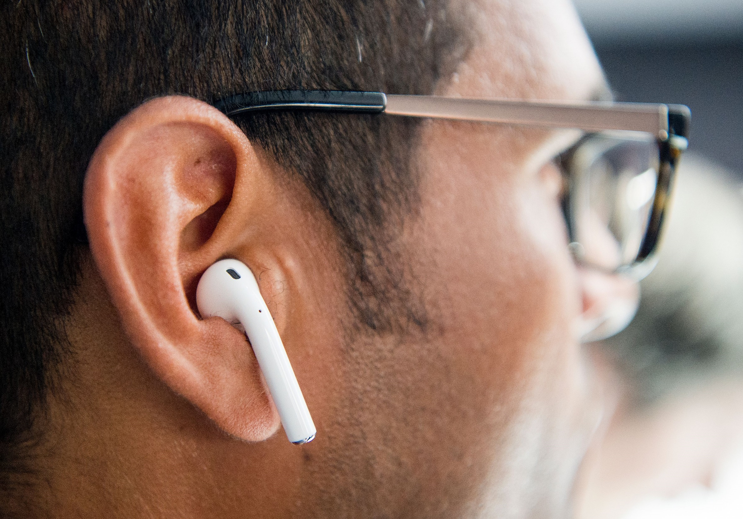
Product Idea
Appearance
Cost
Mobile App

Slide 4
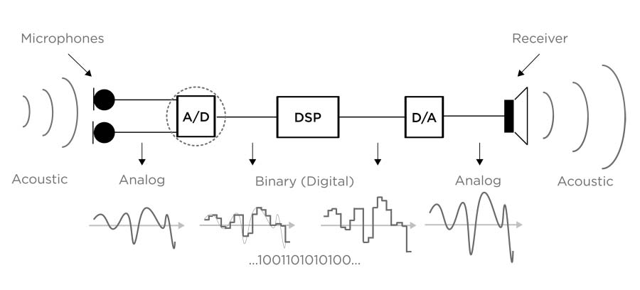
Early Prototype

Slide 5
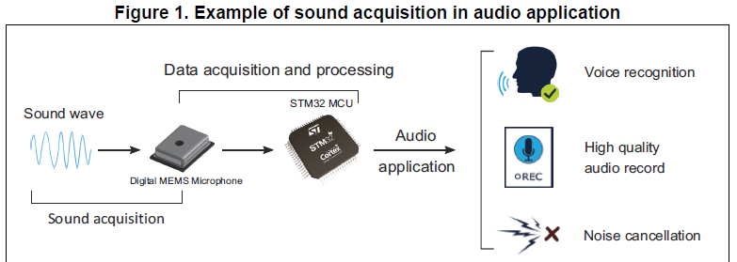
Project Description

Slide 6
Block Diagram
STM32
Audio Codec
Option 1
MEMS Microphone
PDM Data
I2S Peripheral
I2S Peripheral
DMA
PDM Data
Clock Signal
Headphones
DAC
Wired
CPU
RAM
PCM Data
PCM Data
DSP Filters
Audio Bluetooth
I2S Peripheral
PCM Data
Bluetooth Earphone
DMA
I2S Peripheral
Option 2
A2DP Peripheral
Wireless

Slide 7
Block Diagram
STM32
Audio Codec
MEMS Microphone
PDM Data
I2S Peripheral
DMA
PDM Data
Option 1
Clock Signal
I2S Peripheral
CPU
PDM Data
RAM
Headphones
DAC
Wired
PCM Data
PDM Filter
Audio Bluetooth
PCM Data
DSP Filters
I2S Peripheral
PCM Data
Bluetooth Earphone
Option 2
DMA
I2S Peripheral
A2DP Peripheral
Wireless

Slide 8
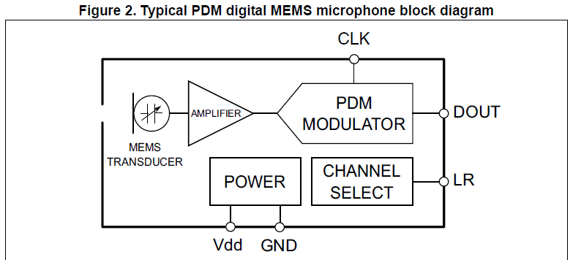
MEMS Microphones
- The digital MEMS microphone is a sensor that convert acoustic pressure waves into a digital signal.

Slide 9
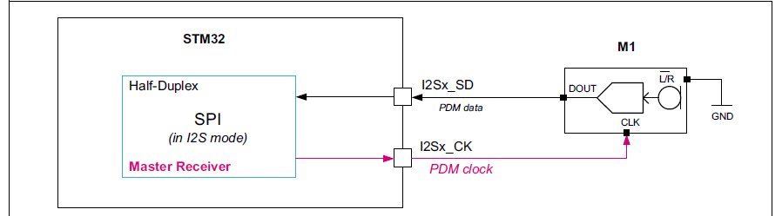
I2S Protocol
- The I2S protocol is widely used to transfer audio data from a microcontroller/DSP (Digital Signal Processor) to an audio codec.
- In order to play melodies or to capture sound from a microphone.

Slide 10
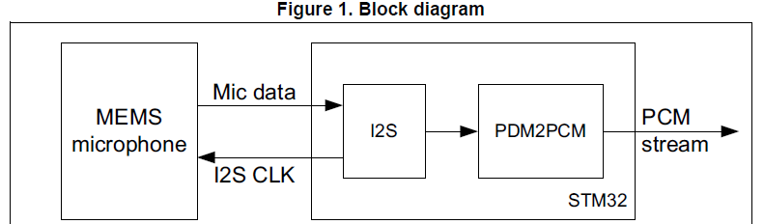
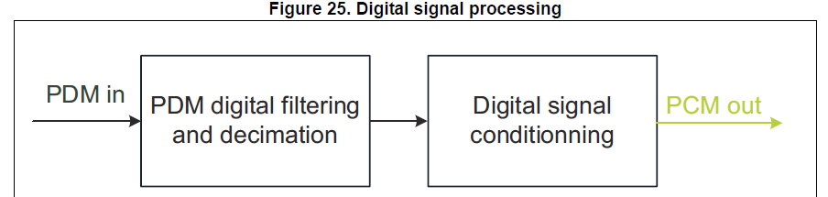
PDM2PCM Conversion

Slide 11
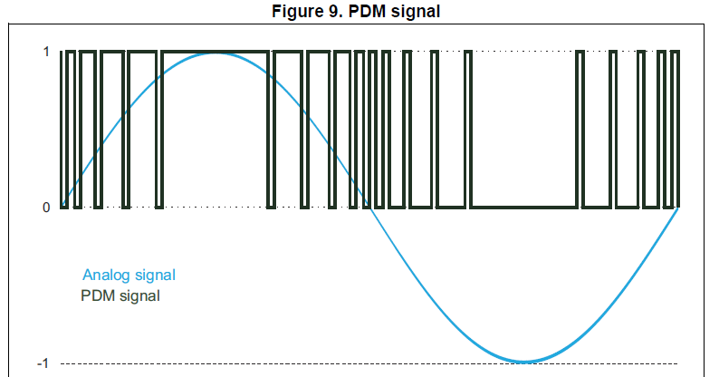
PDM Signal
- A large cluster of 1s correspond to a high (positive) amplitude value.
- A large cluster of 0s correspond to a low (negative) amplitude value.
- Alternating 1s and 0s correspond to a zero amplitude value.

Slide 12
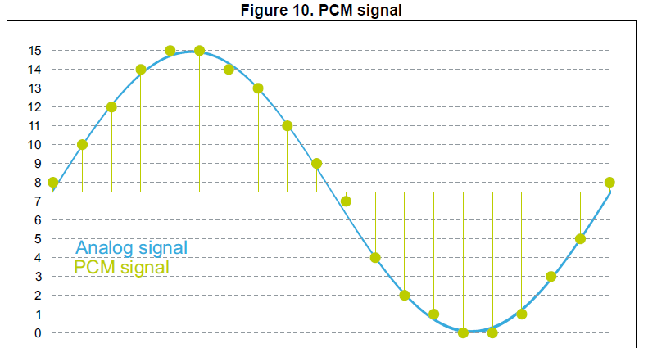
PCM Signal
- Specific amplitude values are encoded into pulses.
- The sampling rate is the number of samples of a signal that are taken per second to represent it digitally.
- The bit depth determines the number of bits of information in each sample.

Slide 13
Block Diagram
Audio Codec
STM32
Option 1
MEMS Microphone
PDM Data
I2S Peripheral
I2S Peripheral
DMA
PDM Data
Clock Signal
Headphones
DAC
Wired
CPU
RAM
PCM Data
PCM Data
Mobile App
Band , Gain
DSP Filters
Audio Bluetooth
I2S Peripheral
PCM Data
Bluetooth Earphone
DMA
I2S Peripheral
Option 2
A2DP Peripheral
Wireless

Slide 14
DSP

Slide 15
Hardware Components
Stm32F446RC : (DAC – I2S - FPU)
MEMS MIC : MP34DT06

Slide 16
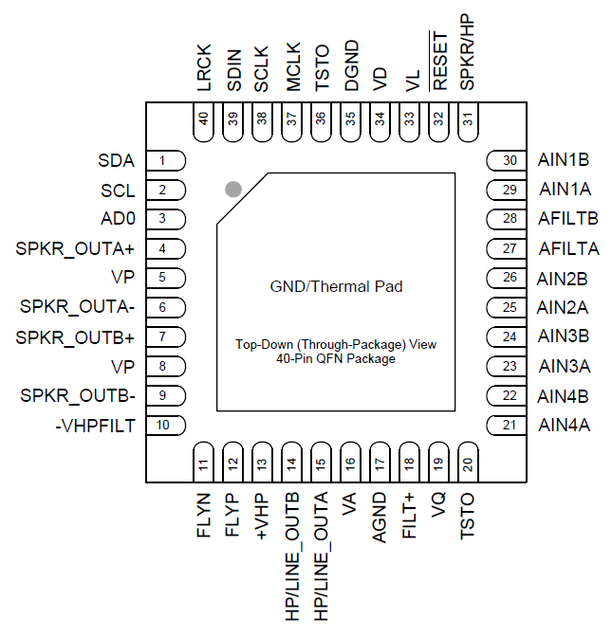
Audio codec (CS43L22)
- The control port operates using an I²C interface.
- The audio port operates using an I²S interface.
- The CS43L22 is a highly integrated, low power, 24-bit audio DAC comprised of a Digital Signal Processing Engine, headphone amplifiers, a digital PWM modulator and two full-bridge power back-ends.

Slide 17
Audio Bluetooth module (WT32I-A-AI6)

Slide 18
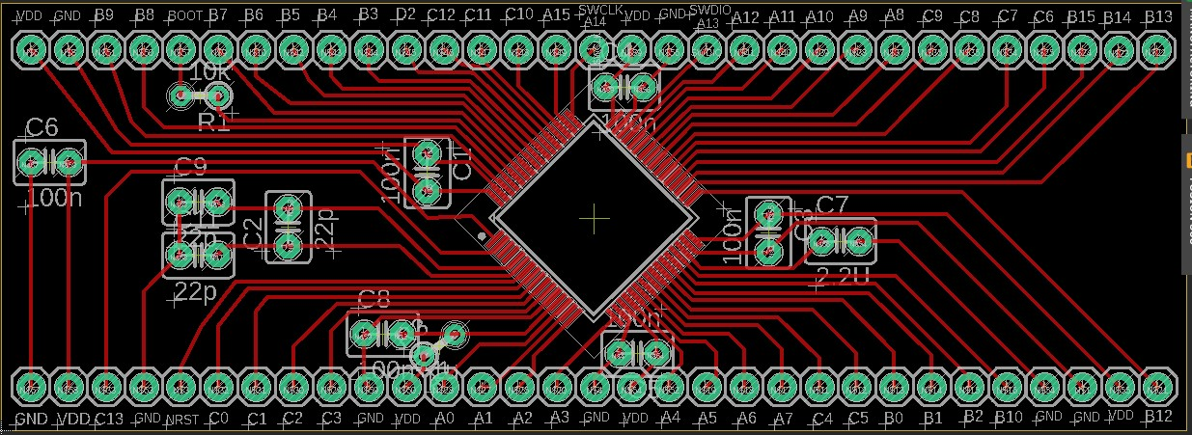
PCB Designs
- STM32F446RC (Version 1):-

Slide 19
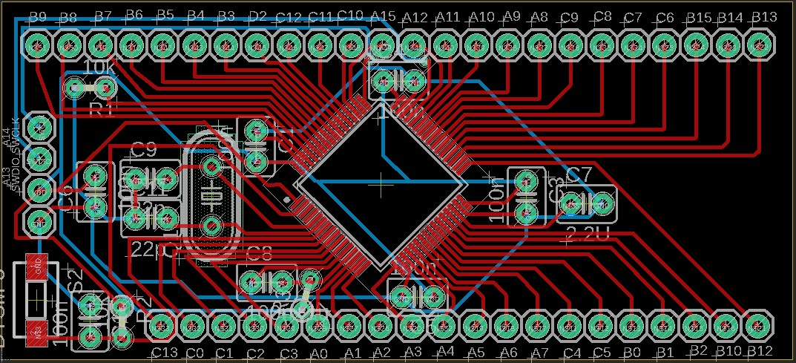
PCB Designs
- STM32F446RC (Version 2):-

Slide 20
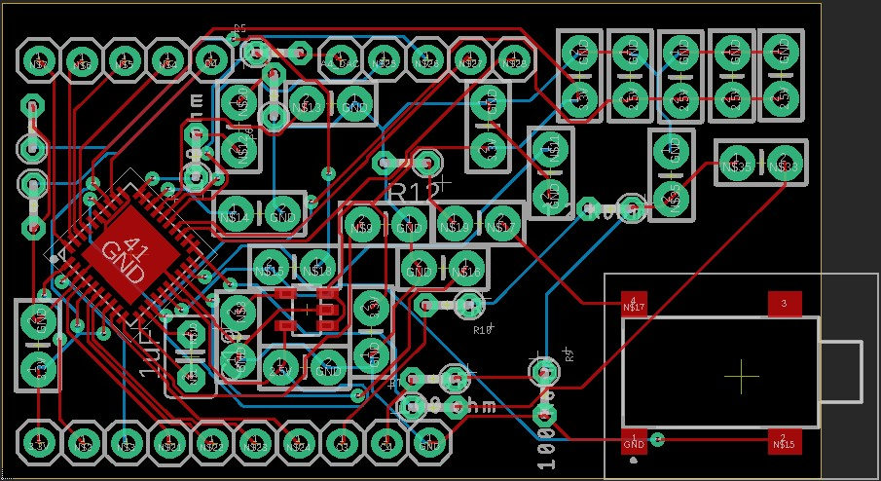
PCB Designs
- CS43L22-CNZ with Analog Pins:-

Slide 21
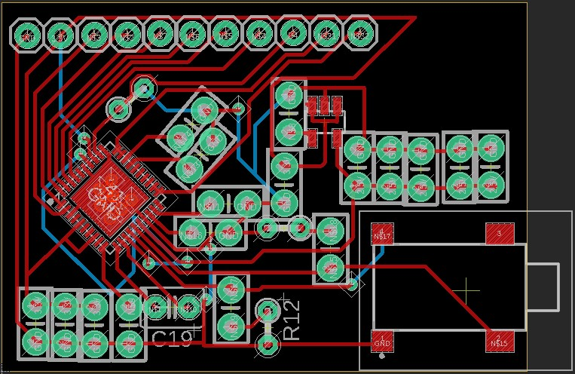
PCB Designs
- CS43L22-CNZ without Analog Pins:-

Slide 22
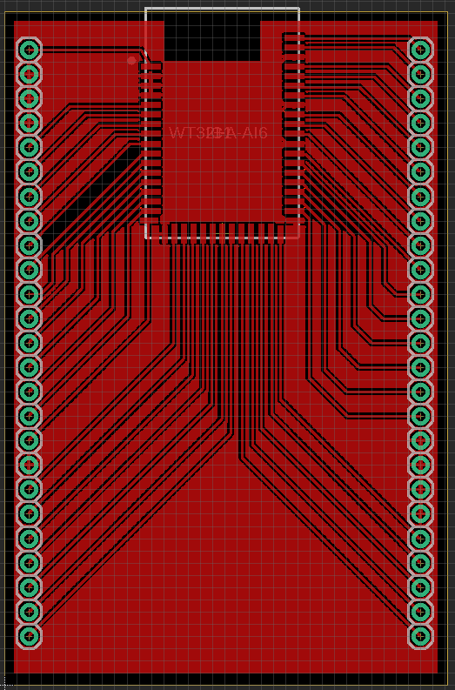
PCB Designs
- Audio Bluetooth Module (WT32I-A-AI6):-

Slide 23
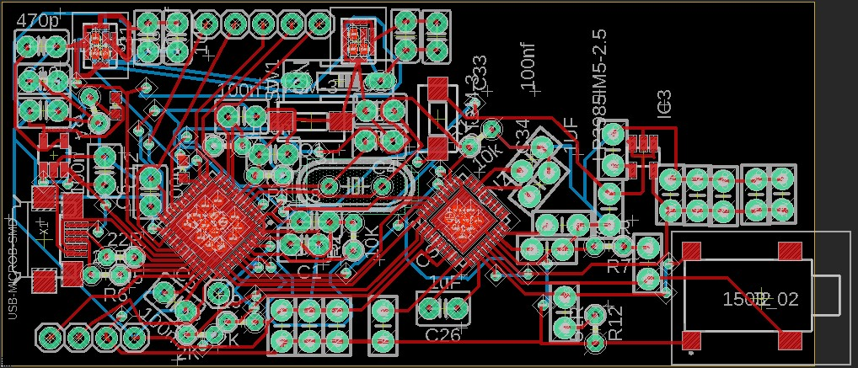
PCB Designs
- STM32F413CG (Version 1) with Audio Codec:-

Slide 24
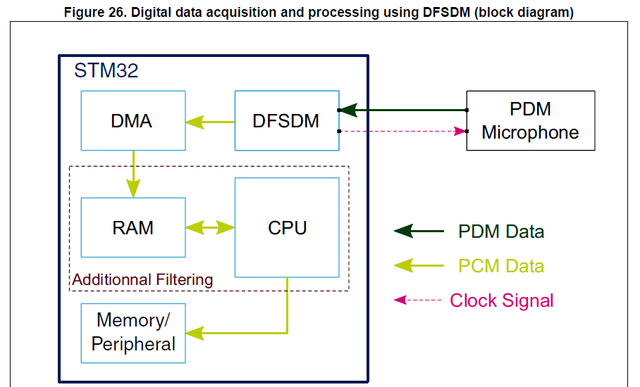
Our Next Step

Slide 25
Mobile App

