Slide 1
BUILD A WEB APPLICATION TO MANAGE MRI IMAGE DATA OF A CLINIC

Slide 2
Contents
I. OVERVIEW
1. About
2. Class
3. Topic
4. Roles
5. Why Need MRI Image Manager
6. What MRI Image Manager Do
II. THEORETICAL BASIS
1. Research Topic
2. Summary
3. Analysis and Evaluation
4. Conclusion
III. PROJECT CONTENT
1. UI Design
2. Function
3. Database
IV. RESULT

Slide 3
OVERVIEW
01
03
05
02
04
06
About
Topic
Why ?
Members:
Phạm Gia Phúc
Trần Đắc Minh
Đỗ Hoàng Quân
Đặng Gia Linh
-Build a web application
-Used: HTML,Javascript,PHP,SQL
Much more efficient than paper bases
Easy to manage
Easy to use
Class
Roles
What ?
ICT
Ui designer & coding: Quân
Function developer: Phúc
Dataset & Php developer:Minh
Document researcher and summary : Linh
-Provide information of the clinic
-Create and store patient MRI data
-Read MRI data

Slide 4
THEORETICAL BASIS

Slide 5





1.Research topic:
Build a web application to manage MRI image data of a clinic
Language: HTML, CSS, Javascript, PHP, SQL
II. SUMMARY:

Slide 6
III.Analysis and Evaluation:
IV.Conclusion:
HTML is standard markup language, easy to study and use, minimal flaws.
CSS is easy to study but pretty hard to use.
Javascript is a stable programming language.
PHP is a powerful language but hard in usage.
SQL is a great language for working with kinds of data.

Slide 7
PROJECT CONTENT

Slide 8

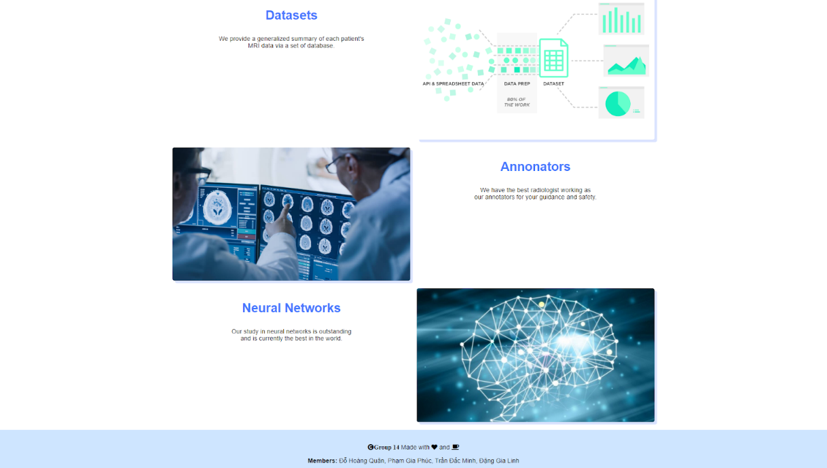
UI DESIGN
HOME PAGE

Slide 9
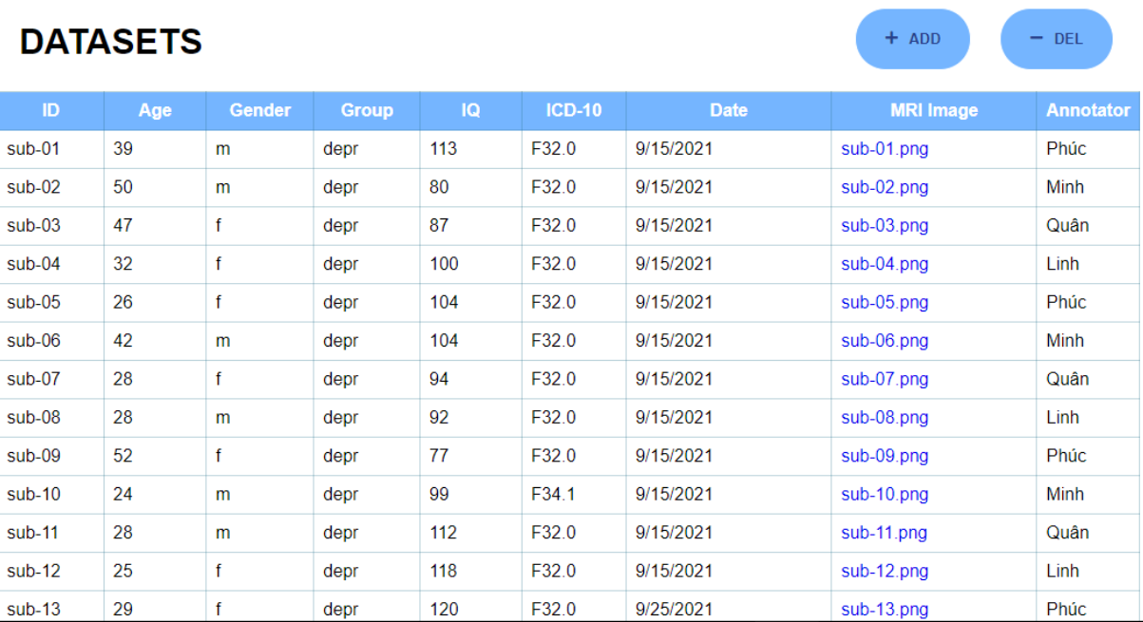
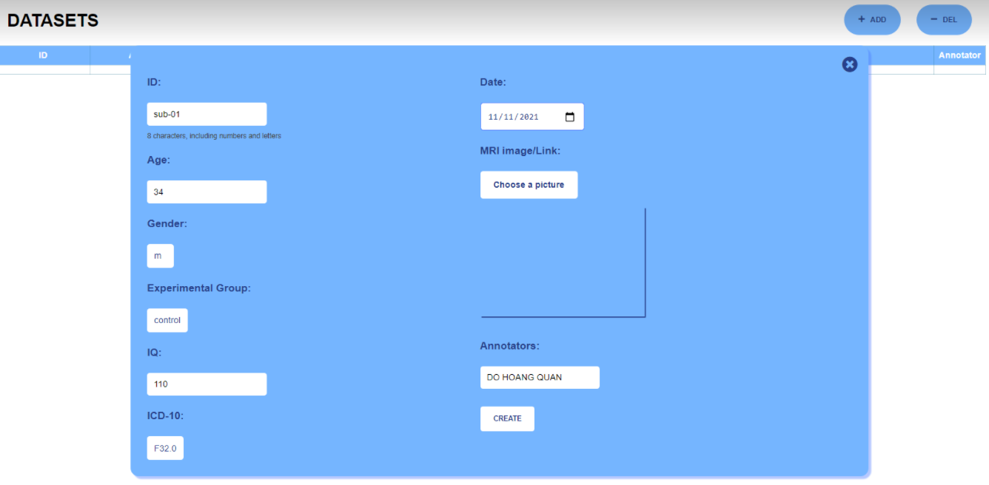
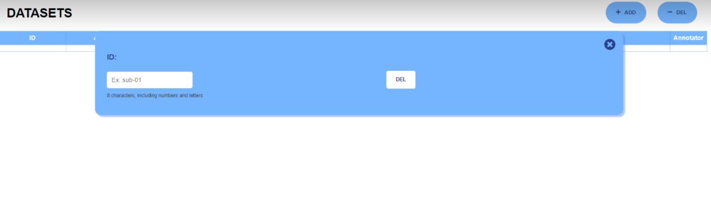
SERVICES PAGE: Datasets

Slide 10
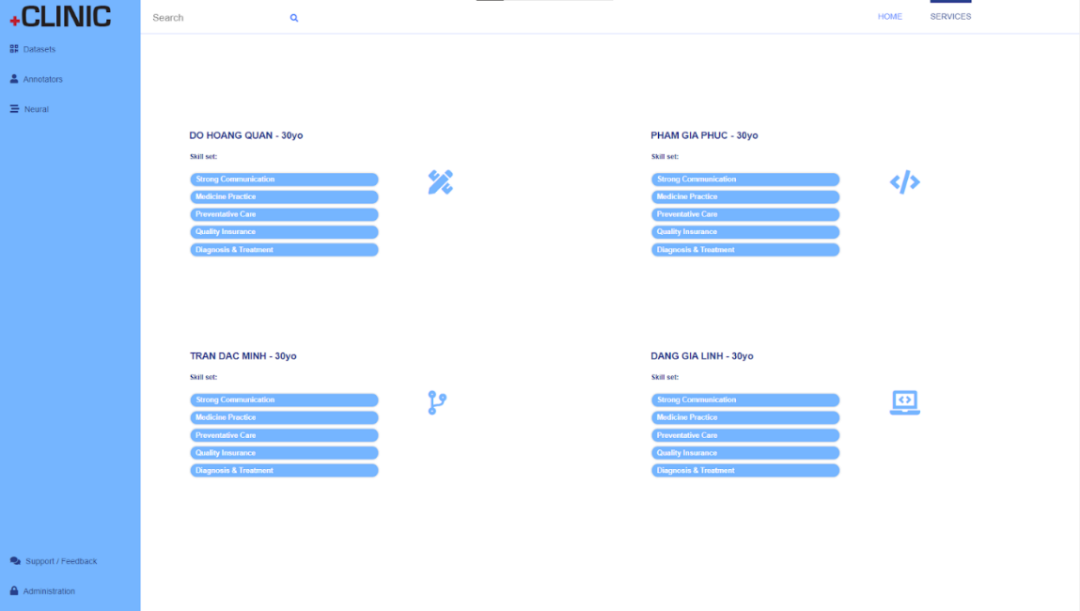
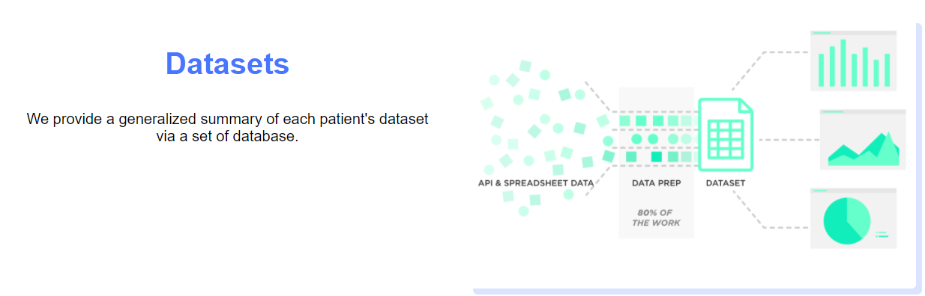
STAFF PAGE
Function:

Slide 11
Read and display dataset
Read and display Database.
Contains 6 categories:
ID
Age
Gender
Group
IQ
ICD-10
Date
MRI Image
Annotator

Slide 12
Create MRI dataset
Adding function to create new information of patient.
Input value of categories and new information of patients is created.

Slide 13
Store MRI Dataset
Added and saved to the database
Database being displayed in the table ò data.

Slide 14
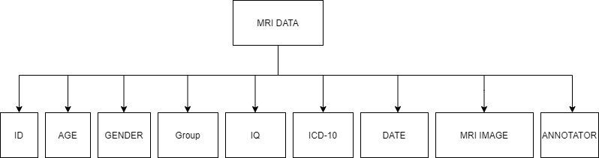
Database
Data descriptions
ID – participants identifier
Age – age of participants
Gender – male/female (m/f)
Group – depressed/healthy control (depr/control)
IQ – IQ scores on Raven's Progressive Matrices (0 – 200)
ICD-10 – International Statistical Classification of Diseases and Related Health Problems 10th Revision
"F32.0": "Mild depressive episode"
"F32.1": "Moderate depressive episode"
"F34.1": "Dysthymia"
"F34.9": "Persistent mood disorder, unspecified"
Date – format of dd/mm/yyyy
MRI Image – link to MRI image
Annotators

Slide 15
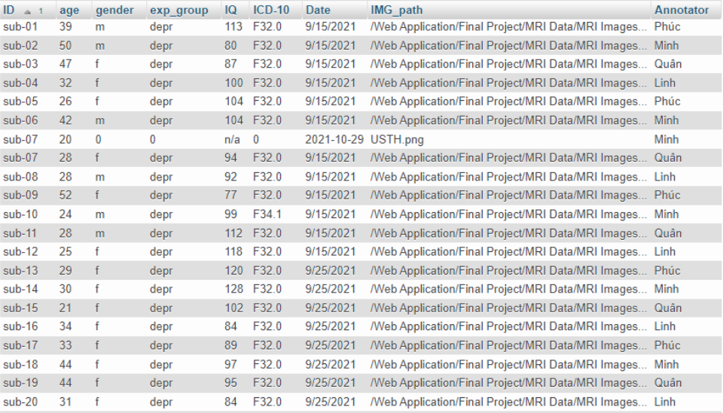

Slide 16
Result
Menu

Slide 17
MRI Image Manager.
Simple user interface.
Friendly.
Detailed database.
Be able to search all kinds of categories.
Lack of response.
Do the typing work.
Can not edit specify information in database.

Slide 18

Thank you for
listening

