Slide 1
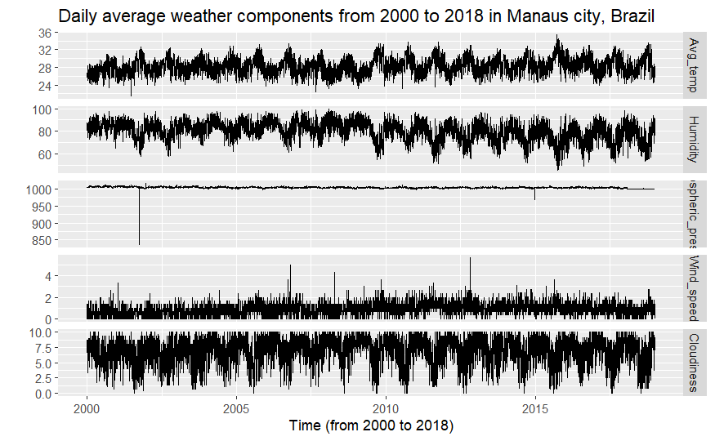
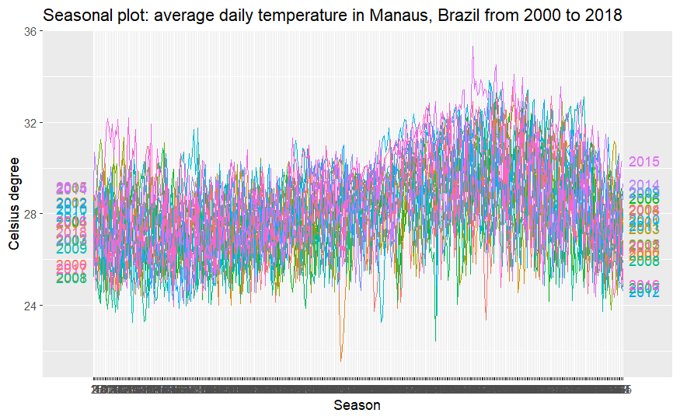
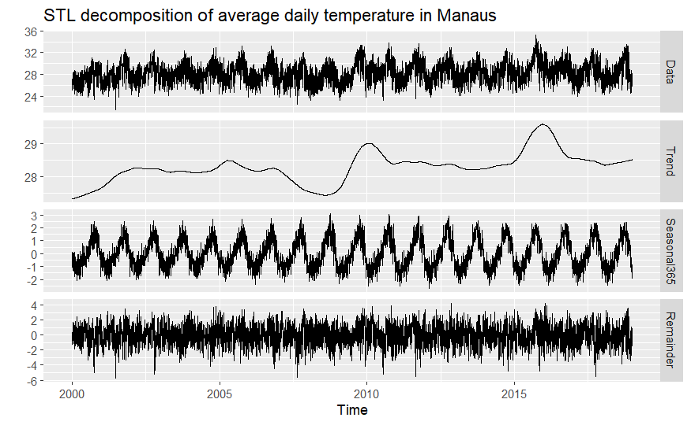
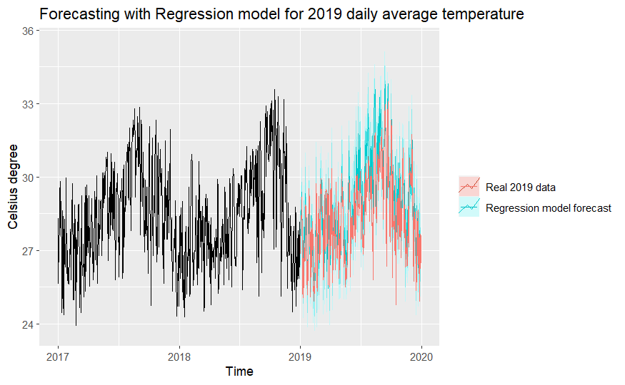
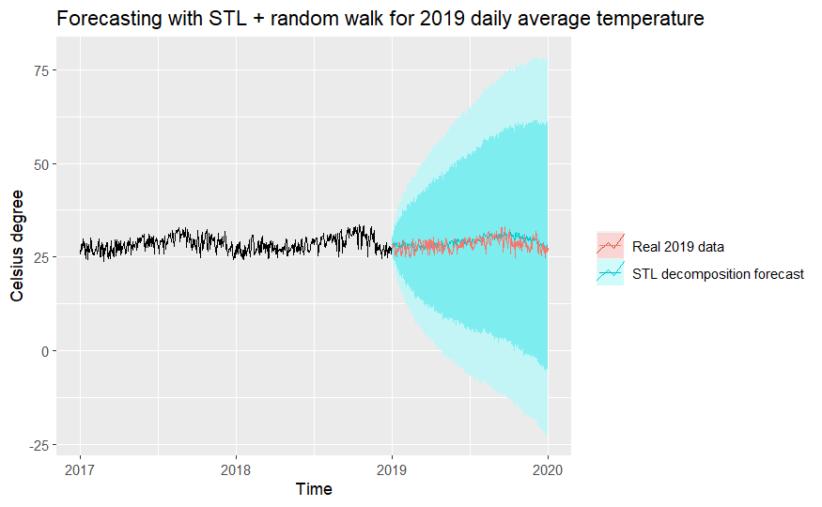
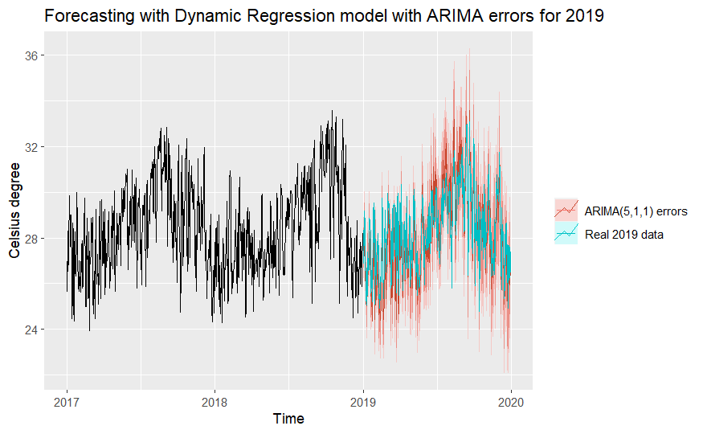
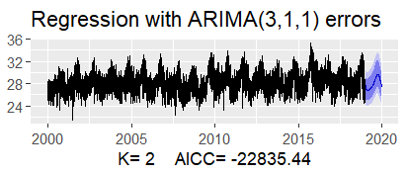
Forecasting of daily average temperature in Manaus city, Brazil
Hieu Ng. Minh, Long Ng. Hoang Applied Forecasting course, VNUK Institute for Research and Executive Education
February 2023
About the data
Brazil Weather, Conventional Stations (1961-2019) dataset on Kaggle.
It is meteorological data observed in conventional meteorological stations of the National Institute of Meteorology - INMET, from 1961 to 2019.
There are 12,251,335 rows (observations) in total. Observations come from 265 stations, are measured 3 times per day, are recorded daily from 01/01/1961 to 31/12/2019.
Daily temperature appears to be highest (warmest) around late August and in September, while the weather is coldest around late January and in February.
Project Introduction
Forecasting the daily temperature is one of the most practical and widespread applications of forecasting techniques.
This project aims to predict the average daily temperature in Manaus, Brazil.
Basic forecasting methods and models are used to exploit historical data and other weather components to produce forecasts.
Executive Summary
The rise in temperature (global warming) causes changes in natural conditions and leads to extreme phenomena which impact humans' lives negatively [1].
Forecasting results
Regression model
STL decomposition
Dynamic regression ARIMA(5,1,1) errors
Accurate temperature forecast helps increase the effectiveness of energy consumption [4], predict other meteorological variables and weather components [5][6], and drive proper decisions on making plans for activities, energy policy, and business development [7].
Basic methods and models that are used in this project including: bench marking methods of forecasting, decomposition (STL), exponential smoothing, time-series regression, ARIMA, dynamic regression models.
The daily temperature can be predicted well with values of other weather components through the regression model.
Dynamic regression models also perform precisely in this task by capturing all patterns including seasonality and trends.
References
[1] Pachauri, R.K.; Allen, M.R.; Barros, V.R.; Broome, J.; Cramer, W.; Christ, R.; Church, J.A.; Clarke, L.; Dahe, Q.; Dasgupta, P.; et al. Climate Change 2014: Synthesis Report. Contribution of Working Groups I, II and III to the Fifth Assessment Report of the Intergovernmental Panel on Climate Change \| EPIC.[2] Sharma, N.; Sharma, P.; Irwin, D.; Shenoy, P. Predicting solar generation from weather forecasts using machine learning. In Proceedings of the 2011 IEEE International Conference on Smart Grid Communications, Brussels, Belgium, 17--20 October 2011; pp. 528--533.[3] Sardans, J.; Peñuelas, J.; Estiarte, M. Warming and drought alter soil phosphatase activity and soil P availability in a Mediterranean shrubland. Plant Soil 2006, 289, 227--238.[4] Green, M.A. General temperature dependence of solar cell performance and implications for device modelling. Prog. Photovoltaics Res. Appl. 2003, 11, 333--340.[5] Jovic, S.; Nedeljkovic, B.; Golubovic, Z.; Kostic, N. Evolutionary algorithm for reference evapotranspiration analysis. Comput. Electron. Agric. 2018, 150, 1--4.[6] Marzo, A.; Trigo, M.; Alonso-Montesinos, J.; Martínez-Durbán, M.; López, G.; Ferrada, P.; Fuentealba, E.; Cortés, M.; Batlles, F.J. Daily global solar radiation estimation in desert areas using daily extreme temperatures and extraterrestrial radiation. Renew. Energy 2017, 113, 303--311.[7] Smith, D.M.; Cusack, S.; Colman, A.W.; Folland, C.K.; Harris, G.R.; Murphy, J.M. Improved Surface Temperature Prediction for the Coming Decade from a Global Climate Model. Science 2007, 317, 796--799.

