Slide 1
Electrical Engineering E6761
Computer Communication Networks
Professor Dan Rubenstein
Tues 4:10-6:40, Mudd 545
Call # 67650
Course URL: http://www.cs.columbia.edu/~danr/EE6761

Slide 2
Today
Course Overview / Structure / Handouts
Intro
Socket Programming

Slide 3
Overview
Bookmark the course web-page!
  http://www.cs.columbia.edu/~danr/EE6761
Syllabus
  Office hours: Mon 3-4?
  TA
  Mid-term date & time
Survey
HW #0 – due tomorrow - not graded!
PA #1

Slide 4
Introduction
(Reading: Kurose-Ross Chap 1)
goal:
get context, overview, “feel” of networking
more depth, detail later in course
approach:
  descriptive
  use Internet as example
Overview:
what’s the Internet
what’s a protocol?
network edge
network core
access net, physical media
performance: loss, delay
protocol layers, service models
backbones, NAPs, ISPs
history
ATM network

Slide 5





What’s the Internet: “nuts and bolts” view
router
workstation
millions of connected computing devices: hosts, end-systems
  pc’s workstations, servers
  PDA’s, phones, toasters
  running network apps
communication links
  fiber, copper, radio, satellite
routers: forward packets (chunks) of data thru network
server
mobile
local ISP
regional ISP
company
network

Slide 6
What’s the Internet: “nuts and bolts” view
protocols: control sending, receiving of msgs
  e.g., TCP, IP, HTTP, FTP, PPP
Internet: “network of networks”
  loosely hierarchical
  public Internet versus private intranet
Internet standards
  RFC: Request for comments
  IETF: Internet Engineering Task Force
  see class web-page for pointers to URLs
router
workstation
server
mobile
local ISP
regional ISP
company
network

Slide 7
What’s the Internet: a service view
communication infrastructure enables distributed applications:
  WWW, email, games, e-commerce, database, voting,
  more?
communication services provided:
  connectionless
  connection-oriented

Slide 8
What’s a network protocol?
all communication activity in Internet governed by protocols
protocols define format, order of msgs sent and received among network entities, and actions taken on msg transmission, receipt
… specific msgs sent
… specific actions taken when msgs received, or other events

Slide 9


What’s a protocol?
a human protocol and a computer network protocol:
Hi
TCP connection
req.
Hi
TCP connection
reply.
Got the
time?
Get http://gaia.cs.umass.edu/index.htm
<file>
time

Slide 10
A closer look at network structure:
network edge: applications and hosts
network core:
  routers
  network of networks
access networks
  residential
  institutional
  mobile
physical media
  wire (digital / analog)
  wireless (radio / cellular)

Slide 11
The network edge:
end systems (hosts):
  run application programs
  e.g., WWW, email
  at “edge of network”
client/server model
  client host requests, receives service from server
  e.g., WWW client (browser)/ server; email client/server
peer-peer model:
  host interaction symmetric
  e.g.: teleconferencing

Slide 12
Network edge: connection-oriented service
Goal: data transfer between end sys.
handshaking: setup (prepare for) data transfer ahead of time
  set up “state” in two communicating hosts
TCP - Transmission Control Protocol
  Internet’s de-facto connection-oriented service
TCP service [RFC 793]
reliable, in-order byte-stream data transfer
  dealing with loss: acknowledgements and retransmissions
flow control:
  sender won’t overwhelm receiver
congestion control:
  senders “slow down sending rate” when network congestion detected

Slide 13
Network edge: connectionless service
Goal: data transfer between end systems
  same as before!
UDP - User Datagram Protocol [RFC 768]: Internet’s connectionless service
  unreliable data transfer
  no flow control
  no congestion control
App’s using TCP:
HTTP (WWW), FTP (file transfer), Telnet (remote login), SMTP (email)
App’s using UDP:
streaming media, teleconferencing, Internet telephony

Slide 14
The Network Core
mesh of interconnected routers
the fundamental question: how is data transferred through net?
  circuit switching: dedicated circuit per call: telephone net
  packet-switching: data sent thru net in discrete “chunks”

Slide 15
Network Core: Circuit Switching
End-end resources reserved for “call”
link bandwidth, switch capacity
dedicated resources: no sharing
circuit-like (guaranteed) performance
call setup required

Slide 16
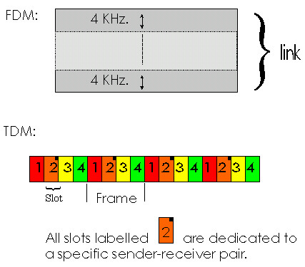
Network Core: Circuit Switching
network resources (e.g., bandwidth) divided into “pieces”
pieces allocated to calls
resource piece idle if not used by owning call (no sharing)
dividing link bandwidth into “pieces”
  frequency division
  time division
  code division

Slide 17
Network Core: Packet Switching
each end-end data stream divided into packets
user A, B packets share network resources
each packet uses full link bandwidth
resources used as needed,
resource contention:
aggregate resource demand can exceed amount available
congestion: packets queue, wait for link use
store and forward: packets move one hop at a time
  transmit over link
  wait turn at next link
Bandwidth division into “pieces”
Dedicated allocation
Resource reservation

Slide 18
Network Core: Packet Switching
10 Mbs
Ethernet
A
C
statistical multiplexing
1.5 Mbs
B
queue of packets
waiting for output
link
45 Mbs
D
E

Slide 19
Packet switching versus circuit switching
Packet switching allows more users to use network!
1 Mbit link
each user:
  100Kbps when “active”
  active 10% of time
circuit-switching:
  10 users
packet switching:
  with 35 users, probability > 10 active less that .004
N users
1 Mbps link

Slide 20
Packet switching versus circuit switching
Is packet switching a “slam dunk winner?”
Great for bursty data
  resource sharing
  no call setup
Excessive congestion: packet delay and loss
  protocols needed for reliable data transfer, congestion control
Q: How to provide circuit-like behavior?
  bandwidth guarantees needed for audio/video apps
  still an unsolved problem (chapter 6 of Kurose-Ross)

Slide 21
Packet-switched networks: routing
Goal: move packets among routers from source to destination
  we’ll study several path selection algorithms (chapter 4)
datagram network:
  destination address determines next hop
  routes may change during session
  analogy: driving, asking directions
virtual circuit network:
  each packet carries tag (virtual circuit ID), tag determines next hop
  fixed path determined at call setup time, remains fixed thru call
  routers maintain per-call state

Slide 22
Access networks and physical media
Q: How to connect end systems to edge router?
residential access nets
institutional access networks (school, company)
mobile access networks
Keep in mind:
bandwidth (bits per second) of access network?
shared (e.g. cable, ethernet) or dedicated (e.g., DSL)?

Slide 23
Residential access: point to point access
Dialup via modem
  up to 56Kbps direct access to router (conceptually)
ISDN: intergrated services digital network: 128Kbps all-digital connect to router
ADSL: asymmetric digital subscriber line
  up to 1 Mbps home-to-router
  up to 8 Mbps router-to-home

Slide 24
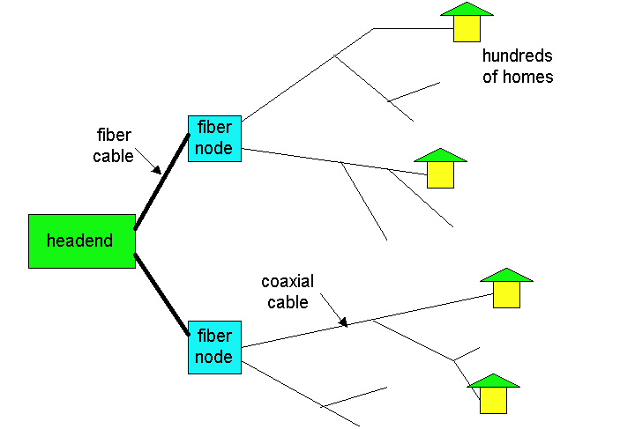
Residential access: cable modems
HFC: hybrid fiber coax
  asymmetric: up to 10Mbps upstream, 1 Mbps downstream
network of cable and fiber attaches homes to ISP router
  shared access to router among home
  issues: congestion, dimensioning
deployment: available via cable companies

Slide 25
Institutional access: local area networks
company/univ local area network (LAN) connects end system to edge router
Ethernet:
  shared or dedicated cable connects end system and router
  10 Mbs, 100Mbps, Gigabit Ethernet
deployment: institutions, home LANs soon
LANs: chapter 5

Slide 26
Wireless access networks
shared wireless access network connects end system to router
wireless LANs:
  radio spectrum replaces wire
  e.g., Lucent Wavelan 10 Mbps
wider-area wireless access
  CDPD: wireless access to ISP router via cellular network
router
base
station
mobile
hosts

Slide 27
Physical Media
Twisted Pair (TP)
two insulated copper wires
  Category 3: traditional phone wires, 10 Mbps ethernet
  Category 5 TP: 100Mbps ethernet
physical link: transmitted data bit propagates across link
guided media:
  signals propagate in solid media: copper, fiber
unguided media:
  signals propagate freely, e.g., radio

Slide 28


Physical Media: coax, fiber
Coaxial cable:
wire (signal carrier) within a wire (shield)
  baseband: single channel on cable
  broadband: multiple channels on cable
bidirectional
common use in 10Mbs Ethernet
Fiber optic cable:
glass fiber carrying light pulses
high-speed operation:
  100Mbps Ethernet
  high-speed point-to-point transmission (e.g., 5 Gps)
low error rate

Slide 29
Physical media: radio
signal carried in electromagnetic spectrum
no physical “wire”
bidirectional
propagation environment effects:
  reflection
  obstruction by objects
  interference
Radio link types:
microwave
  e.g. up to 45 Mbps channels
LAN (e.g., waveLAN)
  2Mbps, 11Mbps
wide-area (e.g., cellular)
  e.g. CDPD, 10’s Kbps
satellite
  up to 50Mbps channel (or multiple smaller channels)
  270 Msec end-end delay
  geosynchronous versus LEOS (delay v. cost)

Slide 30
Delay in packet-switched networks
packets experience delay on end-to-end path
four sources of delay at each hop
nodal processing:
  check bit errors
  determine output link
queueing
  time waiting at output link for transmission
  depends on congestion level of router
transmission
A
propagation
B
nodal
processing
queueing

Slide 31
Delay in packet-switched networks
Transmission delay:
R=link bandwidth (bps)
L=packet length (bits)
time to send bits into link = L/R
Propagation delay:
d = length of physical link
s = propagation speed in medium (~2x10⁸ m/sec)
propagation delay = d/s
Note: s and R are very different quantitites!
transmission
A
propagation
B
nodal
processing
queueing

Slide 32

Queueing delay (revisited)
R=link bandwidth (bps)
L=packet length (bits)
a=average packet arrival rate
traffic intensity = La/R
La/R ~ 0: average queueing delay small
La/R -> 1: delays become large
La/R > 1: more “work” arriving than can be serviced, average delay infinite!

Slide 33
Protocol “Layers”
Networks are complex!
many “pieces”:
  hosts
  routers
  links of various media
  applications
  protocols
  hardware, software
Question:
Is there any hope of organizing structure of network?
Or at least our discussion of networks?

Slide 34
Why layering?
Dealing with complex systems:
explicit structure allows identification, relationship of complex system’s pieces
  layered reference model for discussion
modularization eases maintenance, updating of system
  change of implementation of layer’s service transparent to rest of system
  e.g., change in gate procedure doesn’t affect rest of system
layering considered harmful?

Slide 35
The ISO/OSI protocol stack
International Standards Organization’s
Open
System Interconnection
what did presentation and session layers do?
application
presentation
session
transport
network
link
physical

Slide 36
Internet protocol stack
application: supporting network applications
  ftp, smtp, http
transport: host-host data transfer
  tcp, udp (reliable delivery, rate regulation)
network: routing of datagrams from source to destination
  ip, routing protocols
link: data transfer between neighboring network elements
  ppp, ethernet, wireless, multiple access protocols
physical: bits “on the wire”
application
transport
network
link
physical

Slide 37
Layering: logical communication
Each layer:
distributed
“entities” implement layer functions at each node
entities perform actions, exchange messages with peers
application
transport
network
link
physical
network
link
physical
application
transport
network
link
physical
application
transport
network
link
physical
application
transport
network
link
physical

Slide 38
Layering: logical communication
data
E.g.: transport
take data from app
add addressing, reliability check info to form “datagram”
send datagram to peer
wait for peer to ack receipt
analogy: post office
application
transport
network
link
physical
transport
ack
network
link
physical
application
transport
network
link
physical
data
data
application
transport
network
link
physical
application
transport
network
link
physical
transport

Slide 39
Layering: physical communication
data
application
transport
network
link
physical
network
link
physical
application
transport
network
link
physical
data
application
transport
network
link
physical
application
transport
network
link
physical

Slide 40
Protocol layering and data
Each layer takes data from above
adds header information to create new data unit
passes new data unit to layer below
source
destination
M
application
transport
network
link
physical
application
transport
network
link
physical
M
message
H
M
H
t
M
segment
t
H
H
H
H
M
datagram
n
t
M
n
t
H
H
H
H
H
H
M
frame
l
n
t
M
l
n
t

Slide 41
Internet structure: network of networks
roughly hierarchical
national/international backbone providers (NBPs)
  e.g. BBN/GTE, Sprint, AT&T, IBM, UUNet
  interconnect (peer) with each other privately, or at public Network Access Point (NAPs)
regional ISPs
  connect into NBPs
local ISP, company
  connect into regional ISPs
local
ISP
regional ISP
NBP B
NAP
NAP
NBP A
regional ISP
local
ISP

Slide 42
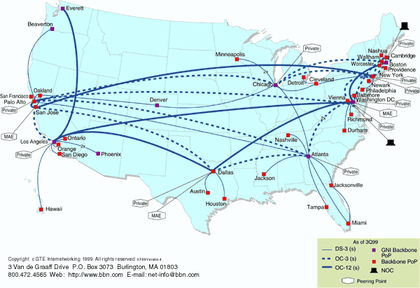
National Backbone Provider
e.g. BBN/GTE US backbone network

Slide 43
Internet History
1961-1972: Early packet-switching principles
1961: Kleinrock - queueing theory shows effectiveness of packet-switching
1964: Baran - packet-switching in military nets
1967: ARPAnet conceived by Advanced Reearch Projects Agency
1969: first ARPAnet node operational
1972:
  ARPAnet demonstrated publicly
  NCP (Network Control Protocol) first host-host protocol
  first e-mail program
  ARPAnet has 15 nodes

Slide 44
Internet History
1972-1980: Internetworking, new and proprietary nets
1970: ALOHAnet satellite network in Hawaii
1973: Metcalfe’s PhD thesis proposes Ethernet
1974: Cerf and Kahn - architecture for interconnecting networks
late70’s: proprietary architectures: DECnet, SNA, XNA
late 70’s: switching fixed length packets (ATM precursor)
1979: ARPAnet has 200 nodes
Cerf and Kahn’s internetworking principles:
  minimalism, autonomy - no internal changes required to interconnect networks
  best effort service model
  stateless routers
  decentralized control
define today’s Internet architecture

Slide 45
Internet History
1980-1990: new protocols, a proliferation of networks
1983: deployment of TCP/IP
1982: smtp e-mail protocol defined
1983: DNS defined for name-to-IP-address translation
1985: ftp protocol defined
1988: TCP congestion control
new national networks: Csnet, BITnet, NSFnet, Minitel
100,000 hosts connected to confederation of networks

Slide 46
Internet History
1990’s: commercialization, the WWW
Early 1990’s: ARPAnet decomissioned
1991: NSF lifts restrictions on commercial use of NSFnet (decommissioned, 1995)
early 1990s: WWW
  hypertext [Bush 1945, Nelson 1960’s]
  HTML, http: Berners-Lee
  1994: Mosaic, later Netscape
  late 1990’s: commercialization of the WWW
Late 1990’s:
est. 50 million computers on Internet
est. 100 million+ users
backbone links runnning at 1 Gbps

Slide 47
ATM: Asynchronous Transfer Mode nets
Internet:
today’s de facto standard for global data networking
1980’s:
telco’s develop ATM: competing network standard for carrying high-speed voice/data
standards bodies:
  ATM Forum
  ITU
ATM principles:
small (48 byte payload, 5 byte header) fixed length cells (like packets)
  fast switching
  small size good for voice
virtual-circuit network: switches maintain state for each “call”
well-defined interface between “network” and “user” (think of telephone company)

Slide 48
ATM layers
Where’s the application?
ATM: lower layer
functionality only
IP-over ATM: later
application
TCP/UDP
IP
ATM Adaptation Layer (AAL): interface to upper layers
  end-system
  segmentation/reassembly
ATM Layer: cell switching
Physical
AAL
ATM
physical
application
TCP/UDP
IP
ATM
physical
AAL
ATM
physical
application
TCP/UDP
IP
application
TCP/UDP
IP
AAL
ATM
physical
AAL
ATM
physical

Slide 49
Intro: Summary
Covered a “ton” of material!
Internet overview
what’s a protocol?
network edge, core, access network
performance: loss, delay
layering and service models
backbones, NAPs, ISPs
history
ATM network
You now hopefully have:
context, overview, “feel” of networking
more depth, detail later in course

