Slide 1

BikeX
Bike-Share Company, Based in Chicago

Slide 2
Business Problem
To understand how casual riders and members use our service

Slide 3
Prepare
Dataset From Google Data Analytic Course
Data Cleaning

Slide 4
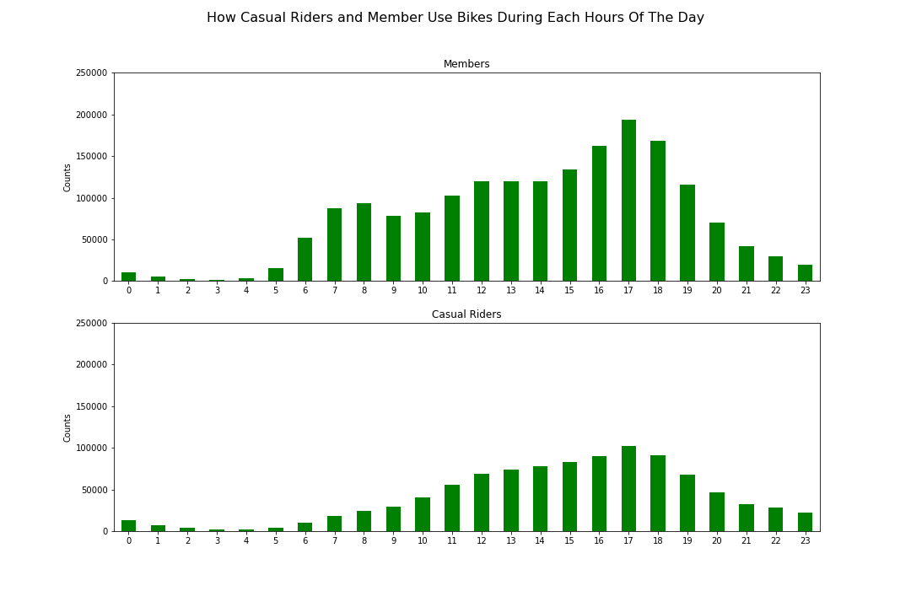
Hours of Day Have Some Impact To How People Ride

Slide 5
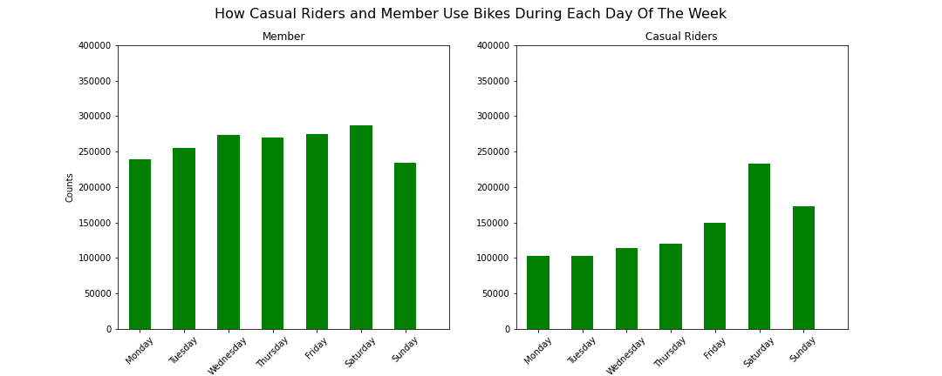
Casual Riders Most Likely to Use Our Service on the Weekend

Slide 6
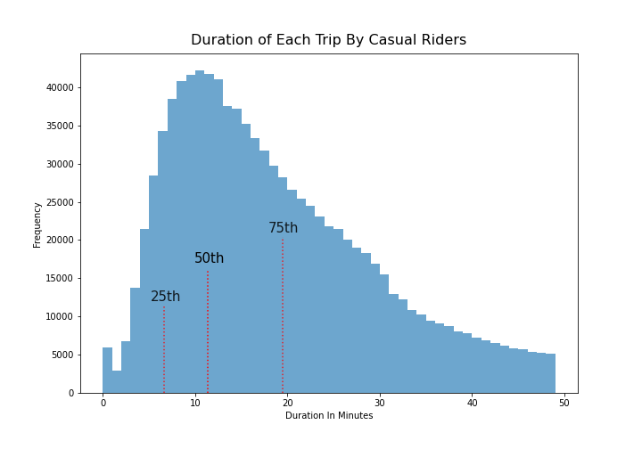
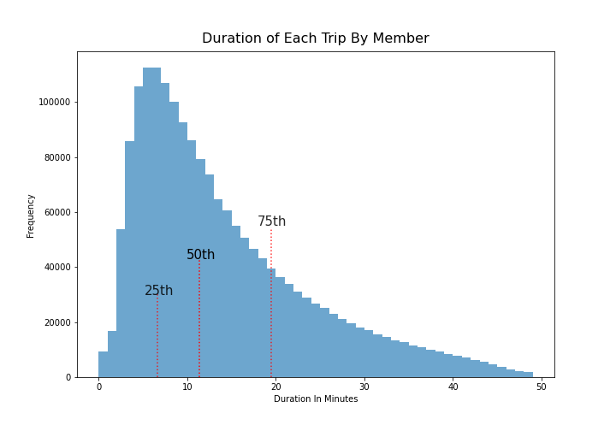
75% of the trip is less than 20 minutes

Slide 7
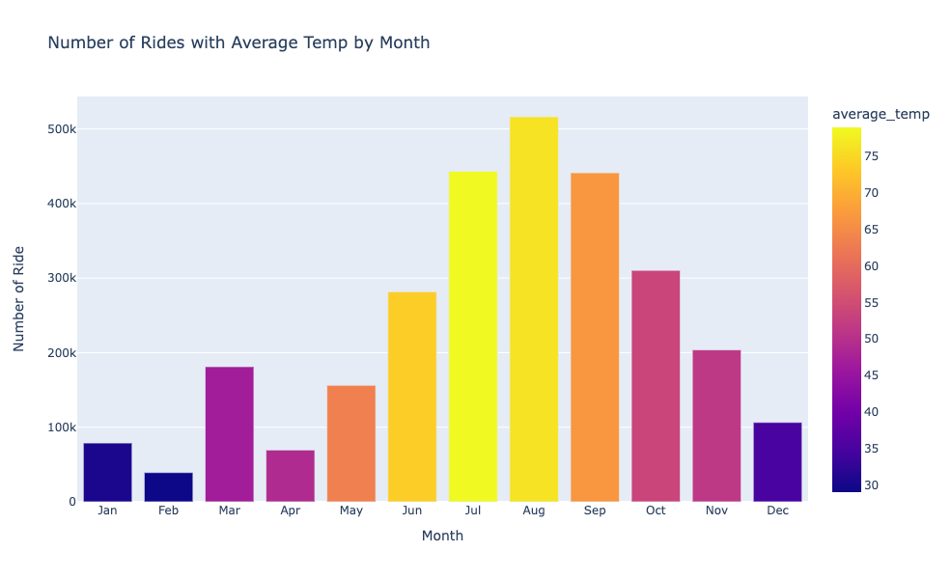
Temperature Has a Big Impact on Cycling

Slide 8
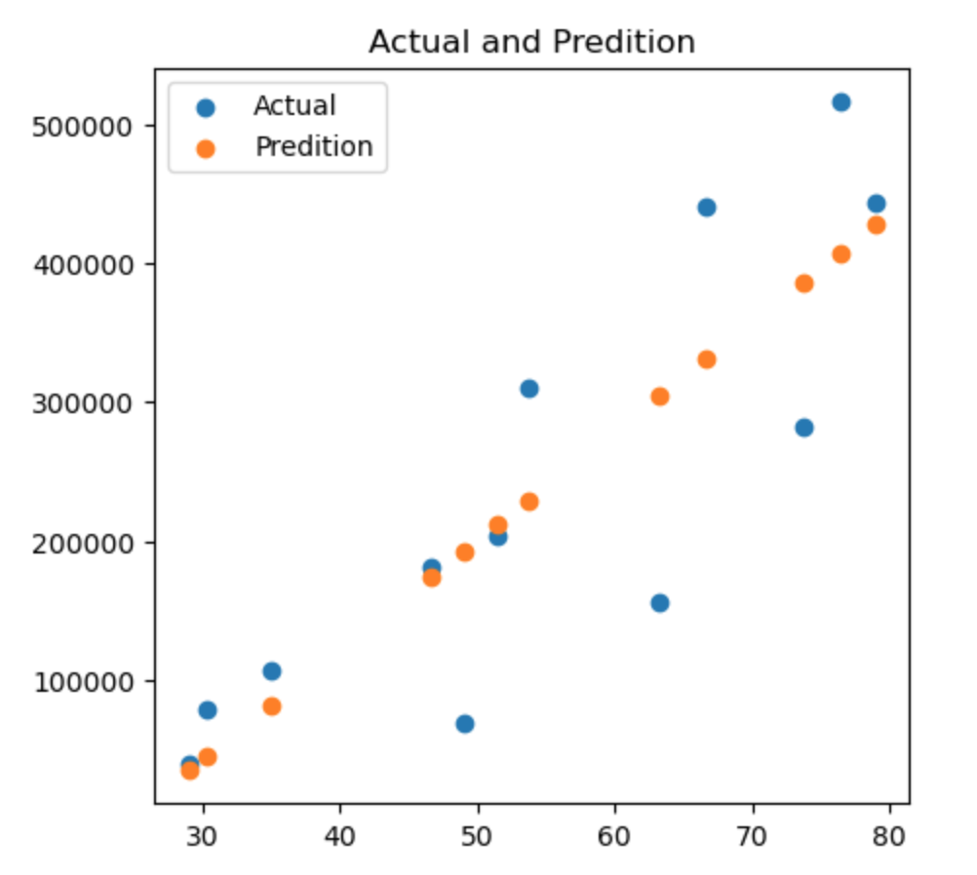
Model Predict Number of Rides Based on Temperature
Accuracy: 72%

Slide 9
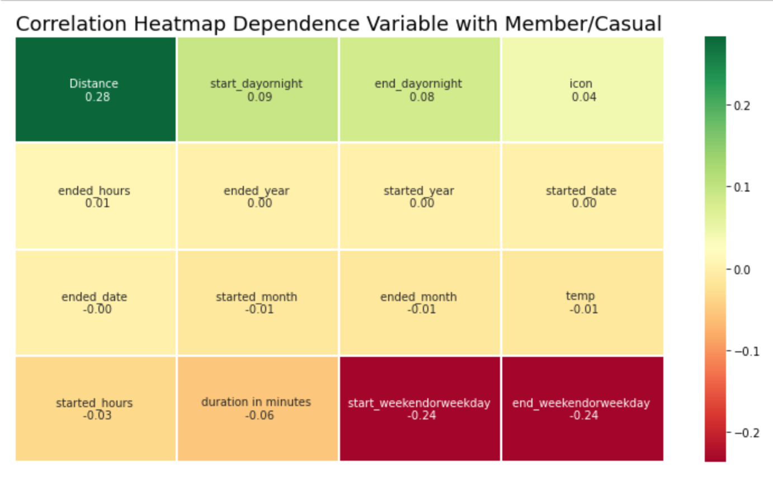
Model Predict Who Will Most Likely to Become a Member
Accuracy: 67.86%

Slide 10
Recommendation
Using model to forecast number of trip along with factor such as minute per trip
1
Targeting casual customer who use our service on weekday and have a long-distance trip
2

Slide 11
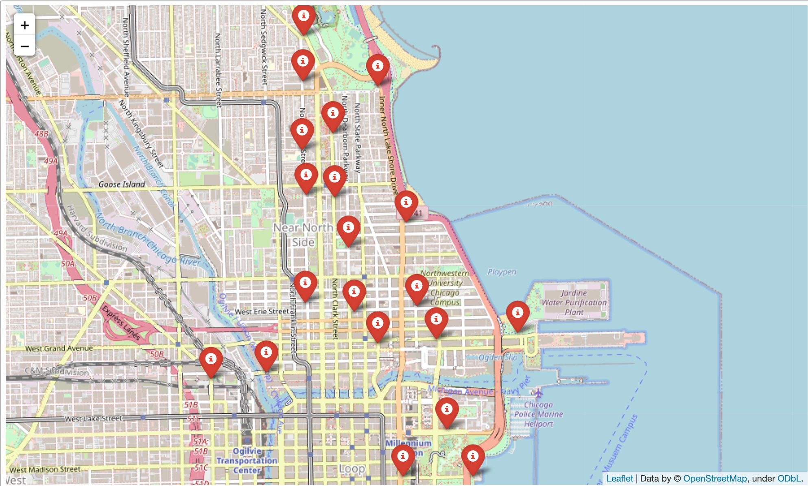
Promoting Campaign at the Top 5% Station With the Most Rides.

Slide 12
Propose Future Work
Improve the accuracy of member predicted model.
Improve the accuracy of number of trip model
Using survey to get more insights

Slide 13
Thank You
If you have any question, please ask Google

