Slide 1

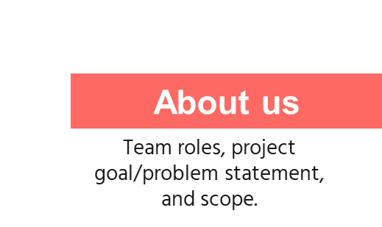

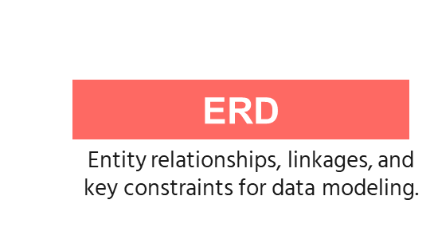
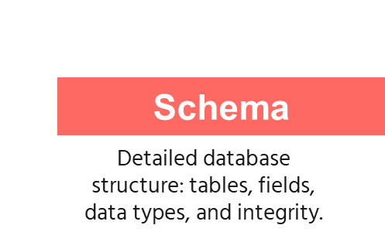
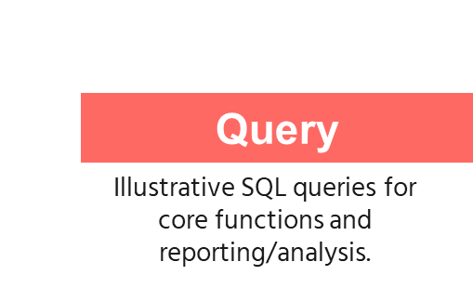
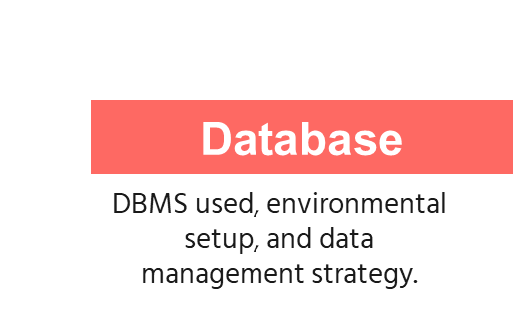
BLOOD DONATION MANAGEMENT SYSTEM
Group 4

Slide 2

ABOUT US
BLOOD DONATION MANAGEMENT SYSTEM
Group 4

Slide 3
ABOUT US
INTRODUCTION
Main factor | Key messages | Goals
Goals | Design secure, efficient DB. |  | System designed on MySQL.
Technique & Tools | Use MySQL, ERD; and others mentioned on README of GitHub. |  | Modeling and Query optimized.
System overview | Manage Donors, Inventory; eliminate manual errors. |  | Achieved centralized data management.

Slide 4
INTRODUCTION
ABOUT US
Main factor | Key messages | Goals
Goals | Design secure, efficient DB. |  | System designed on MySQL.
Technique & Tools | Use MySQL, ERD; and others mentioned on README of GitHub. |  | Modeling and Query optimized.
System overview | Manage Donors, Inventory; eliminate manual errors. |  | Achieved centralized data management.

Slide 5



Slide 6
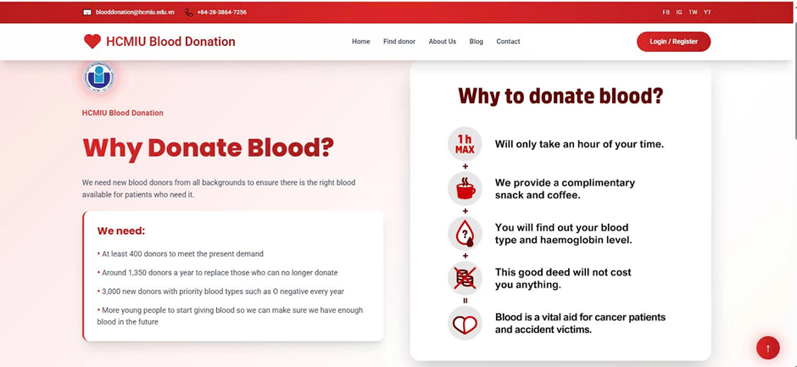

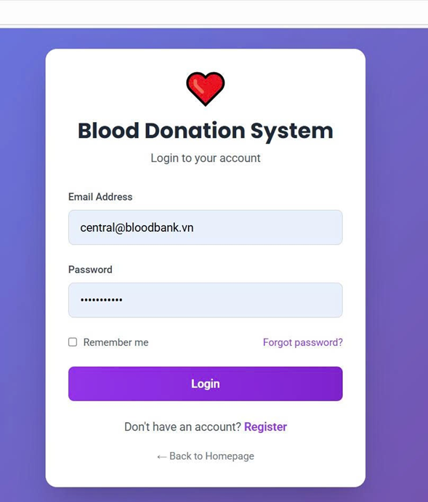

Modern Interface
Homepage
Login Account
Responsive Design
Flexbox/Grid with media queries for all screen sizes.
Role-Based Login
Secure access for Admin, Doctor, Patient, and Donor
Intuitive Navigation
Simple menu for events, history, and requests.

Slide 7
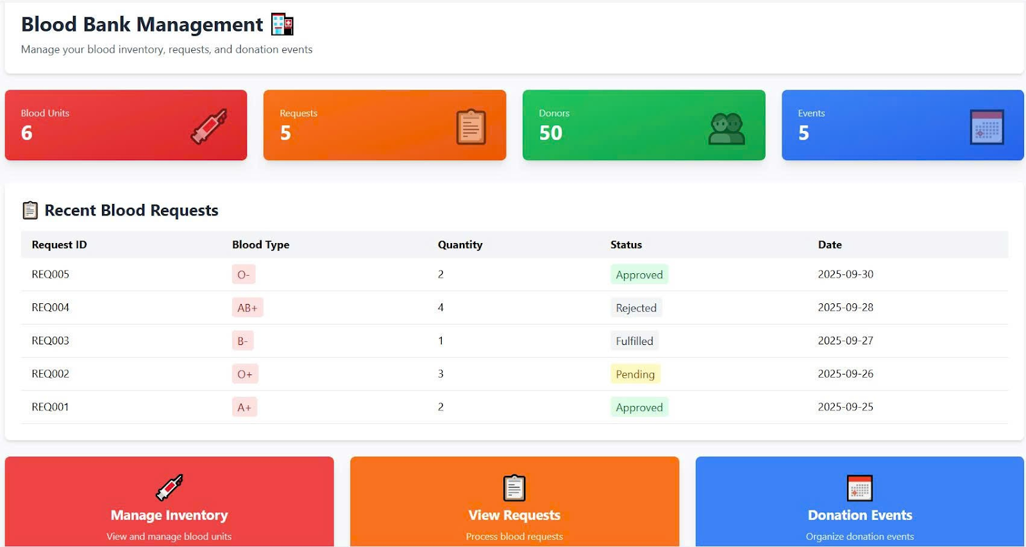
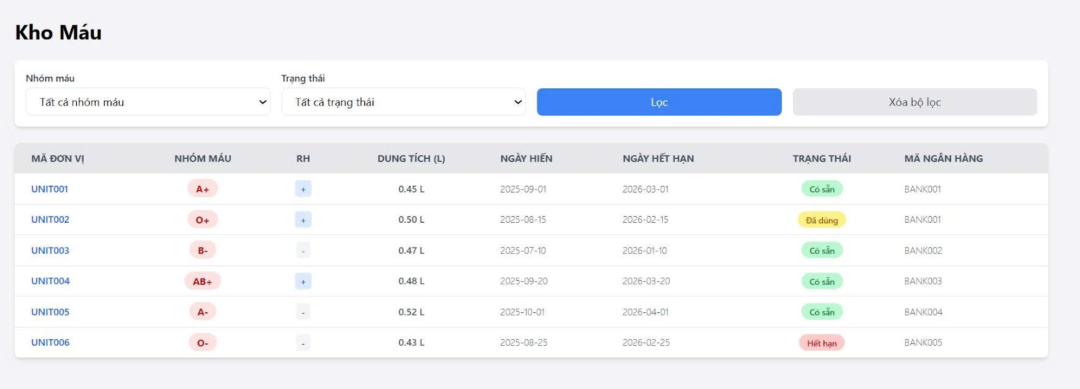
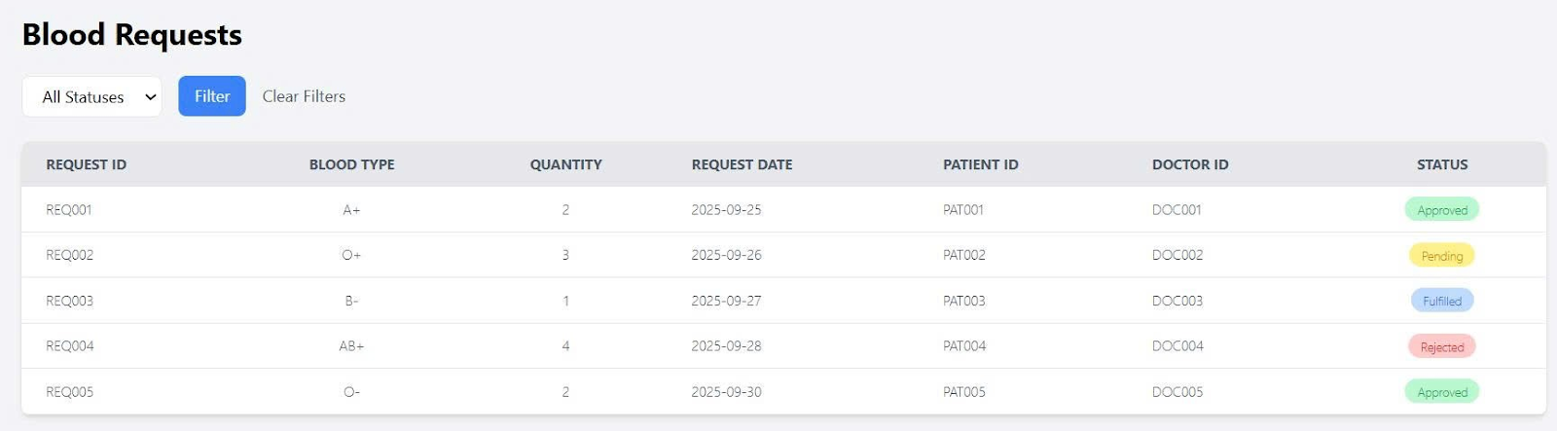
Modern Interface
Blood Bank Management
Login Account
Homepage
Responsive Design
Flexbox/Grid with media queries for all screen sizes.
Role-Based Login
Secure access for Admin, Doctor, Patient, and Donor
Intuitive Navigation
Simple menu for events, history, and requests.
Total blood units
Total requests
Total donors
Total events

Slide 8
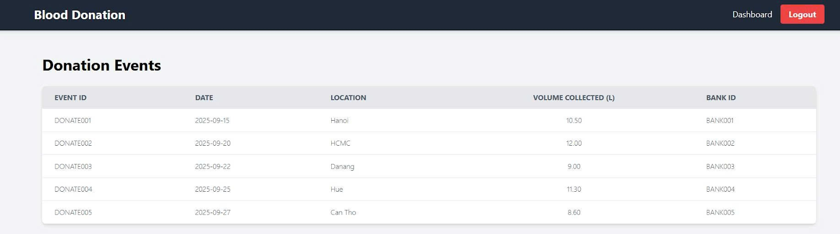
Blood Bank Management
Homepage
Total blood units
Total requests
Total donors
Total events

Slide 9
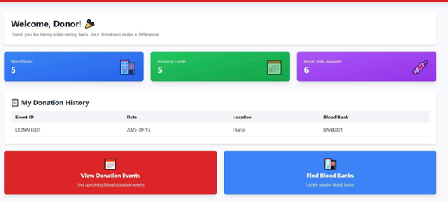
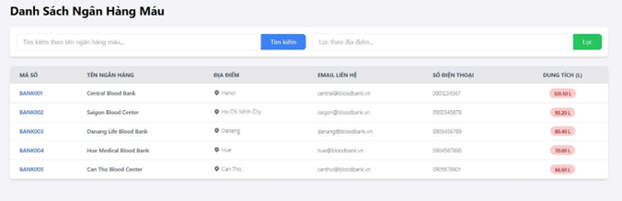
Blood Bank Management
Blood Bank Management
Total blood units
Total requests
Total donors
Total events
Donors
“This is a quote, words full of wisdom that someone important said and can make the reader get inspired.”
—SOMEONE FAMOUS
Blood Bank List

Slide 10
Total blood units
Total requests
Total donors
Total events
Donors
Blood Bank List

Slide 11
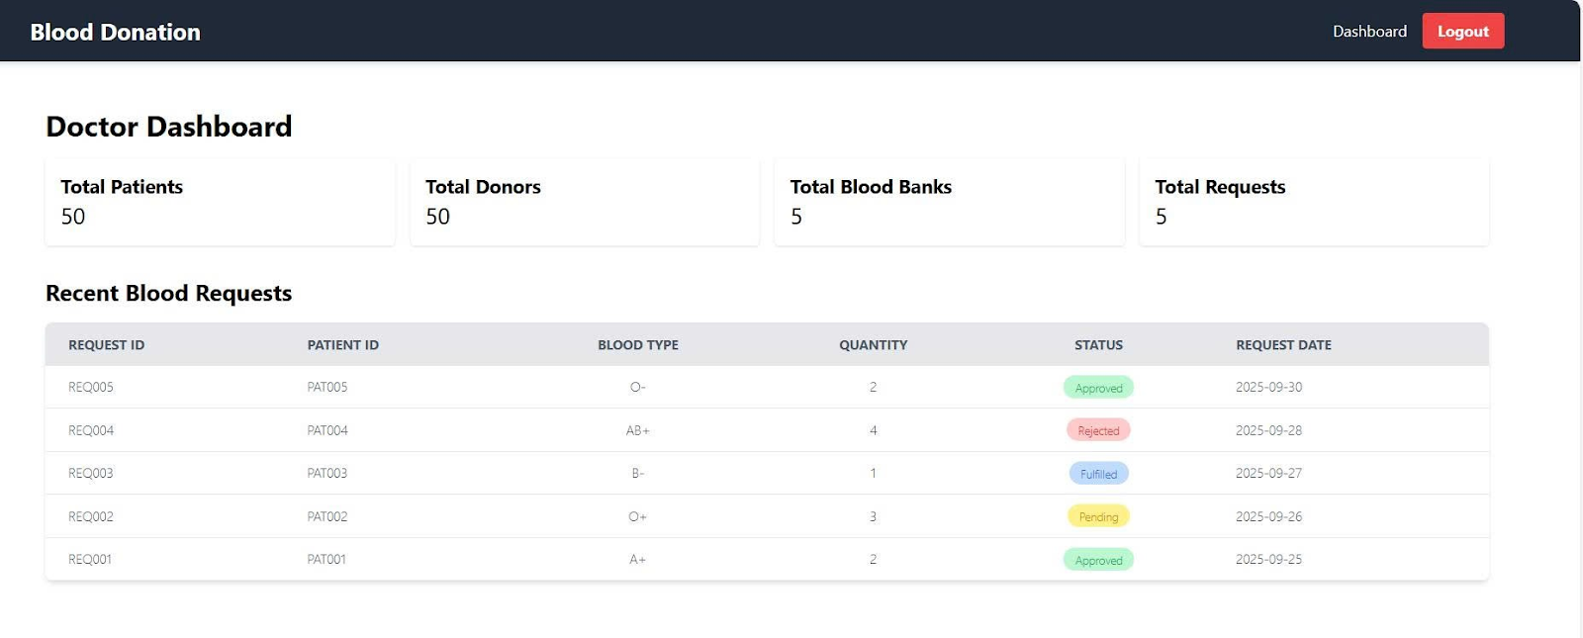
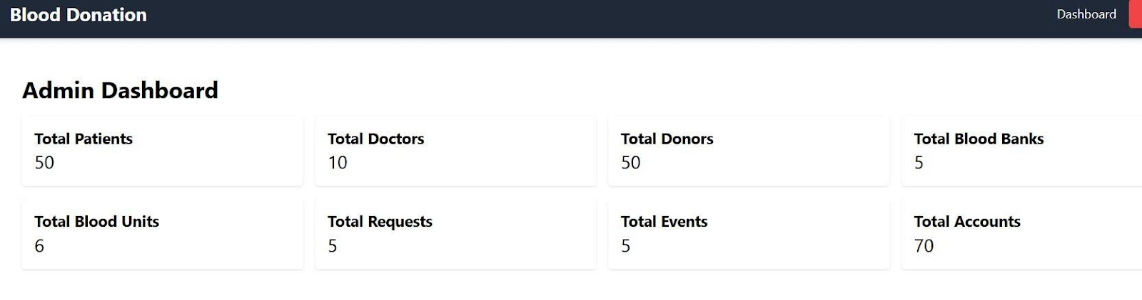
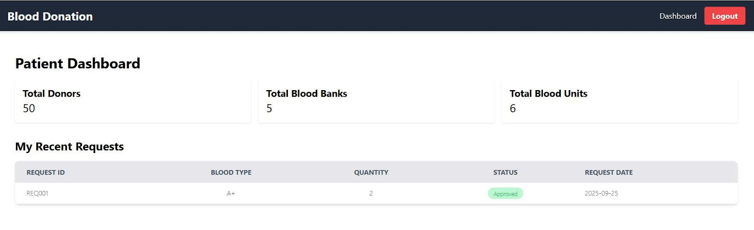



Doctor Dashboard
General Dashboard
Patient Dashboard
This section describes how user accounts are linked to patient and doctor profiles, ensuring each user has a unique identity in the system

Slide 12
Doctor Dashboard
General Dashboard
Patient Dashboard

Slide 13
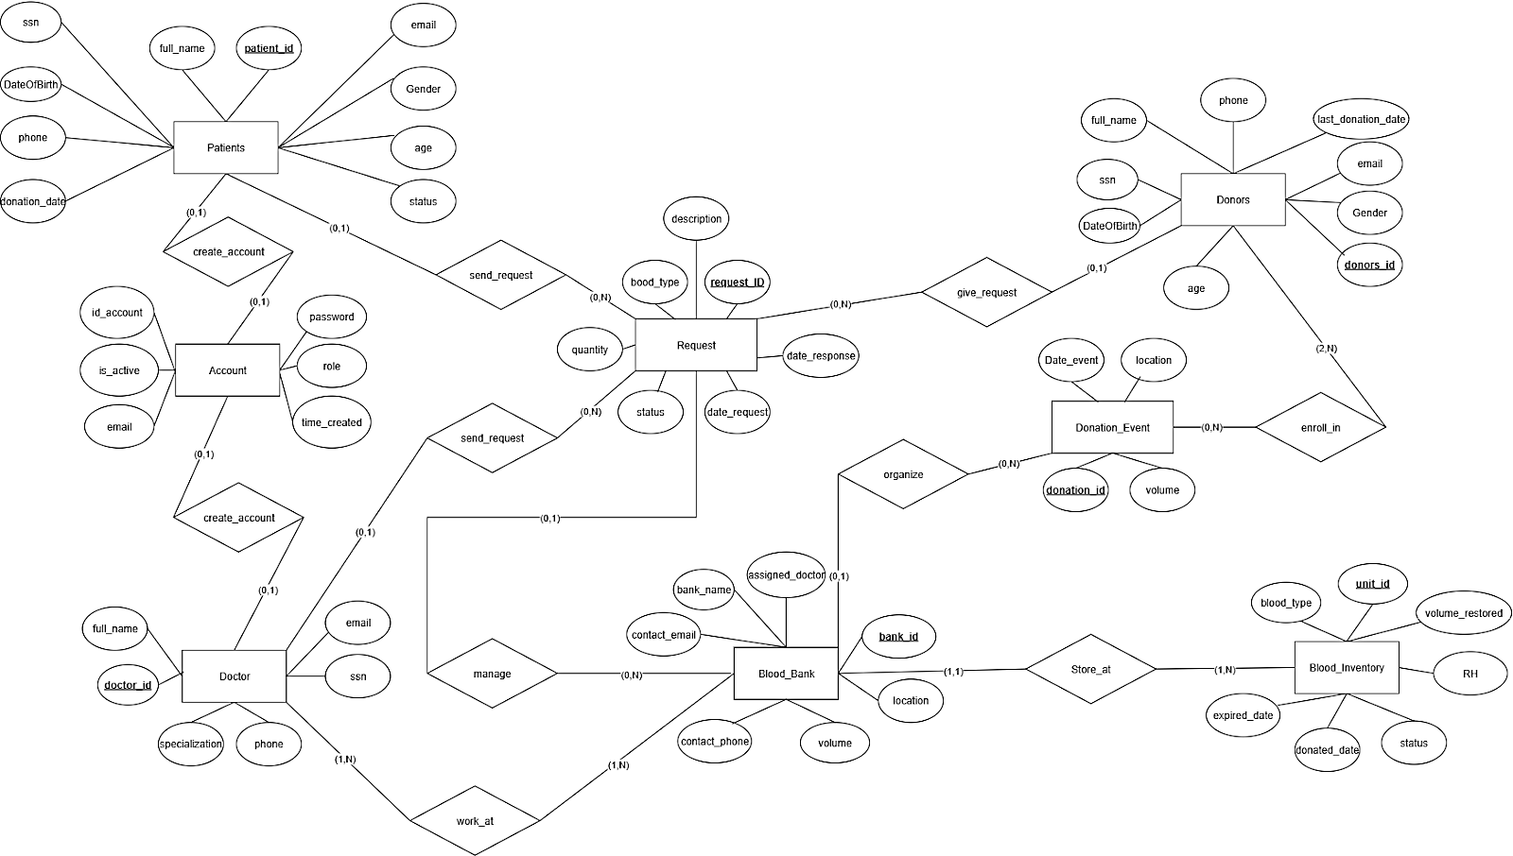

Slide 14
Doctor Dashboard
General Dashboard
Patient Dashboard
This section describes how user accounts are linked to patient and doctor profiles, ensuring each user has a unique identity in the system

Slide 15
User Authentication Relationship
Patient – ACCOUNT Relationship
Doctor – ACCOUNT Relationship
Each patient must have a unique account to log in and manage their information
Foreign Key(FK): Patients.account_id references ACCOUNT.account_id.
Cardinality: 1:1 (One account links to one patient, and vice versa).
Similarly, each doctor in the system also needs an account to access related functions.
Foreign Key(FK): Doctor.account_id references
ACCOUNT.account_id.
Cardinality: 1:1 (One account links to one doctor, and vice versa).
This section describes how user accounts are linked to patient and doctor profiles, ensuring each user has a unique identity in the system

Slide 16
Blood Request Transaction Relationships
Patients ↔ Request | patient_id | 1:N | A patient can send multiple requests; each request belongs one patient.
Doctor ↔ Request | doctor_id | 1:N | A doctor can manage multiple requests; each request has one assigned doctor.
BLOOD_BANK ↔ Request | bank_id | 1:N | A blood bank can handle multiple requests; each request is processed by one bank.
Donors ↔ Request | donor_id | 1:N | A donor can fulfill multiple requests; each request is fulfilled by one donor.
Blood_Inventory ↔ Request | fulfilled_inventory_id | 1:N | An inventory unit can fulfill one request(1:1 or 1:N depending on blood type needs).

Slide 17
Blood Bank and Inventory Relationship
Many-to-Many Relationships (N:N)
Donor & Donation Event
Donation Event
Request
Donors
Doctor
Process to ensure 3NF rule
Related Entities | Foreign Key (FK) | Relationship Type | Explanation
BLOOD_BANK ↔ Blood_Inventory | bank_id | 1:N | Each blood unit belongs to one bank; banks can have multiple units.
BLOOD_BANK ↔ Donation_Event | Bank_id | 1:N | Each donation event is organized by one bank; banks can organize multiple events.
1. Doctor – Blood Bank (“work_at” relationship)
Junction Table: Doctor_BloodBank
Primary Key (PK): Composite of two foreign keys: (doctor_id, bank_id)
Meaning: Doctors can work at multiple banks; banks can employ multiple doctors.
2. Donors – Donation Event ("enroll_in" relationship)
Junction Table: Donors_DonationEvent
Primary Key (PK): Composite of two foreign keys: (donors_id, donation_id)
Meaning: Donors can join multiple events; events can have multiple donors.
Patients
Account
Blood Bank
Blood Inventory
Doctor & Blood Bank

Slide 18
Process to ensure 3NF rule
Blood Bank and Inventory Relationship
Related Entities | Foreign Key (FK) | Relationship Type | Explanation
BLOOD_BANK ↔ Blood_Inventory | bank_id | 1:N | Each blood unit belongs to one bank; banks can have multiple units.
BLOOD_BANK ↔ Donation_Event | Bank_id | 1:N | Each donation event is organized by one bank; banks can organize multiple events.
Doctor
Donors
Request
Donation Event
Donor & Donation Event
Patients
Account
Blood Bank
Blood Inventory
Doctor & Blood Bank
Many-to-Many Relationships (N:N)
1. Doctor – Blood Bank (“work_at” relationship)
Junction Table: Doctor_BloodBank
Primary Key (PK): Composite of two foreign keys: (doctor_id, bank_id)
Meaning: Doctors can work at multiple banks; banks can employ multiple doctors.
2. Donors – Donation Event ("enroll_in" relationship)
Junction Table: Donors_DonationEvent
Primary Key (PK): Composite of two foreign keys: (donors_id, donation_id)
Meaning: Donors can join multiple events; events can have multiple donors.

Slide 19







Show how the system retrieves, filters, and processes data for web features.
User Authentication
Doctor/Patient Dashboards.
Blood Inventory Management & Statistical Reporting
SQL: Implementation code.
Relational Algebra: Theoretical expression.
Query Tree: Visual execution plan.

Slide 20

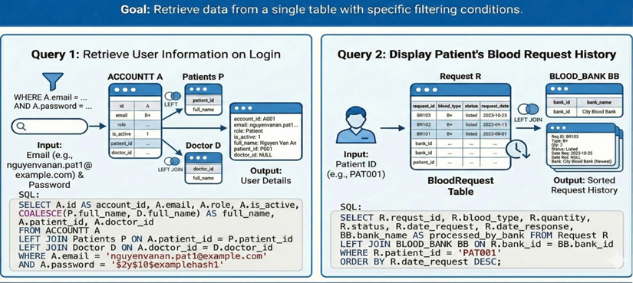

BASIC RETRIVAL
Patient’s request history: retrieve data from a single table with specific filtering access the blood request history of a specific patient, helping them track the status of the request.
User Authentication
Doctor/Patient Dashboards.
Blood Inventory Management & Statistical Reporting
SQL: Implementation code.
Relational Algebra: Theoretical expression.
Query Tree: Visual execution plan.
Show how the system retrieves, filters, and processes data for web features.
User information on login: retrieve data from a single table with specific filtering conditions

Slide 21

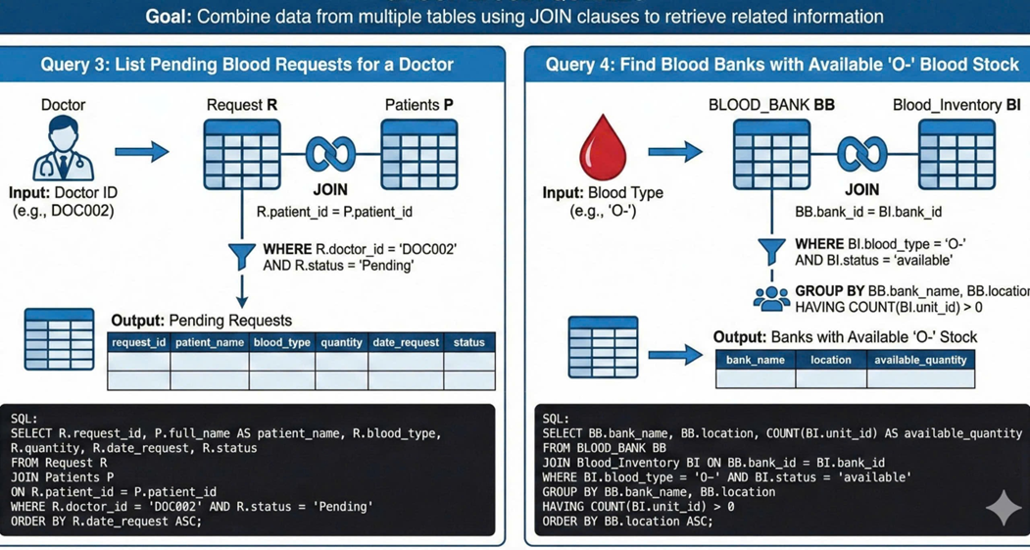
Patient’s request history: retrieve data from a single table with specific filtering access the blood request history of a specific patient, helping them track the status of the request.
User information on login: retrieve data from a single table with specific filtering conditions
Show how the system retrieves, filters, and processes data for web features.
SQL: Implementation code.
Relational Algebra: Theoretical expression.
Query Tree: Visual execution plan.
User Authentication
Doctor/Patient Dashboards.
Blood Inventory Management & Statistical Reporting

Slide 22
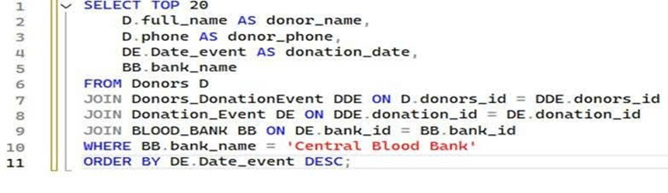
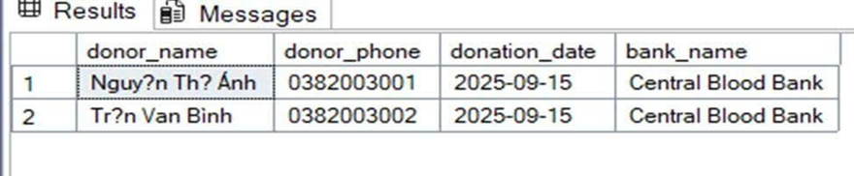
List Recent Donations at a Specific Blood Bank
Patient’s request history: retrieve data from a single table with specific filtering access the blood request history of a specific patient, helping them track the status of the request.
User information on login: retrieve data from a single table with specific filtering conditions

Slide 23
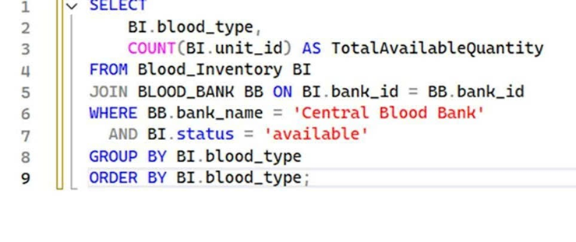
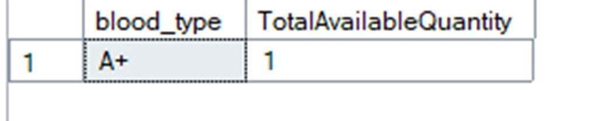
AGGREGATION QUERY
List Recent Donations at a Specific Blood Bank

Slide 24
AGGREGATION QUERY
List Recent Donations at a Specific Blood Bank
Summarize Available Blood Stock by Type at a Specific Bank

Slide 25


CONCLUSION
Query Strategy Overview
Authentication & History: Fast single-table lookups.
Operational Workflow: Multi-table JOINs for Doctor–Patient–Bank relations.
Management Decisions: Aggregation (GROUP BY, SUM) for real-time inventory insights.

Slide 26



CONCLUSION
Doctors (10)
Patients (50)
Accounts (60)
Blood Banks (50)
Donors (50)
Blood Inventory (6)
Requests (5)
Donation Events (5)
Doctors
Blood Banks
Donors (register in Donation Event)
Patients
Query Strategy Overview
Authentication & History: Fast single-table lookups.
Operational Workflow: Multi-table JOINs for Doctor–Patient–Bank relations.
Management Decisions: Aggregation (GROUP BY, SUM) for real-time inventory insights.

Slide 27
REFERENTIAL INTEGRITY
Rule: Strictly adhere to the Insert Order (Execution Order)
Doctors (10)
Patients (50)
Accounts (60)
Blood Banks (50)
Donors (50)
Blood Inventory (6)
Requests (5)
Donation Events (5)
Doctors
Blood Banks
Donors (register in Donation Event)
Patients
Insert data into Independent tables first: (Example: Doctor, Patient) | Then, insert into Dependent tables (Example: Account, Request) | Satisfy Foreign Keys (FKs)
Step 1 | Step 2 | Goal

Slide 28
REFERENTIAL INTEGRITY
Rule: Strictly adhere to the Insert Order (Execution Order)
Doctors (10)
Patients (50)
Accounts (60)
Blood Banks (50)
Donors (50)
Blood Inventory (6)
Requests (5)
Donation Events (5)
Insert data into Independent tables first: (Example: Doctor, Patient) | Then, insert into Dependent tables (Example: Account, Request) | Satisfy Foreign Keys (FKs)
Step 1 | Step 2 | Goal
Doctors
Blood Banks
Donors (register in Donation Event)
Patients

Slide 29
THANKS!
Do you have any questions?

