Slide 1
Project 1: Customer segment analysis
Project on customer behavior analysis and segmentation based on transaction data

Slide 2
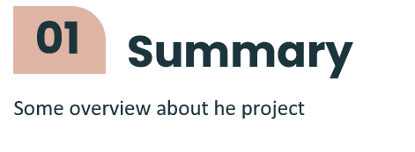
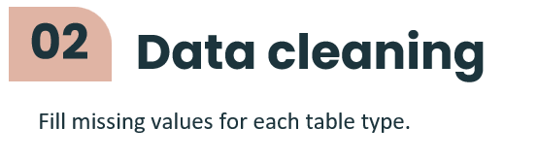
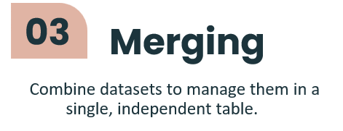
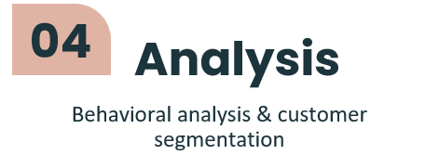
Table of contents

Slide 3
 | Fill_mode | Fill_median | Specific
transactions_data | Zip, merchant, state,mcc,… | amount | transactions_data.date : fill backwards transactions_data.errors : fill constant
cards | card_brand, card_type | credit_limit, num_cards_issued, year_pin_last_changed | cards.has_chip cards.id
users | gender | per_capita_income, yearly_income, total_debt,… | $: reomove by specific def
mcc_codes | None | None | None
train_fraud_labels | None | None | None

Slide 4
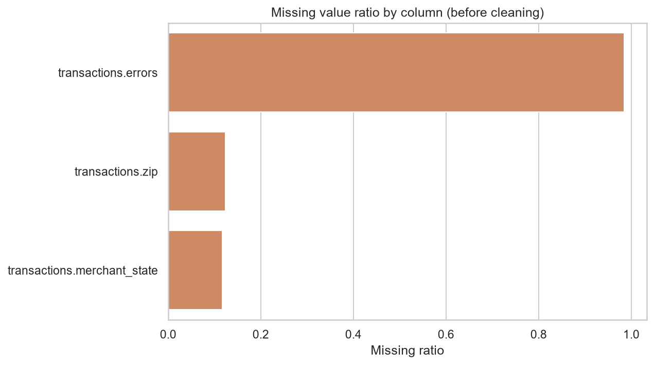
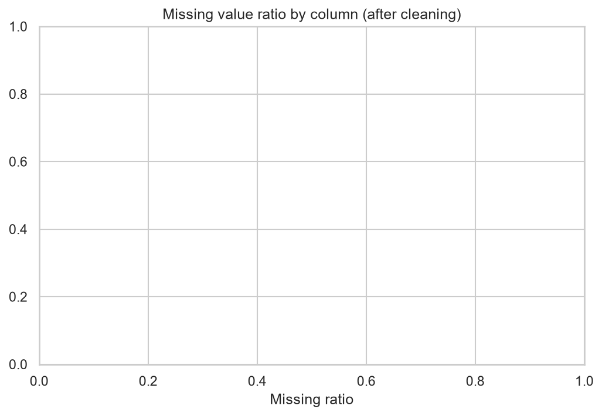

Slide 5
Table merged into master | Common Column (Key) | Join Type | Notes
cards | card_id | Left join | Adds card information to each transaction
users | client_id | Left join | Adds customer/client information
mcc | mcc | Left join | Adds merchant category description
fraud (only id, is_fraud columns kept) | id | Left join | Attaches fraud label to each transaction

Slide 6
Customer behavior analysis
- analysis for entire segment
- analysis for each segment
Developing customer segments
- Segment customers into groups based on behavioral analysis
Proposal for company X
- Provide recommendations on the approach for each customer segment

Slide 7
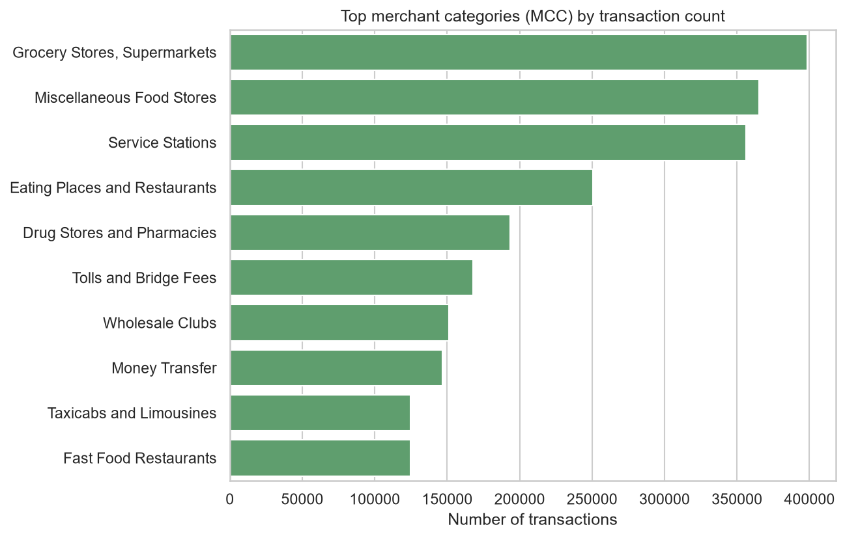
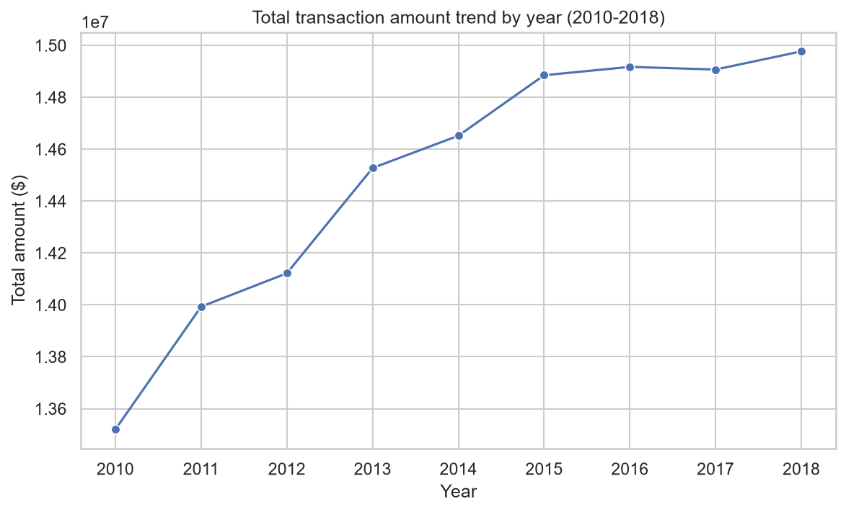
Customer behavior analysis(analysis for entire segment)

Slide 8
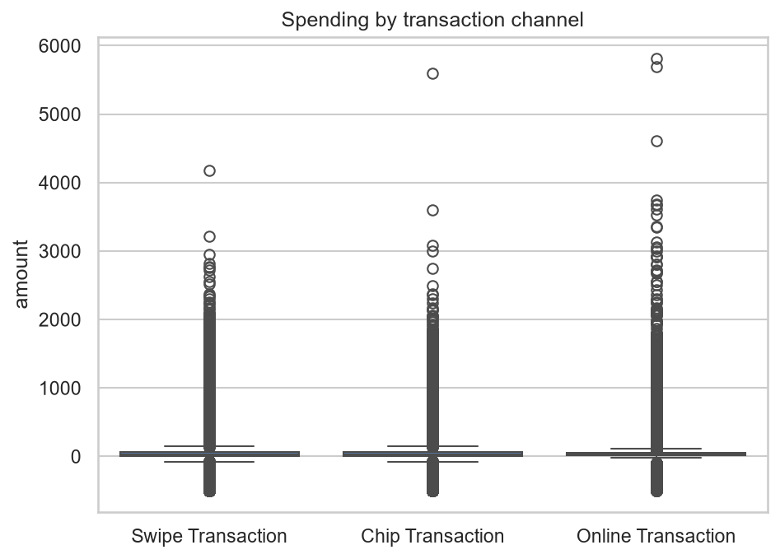
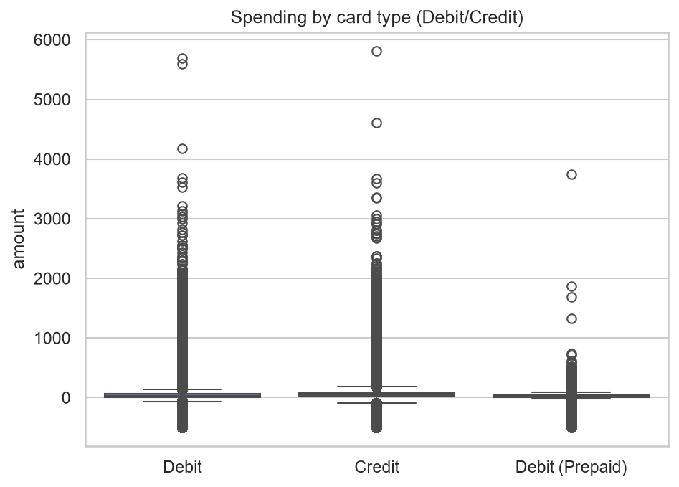
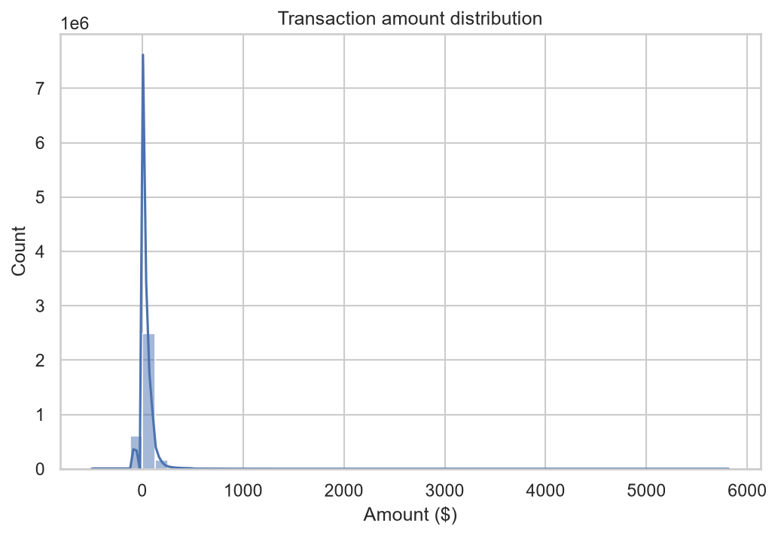
Customer behavior analysis(analysis for entire segment)

Slide 9
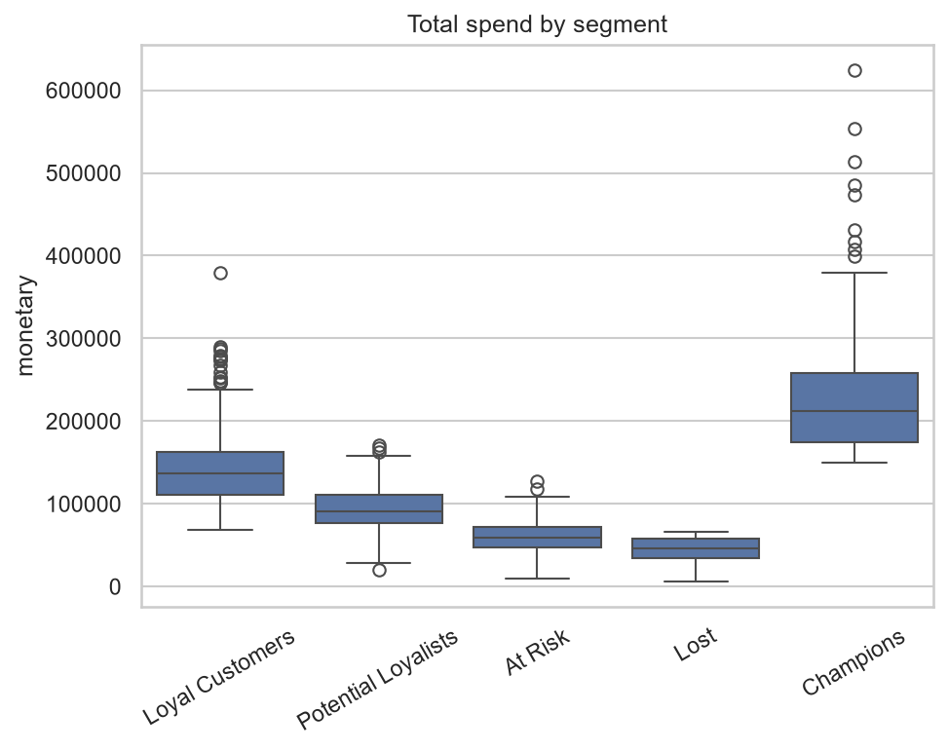
Customer behavior analysis(analysis for each segment)

Slide 10
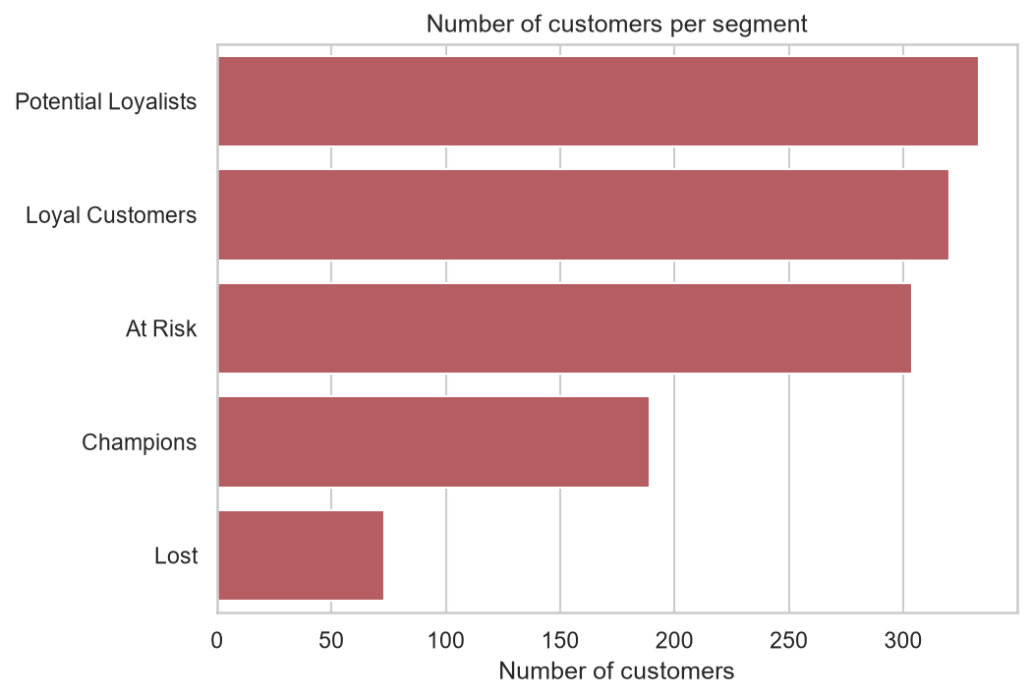
Developing customer segments
- Segment customers into groups based on behavioral analysis

Slide 11
Proposal for company X
- Provide recommendations on the approach for each customer segment
1. Segmentation: Retain Champions with VIP perks, upsell Potential Loyalists, win back At Risk, deprioritize Lost.
2. Transactions: Partner cashback on top MCCs, tighten fraud checks on Online (highest outliers), optimize pricing for small transactions with separate monitoring for >$2000 ones.
3. Growth: Volume plateaued 2015–2018, signaling saturation — invest in new customer acquisition or product expansion.

Slide 12
Thanks!
Does anyone have any questions?
phamminhman0303@gmail.com
+00 000 000 000
Please keep this slide for attribution

