Slide 1
Warehouse Management
Class Name: PF1126
Group Name: Vu Minh Long
Member: Vu Quang Minh
Phan Canh Long Vu
Nguyen Gia Long

Slide 2
Objectives
Increase Warehouse Management Efficiency
Accurate Inventory Data
Improve Inventory Processes
Enhance Traceability and Reporting
Improve Order Management
Improve Security and Decentralization

Slide 3
Introduction to Project
Warehouse Management System is designed to support efficient management of import and export processes and inventory of finished products.
This system helping to optimize warehouse management processes, from inventory tracking, supplier management, to product distribution and processing of input/output requests.
The system provides solutions to improve management efficiency, ensure accurate and relevant data, and support management based on detailed reports.

Slide 4
Customer Requirements
User management
Supplier management
Warehouse management
Product management
Stock management
Inbound/Outbound/Transfer management
Inventory Audit

Slide 5
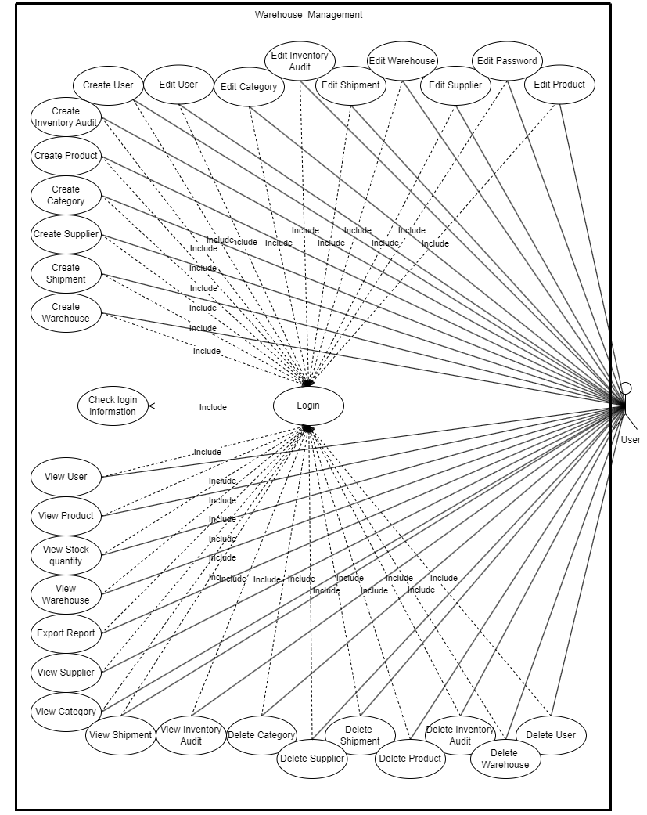
Use Case

Slide 6
Sequence Diagram

Slide 7
Class Diagram

Slide 8
Entity Relationship Diagram

Slide 9
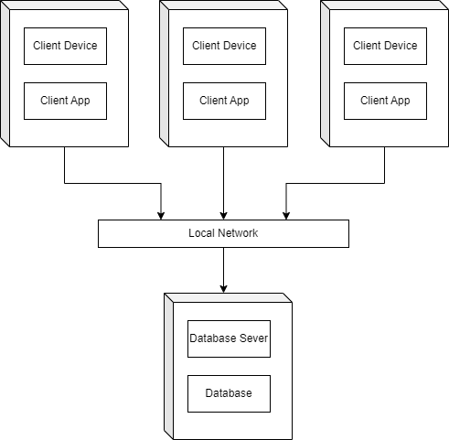
Deployment Diagram

Slide 10
UI Design

Slide 11
Task Assign (to each team member)

Slide 12
Experience Learned

Slide 13


Slide 14
Q & A

