Slide 1


Olist Performance
Minh Nguyen

Slide 2
Table of content
Olist Datasets
Objectives
Analysis
Conclusion

Slide 3
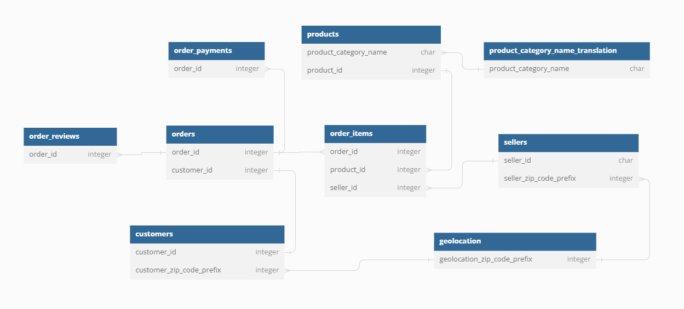
Olist Datasets

Slide 4
Objectives
Overview of business growth
Identify growth problem
Insights for customers’ behavior
Insights for improvement

Slide 5
Analysis

Slide 6
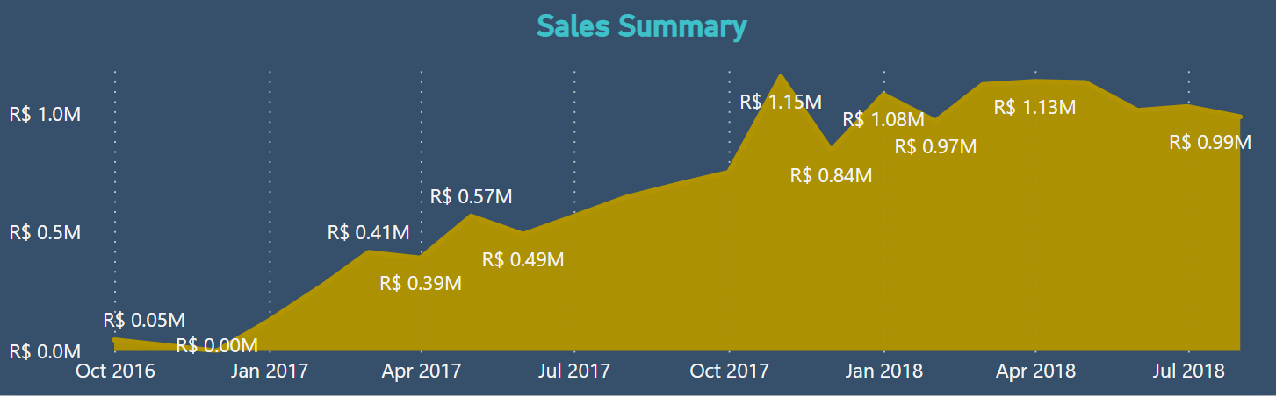
Overall Performance
Revenue showed strong performance in 2017 but slowed in 2018.
Look at competitor strategies.

Slide 7
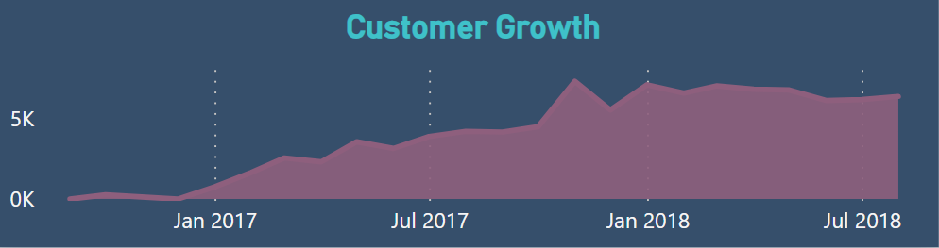
Customer Acquisition
Slowdown in new customer growth beginning of 2018. In line with Revenue growth.
Indicates that revenues are mostly from one-time customers.
Analyze customer acquisition strategies from 2017 - 2018.

Slide 8
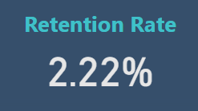
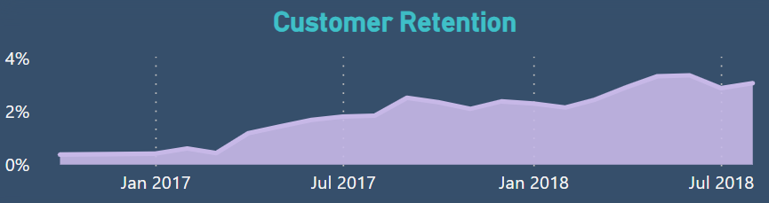
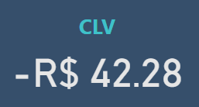
Customer Retention
Overall customer retention rate is 2.22% and growing slowly. Customer Lifetime Value is at concerning low.
Enhance customer experience for all stages of sale.
Personalized recommendations, implement loyalty programs, and post-purchase engagement.

Slide 9
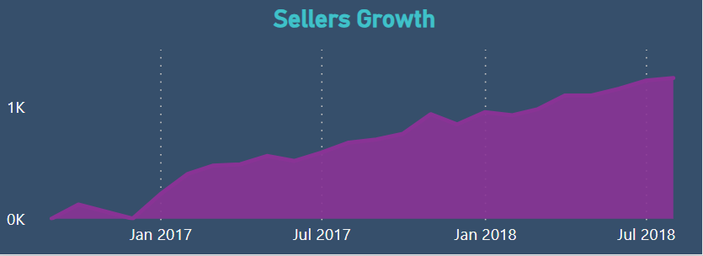
Sellers Growth
Even though more and more businesses want to sell on Olist.
Product diversity which increase customer experience.
Less dependent on any one sellers.

Slide 10
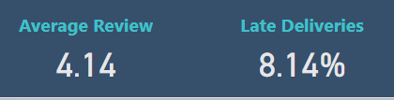
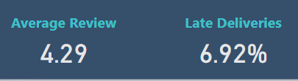
Reviews & deliveries
New Customers Repeat Customers
Insignificant difference between new and existing customers for average reviews and late deliveries rate.
Reviews and late deliveries don’t affect customer retention.

Slide 11
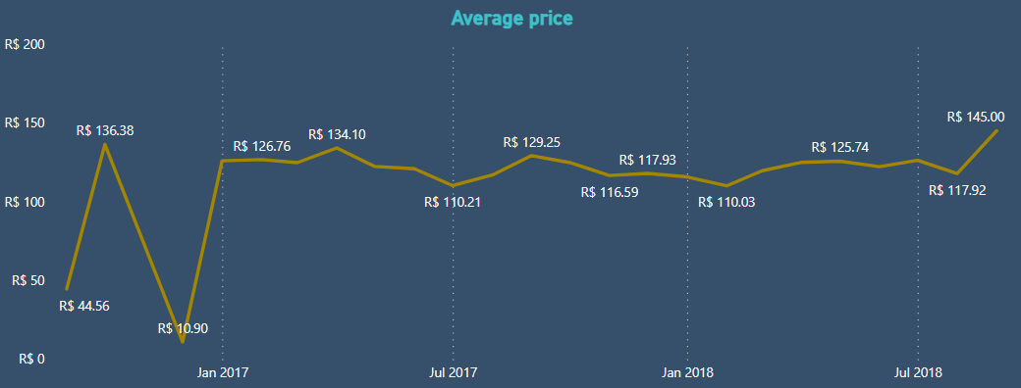
Pricing
Average prices are stable.
Of the top selling products, retention rate do not change with price.
Low customer retention is caused by other factors without data.

Slide 12
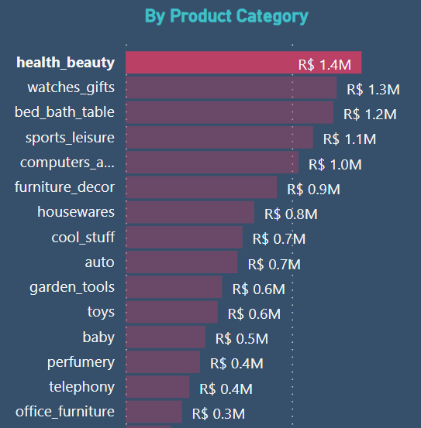
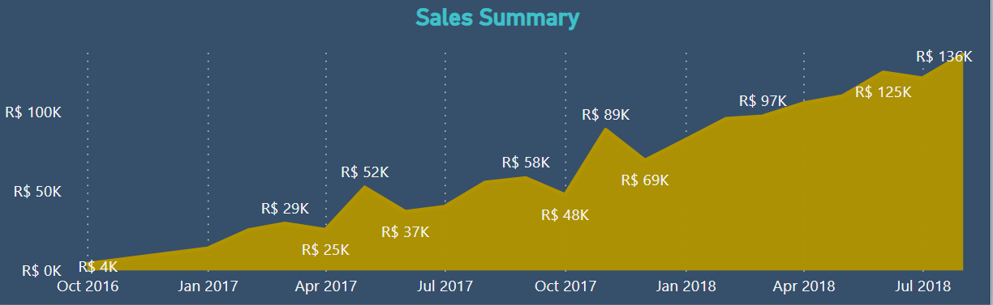
Top products for New customers
Health and beauty products are top growing products for new customers.
This category generally have high repeat purchases.
Reorder reminders.

Slide 13
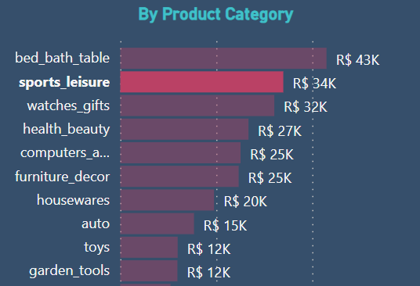
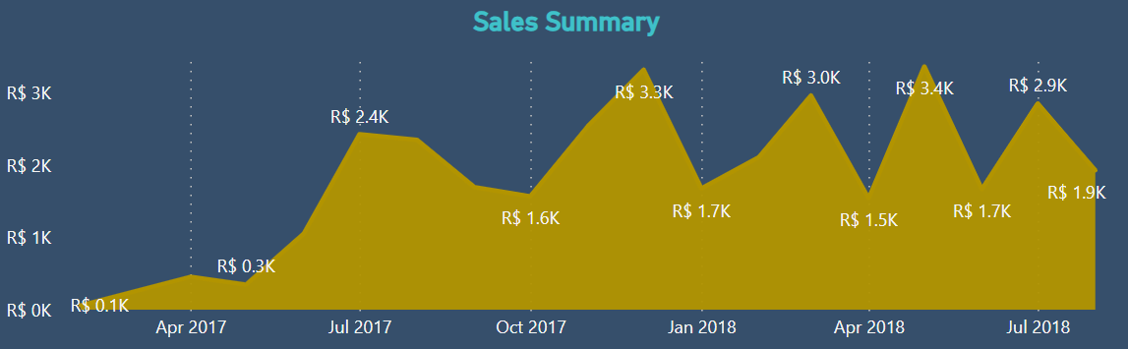
Top Repeat Purchases
Home décor, sports and gifts are top categories for repurchases.
These products are lifestyle enhancer, seasonal and regular consumption/replacement products.
Seasonal promotions.

Slide 14
Conclusion

Slide 15
Conclusion
Insights
Olist has been a powerhouse in growing its revenue in 2017 but has since hit a ceiling. Looking further, we instantly see that their revenue primarily generated from new one-time customers. Even though their average reviews are great, their customers rarely make repurchases. Although we can try to fix Olist retention rate problem with post-purchase engagement strategies, we still need more data to identify the root cause.
Recommendation
Enhance customer experience for all stages of sale.
Improve website experience. Deliveries update. Post-purchase engagement: - Personalized recommendations. - Implement loyalty programs. - Reorder reminders. - Seasonal promotions. - Customer surveys.
Re-engagement Campaigns.

Slide 16
Additional Data
Customer Demographic: - Age - Gender - Occupation - Family: Marital status, children => Customized ads and targeted marketing
Marketing Campaigns - Campaign info/cost. - Traffic source/click through rate. - Conversion rate. => Customer acquisition cost and Return-on-investment.
Website - Total traffic. - Time spent on site. - Bounce rate. - Click through rate. => Website visibility, quality, and interest.
Operation - Invoiced time stamp. - Processed time stamp. => Find process inefficiency.
Customer Service - Experience surveys. - Customer ratings for calls.

Slide 17
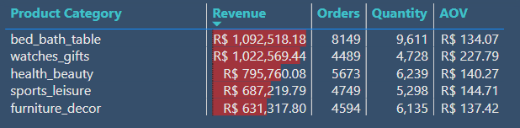
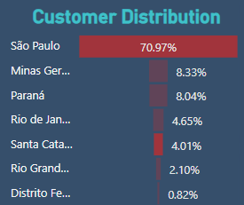
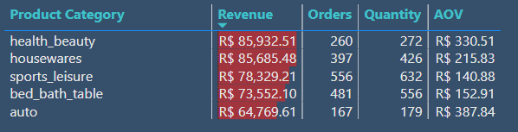
Test Sample

Slide 18
THANK YOU
Minh Nguyen

