Slide 1
BookStore Web
Built on Spring Boot and Thymeleaf
Description:
A commercial bookstore web with security function. A anonymous client can view all the book in store and also search the title of the book.
An register user can view all books, put in the shopping cart, also register the billing payment, shipping address. When finish selecting all the books, check out the order. Order will be mail to the user.
Admin portal can create,read, update,delete all the book in the store. User just can read book.
Anonymous can register an user, with username and email. Password will be sent to the registered email.

Slide 2
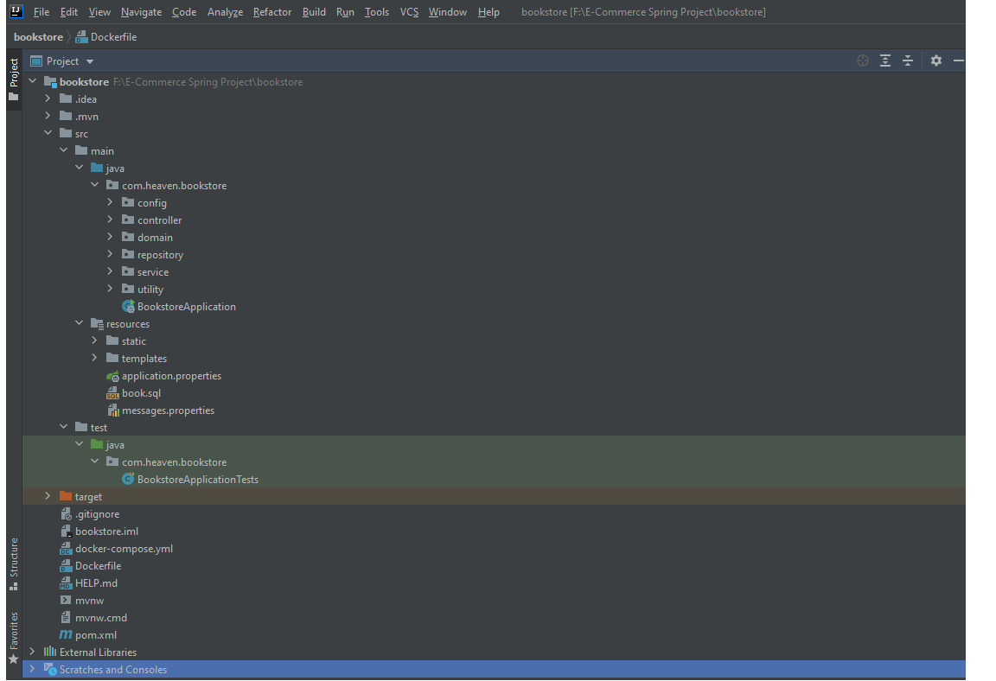
BookStore Web - Layout

Slide 3
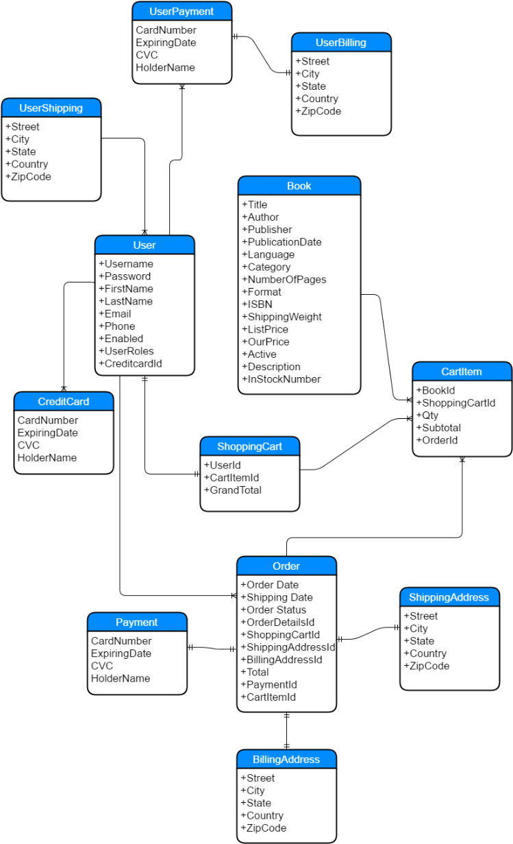
Bookstore- ER Diagram

Slide 4
Bookstore - My Account Module
My Account
Guest
User
Order History
Login
Profile
Create Account
Forget Password
Billing
Shipping

Slide 5
Bookstore - Browse Book
Book List
Search
View Book Detail Info
By Category
Show book availability
Add book to shopping cart
Fuzzy Search
By Keywords in book title

Slide 6
Bookstore - Shopping Cart
Shopping Cart
Order Confirmation
Checkout
Cart Item
Payment
Shipping
Modify cart item
Billing

Slide 7
Admin Portal – Book Management
Book List
Add Book
Book
Update Book
Delete Book

Slide 8
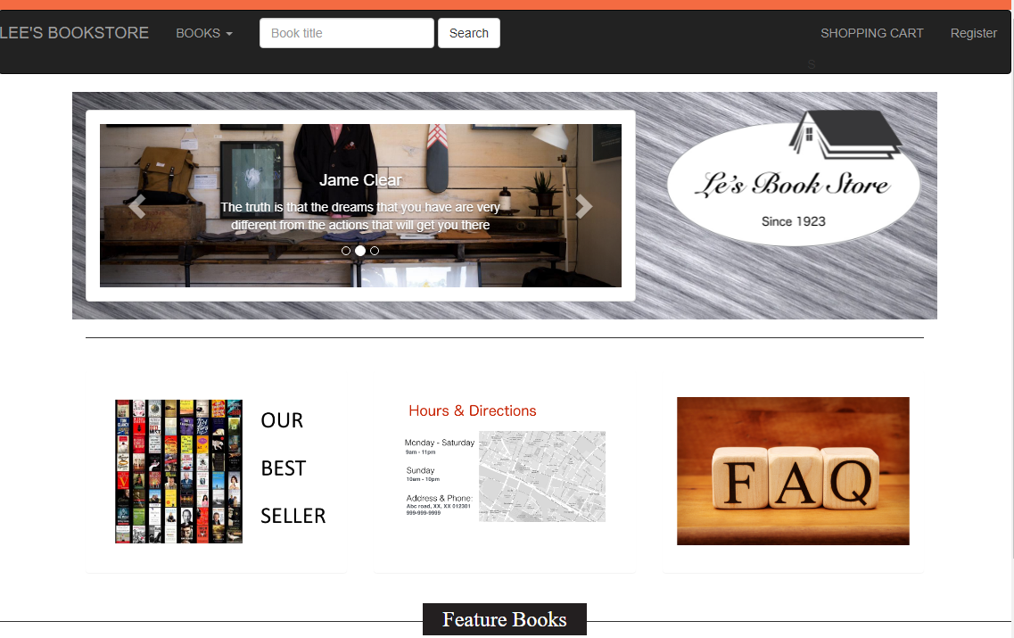
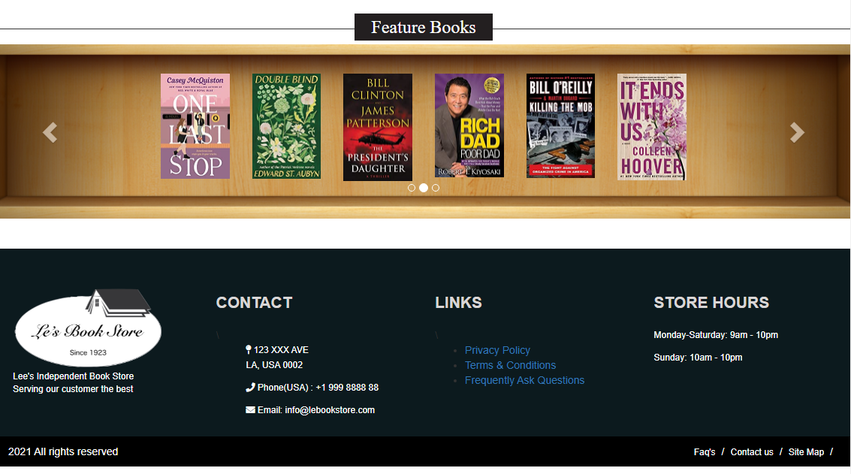

Slide 9
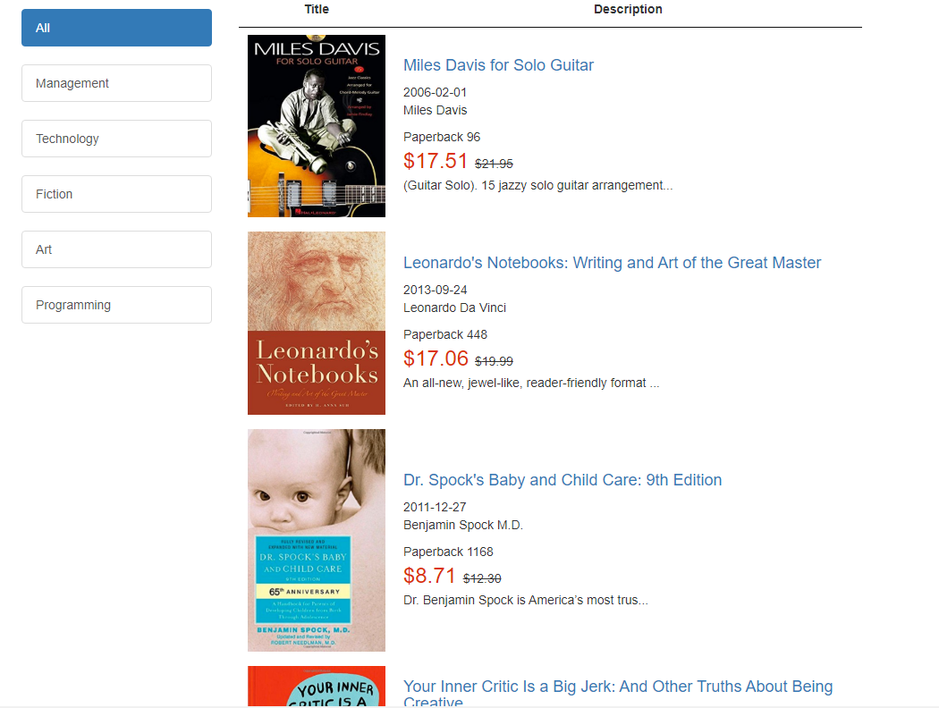

Slide 10
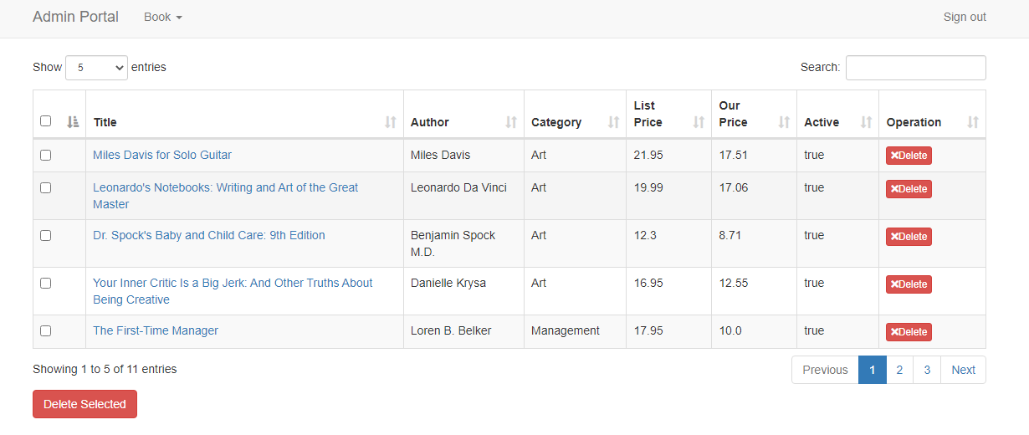

Slide 11
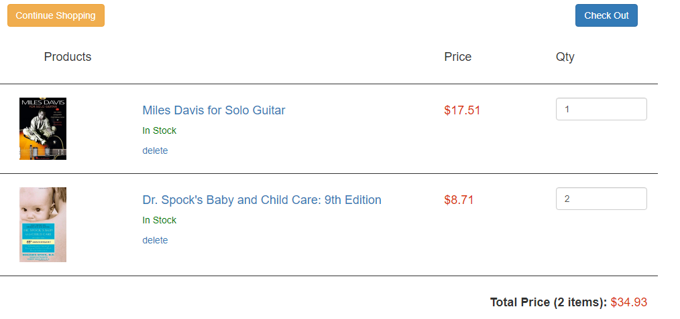
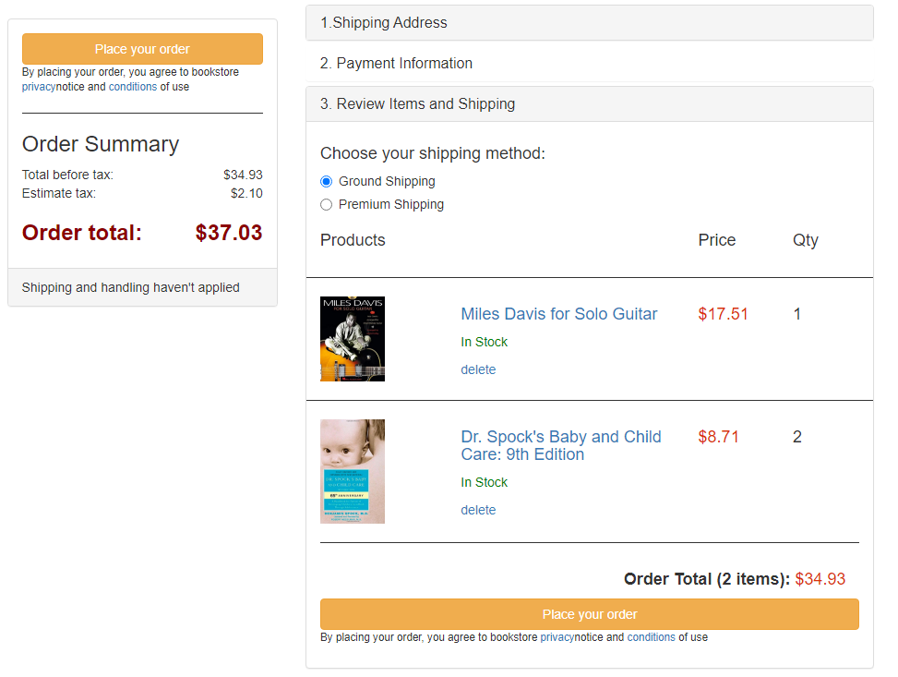
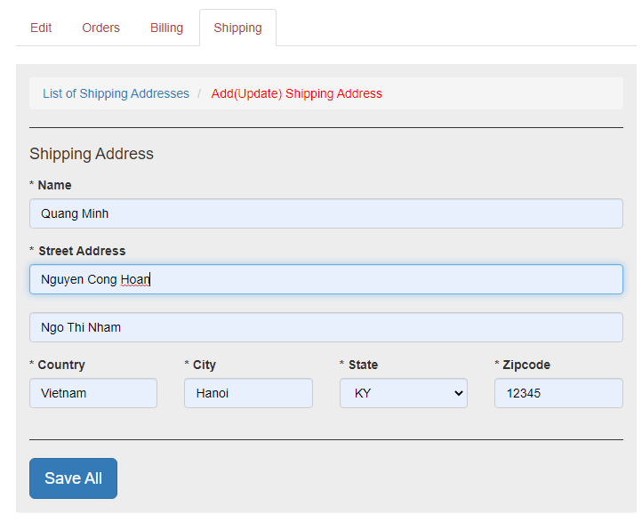
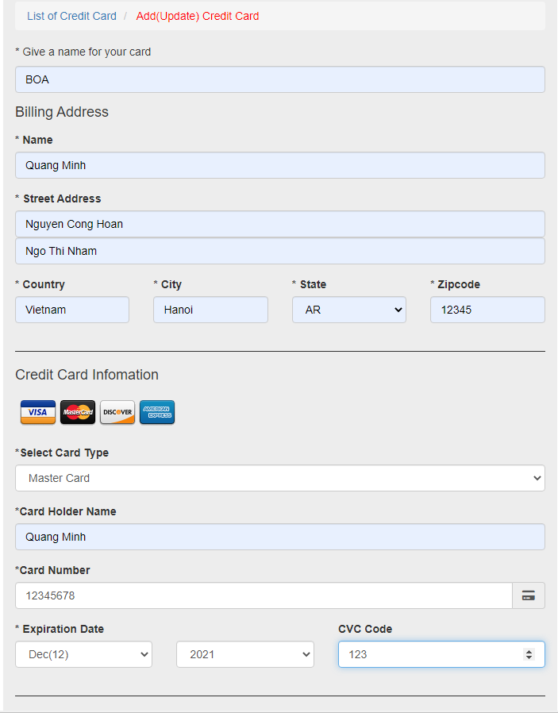

Slide 12
