Slide 1
Process Specifications and Structured Decisions
9
Kendall & Kendall
Systems Analysis and Design, 9e

Slide 2
Learning Objectives
Understand the purpose of process specifications.
Recognize the difference between structured and semistructured decisions.
Use structured English, decision tables, and decision trees to analyze, describe, and document structured decisions.
Choose an appropriate decision analysis method for analyzing structured decisions and creating process specifications.
9-<number>

Slide 3
Logic of Decisions
Documenting and analyzing logic:
  Structured English
  Decision tables
  Decision trees
Logic and structured decisions are distinguishable from semistructured decisions
Structured decision analysis methods promote completeness, accuracy, and communication
9-<number>
Notes:
It is important to recognize logic and structured decisions that occur in a business and how they are different from semistructured decisions that tend to involve human judgments.
It is also critical to recognize that structured decisions lend themselves to analysis with systematic methods.

Slide 4
Major Topics
Process specifications
Business rules
Structured English
Decision tables
Decision trees
Horizontal balancing
9-<number>

Slide 5
Process Specifications
Sometimes called minispecs
Created for primitive processes as well as for some higher level processes on a data flow diagram
Created for class methods in object-oriented design and for the steps in a use case
9-<number>
Notes:
Called minispecs because they are a small portion of the total product specifications.
Specifications explain the decision-making logic and formulas that transform process input data into output.

Slide 6
Goals of Producing Process Specifications
Reduce process ambiguity
Obtain a precise description of what is accomplished
Validate the system design
9-<number>
Notes:
Reduce process ambiguity—compels the analyst to learn details about how the process works.
Obtain a precise description of what is accomplished—usually included in a packet of specifications for the programmer.
Validate the system design—ensures that a process has all the input data flow necessary for producing the output.

Slide 7
Process Specifications Are Not Created for
Processes that represent physical input and/or output
Processes that represent simple data validation
Processes that use prewritten code
9-<number>
Notes:
Sometimes the process is very simple or the computer code already exists. In these cases process specifications are not created.
Processes that use prewritten code—these processes are generally included in a system as subprograms and functions.

Slide 8
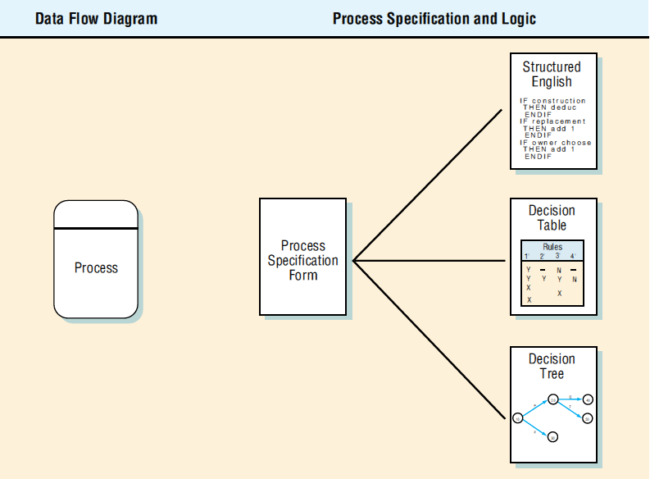
How Process Specifications Relate to the Data Flow Diagram (Figure 9.1)
9-<number>
Notes:
Process specifications link the process to the DFD and the data dictionary.

Slide 9
Process Specification Format Information
The process number
The process name
Description of what the process accomplishes
A list of input data flow
Output data flows
Type of process
Uses prewritten code
Process logic description
Logic method reference
List any unresolved issues
9-<number>

Slide 10
The Process Number
Must match the process ID on the data flow diagram
Allows the analyst to work on or review any process, and to locate the data flow diagram containing the process easily
9-<number>

Slide 11
The Process Name
The same as displays within the process symbol on the DFD
9-<number>

Slide 12
Description of What the Process Accomplishes
Example:
  Determine if an item is available for sale. If it is not available, create a backordered item record. Determine the quantity available.
9-<number>

Slide 13
List of Input Data Flow
Uses the names found on the data flow diagram
Data names used in the formula or logic should match the data dictionary, for consistency and good communication
9-<number>

Slide 14
Output Data Flows
Uses data flow diagram and data dictionary names
9-<number>

Slide 15
Type of Process
Batch
Online
  Require screen design or web pages
Manual
  Should have well-defined procedures for employees performing the process tasks
9-<number>

Slide 16
Uses Prewritten Code
Include the name of the subprogram or function containing the code
9-<number>

Slide 17
Process Logic Description
This should state policy and business rules, not computer language pseudo-code
Business rules are the procedures that allow a corporation to run its business
9-<number>

Slide 18
Common Business Rule Formats
Definitions of business terms
Business conditions and actions
Data integrity constraints
Mathematical and functional derivations
Logical inferences
Processing sequences
Relationships among facts about the business
9-<number>

Slide 19
Logic Method Reference
If there is not enough room for a complete structured English description include a reference to the structured English description, decision table, or tree depicting the logic
9-<number>

Slide 20
List Any Unresolved Issues
Incomplete portions of logic
These issues form the basis of the questions used for follow-up interviews with users or business experts you have added to your project team
9-<number>

Slide 21
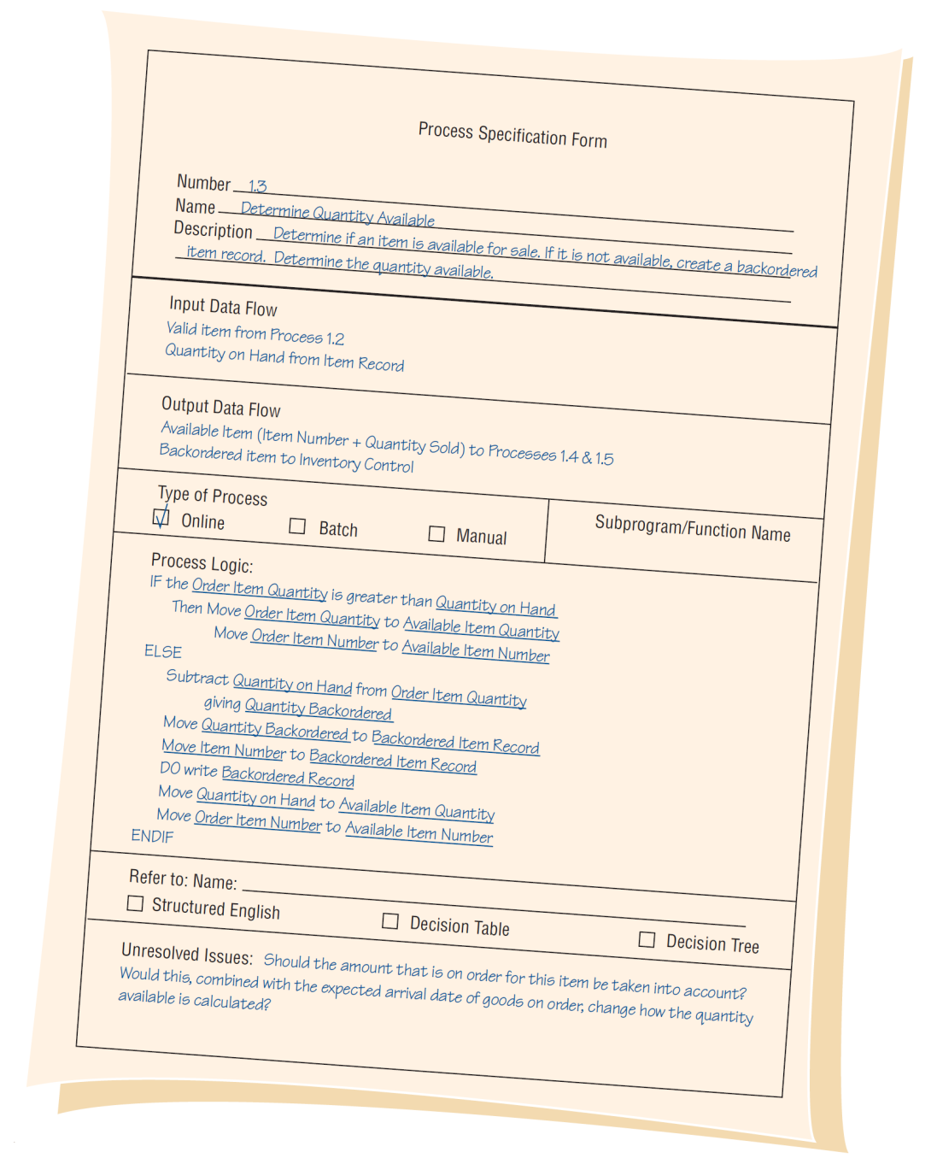
An Example of a Completed Process Specification Form (Figure 9.2)
9-<number>
Notes:
Completing this form facilitates linking process to the data flow diagram and the data dictionary.

Slide 22
Structured English
Used when the process logic involves formulas or iteration, or when structured decisions are not complex
Based on structured logic and simple English statements such as add, multiply, and move
9-<number>
Notes:
Structured logic—instructions organized into nested and grouped procedures.

Slide 23
Writing Structured English
Express all logic in terms of sequential structures, decision structures, case structures, or iterations
Use and capitalize accepted keywords such as IF, THEN, ELSE, DO, and PERFORM
Indent blocks of statements to show their hierarchy (nesting) clearly
Underline words or phrases that have been defined in a data dictionary
Clarify the logical statements
9-<number>
Notes:
Underline words or phrases that have been defined in a data dictionary to signify that they have a specialized, reserved meaning.
Be careful when using “and” and “or.”
Avoid confusion when using logical comparisons such as “greater than” and “greater than or equal to” and like relations.
Clarify the logical statements now rather than waiting until the program coding stage.

Slide 24
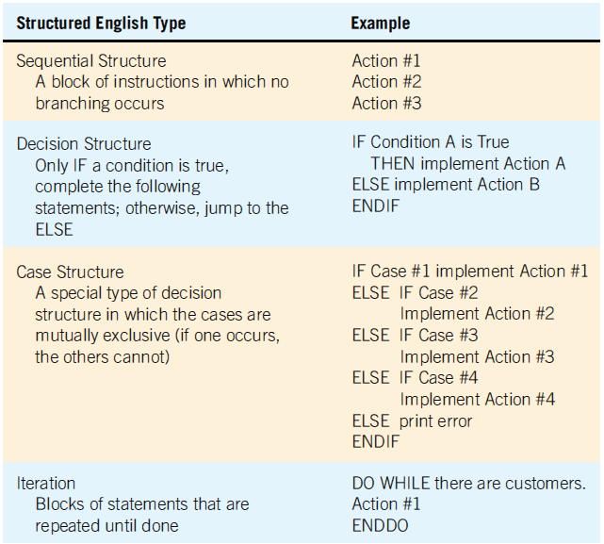
Examples of Structured English Types
(Figure 9.3)
9-<number>

Slide 25
Advantages of Structured English
Clarifying the logic and relationships found in human languages
An effective communication tool, it can be taught to and understood by users in the organization
9-<number>
Notes:
If communication is important, structured English is a viable alternative for decision analysis.

Slide 26
Data Dictionary and Process Specification
The data dictionary is a starting point for creating structured English:
  Sequence—a simple sequence of statements MOVE, ADD, and SUBTRACT
  Selection—[] entries become IF…THEN...ELSE statements
  Iteration { } entries become DO WHILE, DO UNTIL, or PERFORM UNTIL
9-<number>
Notes:
All computer programs may be coded using the three basic constructs: sequence, selection and iteration. The data dictionary indicates which of these constructs must be included in the process specifications.

Slide 27
Decision Tables
A table of rows and columns, separated into four quadrants:
  Conditions
  Condition alternatives
  Actions to be taken
  Rules for executing the actions
9-<number>

Slide 28
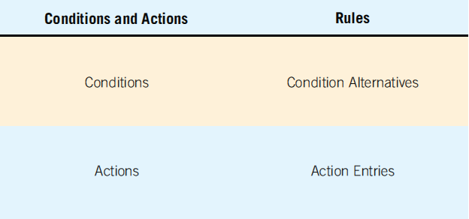
Standard Format Used for Presenting a Decision Table (Figure 9.7)
9-<number>
Notes:
A decision table is a table of rows and columns, separated into four quadrants.
The upper left quadrant contains the conditions.
The upper right quadrant contains the condition alternatives.
The lower half of the table contains the actions to be taken on the left and the rules for executing the actions on the right.
When a decision table is used to determine which action needs to be taken, the logic moves clockwise beginning from the upper left.

Slide 29
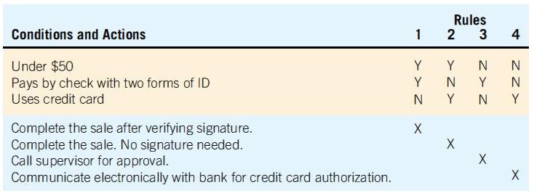
Customer Checkout Decision Table (Figure 9.8)
9-<number>

Slide 30
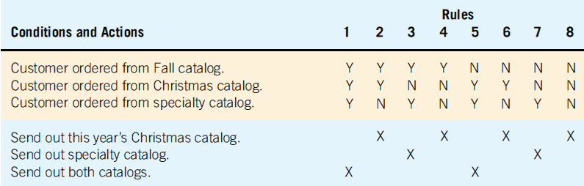
Constructing a Decision Table for Deciding Which Catalog to Send to Customers Who Order Only from Selected Catalogs (Figure 9.9)
9-<number>

Slide 31
Developing Decision Tables
Determine conditions that affect the decision
Determine possible actions that can be taken
Determine condition alternatives for each condition
Calculate the maximum number of columns in the decision table
9-<number>
Notes:
Determine the number of conditions that affect the decision—the number of conditions becomes the number of rows in the top half of the decision table.
Determine the number of possible actions that can be taken—this becomes the number of rows in the lower half of the decision table.
Determine condition alternatives for each condition—in the simplest form two alternatives (Y or N), in an extended there may be many alternatives.
Calculate the maximum number of columns in the decision table—the product of the number of alternatives for each condition. If there were four conditions and 2 alternatives for each condition, there would be 16 possibilities
(2 x 2 x 2 x 2).

Slide 32
Developing Decision Tables
Fill in the condition alternatives
Complete table by inserting an X where rules suggest actions
Combine rules where it is apparent
Check for impossible situations
Rearrange to make more understandable
9-<number>
Notes:
Determine the number of conditions that affect the decision—the number of conditions becomes the number of rows in the top half of the decision table.
Determine the number of possible actions that can be taken—this becomes the number of rows in the lower half of the decision table.
Determine condition alternatives for each condition—in the simplest form two alternatives (Y or N), in an extended there may be many alternatives.
Calculate the maximum number of columns in the decision table – the product of the number of alternatives for each condition. If there were four conditions and 2 alternatives for each condition, there would be 16 possibilities
(2 x 2 x 2 x 2).

Slide 33
Developing Decision Tables
Step 1
Determine the number of conditions that may affect the decision
Combine rows that overlap, such as conditions that are mutually exclusive
The number of conditions becomes the number of rows in the top half of the decision table
9-<number>

Slide 34
Developing Decision Tables
Step 2
Determine the number of possible actions that can be taken
That number becomes the number of rows in the lower half of the decision table
9-<number>

Slide 35
Developing Decision Tables
Step 3
Determine the number of condition alternatives for each condition
In the simplest form of decision table, there would be two alternatives (Y or N) for each condition
An extended entry table may have many alternatives for each condition
Make sure that all possible values for the condition are included
9-<number>

Slide 36
Developing Decision Tables
Step 4
Calculate the maximum number of columns in the decision table by multiplying the number of alternatives for each condition
If there were four conditions and two alternatives (Y or N) for each of the conditions, there would be 16 possibilities
9-<number>

Slide 37
Developing Decision Tables
Step 5
Fill in the condition alternatives
Start with the first condition and divide the number of columns by the number of alternatives for that condition
If there are 16 columns and two alternatives (Y or N), then 16 divided by 2 is 8
Choose one of the alternatives, say Y, and write it in the first eight columns
Finish by writing N in the remaining eight columns
9-<number>

Slide 38
Checking for Completeness and Accuracy
Four main problems:
  Incompleteness
  Impossible situations
  Contradictions
  Redundancy
9-<number>
Notes:
Incompleteness—if a condition is left out, the whole decision table would change because a new condition, new set of alternatives, new action, and one or more new action rules would have to be added.
Impossible situations—for example a person can not earn greater than $50,000 per year and less that $2,000 per month.
Contradictions—occur when rules suggest different actions but satisfy the same conditions.
Redundancy—occurs when identical sets of alternatives require the exact same action.

Slide 39
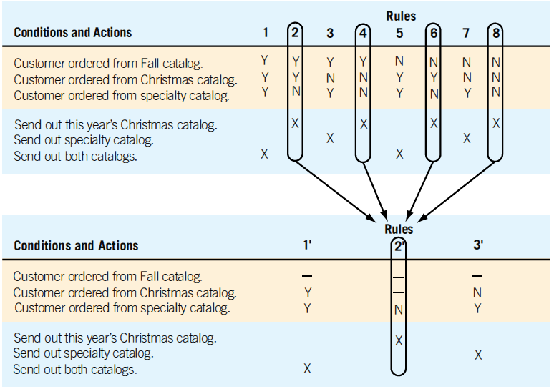
Combining Rules to Simplify the Decision Table (Figure 9.10)
9-<number>

Slide 40
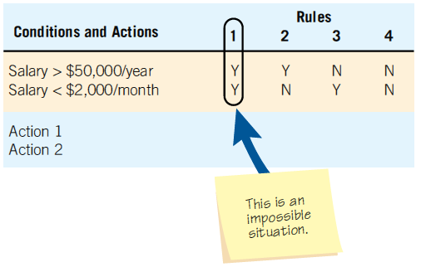
Checking the Decision Table for
Impossible Situations (Figure 9.12)
9-<number>

Slide 41
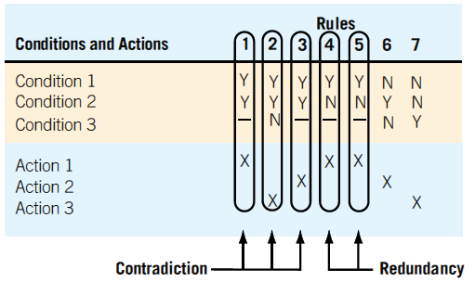
Checking for Contradictions and Redundancy (Figure 9.13)
9-<number>

Slide 42
Decision Table Advantages
Help the analysis ensure completeness
Easy to check for possible errors
  Impossible situations
  Contradictions
  Redundancy
9-<number>
Notes:
Decision table processors, which take the decision table as input and provide computer program code as output, are available.

Slide 43
Decision Trees
Decision trees are used when complex branching occurs in a structured decision process
Trees are also useful when it is essential to keep a string of decisions in a particular sequence
9-<number>
Notes:
Drawn on their side, with the root of the tree on the left side and the tree branches out to the right.
Used mainly for identifying and organizing conditions and actions in a completely structured decision process.

Slide 44
Drawing Decision Trees
Identify all conditions and actions and their order and timing (if they are critical)
Begin building the tree from left to right, making sure you list all possible alternatives before moving to the right
9-<number>

Slide 45
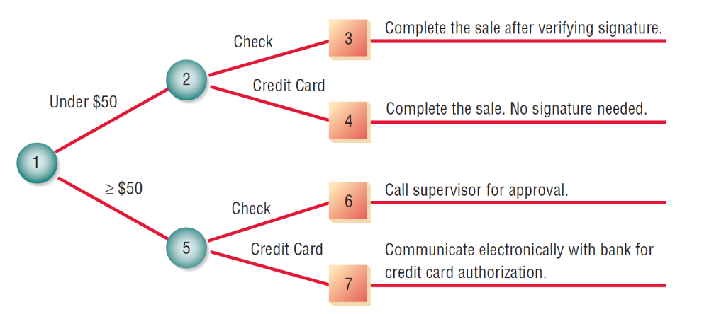
Drawing a Decision Tree to Show the Noncash Purchase Approval Actions for a Department Store (Figure 9.14)
9-<number>
Notes:
A tree does not need to be symmetrical.
Most decision trees have conditions that have a different number of branches.
Identical actions may appear more than once.

Slide 46
Decision Tree Advantages
The order of checking conditions and executing actions is immediately noticeable
Conditions and actions of decision trees are found on some branches but not on others
Compared to decision tables, decision trees are more readily understood by others in the organization
9-<number>

Slide 47
Selecting a Structured Decision Analysis Technique
Use structured English when there are many repetitious actions or when communication to end users is important
Use decision tables when a complex combination of conditions, actions, and rules are found or you require a method that effectively avoids impossible situations, redundancies, and contradictions
Use decision trees when the sequence of conditions and actions is critical or when not every condition is relevant to every action (the branches are different)
9-<number>

Slide 48
Summary
Process specifications
Decision analysis
  Structured English
    Logic is expressed in sequential structures, decision structures, case structures, or iterations
9-<number>

Slide 49
Summary (continued)
  Decision tables
    Four quadrants are used to:
      Describe the conditions
      Identify possible decision alternatives
      Indicate which actions should be performed
      Describe the actions
  Decision trees
    Consist of nodes and branches
9-<number>

Slide 50
Summary (continued)
Decision analysis advantages
  Structured English is useful when many actions are repeated and when communicating with others is important
  Decision tables provide complete analysis of complex situations while limiting the need for change attributable to impossible situations, redundancies, or contradictions
  Decision trees are important when proper sequencing of conditions and actions is critical and when each condition is not relevant to each action
9-<number>

Slide 51

Copyright © 2014 Pearson Education, Inc.
Publishing as Prentice Hall
9-<number>

