Slide 1
Designing Effective Output
11
Kendall & Kendall
Systems Analysis and Design, 9e
Kendall & Kendall Copyright © 2014 Pearson Education, Inc. Publishing as Prentice Hall

Slide 2
Learning Objectives
Understand the objectives for effective output design
Relate output content to output methods inside and outside the organizational context
Realize how output bias affects users
Design display output
Design dashboard, widgets, and gadgets
Design a websites for ecommerce and corporate uses that include Web 2.0 technologies
Understand the development process for apps used on smartphones and tablets
Kendall & Kendall Copyright © 2014 Pearson Education, Inc. Publishing as Prentice Hall
11-<number>

Slide 3
Output
Information delivered to users
Output forms
  Hard-copy—printed reports
  Soft-copy—computer screens, microforms, and audio
To create output, the analyst works interactively with the user until the output is satisfactory
Kendall & Kendall Copyright © 2014 Pearson Education, Inc. Publishing as Prentice Hall
11-<number>
Notes:
Output can be delivered via:
intranets
extranets
the Web

Slide 4
Major Topics
Designing output
Output technologies
Factors in choosing an output technology
Report design
Screen design
Website design
Smartphones and tablet design
Kendall & Kendall Copyright © 2014 Pearson Education, Inc. Publishing as Prentice Hall
11-<number>

Slide 5
Output Design Objectives
Serve a specific user or organizational purpose
Meaningful to the user
Deliver the appropriate quantity of output
Make sure the output is where it is needed
Provide output on time
Choosing the most effective output method
Kendall & Kendall Copyright © 2014 Pearson Education, Inc. Publishing as Prentice Hall
11-<number>
Notes:
Output is essential to ensuring the use and acceptance of the information system.
Serve a specific user or organizational purpose—if the output is not functional, it should not be created, there are costs of time and materials with all output from the system.
Meaningful to the user—on the basis of interviews, observations, cost considerations, and prototypes, it is possible to design output that addresses what users need and prefer.
Deliver the appropriate quantity of output—the system must provide what each person needs to complete his or her work.
Make sure the output is where it is needed—to be used and useful, output must be presented to the right user.
Provide output on time—accurate timing of output can be critical to business operations.
Choosing the right output method—there are tradeoffs in output methods; costs differ, accessibility, flexibility, durability, distribution, storage, retrieval, transportability, overall impact.

Slide 6
Relating Output Content to Method
Content of output must be considered as interrelated to the output method
  External—going outside the business
  Internal—staying within the business
Kendall & Kendall Copyright © 2014 Pearson Education, Inc. Publishing as Prentice Hall
11-<number>
Notes:
Internal output is used within the corporation.
External output is used outside the organization.

Slide 7
External Output
Examples:
  Utility bills
  Advertisements
  Paychecks
Differs from internal output in:
  Distribution
  Design
  Appearance
Kendall & Kendall Copyright © 2014 Pearson Education, Inc. Publishing as Prentice Hall
11-<number>
Notes:
Many external documents must include instructions to the recipient if they are to be used correctly.

Slide 8
Internal Output
Examples:
  Summary reports
  Detailed reports
  Historical reports
  Exception reports
Might consist of material available on an intranet
Kendall & Kendall Copyright © 2014 Pearson Education, Inc. Publishing as Prentice Hall
11-<number>

Slide 9
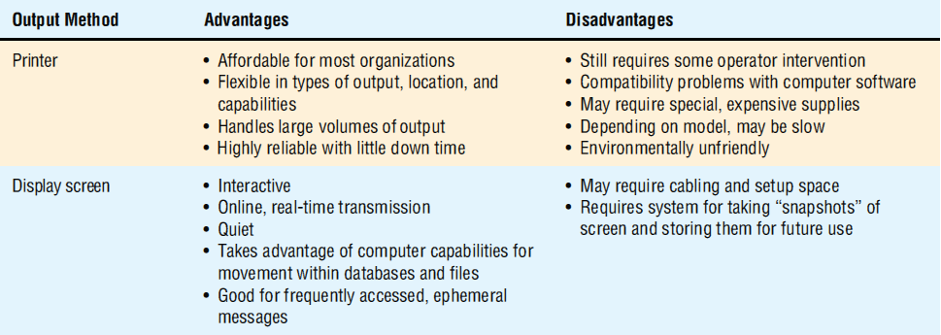
A Comparison of Output Methods
(Figure 11.2)
Kendall & Kendall Copyright © 2014 Pearson Education, Inc. Publishing as Prentice Hall

Slide 10
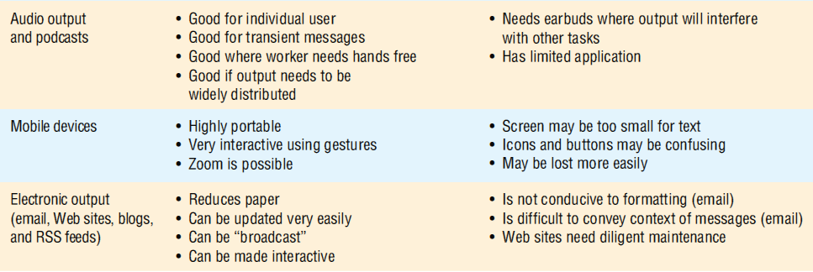
A Comparison of Output Methods
(Figure 11.2) (continued)
Kendall & Kendall Copyright © 2014 Pearson Education, Inc. Publishing as Prentice Hall
11-<number>

Slide 11
Factors to Consider When Choosing Output Technology
Who will use the output?
How many people need the output?
Where is the output needed?
What is the purpose?
What is the speed with which output is needed?
How frequently will the output be accessed?
How long will the output be stored?
Regulations depicting output produced, stored, and distributed
Initial and ongoing costs of maintenance and supplies
Human and environmental requirements
Kendall & Kendall Copyright © 2014 Pearson Education, Inc. Publishing as Prentice Hall
11-<number>
Notes:
Although the technology changes rapidly, certain usage factors remain fairly constant in relation to technological breakthroughs.
Who will use the output—job requirements help dictate what output is appropriate.
How many people need the output:
if many people need output, Web-based with a print option or printed copies.
if only one use, a screen or audio.
if many people, different outputs, different times for short periods and need it quickly then Web documents or screens connected to terminals.
Where is the output needed—physical destination of the output.
What is the purpose—what user and organizational tasks are supported.
What is the speed with which output is needed—the higher the level of management the faster the output is desired.
How frequently will the output be accessed—infrequently accesses output that is needed by only a few users is well suited to a CD-ROM archive.
How long will the output be stored—paper deteriorates with age. Microforms or digitized is better.
Regulations depicting output produced, stored, and distributed—the appropriate format for some output is regulated by the government.
Initial and ongoing costs of maintenance and supplies—initial cost and ongoing cost must be considered.
Human and environmental requirements—accessibility, absorption, controlled temperature, space for equipment, cabling, proximity to Wi-Fi transmitters or access points.

Slide 12
Green IT Initiatives
May limit the quantity of paper reports that are printed
May discourage employees from printing out copies of email messages by adding a green IT notification to the bottom of each corporate email message
Kendall & Kendall Copyright © 2014 Pearson Education, Inc. Publishing as Prentice Hall
11-<number>

Slide 13
Output Bias
Analysts must avoid unnecessarily biasing output and make users aware of the possible biases in output
Bias is introduced in three main ways:
  How information is sorted
  Setting of acceptable limits
  Choice of graphics
Kendall & Kendall Copyright © 2014 Pearson Education, Inc. Publishing as Prentice Hall
11-<number>
Notes:
Bias is present in everything that humans create.
How information is sorted—bias is introduced to output when the analyst and users make choices about how information is sorted for a report; alphabetical, chronological, cost.
Setting of acceptable limits—the predefinition of limits for particular values being reported.
Choice of graphics—bias can occur in the selection of the graph size, its color, the scale used, and even the type of graph.

Slide 14
Avoiding Bias in the Design Output
Be aware of the sources of bias
Design of output that includes users
Work with users so that they are informed of the output’s biases
Creating output that is flexible and allows users to modify limits and ranges
Train users to rely on multiple output for conducting “reality tests” on system output
Kendall & Kendall Copyright © 2014 Pearson Education, Inc. Publishing as Prentice Hall
11-<number>
Notes:
Systems analyst first need to recognize the potential impact of output and be aware of the possible ways in which output is unintentionally biased. They then need to be proactive in helping users design output with minimal, but identifiable, biases.

Slide 15
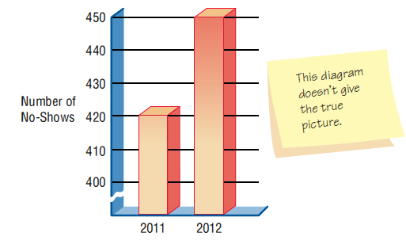
A Misleading Graph Will Most
Likely Bias the User (Figure 11.5)
Kendall & Kendall Copyright © 2014 Pearson Education, Inc. Publishing as Prentice Hall
11-<number>

Slide 16
Designing Printed Output
Detailed reports
  Print a report line for every record on the master file
Exception reports
  Print a line for all records that match a certain condition
Summary reports
  Print one line for a group of records that are used to make decisions
Kendall & Kendall Copyright © 2014 Pearson Education, Inc. Publishing as Prentice Hall
11-<number>

Slide 17
Designing Output for Displays
Keep the display simple
Keep the presentation consistent
Facilitate user movement among displayed output
Create an attractive and pleasing display
Kendall & Kendall Copyright © 2014 Pearson Education, Inc. Publishing as Prentice Hall
11-<number>
Notes:
Differences between printed and display:
display is ephemeral
display can be more specifically targeted to the user
display is available on a more flexible schedule
display is not portable in the same way as printed
display can sometimes be changed through direct interaction
display users need to be instructed on use
access to displays may be controlled through a password

Slide 18
Graphical Output in Screen Design
The purpose of the graph
The kind of data to be displayed
The audience
The effects on the audience of different kinds of graphical output
Kendall & Kendall Copyright © 2014 Pearson Education, Inc. Publishing as Prentice Hall
11-<number>
Notes:
Output must be accurate, easy to understand and use.
In the instance of a decision support system, the purposes of graphical displays are to support any of the three phases of problem solving or user experiences: intelligence, design, or choice.

Slide 19
Dashboards
Make sure the data has context
Display the proper amount of summarization and precision
Choose appropriate performance measures for display
Present data fairly
Kendall & Kendall Copyright © 2014 Pearson Education, Inc. Publishing as Prentice Hall
11-<number>

Slide 20
Dashboards (continued)
Choose the correct style of graph or chart for display
Use well-designed display media
Limit the variety of item types
Highlight important data
Kendall & Kendall Copyright © 2014 Pearson Education, Inc. Publishing as Prentice Hall
11-<number>

Slide 21
Dashboards (continued)
Highlight important data
Arrange the data in meaningful groups
Keep the screen uncluttered
Keep the entire dashboard on a single screen
Allow flexibility
Kendall & Kendall Copyright © 2014 Pearson Education, Inc. Publishing as Prentice Hall
11-<number>

Slide 22
Widgets and Gadgets
Can be any type of a program that may be useful to any person interacting with a computer
Can empower users to take part in design of their own desktop
Kendall & Kendall Copyright © 2014 Pearson Education, Inc. Publishing as Prentice Hall
11-<number>
Notes:
Widgets and gadgets—clocks, calculators, bookmark helpers, translators, search engines, easy access to utilities, quick launch panels, sticky notes
Designers can learn what users prefer when they study user-designed desktops.

Slide 23
Designing a Website
Use professional tools
Study other sites
Use Web resources
Examine the sites of professional website designers
Use the tools you’ve learned
Use storyboarding, wireframing, and mockups
Kendall & Kendall Copyright © 2014 Pearson Education, Inc. Publishing as Prentice Hall
11-<number>
Notes:
Use professional tools—Web editors such as Macromedia Dreamweaver.
Studying other sites—Firefox is a great browser for studying other websites.
Use Web resources—look at websites that give hints on design. i.e. useit.com
Examine the sites of professional website designers—often visited and praised websites.
Use the tools you’ve learned—use a form to evaluate Web pages systematically.
Consult the books—read about Web design.
Examine poorly designed Web pages—critique poor web pages and remember to avoid those mistakes.

Slide 24
Designing a Website (continued)
Consult the books
Examine poorly designed websites
Creating Web templates
  Style sheets allow you to format all Web pages in a site consistently
Using plug-ins, audio, and video sparingly
Kendall & Kendall Copyright © 2014 Pearson Education, Inc. Publishing as Prentice Hall
11-<number>
Notes:
Creating Web templates—if you adopt a standard-looking page for most of the pages you create, you’ll get the website up and running quickly and it will consistently look good.
Using plug-ins, audio, and video sparingly—remember that everyone does not have new plug-ins.

Slide 25
Storyboarding
In developing a website or app a storyboard could be used to show the differences between screens
It can show how a visitor to the site would navigate the website
Kendall & Kendall Copyright © 2014 Pearson Education, Inc. Publishing as Prentice Hall
11-<number>

Slide 26
Wireframing
Page design can be accomplished using a process called wireframing
Wireframing because it shows only the basics
There is no color, no type style; graphics are shown as a simple box with an X drawn in
In this way, each of the items acts as a placeholder
Kendall & Kendall Copyright © 2014 Pearson Education, Inc. Publishing as Prentice Hall
11-<number>

Slide 27
Wireframing
Wireframing allows the designer to plan:
  The overall design, showing what element appears at each position on the page
  The navigational design, showing how to move from one page to the next using buttons, tabs, links, and pull-down menus
  The interface design, showing how to interact with the website by inputting data or responding to questions
Kendall & Kendall Copyright © 2014 Pearson Education, Inc. Publishing as Prentice Hall
11-<number>

Slide 28
Mockups
The term wireframe has largely been replaced with mockup
Mockups show what the output and input will look like
Abundant software is available to help a systems designer develop a mockup
Kendall & Kendall Copyright © 2014 Pearson Education, Inc. Publishing as Prentice Hall
11-<number>

Slide 29
Mockups
The software has objects that can be dragged and dropped onto the screen
Templates are available for any type of display including:
  Desktops
  Notebooks
  Smartphones
  Tablets
When designing for smartphones and tablets, both screen orientations are included
Kendall & Kendall Copyright © 2014 Pearson Education, Inc. Publishing as Prentice Hall
11-<number>

Slide 30
Designing a Website (continued)
Plan ahead, pay attention to:
  Structure
  Content
  Text
  Graphics
  Presentations style
  Navigation
  Promotion
Kendall & Kendall Copyright © 2014 Pearson Education, Inc. Publishing as Prentice Hall
11-<number>
Notes:
Plan ahead—good websites are well thought out.

Slide 31
Structure
One of the most important steps in developing a professional website
Each page in the Web structure should have a distinct message
Can benefit from using website diagramming and mapping tools
Kendall & Kendall Copyright © 2014 Pearson Education, Inc. Publishing as Prentice Hall
11-<number>
Notes:
Think about your goals and objectives.
Diagramming and mapping tools become even more important when maintaining a website.

Slide 32
Content
Appropriate content is needed to keep the user interested
Use a metaphor or images that provide metaphor for your site
Should include a FAQ page
May take advantage of prewritten software
Kendall & Kendall Copyright © 2014 Pearson Education, Inc. Publishing as Prentice Hall
11-<number>
Notes:
If a user stays at your site for a long period of time, your site has a high degree of stickiness.
Avoid the overuse of cartoons and don’t be repetitive.
FAQ are created based on the experiences of users and technical support people who identify the topics of continuing concern.
Prewritten software may include search engines, mapping software, weather information, and news and stock tickers.

Slide 33
Text
Each Web page should have a title
Place meaningful words in the first sentence appearing on your Web page
Clear writing is important
Kendall & Kendall Copyright © 2014 Pearson Education, Inc. Publishing as Prentice Hall
11-<number>
Notes:
Don’t forget that text is important.

Slide 34
Content Management Systems
Content on ecommerce sites needs to be constantly updated
Content management systems (CMSs) are software tools that help to develop and maintain websites and online applications
Kendall & Kendall Copyright © 2014 Pearson Education, Inc. Publishing as Prentice Hall
11-<number>

Slide 35
Graphics
Use either JPEG, GIF, or PNG formats
Keep the background simple and readable
Create a few professional-looking graphics for use on your pages
Keep images small and reuse bullet or navigational buttons
Include text in what is called a Title or ALT attribute for images and image hot spots
Examine your website on a variety of displays and screen resolutions
Kendall & Kendall Copyright © 2014 Pearson Education, Inc. Publishing as Prentice Hall
11-<number>
Notes:
JPEG’s are best for photographs, and GIFS are best for artwork.
When using a background pattern, make sure that you can see the text clearly on top of it.
Once an image has been received, it will be taken from the cache when ever it is used again.
The text displays when the user moves the mouse over the image and is essential to support Web accessibility impaired site visitors.
Scenes and text that look good on a high-end video display may not look good to others with poorer-quality equipment.

Slide 36
Presentation Style
Provide a home page
Keep the number of graphics to a reasonable minimum
Use large and colorful fonts for headings
Use interesting images and buttons for links
Use CSS to control the formatting and layout of the Web page
Kendall & Kendall Copyright © 2014 Pearson Education, Inc. Publishing as Prentice Hall
11-<number>
Notes:
Provide a home page—should be 100 kilobytes or less and load in less then 14 seconds. Should be much like a menu.
Keep the number of graphics to a reasonable minimum—it takes additional download time to transfer a graphics-intensive site.
A group of images combined into a single image is called an image map, which contains various hot spots that act as links to other pages.
Cascading style sheets (CSS) control the formatting of the Web pages. A change to the style sheet will change all the Web pages using it.

Slide 37
Presentation Style (continued)
Use divisions and cascading styles or tables to enhance a layout
Use the same graphics image on several Web pages
Use Javascript to enhance Web page layout
Avoid overusing animation, sound, and other elements
Kendall & Kendall Copyright © 2014 Pearson Education, Inc. Publishing as Prentice Hall
11-<number>
Notes:
Tables are easy to use and provide adequate layout. Tables are not well suited for visually impaired.
Divisions eliminate the need for tables within tables and simplify design helps make the site accessible for visually impaired.
Use the same graphics image on several Web pages—consistency will be improved, and pages will load more quickly.
Use Javascript to enhance Web page layout—have images that change when a mouse moves over them or having menus expand and so on.

Slide 38
Navigation
The three-clicks rule
Promote the website
Include a navigation bar and links to the home page on every page on the website
Kendall & Kendall Copyright © 2014 Pearson Education, Inc. Publishing as Prentice Hall
11-<number>
Notes:
The three-clicks rule—a user should be able to move from the page they are currently on to the page containing the information they want in three clicks of the mouse button.

Slide 39
Promotion
Promote your site
Submit often to search engines
Include key words in metatags
Encourage your readers to bookmark your website
Kendall & Kendall Copyright © 2014 Pearson Education, Inc. Publishing as Prentice Hall
11-<number>
Notes:
Promote your site—don’t assume that users will find your website.
Submit often to search engines—don’t assume that search engines will automatically find your website.
Include key words in metatags—search engines use metatags to link search requests to your site.
Encourage your readers to bookmark your website—users will be encouraged to revisit if they bookmark your site.

Slide 40
Web 2.0 Technologies and Social Media Design
It is important to include Web 2.0 technologies that focus on enabling and facilitating user-generated content and collaboration
Types of technologies you should think about including:
  Blogs
  Wikis
  Links to social networks on which the company has a presence
  Tagging
Kendall & Kendall Copyright © 2014 Pearson Education, Inc. Publishing as Prentice Hall
11-<number>

Slide 41
Tagging
Tagging or social bookmarking provides useful pointers to online resources such as:
  Websites
  content on corporate intranets
  Corporate documents, or photos that are relevant to the organization and to users
Kendall & Kendall Copyright © 2014 Pearson Education, Inc. Publishing as Prentice Hall
11-<number>

Slide 42
Reasons for Using Collaborative
Tools
Companies use collaborative tools to:
  Communicate an integrated branding and messaging strategy across multiple platforms
  To gauge consumer opinion
  To gather feedback
  To create a community of users
Kendall & Kendall Copyright © 2014 Pearson Education, Inc. Publishing as Prentice Hall
11-<number>

Slide 43
Internal Use of Social Media
Inward-facing Web technologies can be useful in:
  Building employee relationships
  Maintaining trust
  Sharing knowledge
  Innovating among employees and groups of employees
  Locating corporate resources more readily
  Nurturing corporate culture and subcultures inside the organization
Kendall & Kendall Copyright © 2014 Pearson Education, Inc. Publishing as Prentice Hall
11-<number>

Slide 44
Five Aspects an Analyst Should Consider
1. Realize differences between corporate objectives and objectives of key stakeholders
2. Serve as the voice of the customer to your client organization
3. Recognize the importance of visual page design for effectively displaying collaborative tools
4. Revise and update the Web 2.0 technologies offered frequently
5. Work to integrate Web 2.0 technologies with the existing branding
Kendall & Kendall Copyright © 2014 Pearson Education, Inc. Publishing as Prentice Hall
11-<number>

Slide 45
Designing for Smartphones and Tablets
1. Set up a developer account
2. Choose a development process
3. Be an original
4. Determine how you will price the app
Kendall & Kendall Copyright © 2014 Pearson Education, Inc. Publishing as Prentice Hall
11-<number>

Slide 46
Designing for Smartphones and Tablets
5. Follow the rules for output design
6. Design your icon
7. Choose an appropriate name for the app
8. Design for a variety of devices
9. Design the output for the app
Kendall & Kendall Copyright © 2014 Pearson Education, Inc. Publishing as Prentice Hall
11-<number>

Slide 47
Designing for Smartphones and Tablets
10. Design the output a second time for different orientation
11. Design the logic
12. Create the user interface using gestures
13. Protect your property
14. Market your app
Kendall & Kendall Copyright © 2014 Pearson Education, Inc. Publishing as Prentice Hall
11-<number>

Slide 48
Choose a Development Process
Prototyping is most likely the best way to develop your app
Quick releases are important
Quality should not be sacrificed, but you can introduce an app and then add features later
Advantages of introducing an app first:
  It allows you to gain an advantage
  Revise the app adding new features
  Increases visibility because the app appears on a list of apps that have been updated
Kendall & Kendall Copyright © 2014 Pearson Education, Inc. Publishing as Prentice Hall
11-<number>

Slide 49
Determine Pricing the App
There are six basic options for pricing:
  1. Choose a low-cost strategy
  2. Introduce an app as a “premium” app
  3. Adopt a “freemium” model
  4. Offer an app for free
  5. Promote an app by reducing its price
  6. Accept advertising
Kendall & Kendall Copyright © 2014 Pearson Education, Inc. Publishing as Prentice Hall
11-<number>

Slide 50
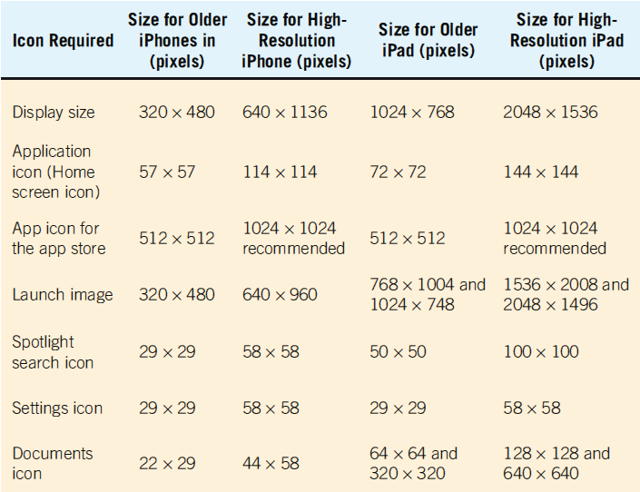
Design the App Icon (Figure 11.17)
Kendall & Kendall Copyright © 2014 Pearson Education, Inc. Publishing as Prentice Hall
11-<number>

Slide 51
Design the App’s Logic
Tablets and smartphones fit in well with the prototyping method of development
Sometimes the best way is to sketch out the logic using structured decision making techniques
Kendall & Kendall Copyright © 2014 Pearson Education, Inc. Publishing as Prentice Hall
11-<number>

Slide 52
Create the User Interface Using Gestures
Smartphones and tablets have innovative user interfaces
Technically called touchscreen capacitive sensing
Design apps assuming that users will demand touch-sensitive interfaces
Use gestures such as:
  Swipes
  Pinches
  Tugs
  Shakes
Kendall & Kendall Copyright © 2014 Pearson Education, Inc. Publishing as Prentice Hall
11-<number>

Slide 53
Market Your App
Need to convince a person to pay for and download your app
To market your app, you will need:
  A large icon
  A description
  A section explaining what is new in the current version
  A sample set of screen shots
Kendall & Kendall Copyright © 2014 Pearson Education, Inc. Publishing as Prentice Hall
11-<number>

Slide 54
Output Production and XML
An XML document may be transformed into different output media types
Methods:
  Extensible Style Language Transformations (XSLT)
  Ajax
  Cascading style sheets (CSS)
Kendall & Kendall Copyright © 2014 Pearson Education, Inc. Publishing as Prentice Hall
11-<number>
Notes:
These methods reinforce the idea that data should be defined once and used many times in different formats.

Slide 55
Extensible Style Language Transformations (XSLT)
XSLT allows you to:
  Select XML elements
  Sort sequence
  Selection of data
Kendall & Kendall Copyright © 2014 Pearson Education, Inc. Publishing as Prentice Hall
11-<number>
Notes:
Select XML elements—insert them into a Web page or another output medium.

Slide 56
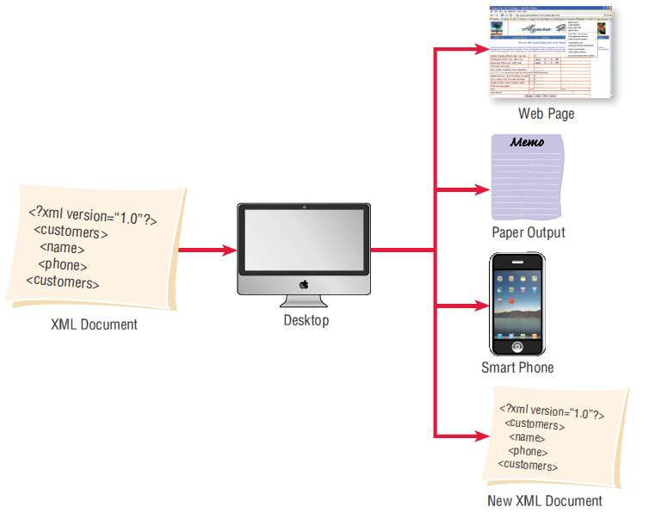
Extensible Style Language Transformation (XSLT) Can Transform XML Documents into Many Different Formats (Figure 11.20)
Kendall & Kendall Copyright © 2014 Pearson Education, Inc. Publishing as Prentice Hall
11-<number>

Slide 57
Ajax
Uses both JavaScript and XML to obtain small amounts of data from a server without leaving the webpage
The user does not have to wait for a new webpage to display after making a selection
Kendall & Kendall Copyright © 2014 Pearson Education, Inc. Publishing as Prentice Hall
11-<number>
Notes:
Using Ajax means that the entire Web page does not have to be reloaded.
Since Ajax covers both input and output it is also covered in chapter 12.

Slide 58
Summary
Output
Output design objectives
Output content
Output technologies
Presentation of output
Kendall & Kendall Copyright © 2014 Pearson Education, Inc. Publishing as Prentice Hall
11-<number>
Notes:
Output—print, display, audio, microforms, CD-ROMs or DVDs, and Web-based documents
Output design objectives:
design output to serve the intended human and organizational purpose
to fit the user
to deliver the right quantity of output
to deliver it to the right place
to provide output on time
to choose the right output method
Output content is related to output method.
Output technologies differ in:
speed
cost
portability
flexibility
accessibility
storage
retrieval
Presentation of output:
be aware of the sources of bias
design of output that includes users
work with users so that they are informed of the output’s biases
create output that is flexible and allows users to modify limits and ranges
train users to rely on multiple output for conducting “reality tests” on system output
Printed reports
design templates
drag and drop interfaces
Display output
aesthetics
usefulness
important to produce prototypes of screens and Web documents to interact with them and make changes where desired

Slide 59
Summary
Display output
Web design
Social media
Smart phone and tablet design
XML transformation
Kendall & Kendall Copyright © 2014 Pearson Education, Inc. Publishing as Prentice Hall
11-<number>
Notes:
Output—print, display, audio, microforms, CD-ROMs or DVDs, and Web-based documents
Output design objectives—
design output to serve the intended human and organizational purpose
to fit the user
to deliver the right quantity of output
to deliver it to the right place
to provide output on time
to choose the right output method
Output content is related to output method.
Output technologies differ in:
speed
cost
portability
flexibility
accessibility
storage
retrieval
Presentation of output
be aware of the sources of bias
design of output that includes users
work with users so that they are informed of the output's biases
create output that is flexible and allows users to modify limits and ranges
train users to rely on multiple output for conducting "reality tests" on system output
Printed reports
design templates
drag and drop interfaces
Display output
aesthetics
usefulness
important to produce prototypes of screens and Web documents to interact with them and make changes where desired

Slide 60

Copyright © 2014 Pearson Education, Inc.
Publishing as Prentice Hall
11-<number>

