Slide 1

IoT for life
TechWiz-2023

Slide 2
roles
Dinh Ba Dat – Team Lead: Bug fixes, business logic validation, quality assurance
Nguyen Duc Canh – Member: Java Back-end Developer
Do Minh Thanh – Member: Angular Front-end Developer
Do Duc Tho: Member: Hardware Components

Slide 3
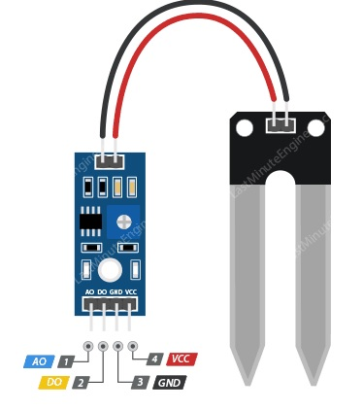
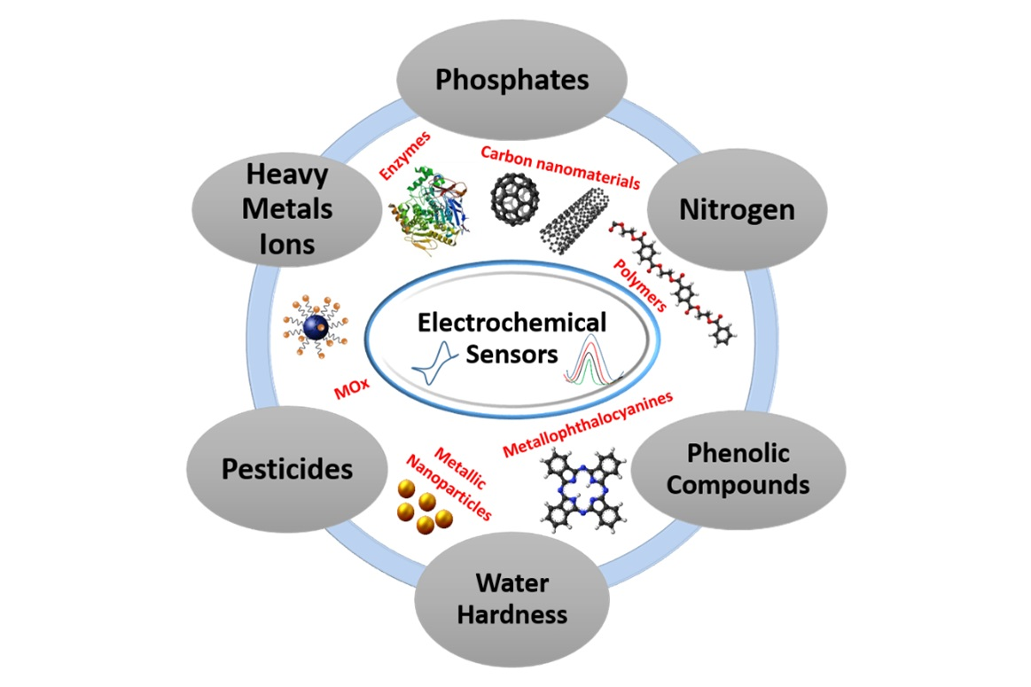
Components outline
Data-warehouse Input
Core Business Components

Slide 4
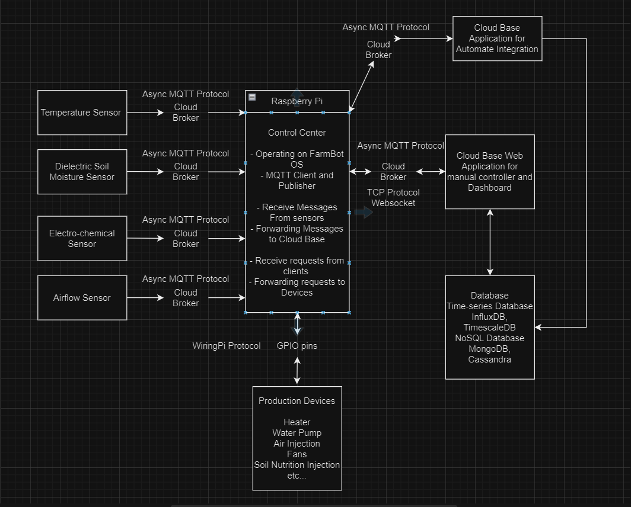
Architecture

Slide 5
MQTT – Message queue telemetry transport
Publish-Subscribe messaging pattern support IOT
Minimal network overhead
QoS
Secure

Slide 6
Performance Balancing
Distribute MQTT Clients
Brokers
Horizontal Scaling
Round-Robin
Dynamic Scaling

Slide 7
Data-Warehouse
Data-Aggregation
Schema-Design
Data-Transformation

Slide 8
IoT
FPT-APTECH 2023

