Slide 1
Mini sharing files
Mentor:
Nguyen Quoc Trinh
Members:
Ngo Nguyet Hanh
Huynh Minh Tin
Ho Nguyen Truong Nhac
Nguyen Quang Phung
Nguyen Huu Hung

Slide 2
Mini shearing file
Description:
MFS is a web application which allows user to share their file to the other over the internet.
Users are required to register and login if they want to upload or download any file from MFS.
Guest user could browse file by category, size or uploader but cannot download any file from MFS.

Slide 3
Functional Specification
Guest (not login):
Search file by name, category, uploader, size
View information of an uploaded file (with comment).
Register new account.

Slide 4
Functional Specification
2 .Registered user:
Search file by name, category, uploader, size
View information of an uploaded file (with comment).
Upload file with a limitation of file size according to account level
Download a file from MFS
CRUD files which have been uploaded by the his/her self
Comment on an uploaded file.

Slide 5
Functional Specification
3. Admin:
CRUD users
View information of each user from user dashboard
Upgrade/downgrade level of a user

Slide 6
Functional Specification
4. System constrains
Checking uploading every level of user
Bronze: maximum 5MB each upload
Silver: maximum 10MB each upload
Gold: maximum 20MB each upload

Slide 7
Functional Specification
4. System constrains
Auto upgrade user level following total size of uploaded files:
Bronze: 20MB
Silver: 50MB
Gold: above 100MB

Slide 8
Functional Specification
4. System constrains
Limit on daily downloading quota:
Bronze: Below 50 MB
Silver: Below 70MB
Gold: Unlimited

Slide 9
Technical Using
Framwork: Spring MVC, Hibernate.
Client side: JSP, Boostrap, Html 5, Css3, Jstl.
Management : trello.
Source control: GitHub
Database system: MySQL.

Slide 10
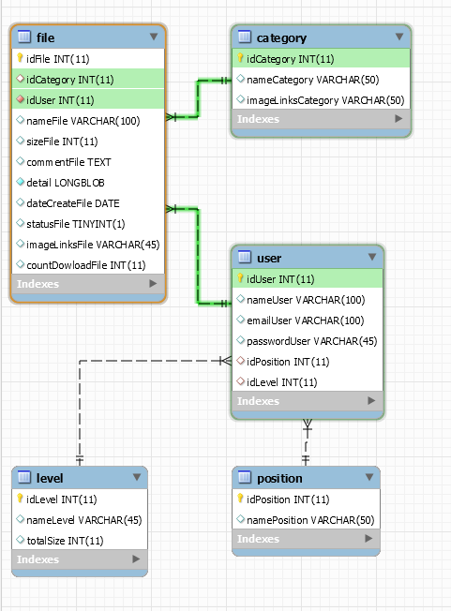
DATABASE

Slide 11
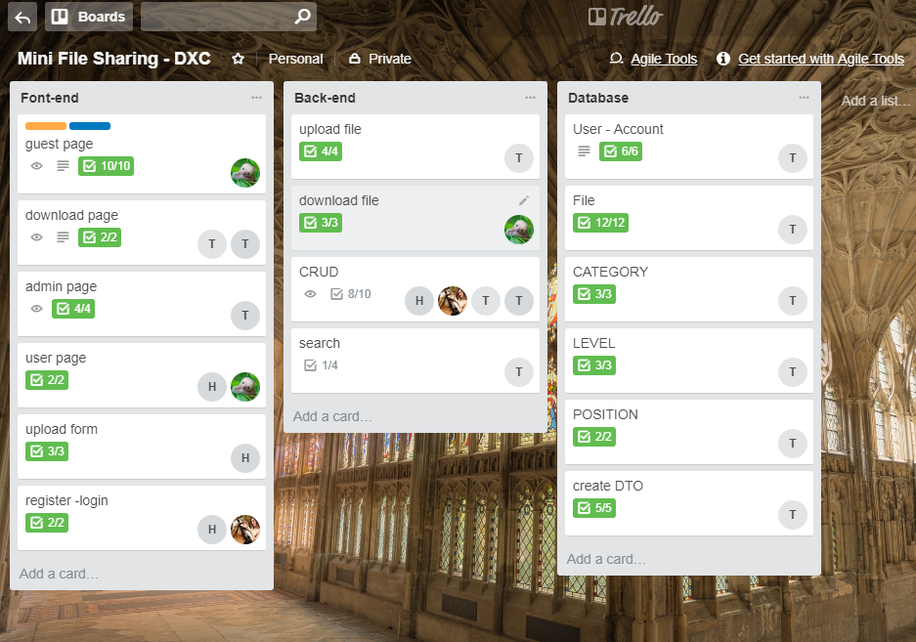
TRELLO

Slide 12
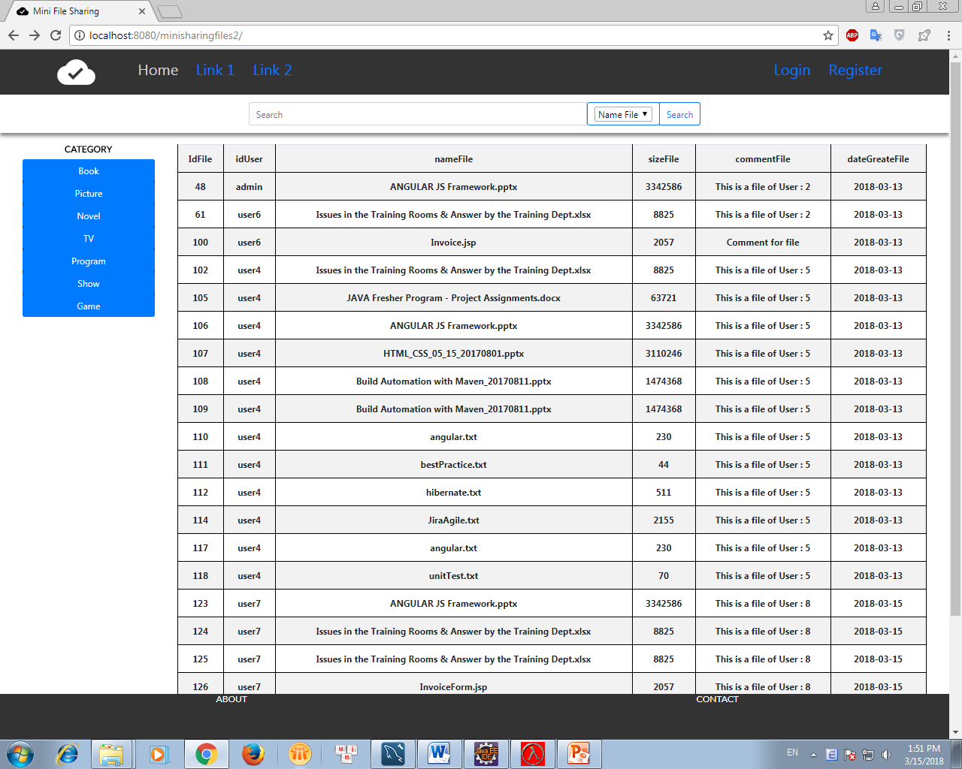
Flow for MFS
Guest

Slide 13
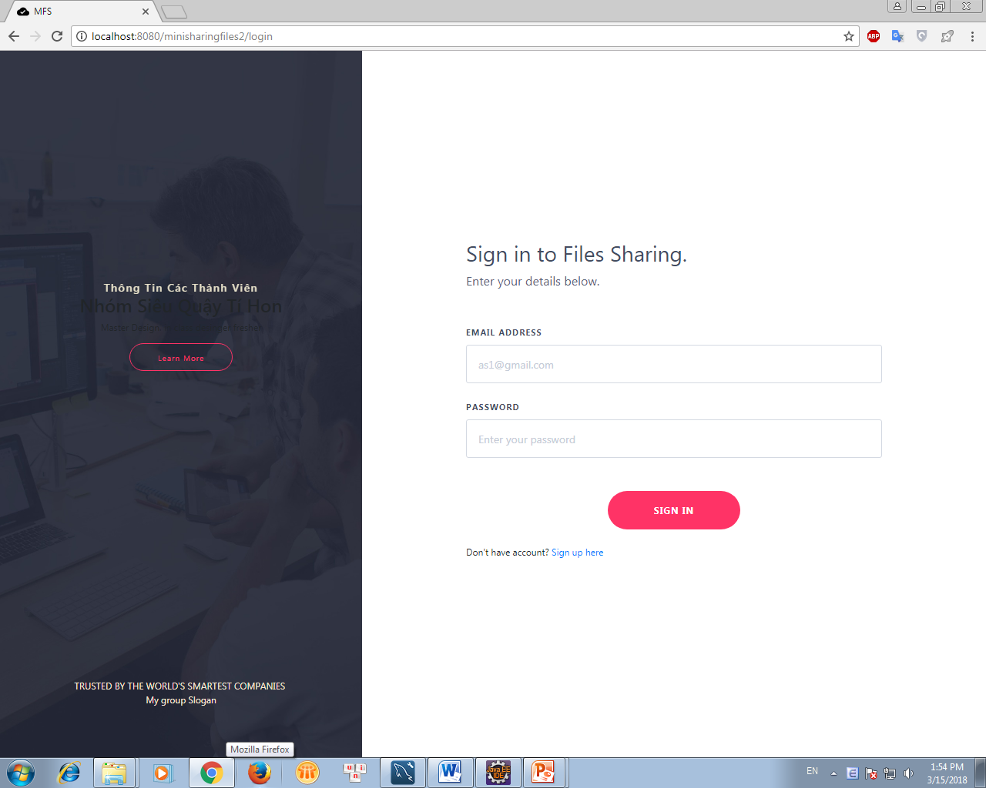
Login Page

Slide 14
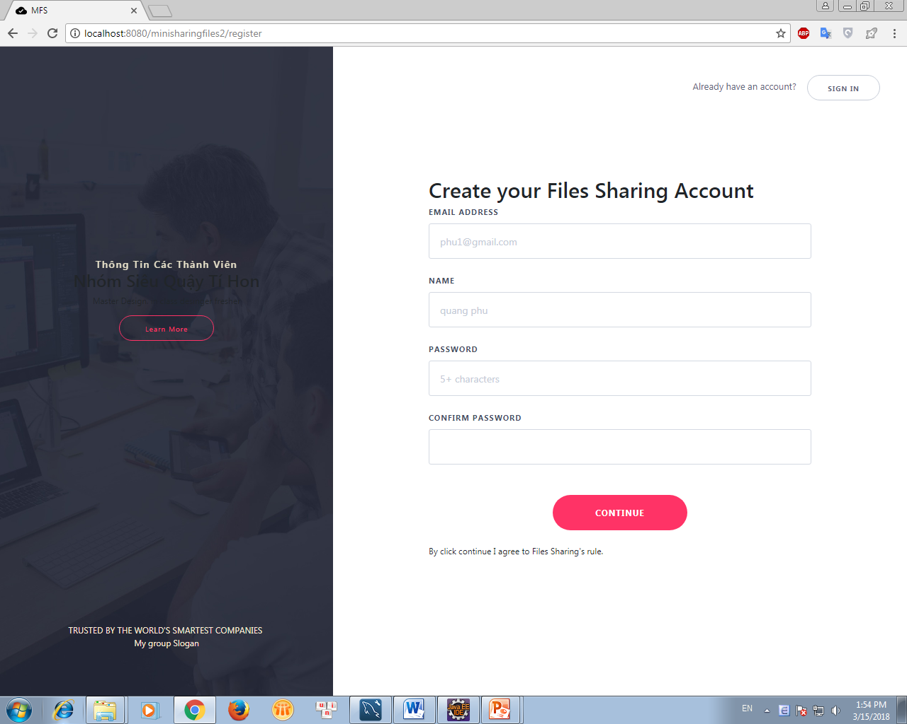
Register Page

Slide 15
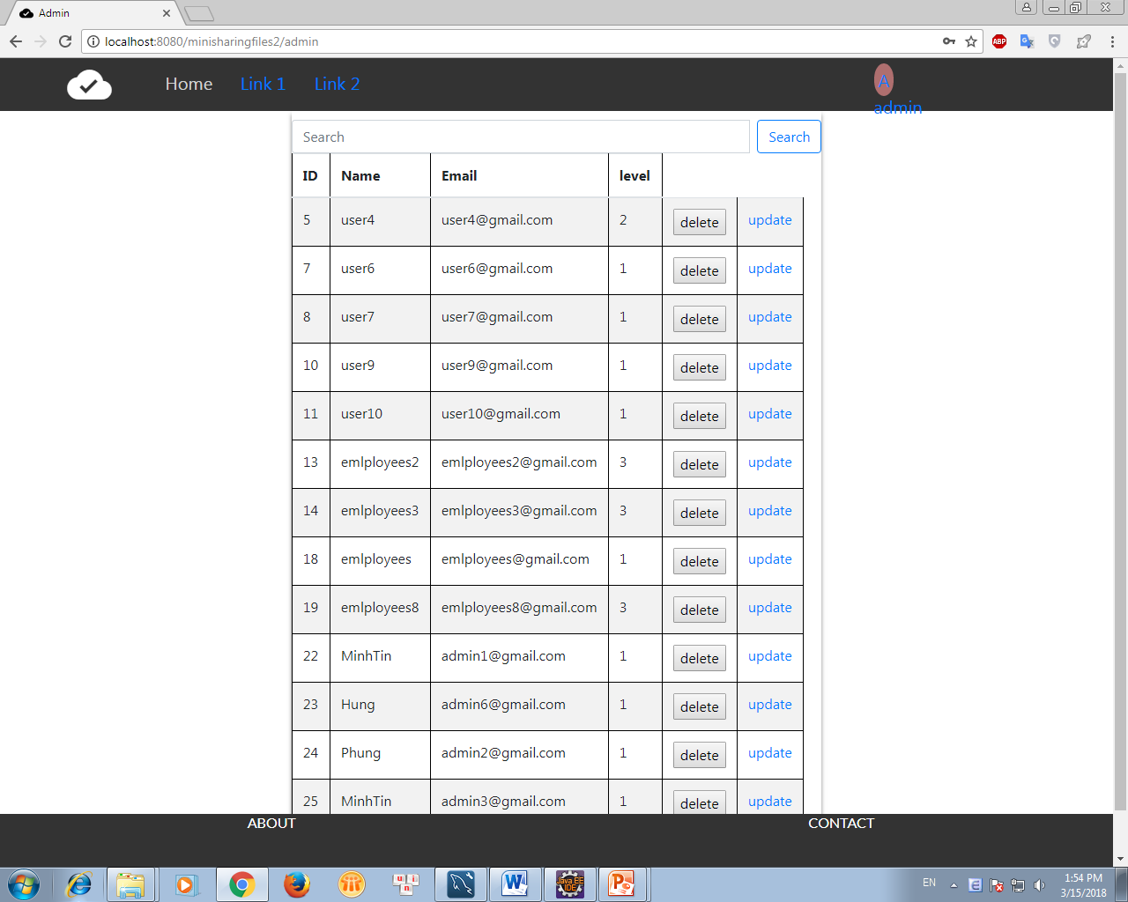
Admin Page

Slide 16
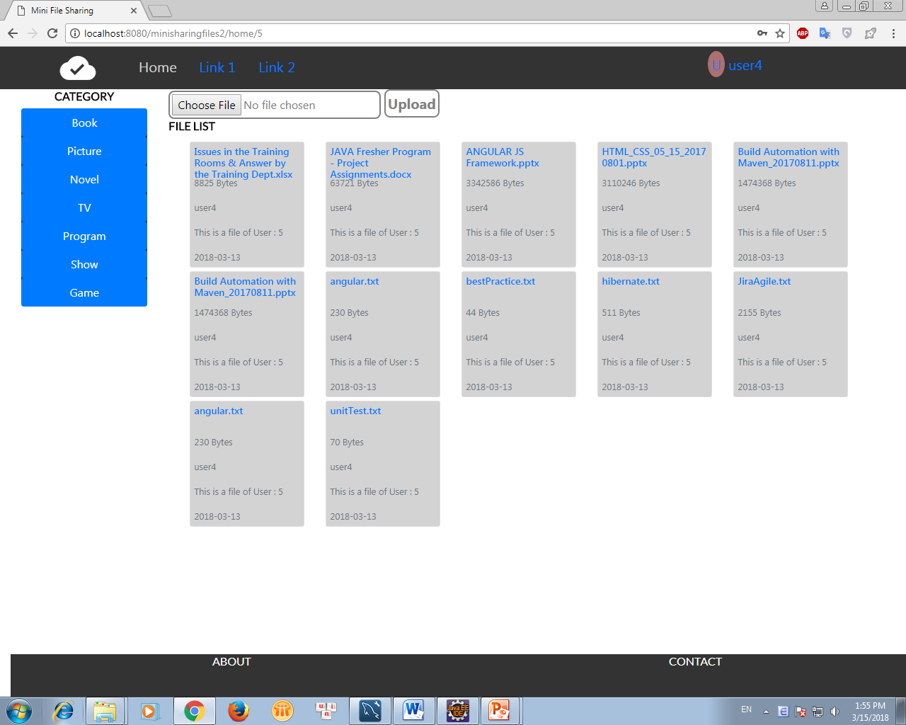
User Page

Slide 17
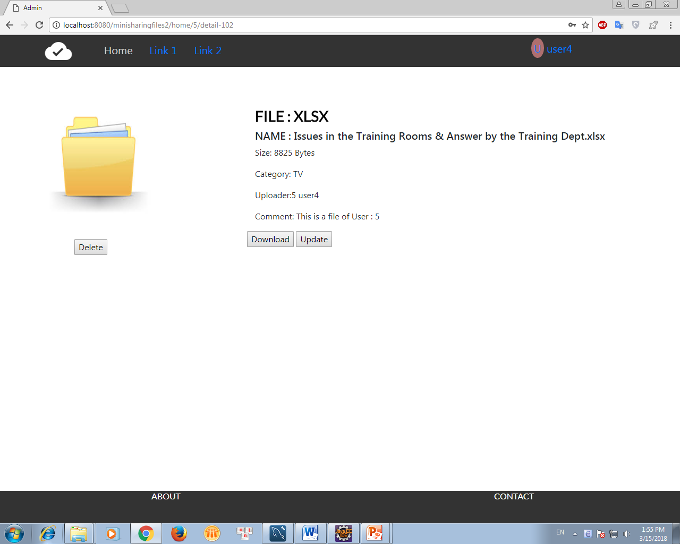
DownLoad Page

Slide 18
DEMO

Slide 19
Thanks for Watching

