Slide 1


Enhancing IT Helpdesk Efficiency through Data-Driven Analysis thru support tickets based on Customer Satisfaction
Vo Dai Minh / IT HELPDESK 27 May 2025

Slide 2
Table of Content
1. Introduction
2. Project Purpose and Objectives
3. Data Collection and Preparation
4. Exploratory Data Analysis (p5-p11)
5. Insights and Recommendations
6. Conclusion
7. Future Work

Slide 3

Introduction
Efficient IT Helpdesk services are key to smooth operations and user satisfaction.
Customer Satisfaction (CSAT) is a core measure of service quality.
This project analyzes support ticket data to uncover pain points and performance drivers.
Insights guide strategies to improve responsiveness, resolution speed, and overall helpdesk efficiency.

Slide 4
Project Purpose & Objectives
Purpose: Use data to uncover actionable insights
Objectives:
- Identify common issues and bottlenecks
- Evaluate resolution times
- Analyze satisfaction drivers
- Propose improvement strategies

Slide 5
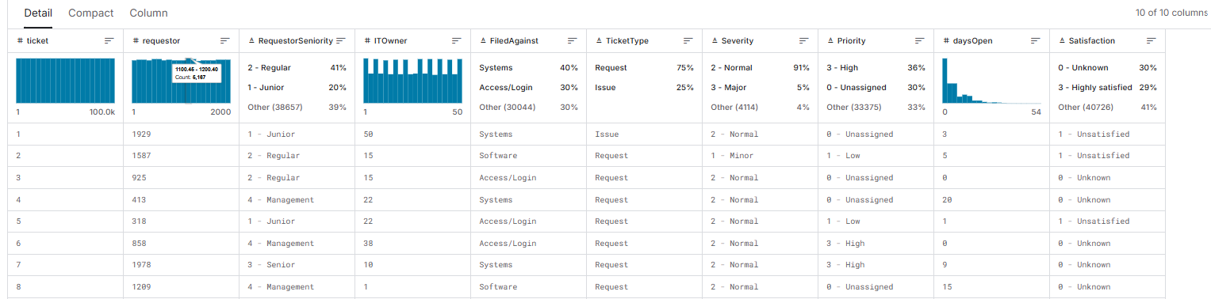
Data Collection and Preparation
Source: Kaggle (Helpdesk Ticket Dataset)
https://www.kaggle.com/datasets/sudhanshu746/analyze-helpdesk-tickets
Description: This dataset provides comprehensive information about IT helpdesk tickets included 10 columns – 100,000 rows)
Table:

Slide 6
Data Collection and Preparation
Data Profiling
Transform columns:
Transform Satisfaction column where cell has content 'Unknown' to be 'Neutral' and map to changed order from 1-4 : Unsatisfied, Neutral, Satisfied, High satisfied.
Split columns of RequestorSenority, Severity, Priority, Satisfaction to create numeric columns of RequestorSeniority_num, Severity_num, Priority_num,Satisfaction_num
Deleting rows: which Priority column is '0 - Unassigned'
Handling Missing values: There is no missing value on dataset
Removing Outlier: Using IQR method by check the Lower bound and Upper Bound of daysOpen and removing rows out of Lower Bound and Upper Bound

Slide 7
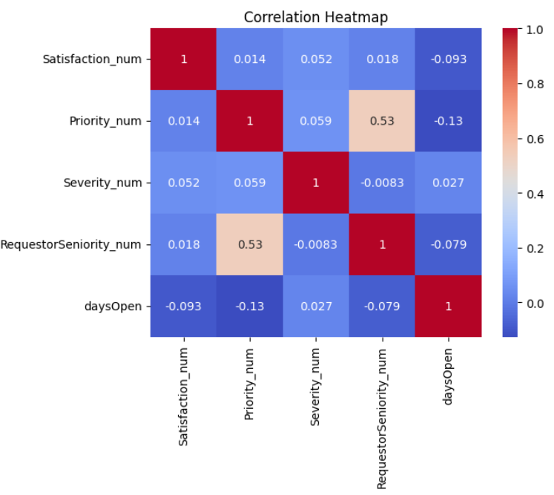
Exploration Data Analysis (EDA)
Calculating Correlation
Correlation heatmap
Display relationship between Satisfaction and different feature
Identify which feature are positively or negatively correlated
Satisfaction_num ~ daysOpen are negatively correlated → Resolution time is shorter, satisfaction is higher
-> 0.093 is quite small, need to analyze other aspects.

Slide 8
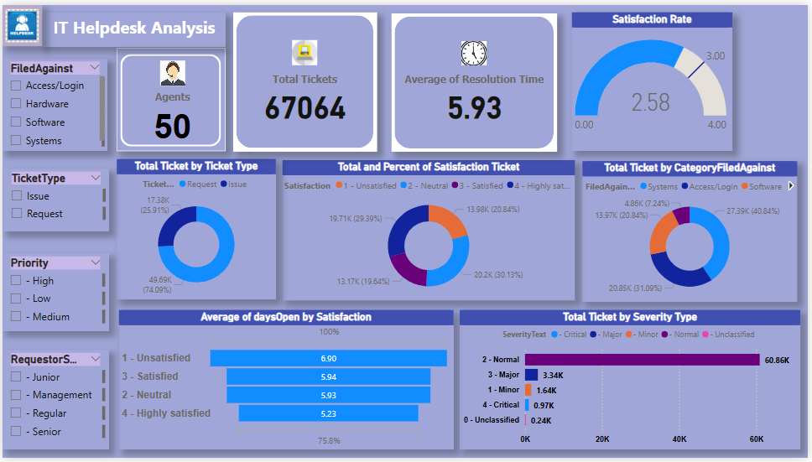
Explotation Data Analysis (EDA)
Extract colab file after cleaning, we have Cleaned_IT_Helpdesk.csv
Visualize file data on PowerBI, we have dashboard

Slide 9
Exploratory Data Analysis (EDA)
📌 1. Dashboard Summary
Metric | Value | Insight
Total Tickets | 67,064 | Total volume of tickets handled
Total Agents | 50 | Support agents in the helpdesk team
Avg. Resolution Time | 5.93 days | Slightly long – may affect satisfaction
Overall Satisfaction Rate | 2.58/4 | Moderate – opportunity to improve

Slide 10
Exploratory Data Analysis (EDA)
📊 2. Ticket Distribution Breakdown:
✅ By Ticket Type
Request: 49.69K (74.09%)
Issue: 17.38K (25.91%)
→ Most tickets are service requests, not problem incidents.
✅ By Category (FiledAgainst)
- Software: 40.84%
- Systems: 31.09%
- Access/Login: 20.84%
- Hardware: 7.24%
→ Software-related issues dominate. Focus training or automation efforts here
✅ By Severity Type
Normal: 60.86K (dominates)
Major: 3.34K
Minor: 1.64K
Critical: 0.97K
Unclassified: 0.24K
→ 🔍 Most tickets are of Normal severity. Critical tickets are rare but crucial.

Slide 11
Exploratory Data Analysis (EDA)
3. Satisfaction Insights
Satisfaction Level | Count | %
1 - Unsatisfied | 13.98K | 20.84%
2 - Neutral | 13.17K | 19.64%
3 - Satisfied | 19.71K | 29.39%
4 - Highly Satisfied | 20.2K | 30.13%
📉 ~41% are unsatisfied or neutral 13.98K → Key area to improve user experience.
Average Days Open by Satisfaction
Unsatisfied: 6.90 days
Neutral: 5.93 days
Satisfied: 5.54 days
Highly Satisfied: 5.23 days
→⏱️ There’s a clear correlation: faster resolution leads to higher satisfaction.

Slide 12
Insights & Recommendations
🎯 Improve resolution times to lift satisfaction.
⚙️ Automate or streamline high-volume categories like Software and Access/Login.
🔍 Analyze why 1 in 5 users is unsatisfied – feedback loops or quality audits recommended.
🧑‍💼 Target training efforts on normal priority and high-frequency ticket types.

Slide 13
Conclusion
The helpdesk team is effectively managing a large volume of tickets with a moderate satisfaction level. However, the data highlights a critical improvement opportunity: reducing resolution time has a direct and measurable impact on customer satisfaction. Additionally, focusing on high-volume categories like Software and Access/Login could yield faster wins through automation, self-service tools, or targeted training.

Slide 14
Future Work
Optimize processes for faster resolution (especially normal priority tickets).
Enhance user satisfaction through feedback-driven improvements.
Automate or template responses for repetitive Software-related issues.
Leverage this data for predictive insights (e.g., identifying tickets likely to result in low satisfaction).

Slide 15

THANK YOU!

