Slide 1
NBA PREDICTION
Win/Lose prediction using team statistics
18127154 - Võ Ngọc Minh
18127155 - Vũ Công Minh

Slide 2
TABLE OF CONTENTS
01
02
03
04
05
INTRODUCTION
What is this topic about
PREPARE DATA
How to crawl NBA team statistics data
CLEANING AND PROCESSING
Clean data & Calculate teams’ elo
MODEL TRAINING AND PREDICTION
Find suitable model for prediction
REFLECTION
Summary the working progress

Slide 3
01
INTRODUCTION

Slide 4
INTRODUCTION
Data has become the front and center of NBA games where almost every decision is now based on analytics.

Slide 5
WHAT IS THIS TOPIC ABOUT?
Using recent games statistics: elo, goal attempts, 3-point success rate, … of 2 teams to predict the game outcome.

Slide 6
02
PREPARE DATA

Slide 7
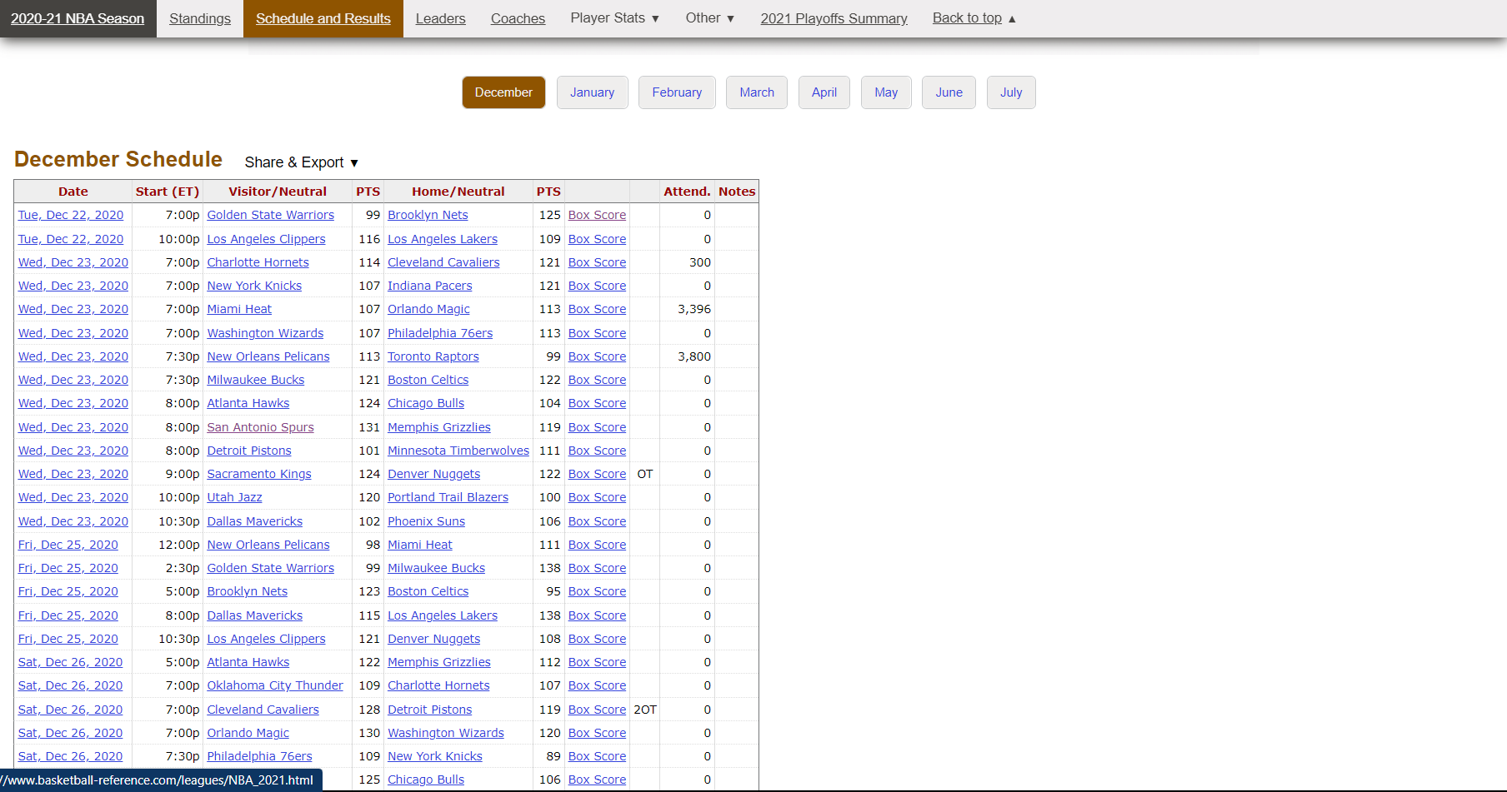
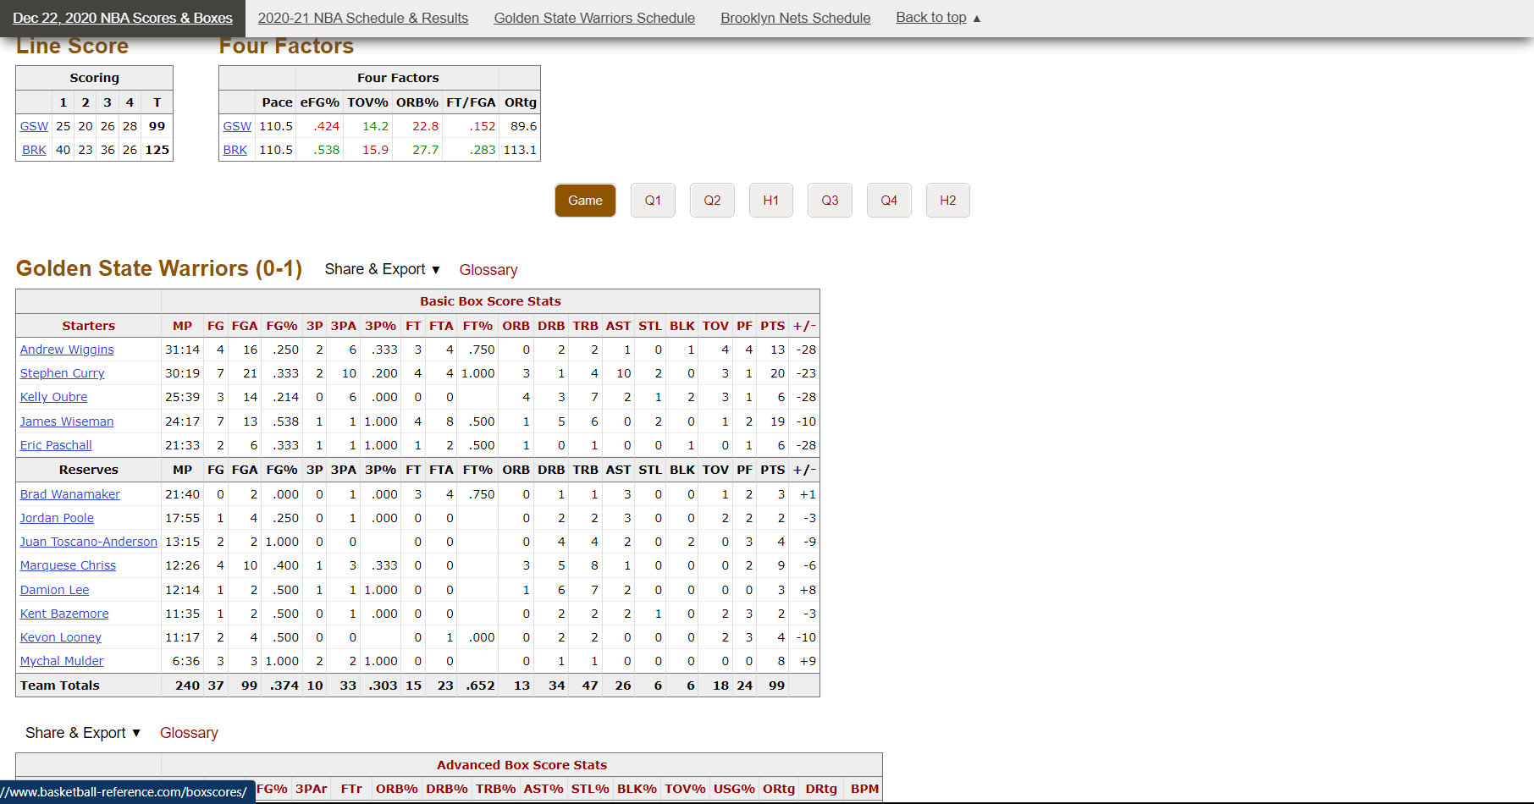
DATA SOURCE
basketball-reference.com

Slide 8
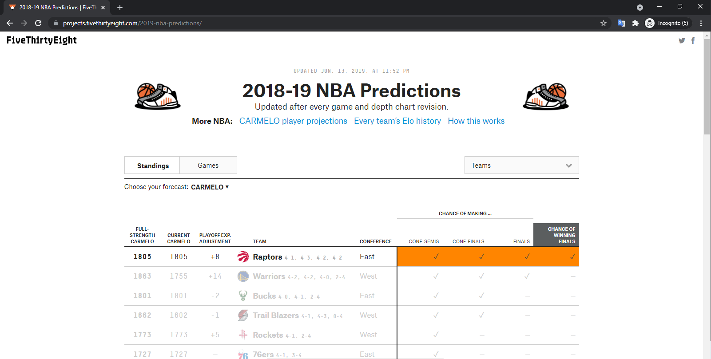
DATA SOURCE
projects.fivethirtyeight.com

Slide 9
RESULT
CSV:
Preseason_elo.csv : All NBA Teams' average stats from last season
Preseason_data.csv : All NBA Team's elo from last season
Raw_data.csv : All NBA games' stats during n years
TEXT:
Full_name.txt : All NBA teams' name and their abbreviations
Raw_description.txt : Get stats' names and their descriptions

Slide 10
CLEANING
AND
PROCESSING
03

Slide 11
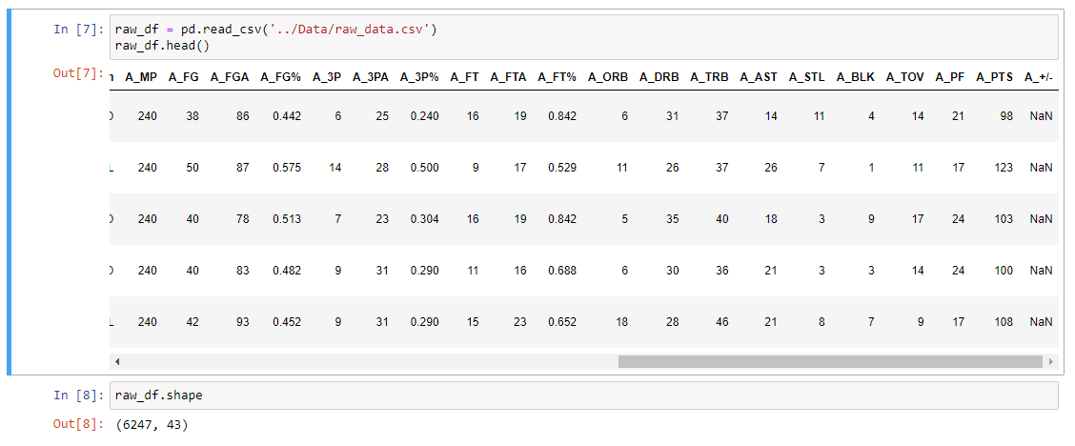
CLEANING DATA

Slide 12
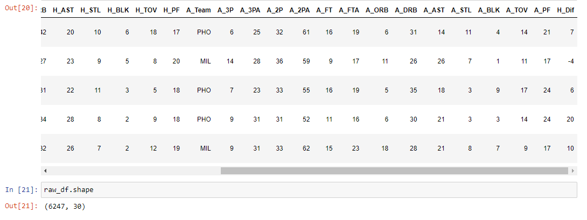
CLEANING DATA

Slide 13
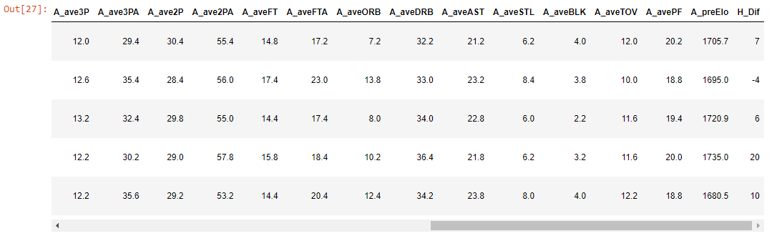
PROCESSING DATA

Slide 14
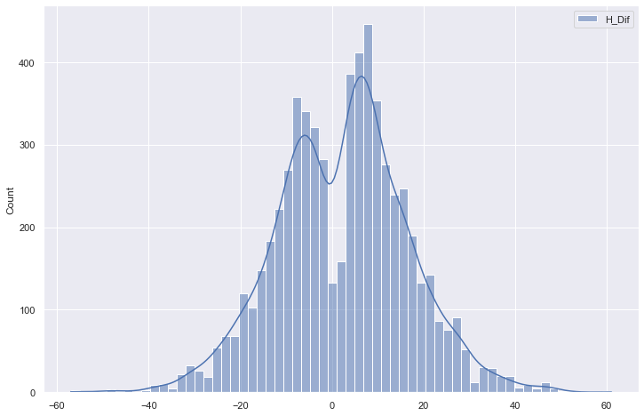
VISUALIZATION

Slide 15
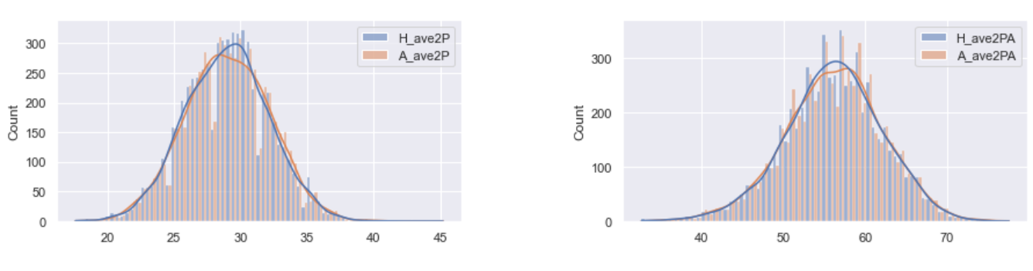
VISUALIZATION

Slide 16
MODEL TRAINING
AND
PREDICTION
04

Slide 17
TRAIN MODEL
PREDICTION MODELS:
Random Forest
Logistic Regression
Neural Network
TUNING HYPERPARAMETERS ALGORITHMS:
GridSearchCV
RandomizedSearchCV ( n_iter = 100 )

Slide 18


PREPROCESS PIPELINE

Slide 19
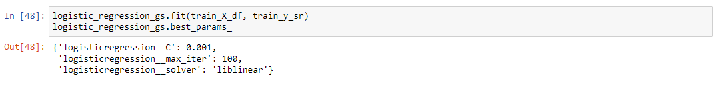
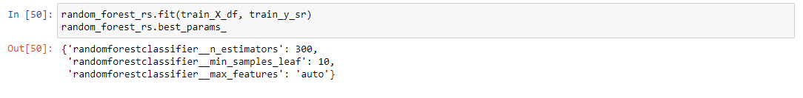
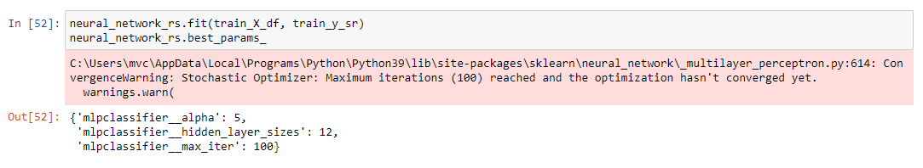
PREDICTION

Slide 20
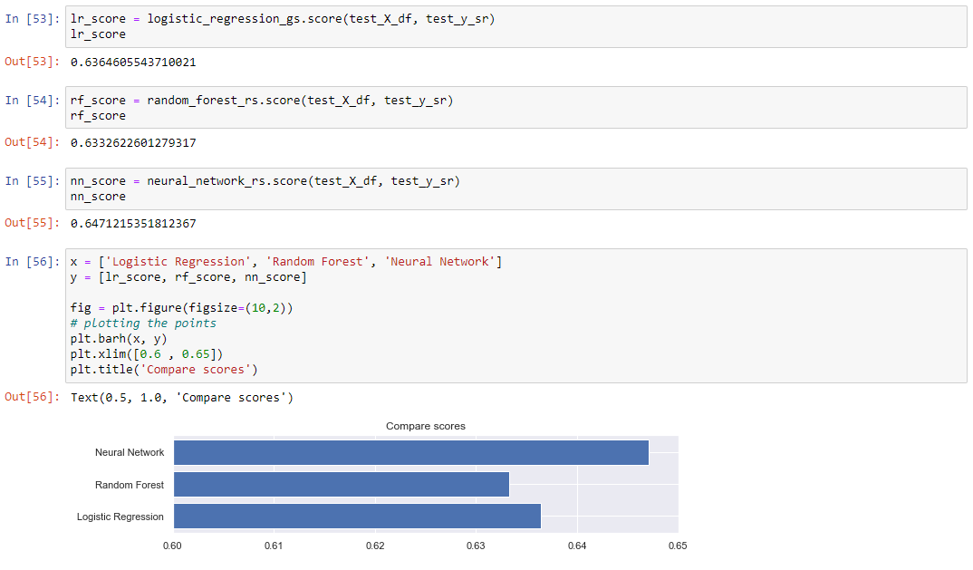
PREDICTION

Slide 21
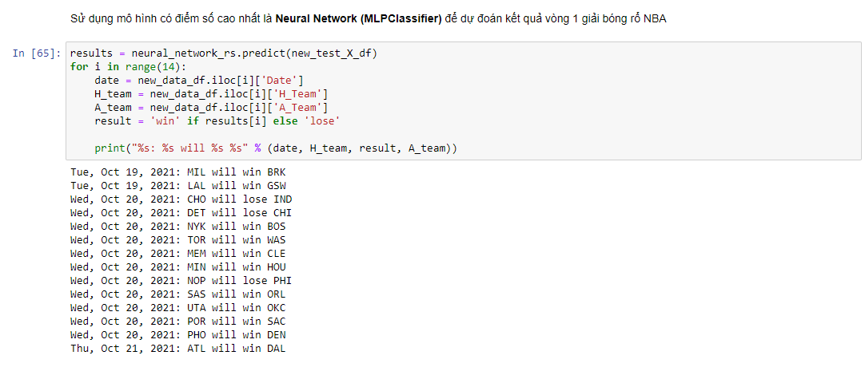
PREDICTION

Slide 22
05
REFLECTION

Slide 23
SELF-REFLECTION
VÕ NGỌC MINH:
Working late at night.
Using selenium better, learn more about tuning hyperparameters.
VŨ CÔNG MINH:
Waste time in handling large data.
Difficulty in researching predictive algorithms and their parameters.
Work is often delayed compared to the plan
Learn more about tuning hyperparameters, predictive algorithms, web scraping with events, …

Slide 24
GROUP-REFLECTION
WHAT WILL WE DO:
Make the code cleaner.
Tuning with moret various parameters to get better parameters.
Instead of predicting win/lose, we can predict what the range outcome will be in.

Slide 25
THANK YOU FOR YOUR ATTENTION

Slide 26
REFERENCES
https://towardsdatascience.com/predicting-the-outcome-of-nba-games-with-machine-learning-a810bb768f20
https://stackoverflow.com/questions/35388647/how-to-use-gridsearchcv-output-for-a-scikit-prediction
https://www.kaggle.com/hatone/mlpclassifier-with-gridsearchcv
https://analyticsindiamag.com/guide-to-hyperparameters-tuning-using-gridsearchcv-and-randomizedsearchcv/
https://www.analyticsvidhya.com/blog/2015/06/tuning-random-forest-model/
https://www.kaggle.com/faressayah/decision-trees-random-forest-for-beginners
https://scikit-learn.org/stable/index.html

