Slide 1
NBA PREDICTION
Win/Lose prediction using team statistics
18127154 - Võ Ngọc Minh
18127155 - Vũ Công Minh

Slide 2
TABLE OF CONTENTS
01
02
03
04
05
INTRODUCTION
What is this topic about
PREPARE DATA
How to crawl NBA team statistics data
CLEANING AND PROCESSING
Clean data & Calculate teams’ elo
MODEL TRAINING AND PREDICTION
Find suitable model for prediction
REFLECTION

Slide 3
01
INTRODUCTION

Slide 4
INTRODUCTION
Data has become the front and center of NBA games where almost every decision is now based on analytics.

Slide 5
WHAT IS THIS TOPIC ABOUT?
Using recent games statistics: elo, goal attempts, 3-point success rate, … of 2 teams to predict the game outcome.

Slide 6
02
PREPARE DATA

Slide 7
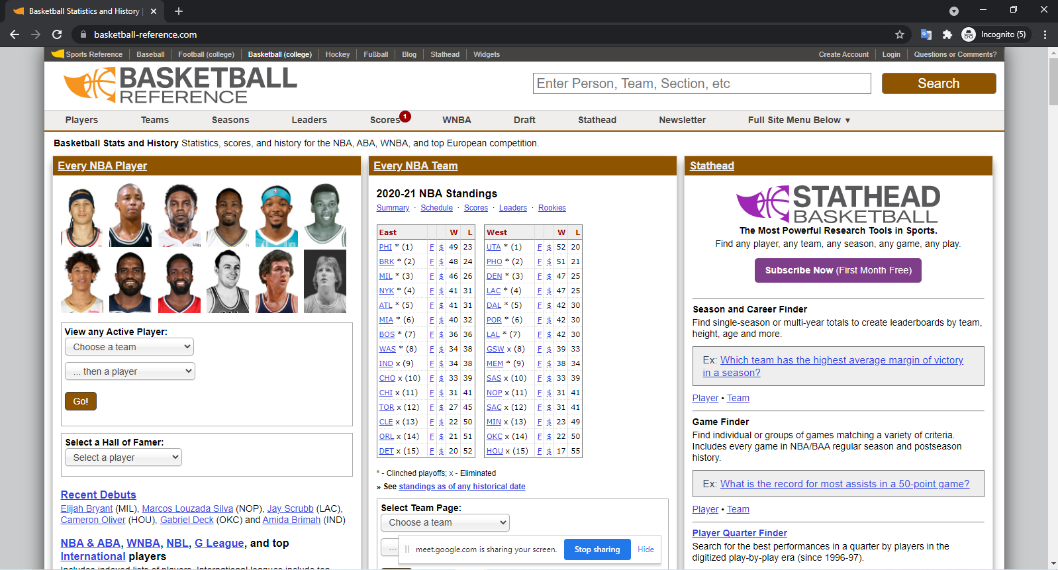
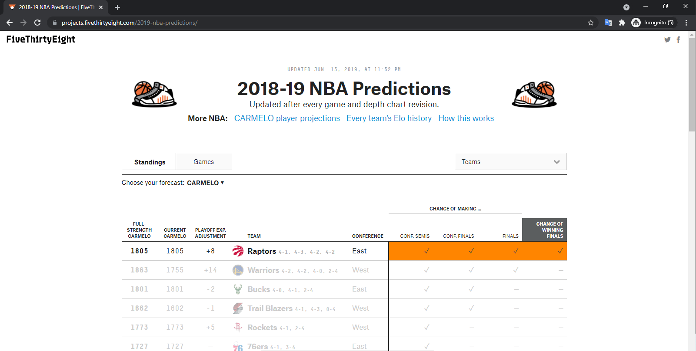
DATA SOURCE
basketball-reference.com
projects.fivethirtyeight.com

Slide 8
RESULT
CSV:
Preseason_elo.csv : All NBA Teams' average stats from last season
Preseason_data.csv : All NBA Team's elo from last season
Raw_data.csv : All NBA games' stats during n years
TEXT:
Full_name.txt : All NBA teams' name and their abbreviations
Raw_description.txt : Get stats' names and their descriptions

Slide 9
CLEANING
AND
PROCESSING
03

Slide 10
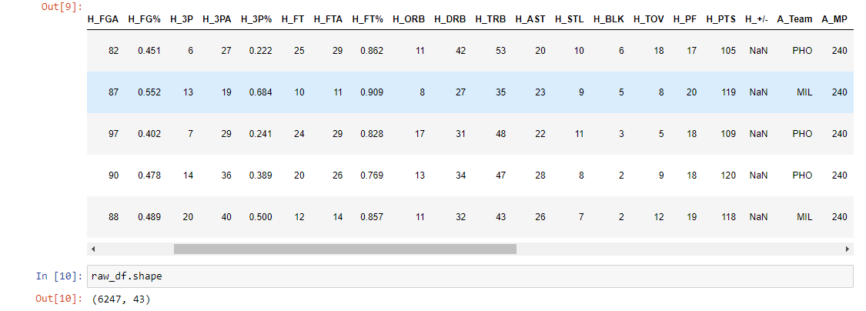
CLEANING DATA

Slide 11
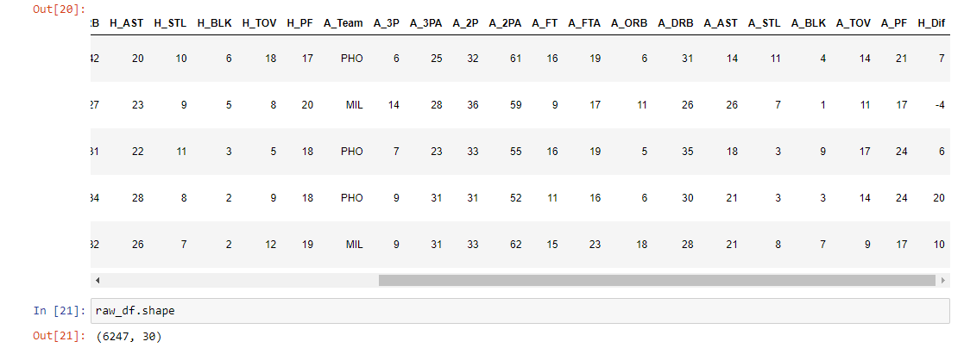
CLEANING DATA

Slide 12
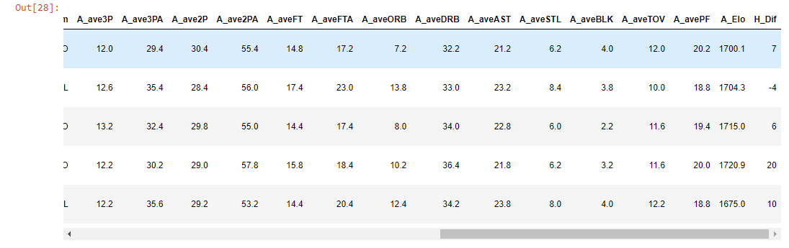
PROCESSING DATA

Slide 13
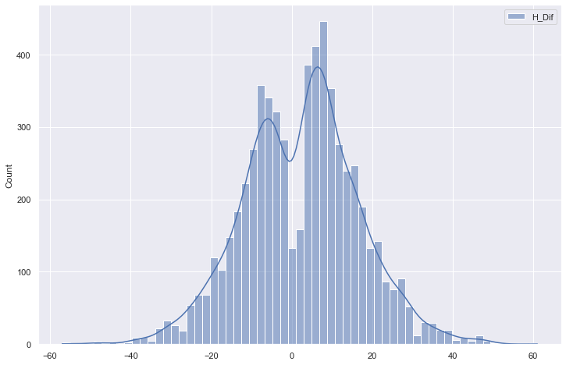
VISUALIZATION

Slide 14
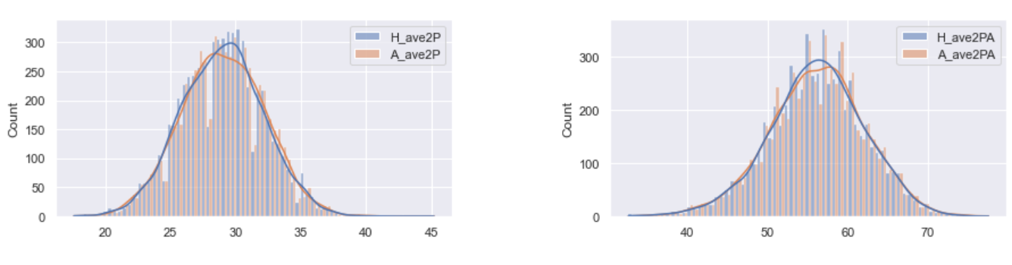
VISUALIZATION

Slide 15
MODEL TRAINING
AND
PREDICTION
04

Slide 16
TRAIN MODEL
PREDICTION MODELS:
Random Forest
Logistic Regression
Neural Network
Linear SVC
TUNING HYPERPARAMETERS ALGORITHMS:
GridSearchCV
RandomizedSearchCV ( n_iter = 100 )

Slide 17

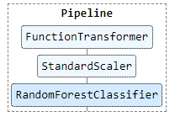
PIPELINE

Slide 18
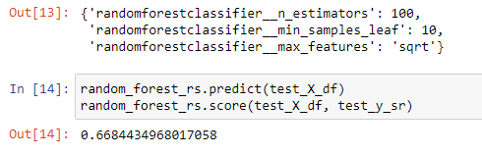
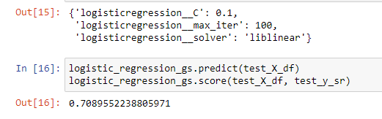
PREDICTION

Slide 19
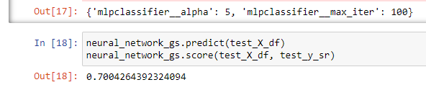
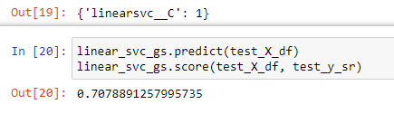
PREDICTION

Slide 20
05
REFLECTION

Slide 21
SELF-REFLECTION
VÕ NGỌC MINH:
Working late at night.
Using selenium better, learn more about tuning hyperparameters.
VŨ CÔNG MINH:
Waste time in handling large data.
Difficulties in researching predictive algorithms and their parameters.
Work is often delayed compared to the plan
Learn more about tuning hyperparameters, predictive algorithms, web scraping with events, …

Slide 22
GROUP-REFLECTION
WHAT WILL WE DO:
Make the code cleaner.
Tuning with moret various parameters to get better parameters.
Instead of predicting win/lose, we can predict what the range outcome will be in.
Predict upcoming NBA season ( 2021-2022 )

Slide 23
THANK YOU FOR YOUR ATTENTION

Slide 24
REFERENCES
https://towardsdatascience.com/predicting-the-outcome-of-nba-games-with-machine-learning-a810bb768f20
https://stackoverflow.com/questions/35388647/how-to-use-gridsearchcv-output-for-a-scikit-prediction
https://www.kaggle.com/viznrvn/optimal-parameters-for-svc-using-gridsearch
https://analyticsindiamag.com/guide-to-hyperparameters-tuning-using-gridsearchcv-and-randomizedsearchcv/
https://www.analyticsvidhya.com/blog/2015/06/tuning-random-forest-model/
https://www.kaggle.com/faressayah/decision-trees-random-forest-for-beginners
https://scikit-learn.org/stable/index.html

