Slide 1


ECE 9013
Final Project
Home Sale Price Prediction
-In Ames, Iowa area
Group: 8
Time: 2022/12/4
Course Instructor: Dimitri Manias

Slide 2

Content
01
02
03
04
05
Introduction
Preprocessing
Models
Main Class
Results & Prospects
Problem & Solution
Data
Pre-processing
4 Different
Model Evaluation

Slide 3

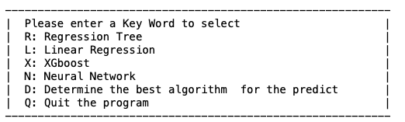
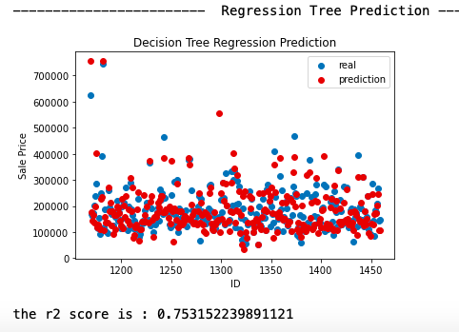
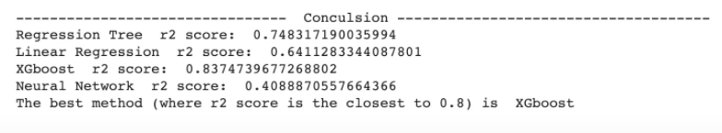
01 Introduction
?
Home
Sale Price Prediction

Slide 4
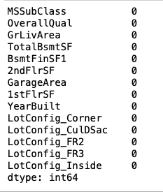
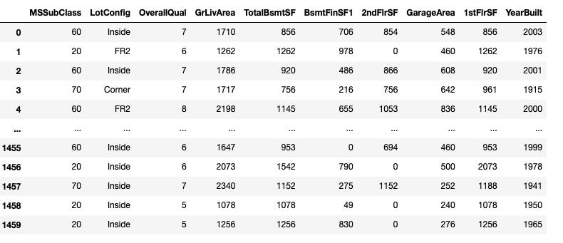
02 Preprocessing
Select useful information
Eliminate null values
One-hot data processing
Split to testing data and train data
Notes:
one hot编码是将类别变量转换为机器学习算法易于利用的一种形式的过程。

Slide 5
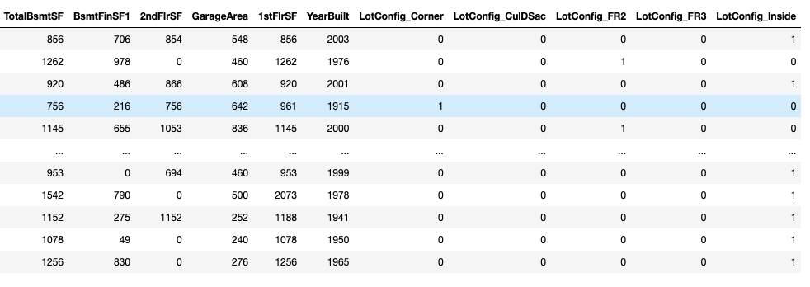
02 Preprocessing
One hot data processing

Slide 6
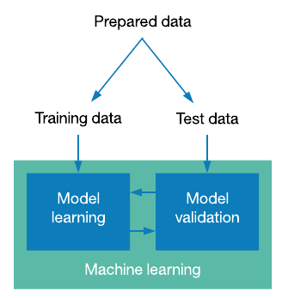
02 Preprocessing
Split dataset
80% 20%

Slide 7

03 Models
def multiple linear regression class:
def __init__ () method: to make sure the input value
def predict () method: training model and get prediction
def plot () method:
def error() method: calculate the R2 score for this model
def regression tree class:
def __init__() : attributes initialization
def predict(): fit model & output house price prediction
def plot(): plot prediction results
def accuracy(): calculate model accuracy, output R2 value

Slide 8
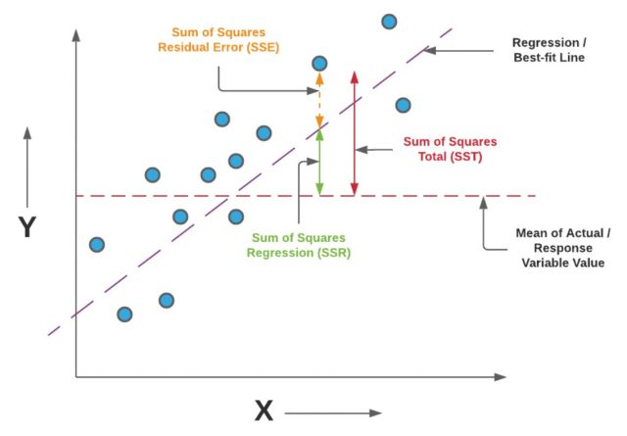
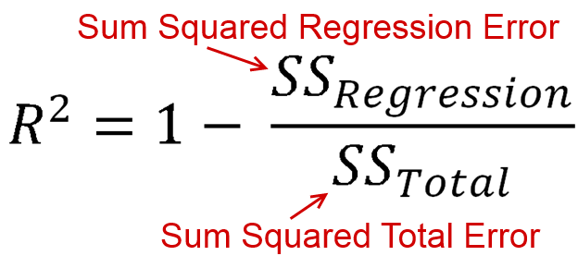
03 Models
R2 score
Notes:
The R2 score is a very important metric for evaluating the performance of regression-based machine learning models. It works by measuring the amount of variance in the predictions explained by the dataset. Simply put, it is the difference between the samples in the dataset and the predictions made by the model. The R2 score for the trained model is 0.81, which is not bad. If the value of the r-squared score is 1, the model is perfect, and if its value is 0, the model performs poorly on unseen datasets
The formula for the R2 score is shown above, along with a schematic diagram. In the next models we will also evaluate the R2 score for our own models on a case-by-case basis. The best-performing models will be compared at the end.

Slide 9
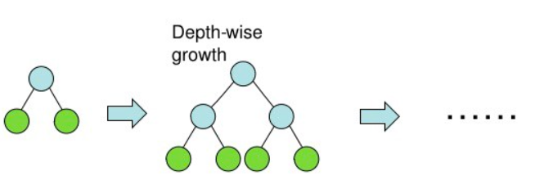
03 Models
Class XGboost
def __init__ () method: to define the input value
def predict () method: apply model and get prediction
def plot () method: plot prediction and actually values
def error() method: calculate the R2 value

Slide 10
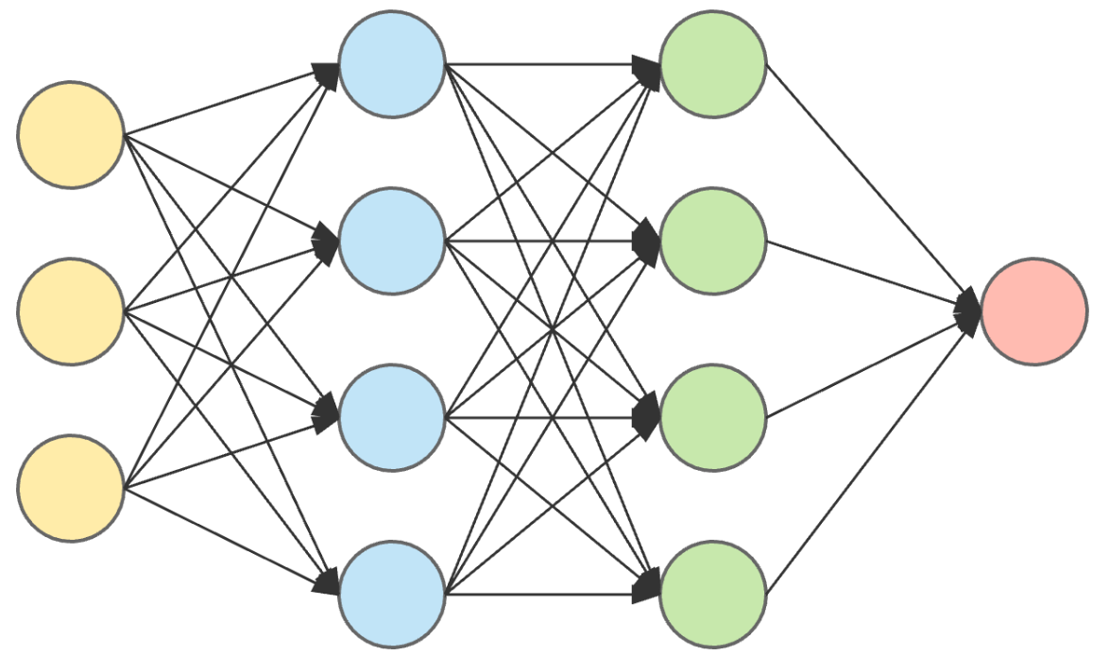
03 Models
Class Neural Network
def __init__ () method: to define the input values
def predict () method: learn and apply logic to get prediction
def plot () method: scatter plot of prediction and actual values
def error() method: provide the R2 score of the predicted result

Slide 11
03 Models
Test Class
Unit testing:
small segments of code
checks functionality
Assert Statement: test if condition returns true

Slide 12
04 Main Class
Combine all classes
Data Pre-Processing
User Interface
Each Class can be called separately
A function that compares results from four classes and find out the best fitted model

Slide 13
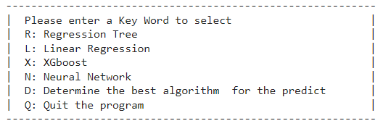

05 Results & Prospects
User input interface
Input other key words:

Slide 14
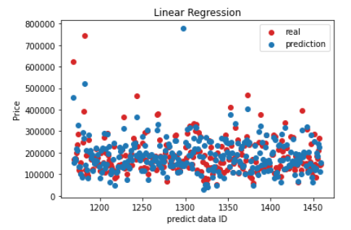
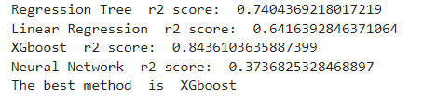

05 Results & Prospects
Results
Input L:
Input D:
Input Q:

Slide 15
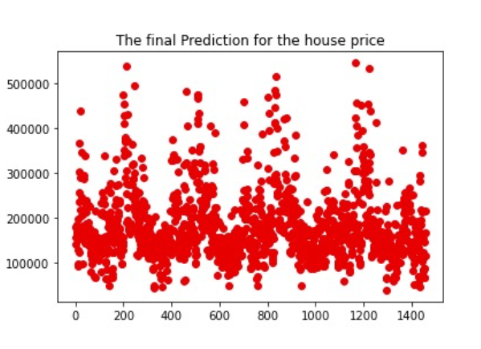
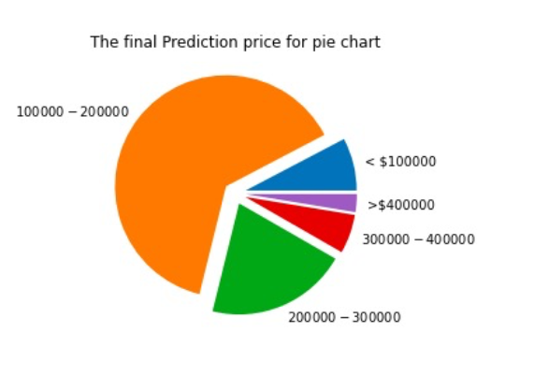
05 Results & Prospects
Prospects:

Slide 16
05 Results & Prospects
Prospects:
Increase prediction accuracy
Increase the number of Attributes
Apply more algorithms
Apply to items other than house prices
Auto-identify attributes
Optimize the pre-processing methods

Slide 17
Reference
[1]“House Prices - Advanced Regression Techniques,” kaggle.com. https://www.kaggle.com/competitions/house-prices-advanced-regression-techniques/code (accessed Dec. 02, 2022).
[2]“XGBoost,” kaggle.com. https://www.kaggle.com/code/dansbecker/xgboost (accessed Dec. 02, 2022).
[3]“machine learning - What are kernel initializers and what is their significance?,” Data Science Stack Exchange. https://datascience.stackexchange.com/questions/37378/whatare-kernel-initializers-and-what-is-theirsignificance#:~:text=The%20term%20kernel_initializer%20is%20a (accessed Dec. 02, 2022).
[4]A. Hayes, “How Multiple Linear Regression Works,” Investopedia, Sep. 21, 2020. https://www.investopedia.com/terms/m/mlr.asp
[5]“Decision-Tree Classifier Tutorial,” kaggle.com. https://www.kaggle.com/code/prashant111/decision-tree-classifier-tutorial (accessed Dec. 02, 2022).
[6]“Neural Network layers” https://towardsdatascience.com/everything-you-need-to-know-about-neural-networks-and-backpropagation-machine-learning-made-easy-e5285bc2be3a(accessed Dec. 02, 2022).

