Slide 1
변수 정의
Group | Meaning | Used variables | Role
Y1 | Click | y_click_present | Y3 + detailed screen variables
Y2 | Screen entropy total | entropy of normalized screen components | Built from screen-only features
Y3 | Behavior entropy total | H_all_7 | Built from all 7 behavior actions
Screen component 1 | Inverse whitespace | 1 - whitespace_ratio | More filled screen
Screen component 2 | Edge density | edge_density | Visual boundaries / clutter
Screen component 3 | Color entropy | color_entropy | Color diversity
Screen component 4 | Layout variation | horizontal_band_std, vertical_band_std | Distribution change across bands

Slide 2
변수 정의
Group | Meaning | Used variables | Role
Screen component 5 | Inverse symmetry | 1 - symmetry_score | Less symmetric layout
Screen component 6 | Object density | component_density | Number of components
Screen component 7 | Text-like density | text_like_density | Text-like region density
Screen component 8 | Card-like blocks | card_like_count | Repeated card regions
Screen component 9 | Image region ratio | image_region_ratio | Image-heavy screens
Screen component 10 | Clutter score | clutter_score | Overall visual complexity
Behavior action | scroll, input_text, wait, open_app, navigate_back, long_press, navigate_home | 7 actions | Used in H_all_7

Slide 3
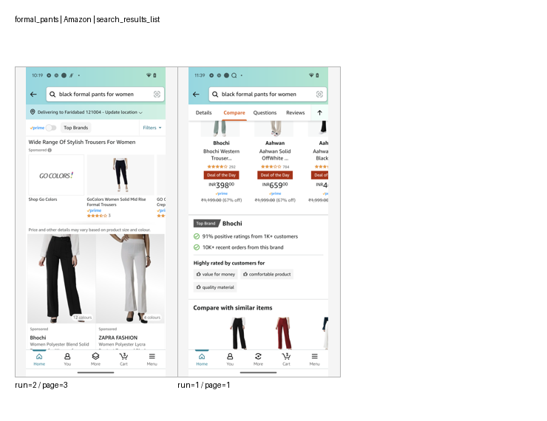
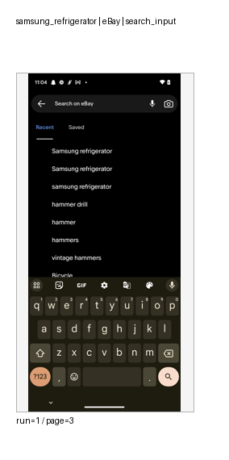
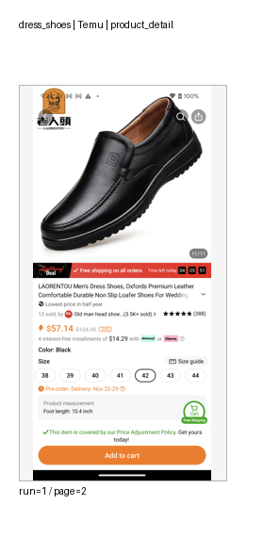
페이지 별 매핑 예시

Slide 4
페이지 별 매핑- 정장 구두
앱 이름 | 1페이지 | 2페이지 | 3페이지 | 4페이지 | 5페이지 | 6페이지
Amazon | entry_home | search_results_list | search_results_list | product_detail | product_detail | -
eBay | entry_home | search_input | search_results_list | product_detail | product_detail | product_detail
ZARA | entry_home | product_detail | product_detail | product_detail | - | -
Gmail | product_detail | product_detail | product_detail | search_input | - | -
PUMA | entry_home | product_detail | search_input | product_detail | - | -
ShopClues | entry_home | product_detail | search_input | - | - | -
ASOS | entry_home | search_input | - | - | - | -
Shopsy | entry_home | product_detail | - | - | - | -
Temu | entry_home | search_input | - | - | - | -
Joom | search_results_list | search_input | - | - | - | -
Decathlon | search_results_list | - | - | - | - | -
H&M | search_results_list | - | - | - | - | -

Slide 5
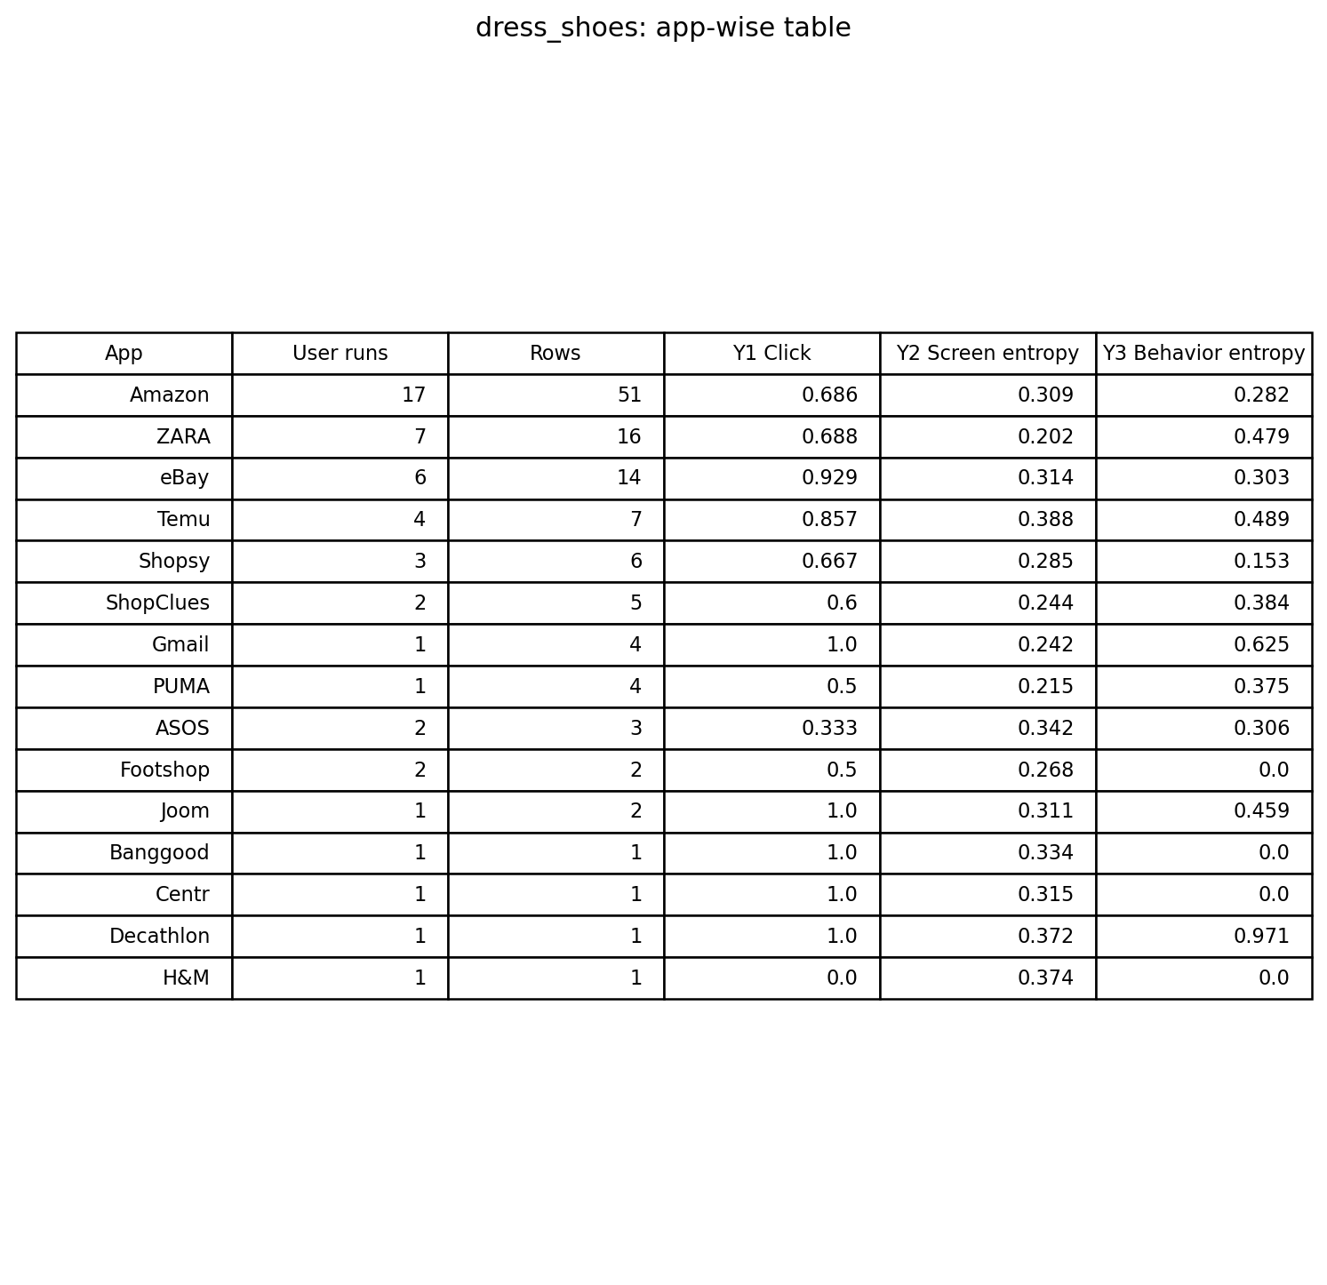
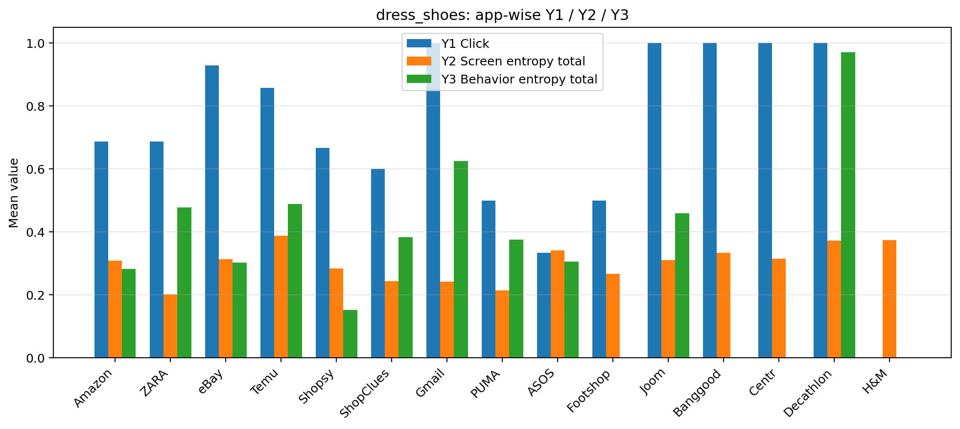
정장구두 - 전체 앱 비교

Slide 6
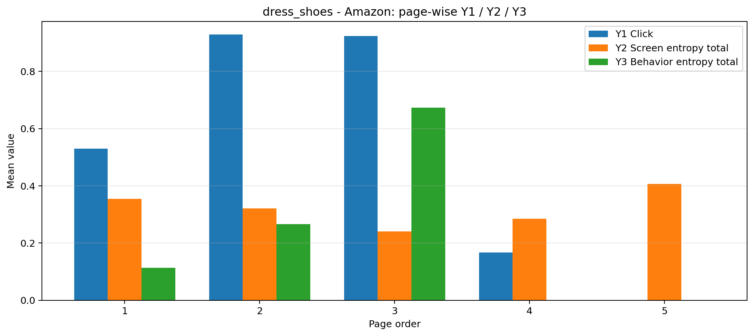
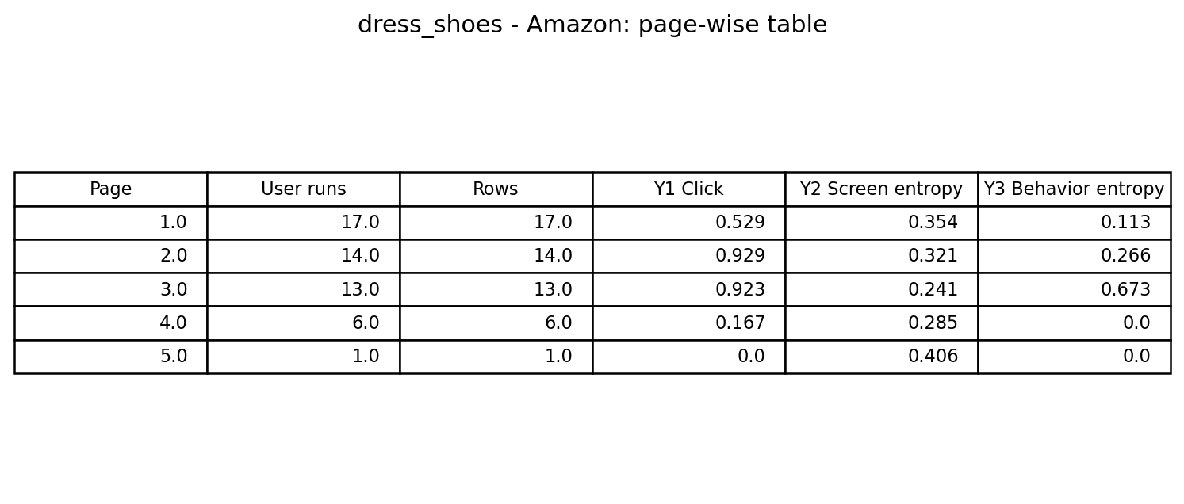
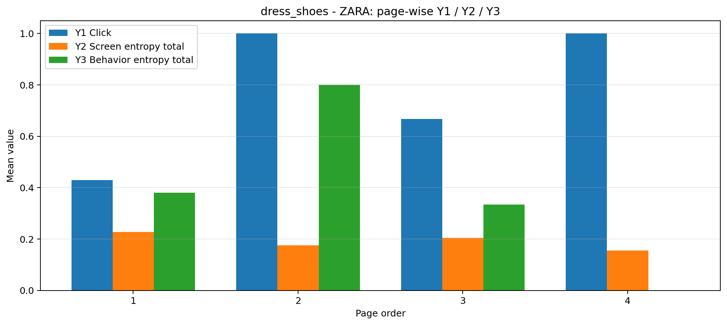
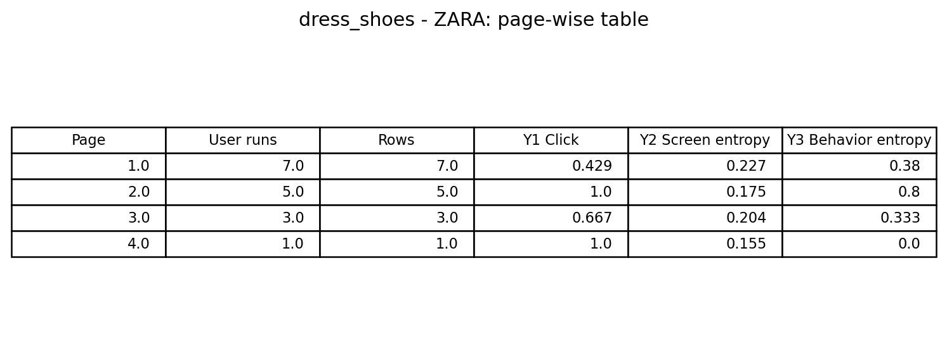
정장구두 - Amazon / ZARA

Slide 7
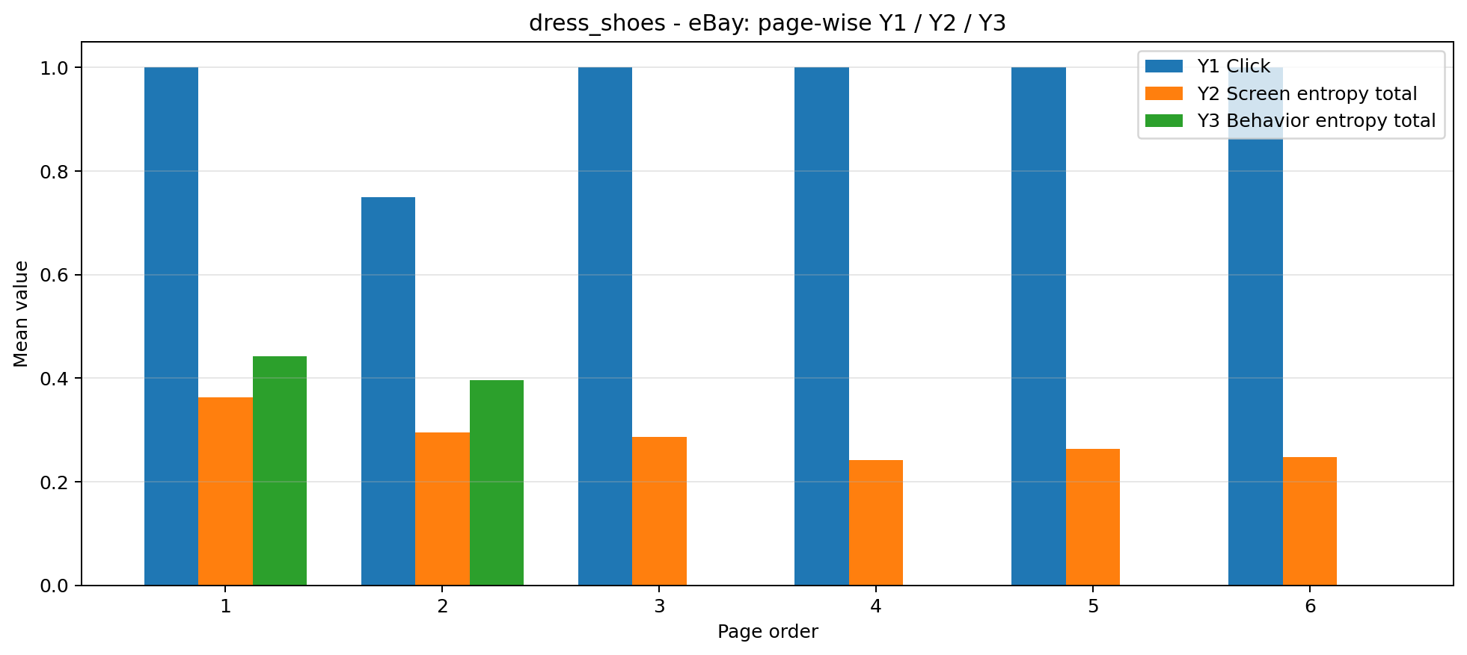
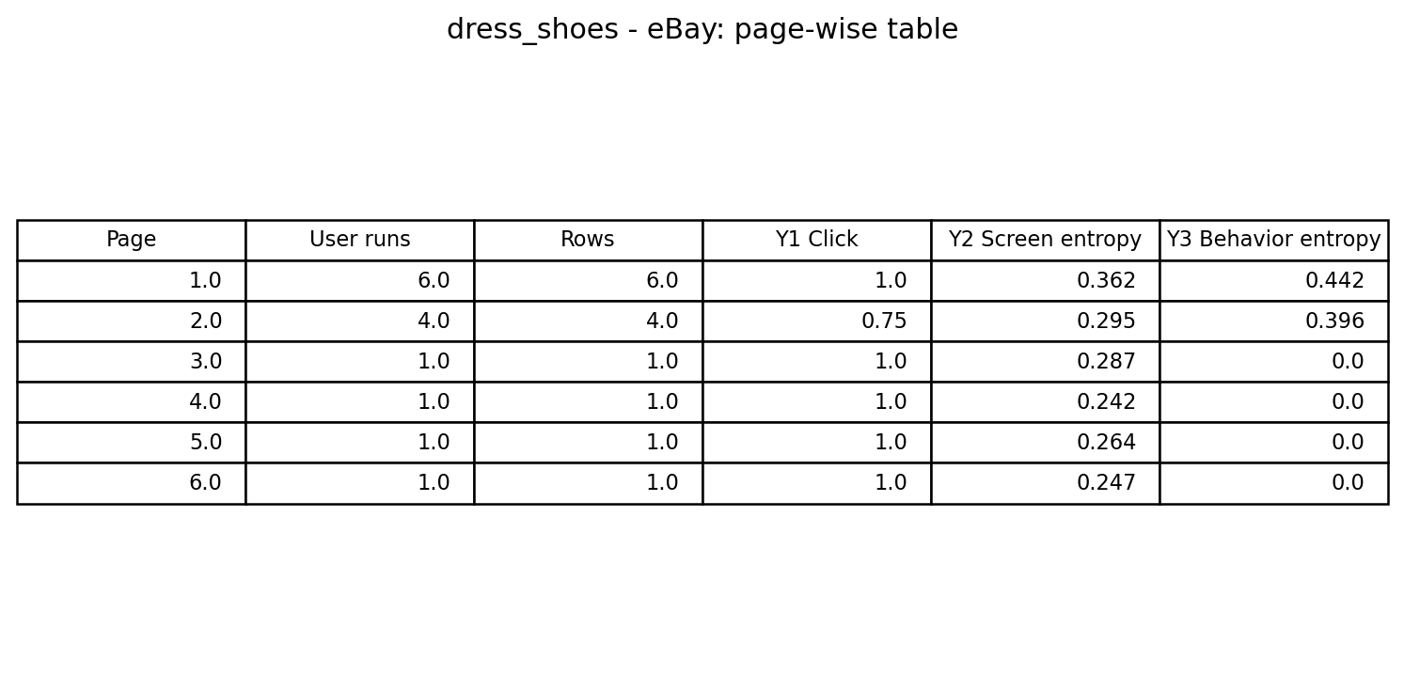
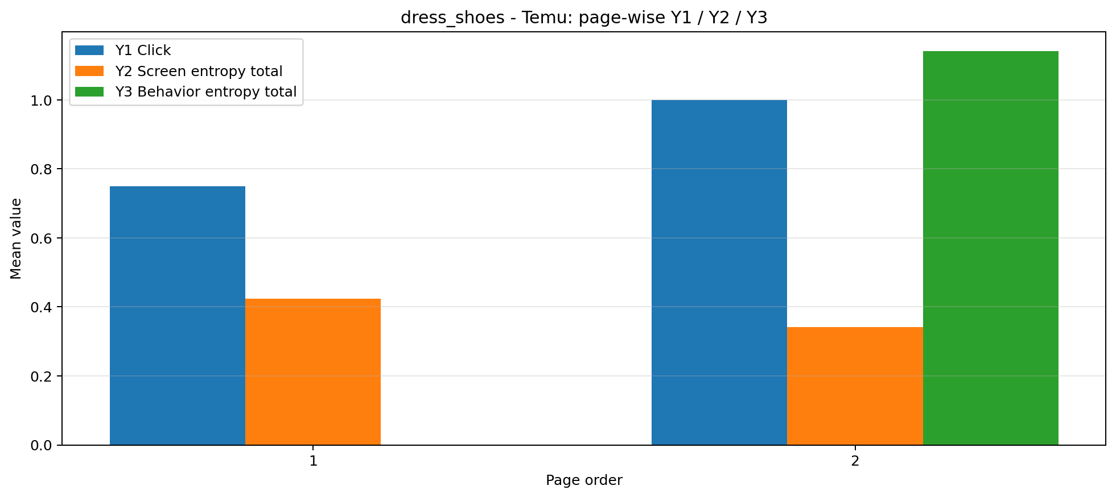
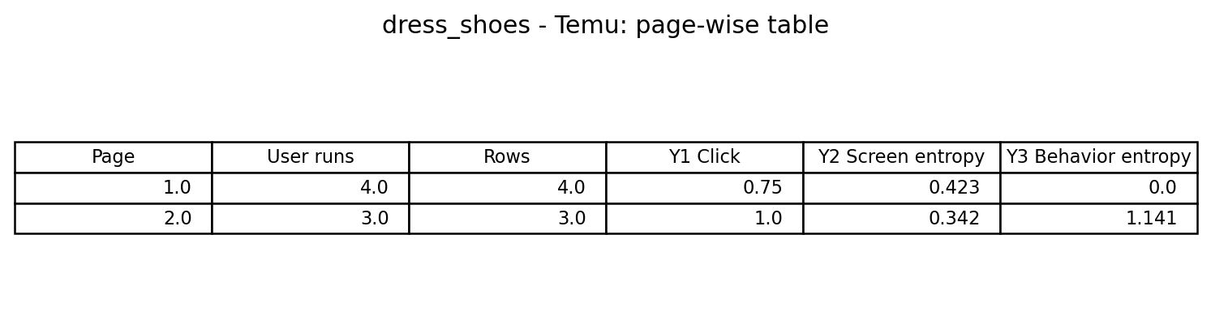
정장구두 - eBay / Temu

Slide 8
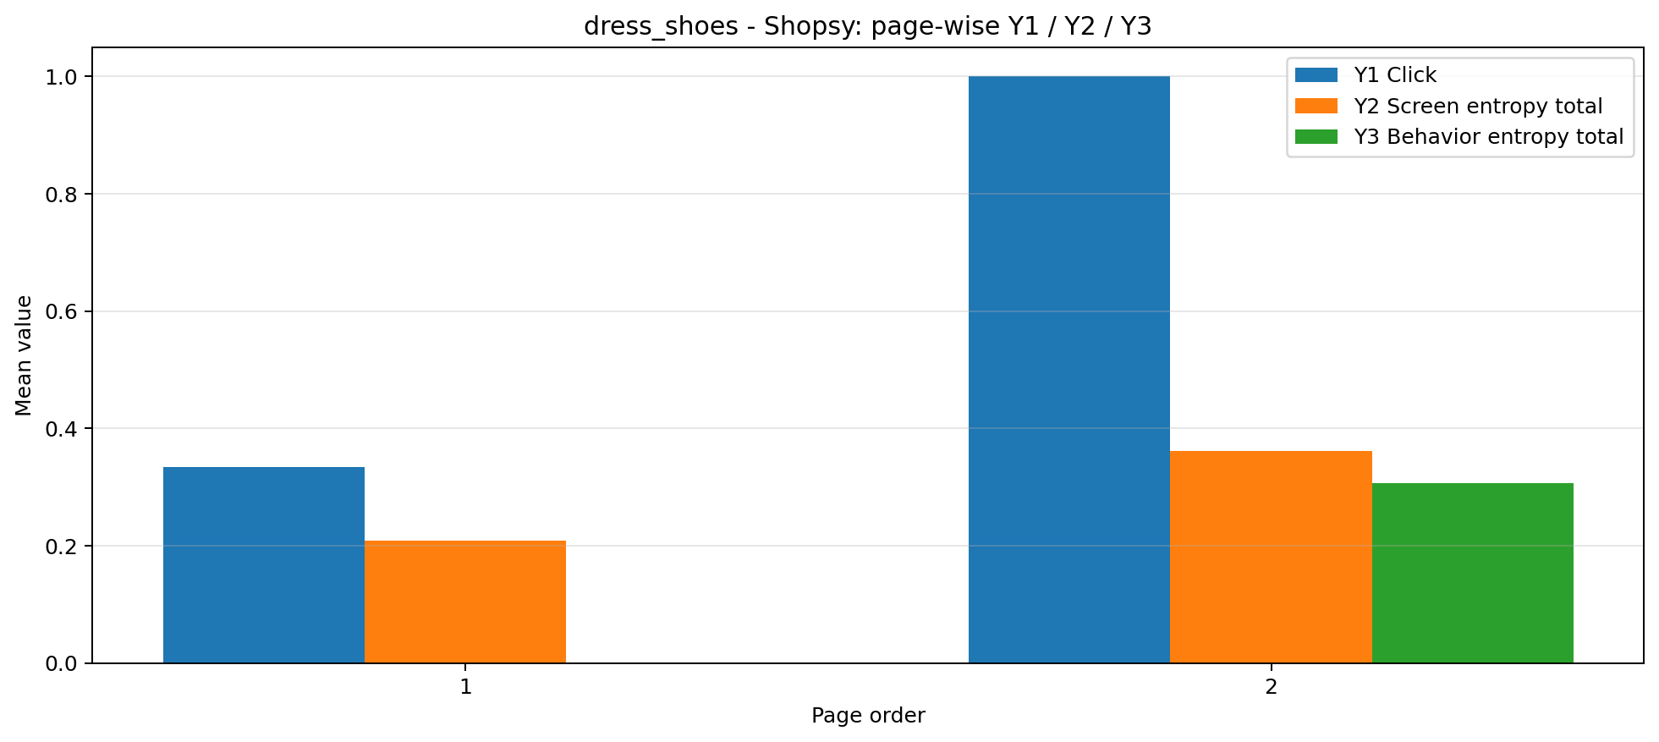
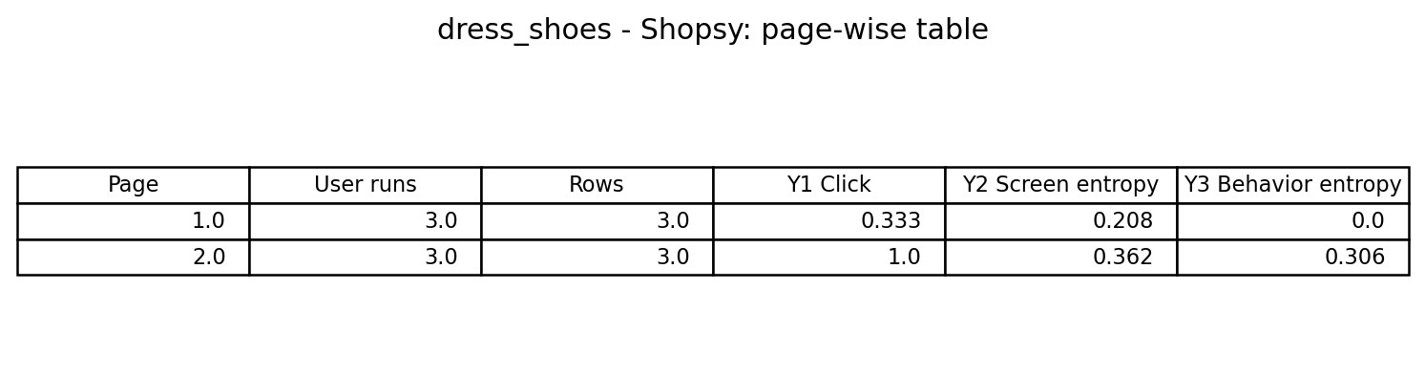
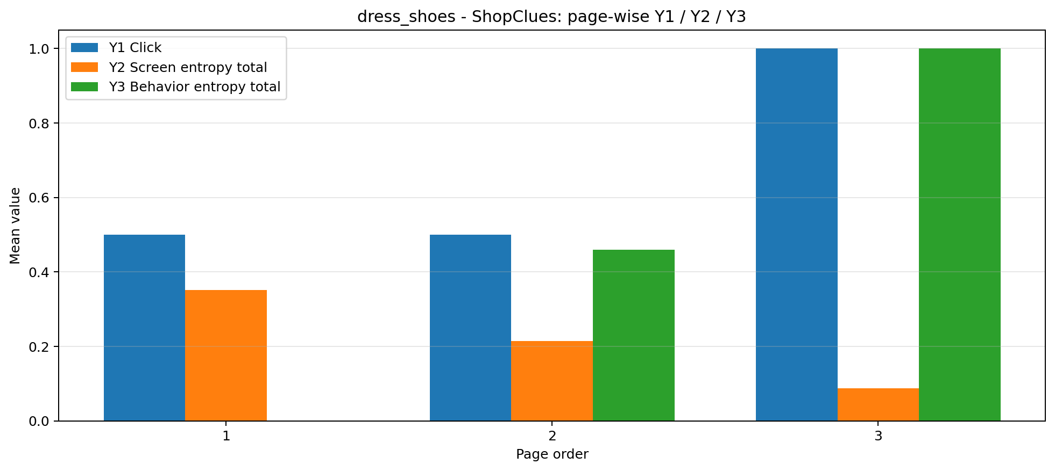
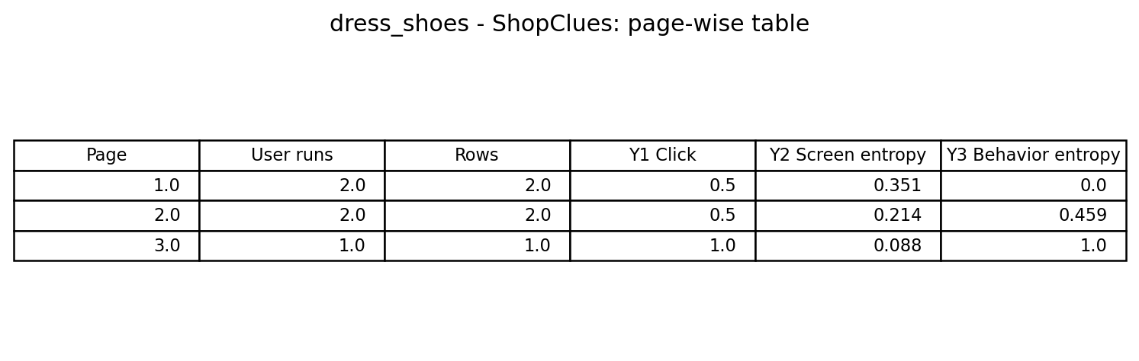
정장구두 - Shopsy / ShopClues

Slide 9
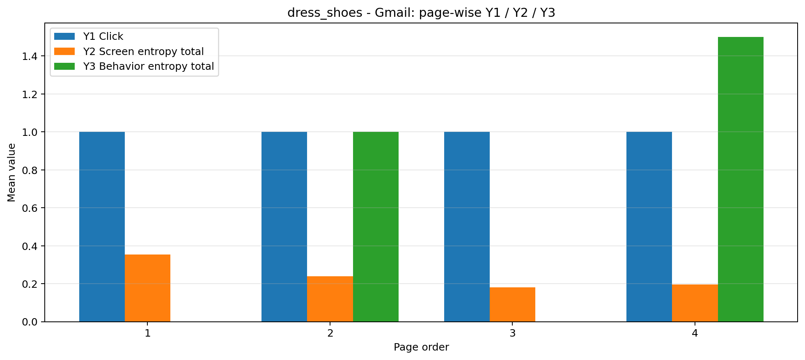
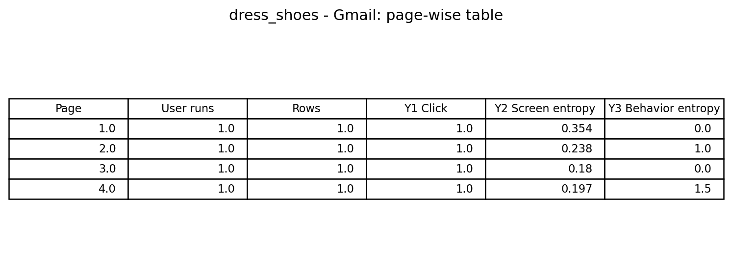
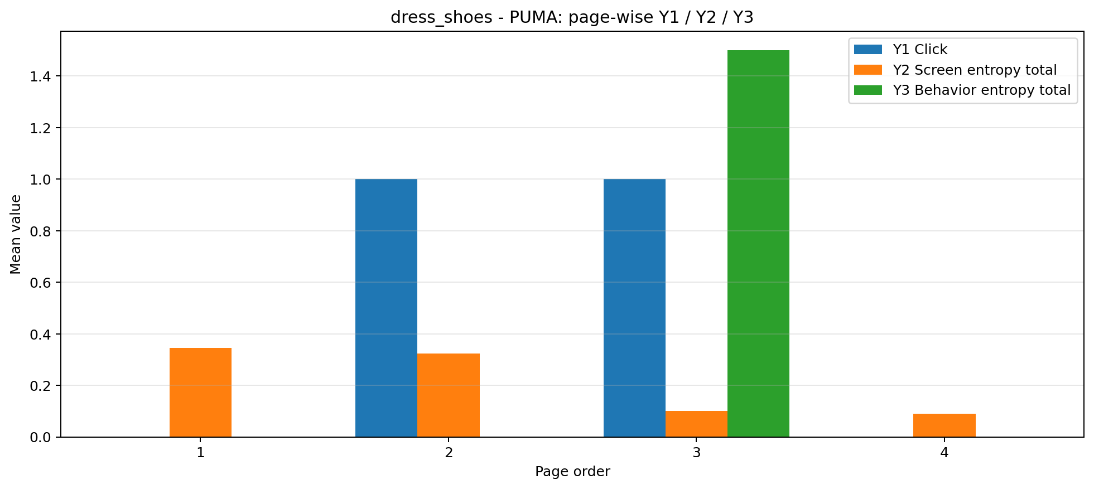
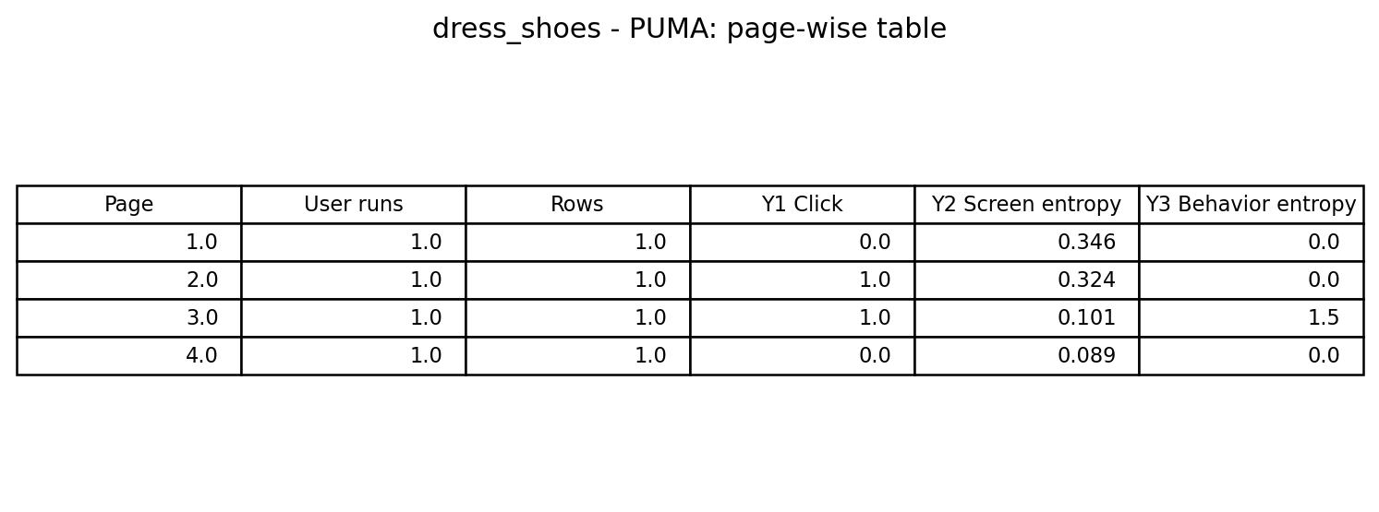
정장구두 - Gmail / PUMA

Slide 10
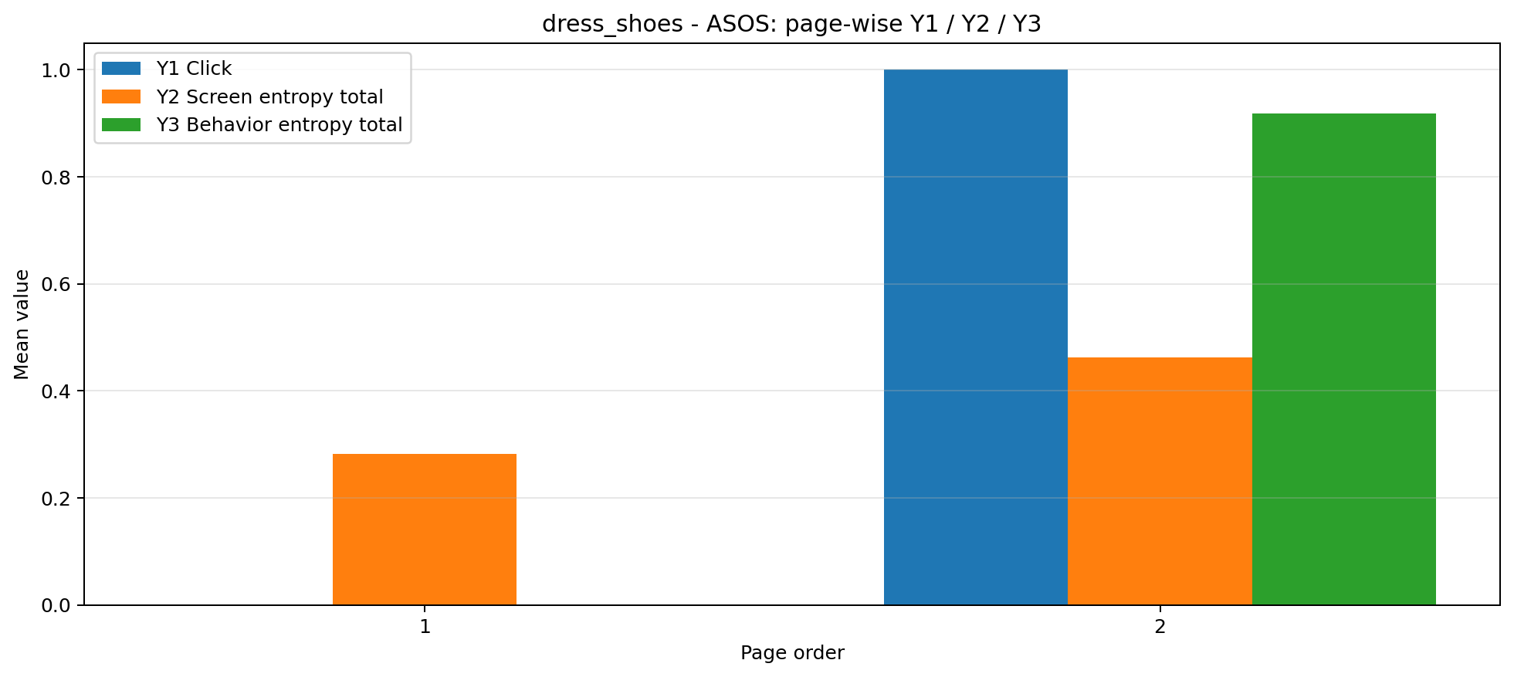
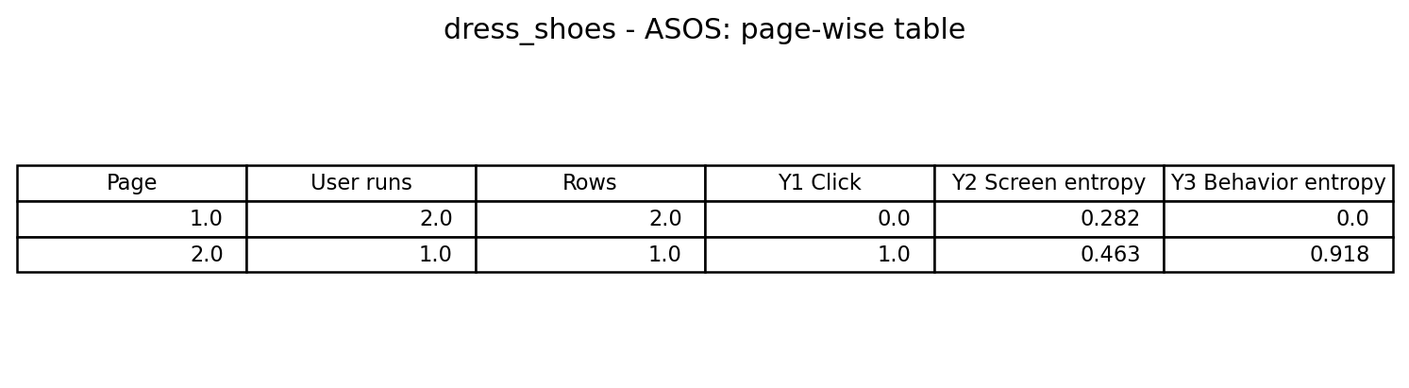
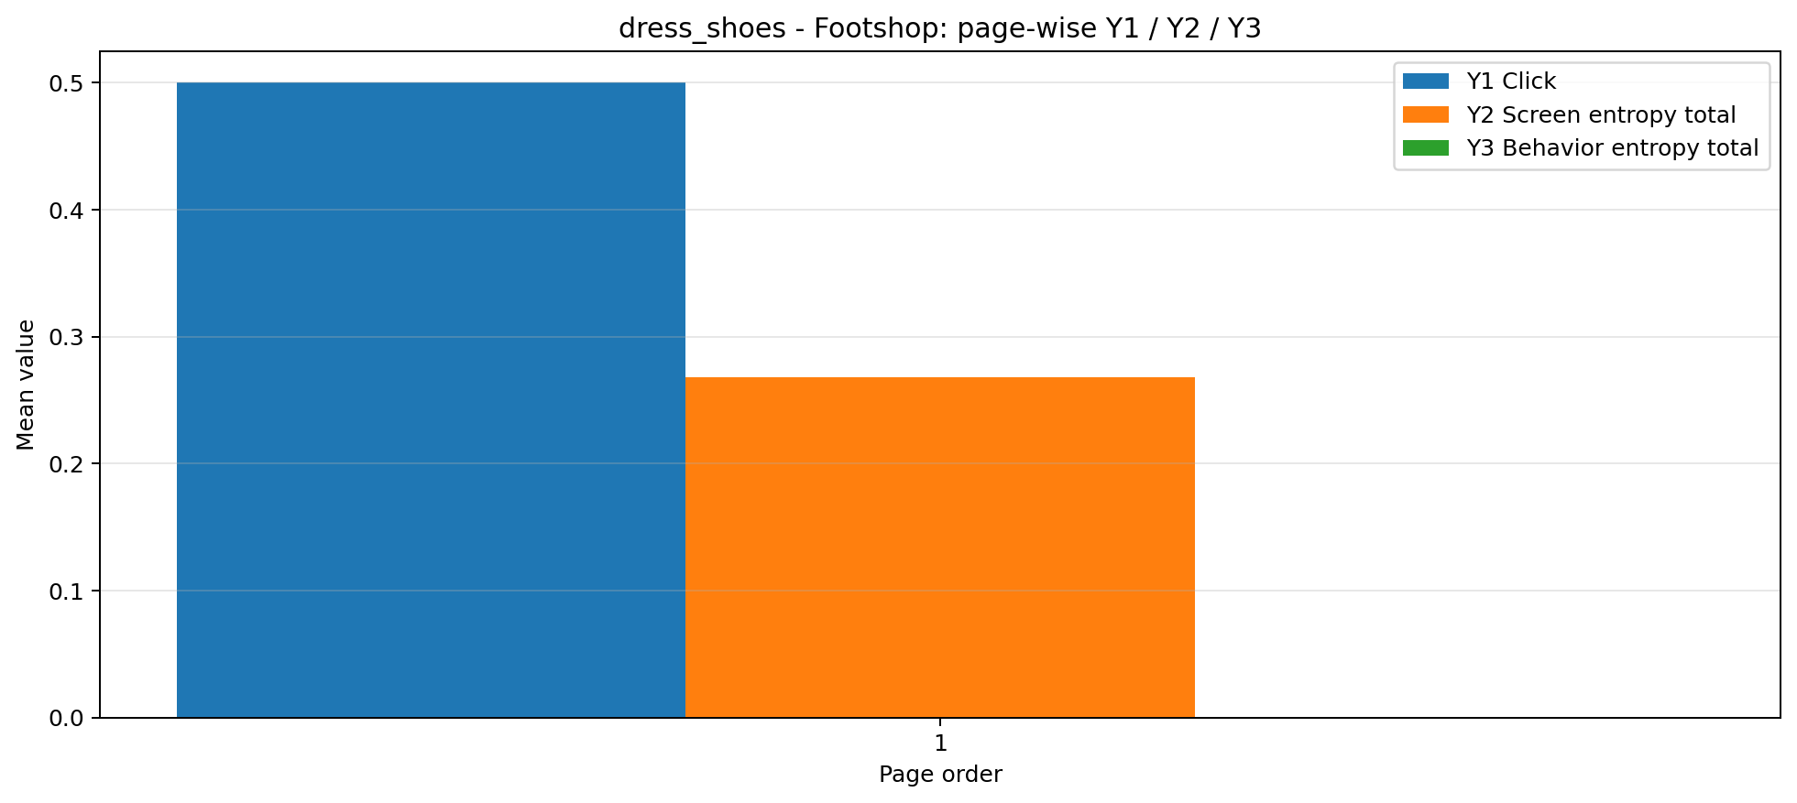
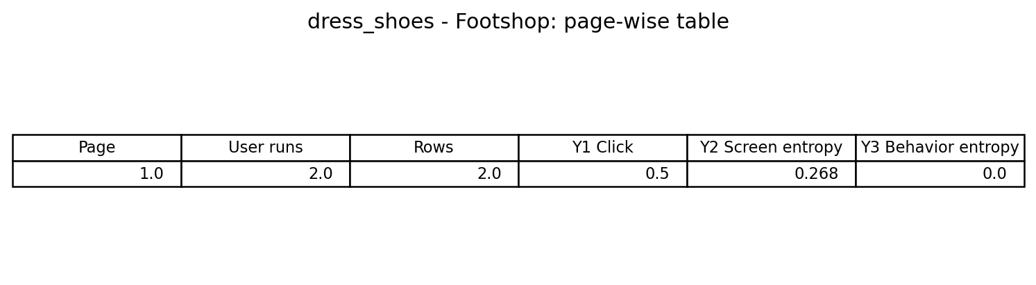
정장구두 - ASOS / Footshop

Slide 11
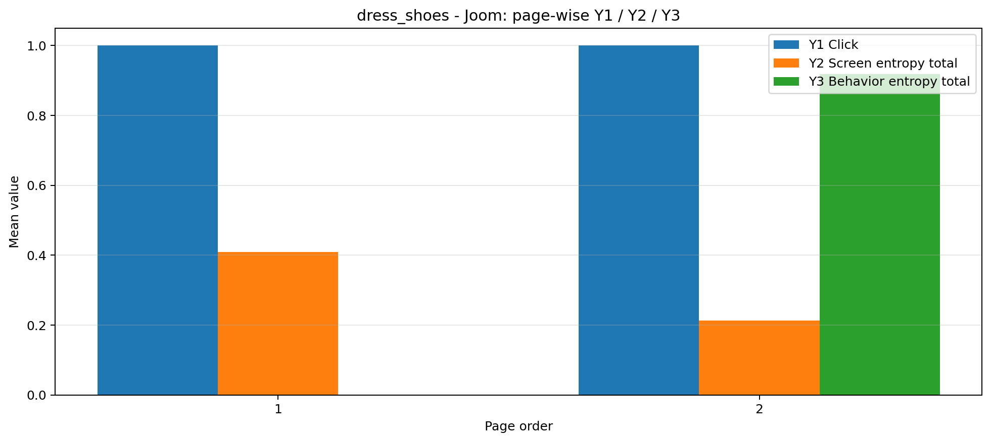
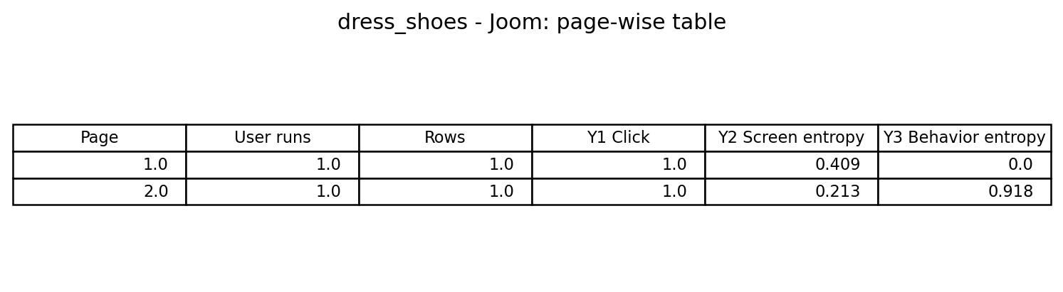
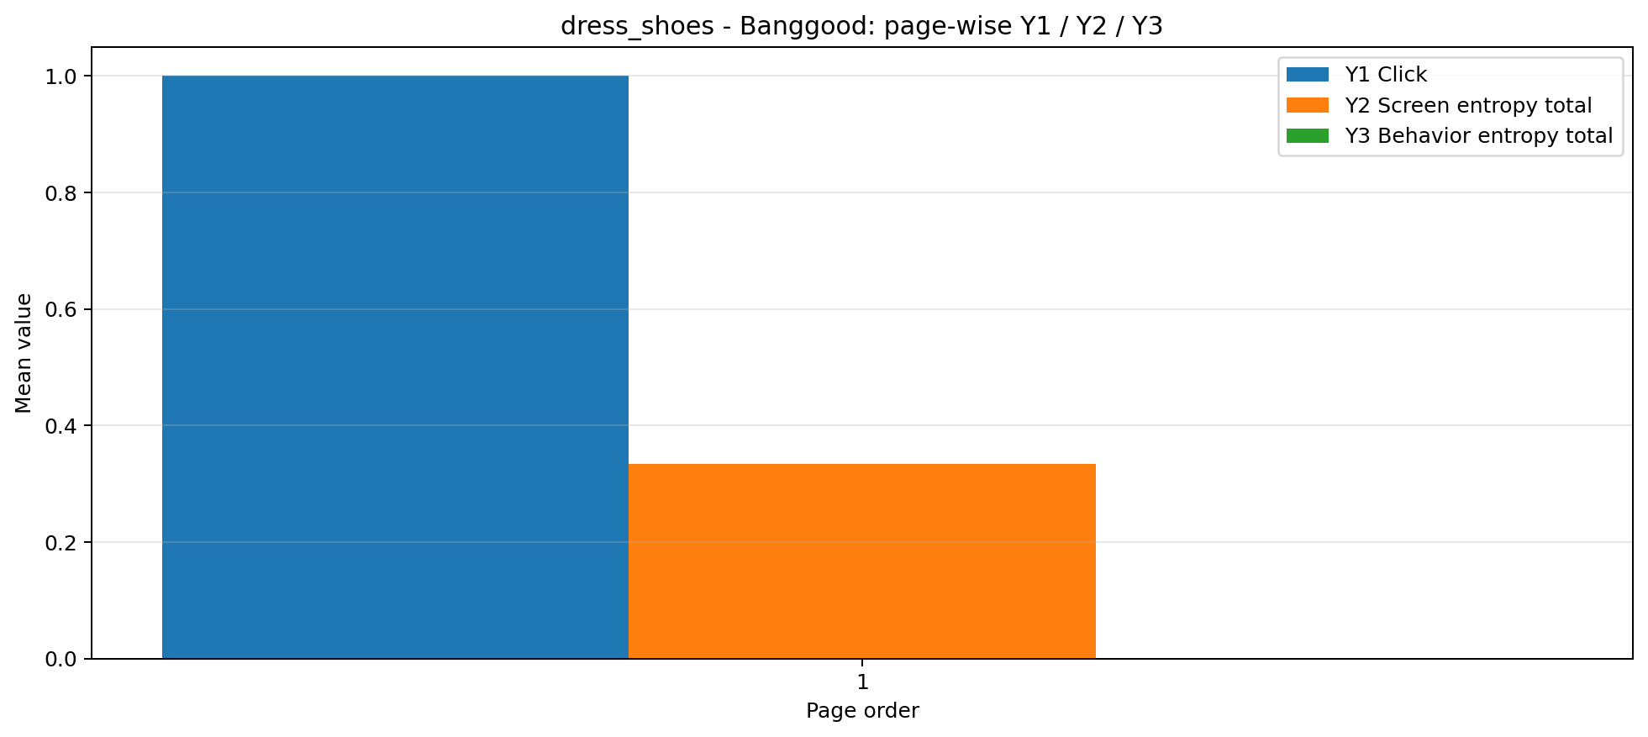
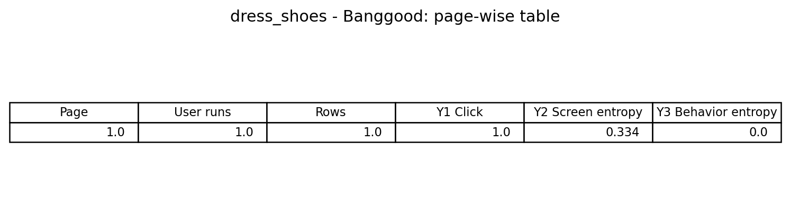
정장구두 - Joom / Banggood

Slide 12
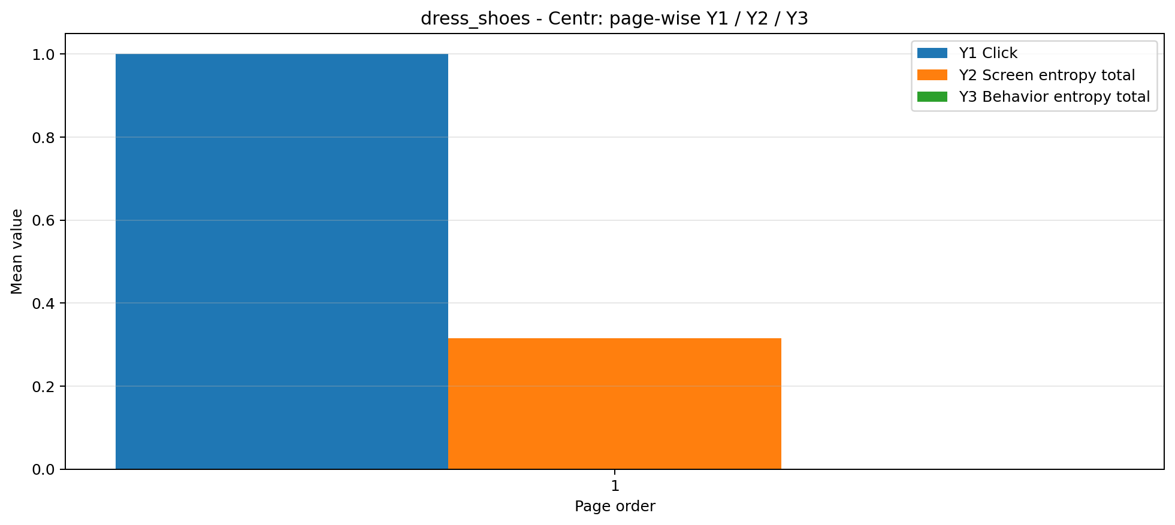
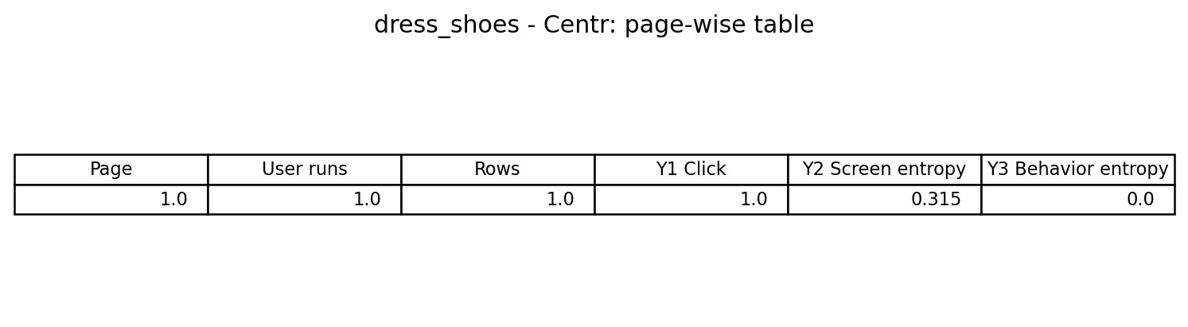
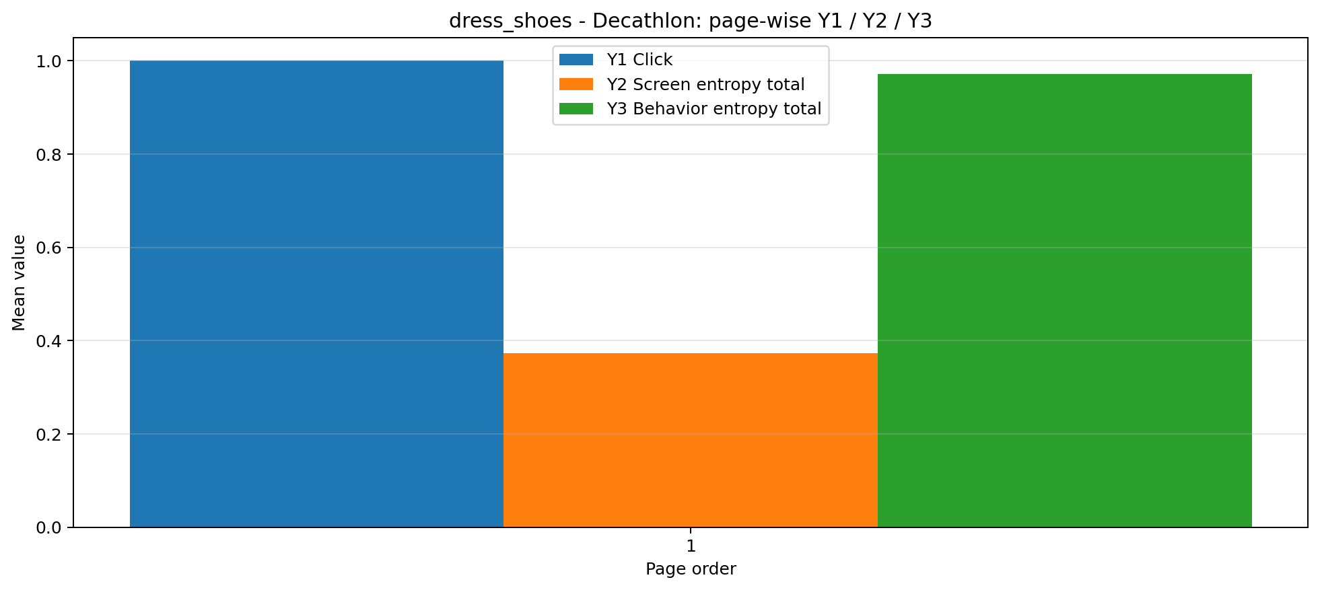
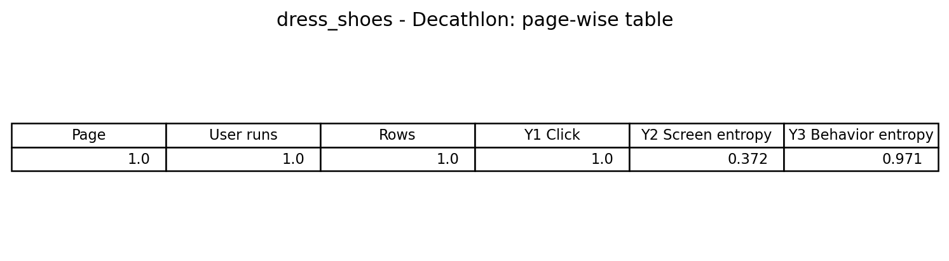
정장구두 - Centr / Decathlon

Slide 13
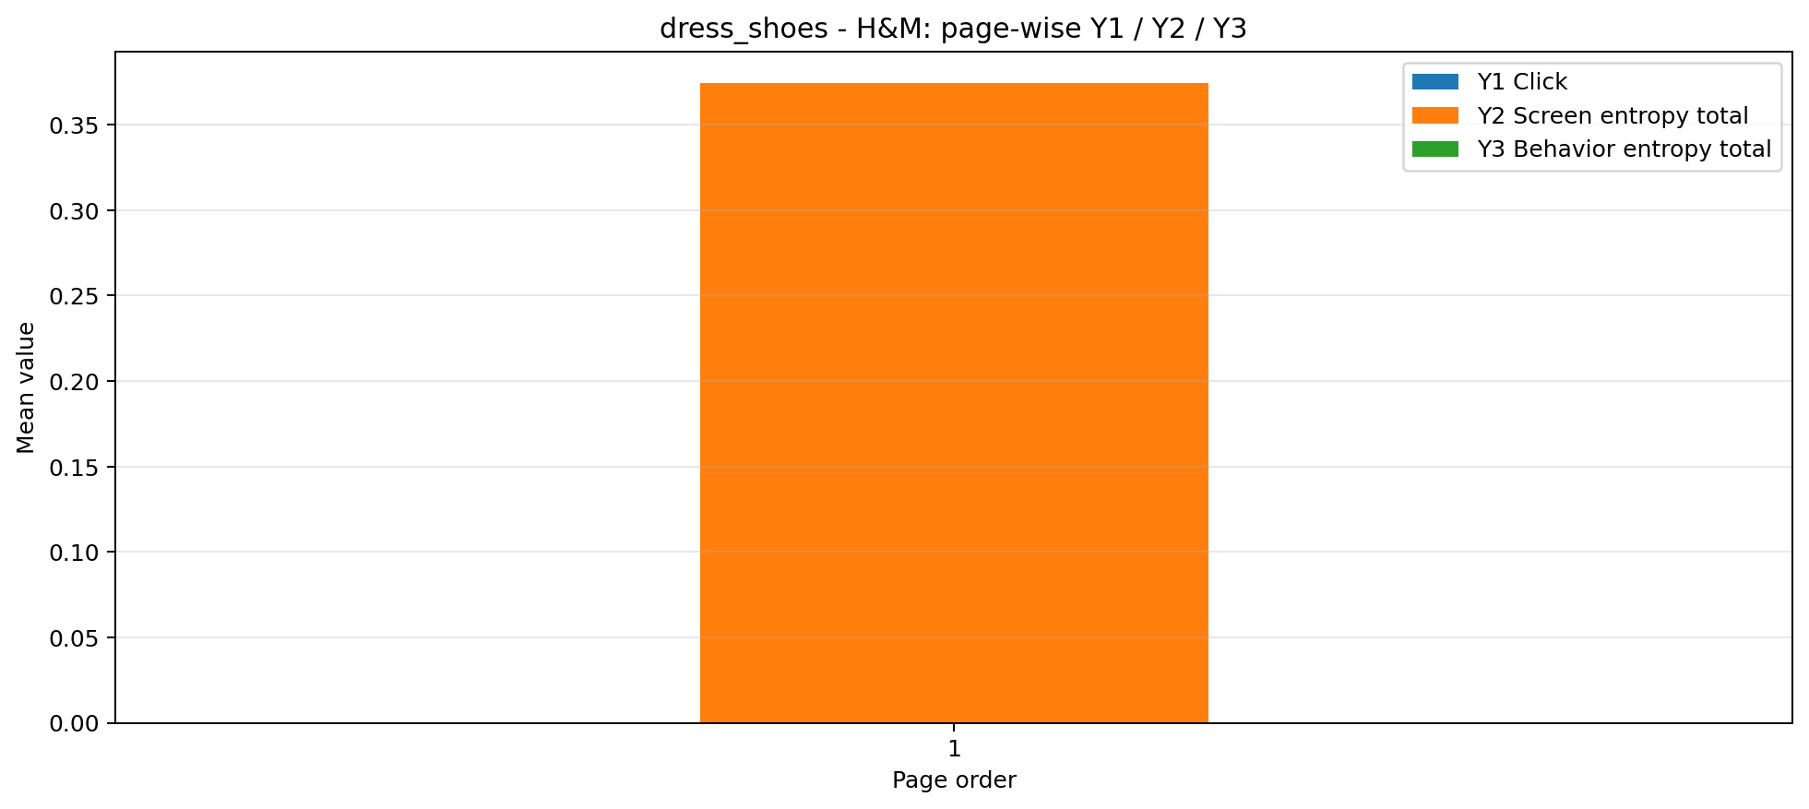

정장구두 - H&M

Slide 14
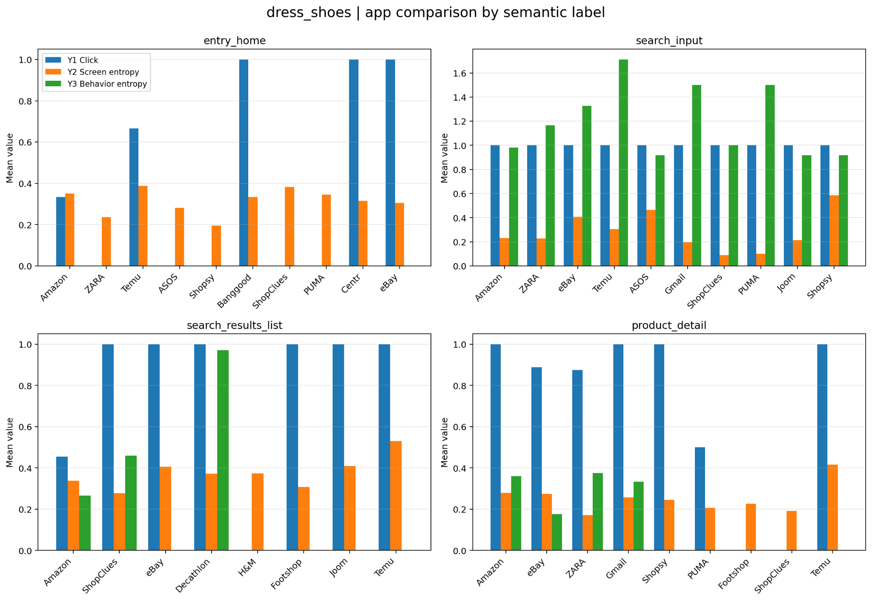
정장구두 종합

Slide 15
페이지 별 매핑- 정장 바지
앱 이름 | 1페이지 | 2페이지 | 3페이지 | 4페이지
Amazon | entry_home | search_input | search_results_list | -
Myntra | entry_home | product_detail | search_results_list | search_input
NykaaFashion | entry_home | search_results_list | product_detail | search_input
eBay | entry_home | product_detail | search_input | -
Temu | entry_home | product_detail | - | -
Tata CLiQ | entry_home | product_detail | search_input | -
Snapdeal | entry_home | product_detail | search_input | -
Flipkart | entry_home | search_input | - | -
Shopsy | entry_home | search_input | entry_home | -

Slide 16
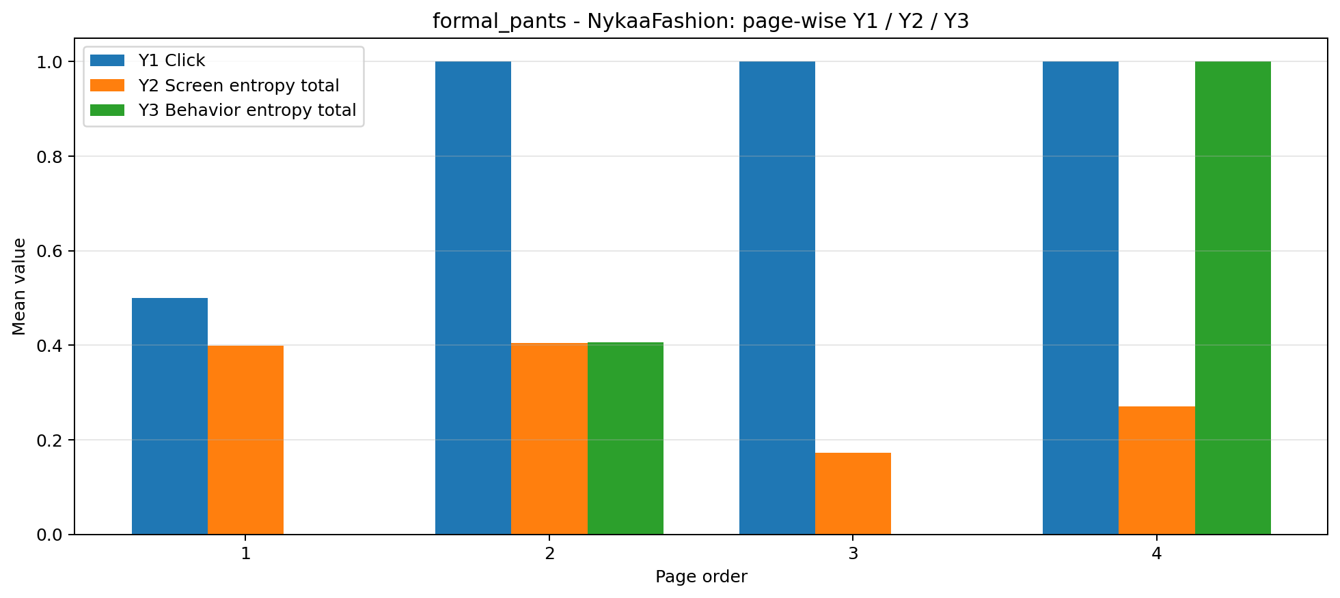
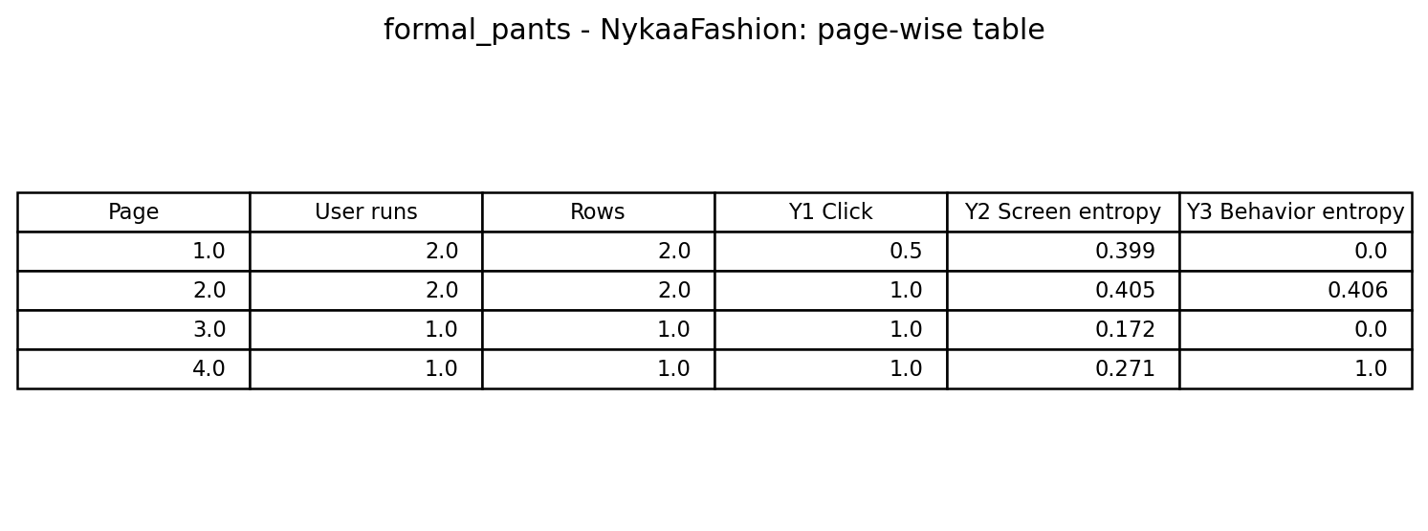
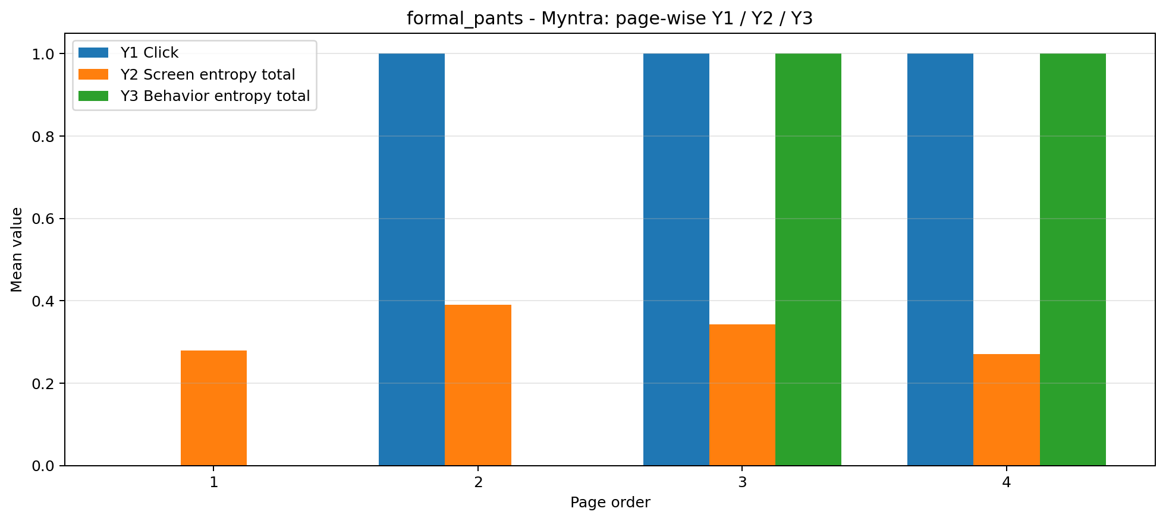
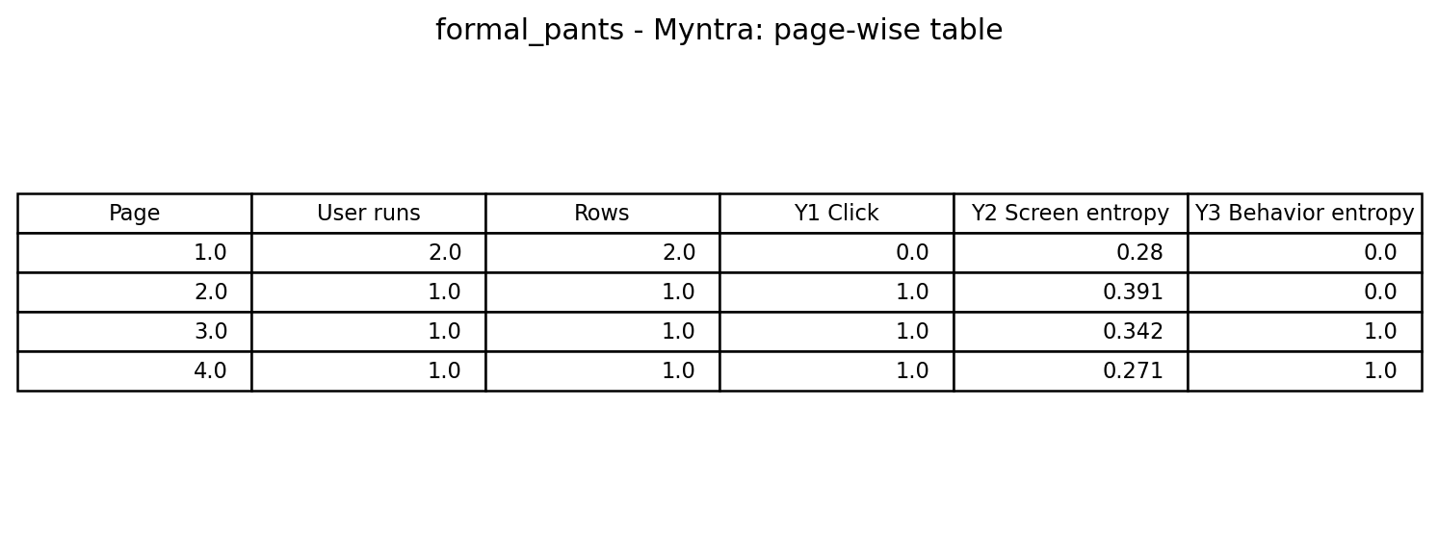
정장바지 - NykaaFashion / Myntra

Slide 17
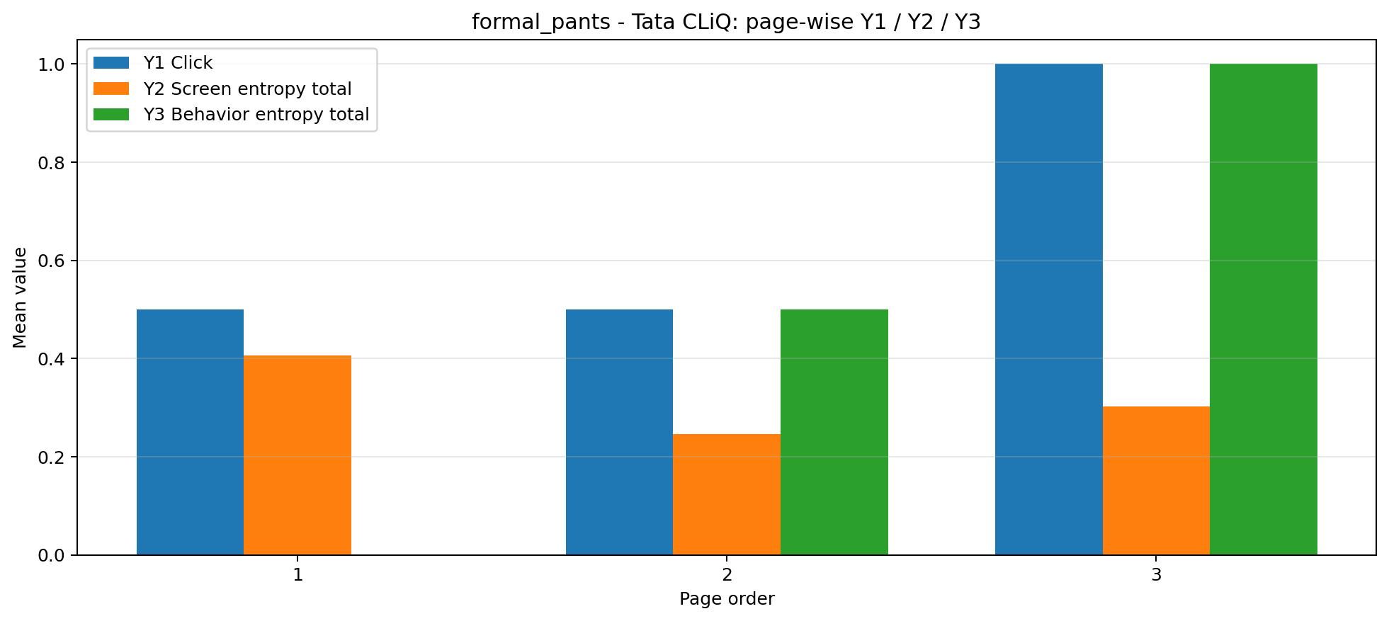
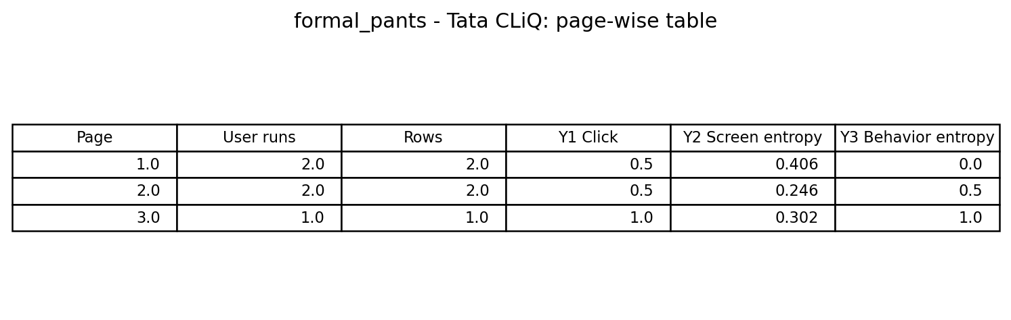
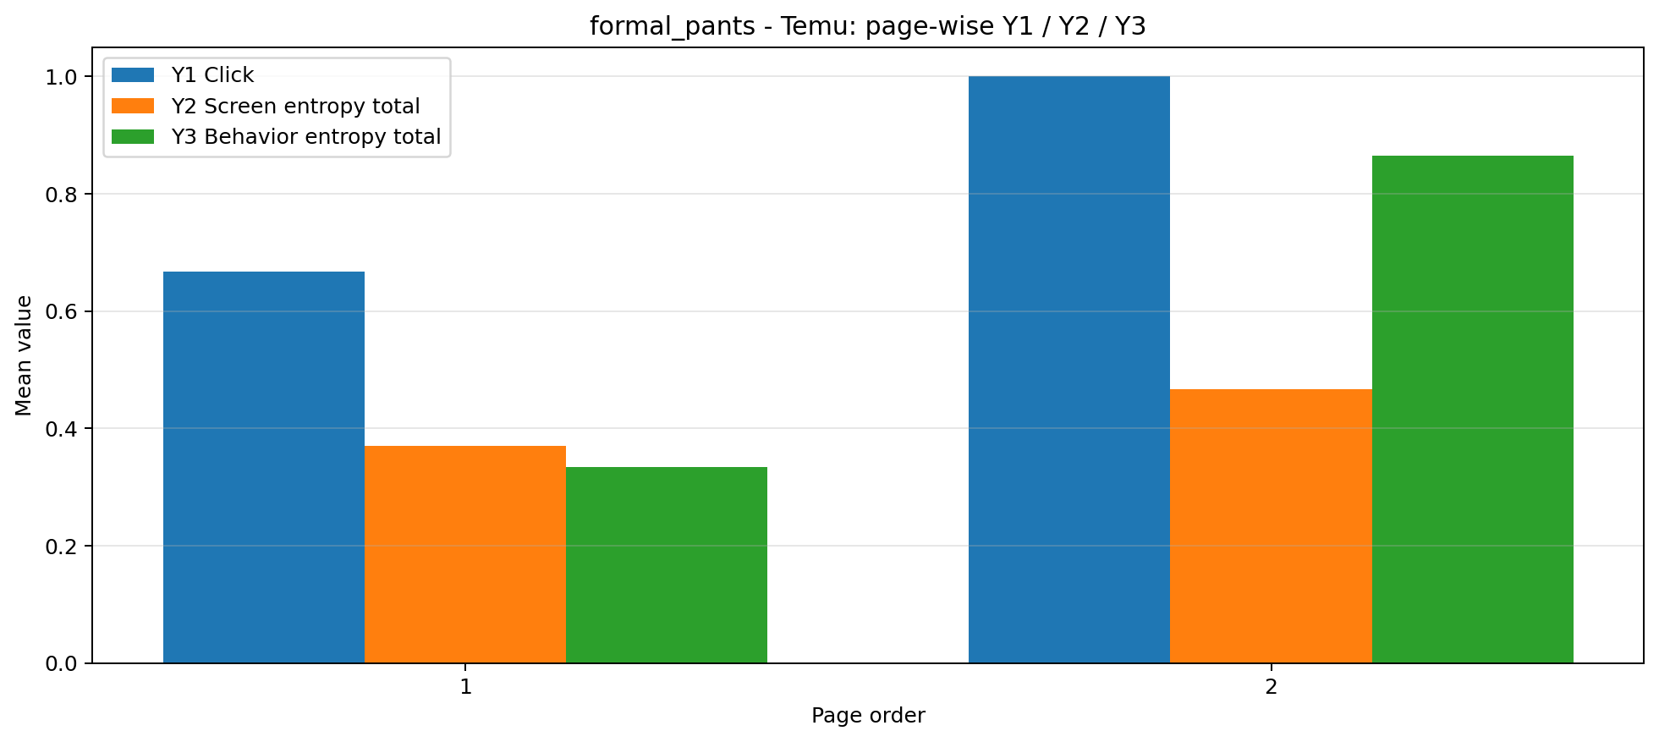
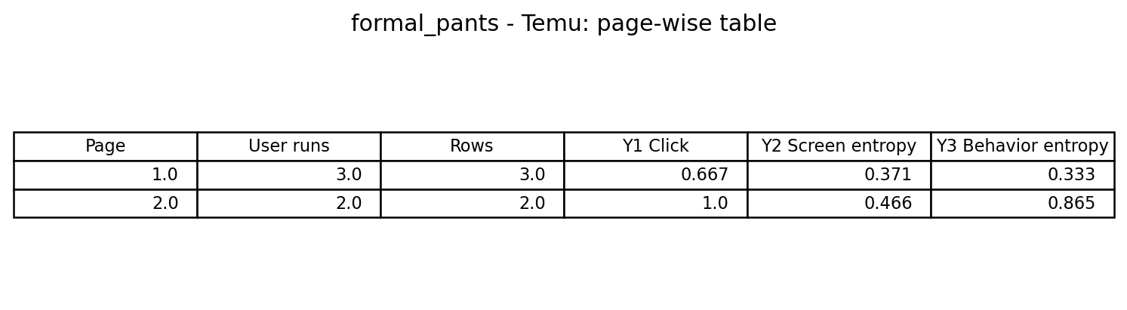
정장바지 - Tata CLiQ / Temu

Slide 18
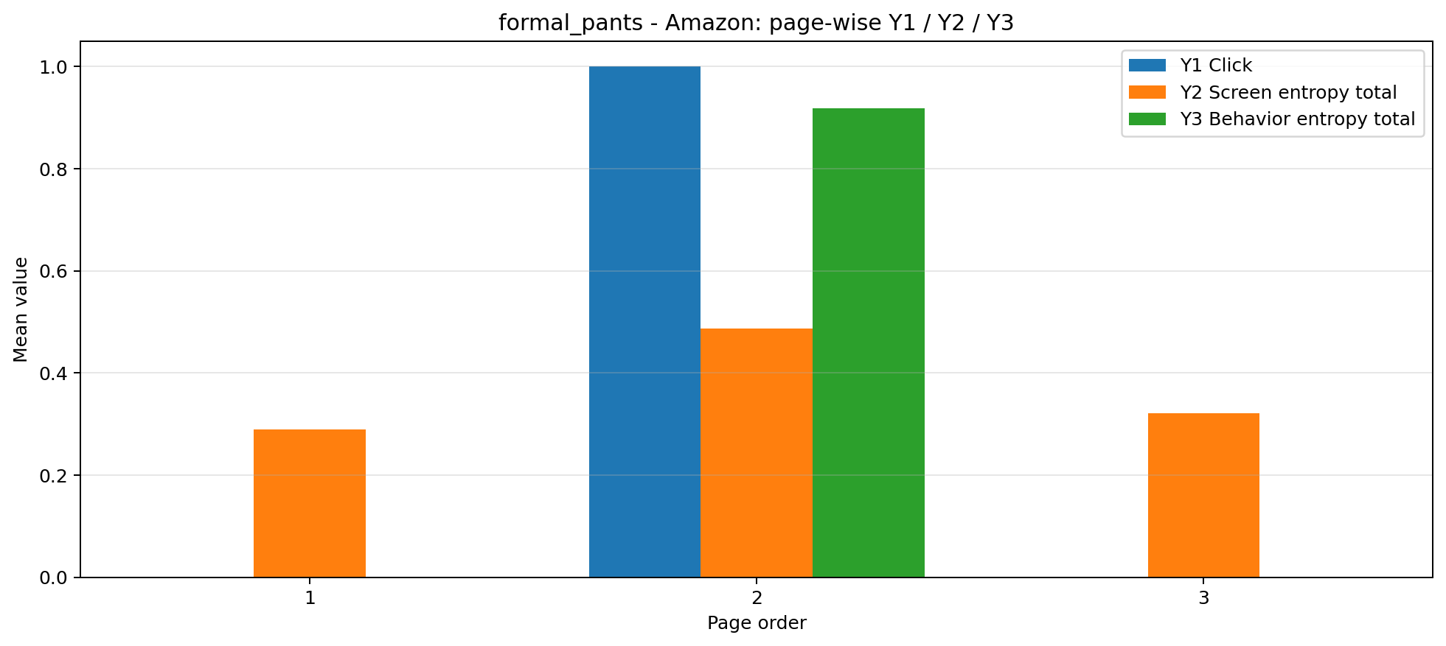
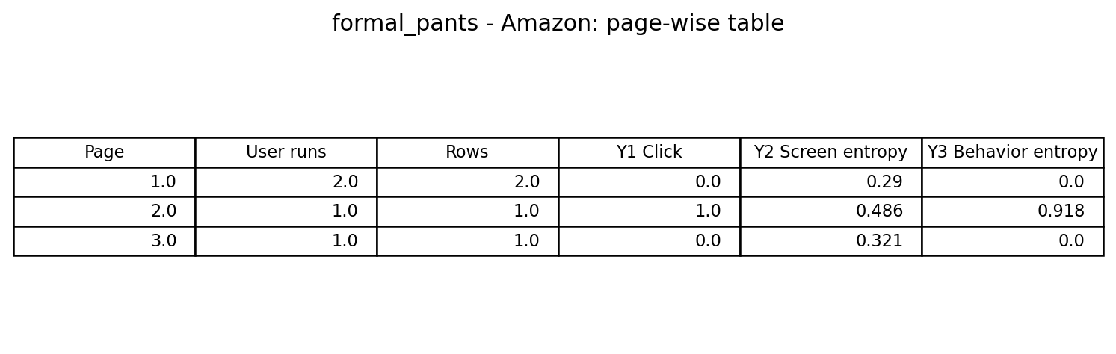
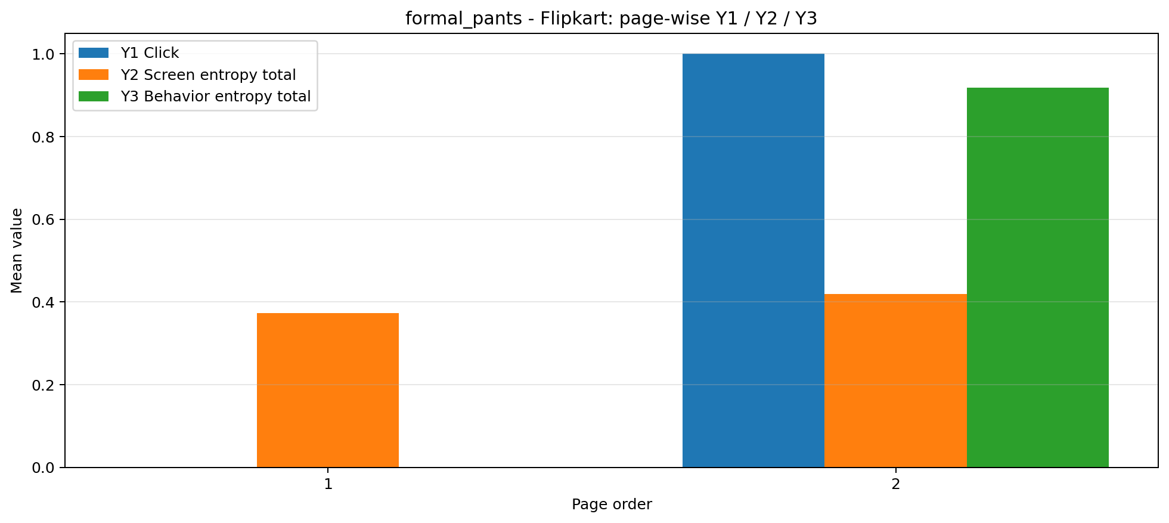
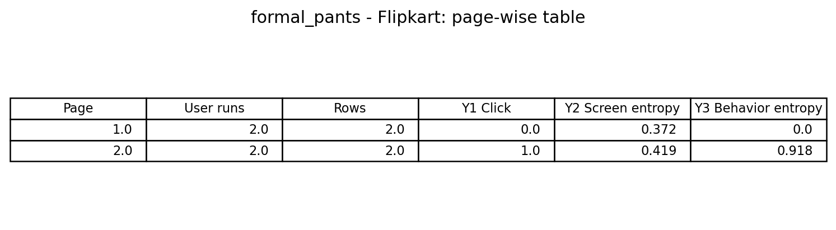
정장바지 - Amazon / Flipkart

Slide 19
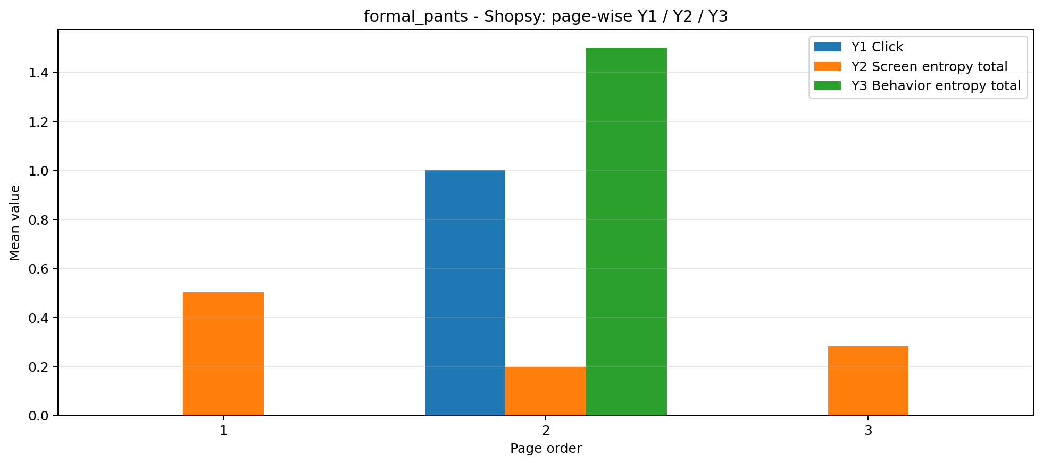

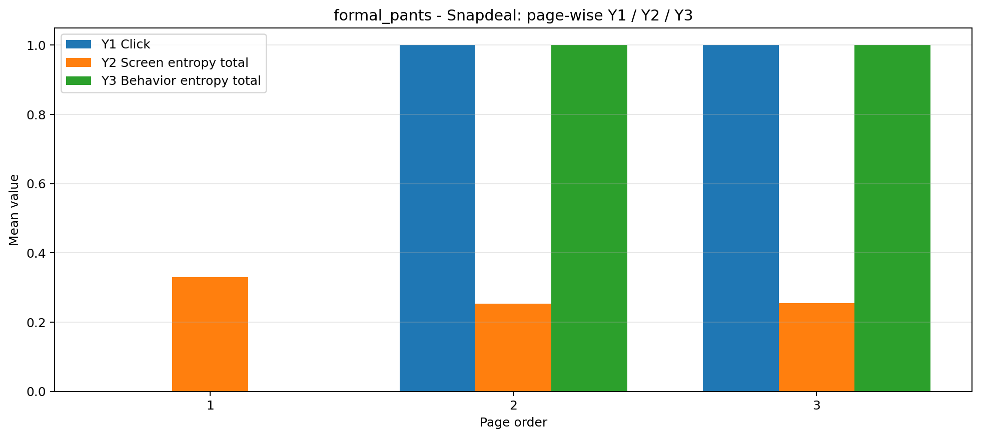
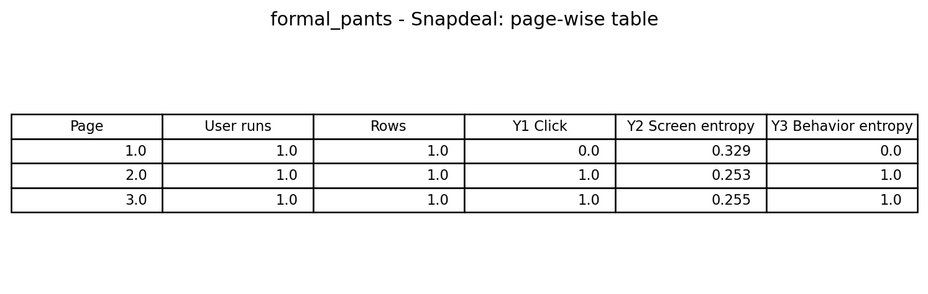
정장바지 - Shopsy / Snapdeal

Slide 20




정장바지 - Tata Neu / eBay

Slide 21

정장바지 종합

Slide 22
페이지 별 매핑- 삼성 냉장고
앱 이름 | 1페이지 | 2페이지 | 3페이지 | 4페이지 | 5페이지
Amazon | entry_home | product_detail | product_detail | product_detail | product_detail
Samsung Shop | entry_home | search_input | product_detail | product_detail | -
Ubuy | entry_home | search_results_list | search_input | product_detail | -
eBay | entry_home | entry_home | search_input | product_detail | -

Slide 23


삼성냉장고 - 전체 앱 비교

Slide 24




삼성냉장고 - Amazon / Samsung Shop

Slide 25




삼성냉장고 - Ubuy / eBay

Slide 26

삼성 냉장고 종합

Slide 27

종합

