Slide 1
SecondLife AI
AI-Powered Sustainable Asset Recycling & Waste Reduction Platform
Automated item classification, material circularity scoring, condition assessment, and community sharing to support global UN Sustainable Development Goals.
Presented by SecondLife AI Project Team • Powered by React, FastAPI & PyTorch Vision

Slide 2
CORE PURPOSE & GLOBAL FRAMEWORK
Project Name & Aligned UN Sustainable Development Goals (SDGs)
PROJECT NAME
SecondLife AI
Vision Statement
To eliminate unnecessary landfill disposal by equipping individuals and communities with instant artificial intelligence tools to classify, repair, reuse, or recycle household items.
Target Impact
• Substantial waste diversion
• Lifetime product extension
• Local community sharing
• Closed-loop circular economy
PRIMARY FOCUS • UN SDG 12: RESPONSIBLE CONSUMPTION & PRODUCTION
Target 12.5: Substantially reduce waste generation through prevention, reduction, recycling, and reuse.
SecondLife AI gives users immediate, actionable guidance on what to do with unwanted items instead of throwing them into landfills, maximizing material circularity.
SUPPORTING GOAL • UN SDG 11: SUSTAINABLE CITIES & COMMUNITIES
Target 11.6: Reduce the adverse per capita environmental impact of cities, including municipal waste management.
Household waste segregation and local item sharing directly reduce municipal solid waste burdens and foster cleaner, more resilient urban communities.
SUPPORTING GOAL • UN SDG 13: CLIMATE ACTION
Target 13.3: Improve education and awareness on climate change mitigation.
Extending item lifespans and recycling scrap materials avoids upstream industrial carbon emissions and prevents organic paper/cardboard landfill methane generation.

Slide 3
CHALLENGES & INNOVATIVE SOLUTION
Problem Statement & SecondLife AI Approach
THE PROBLEM
Linear 'Take-Make-Dispose' Economy
• Millions of usable household items are dumped into landfills annually due to lack of immediate disposal guidance.
• Consumers struggle to determine whether an item can be repaired, donated, upcycled, or recycled.
• Improper category classification leads to contaminated recycling streams and missed donation opportunities.
OUR SOLUTION
SecondLife AI Circular Platform
1. AI Image & Text Classifier: Instantly normalizes items into 8 core categories (Electronics, Clothing, Paper, Plastic, Glass, Metal, Furniture, Other).
2. Condition-Aware Recommendation Engine: Evaluates item state (Good, Fair, Damaged, Not usable) to suggest Repair, Reuse, Donation, or Scrap Recycling.
3. Digital Provenance & QR Tagging: Generates printable QR tags and item certificates for transparent community sharing.

Slide 4
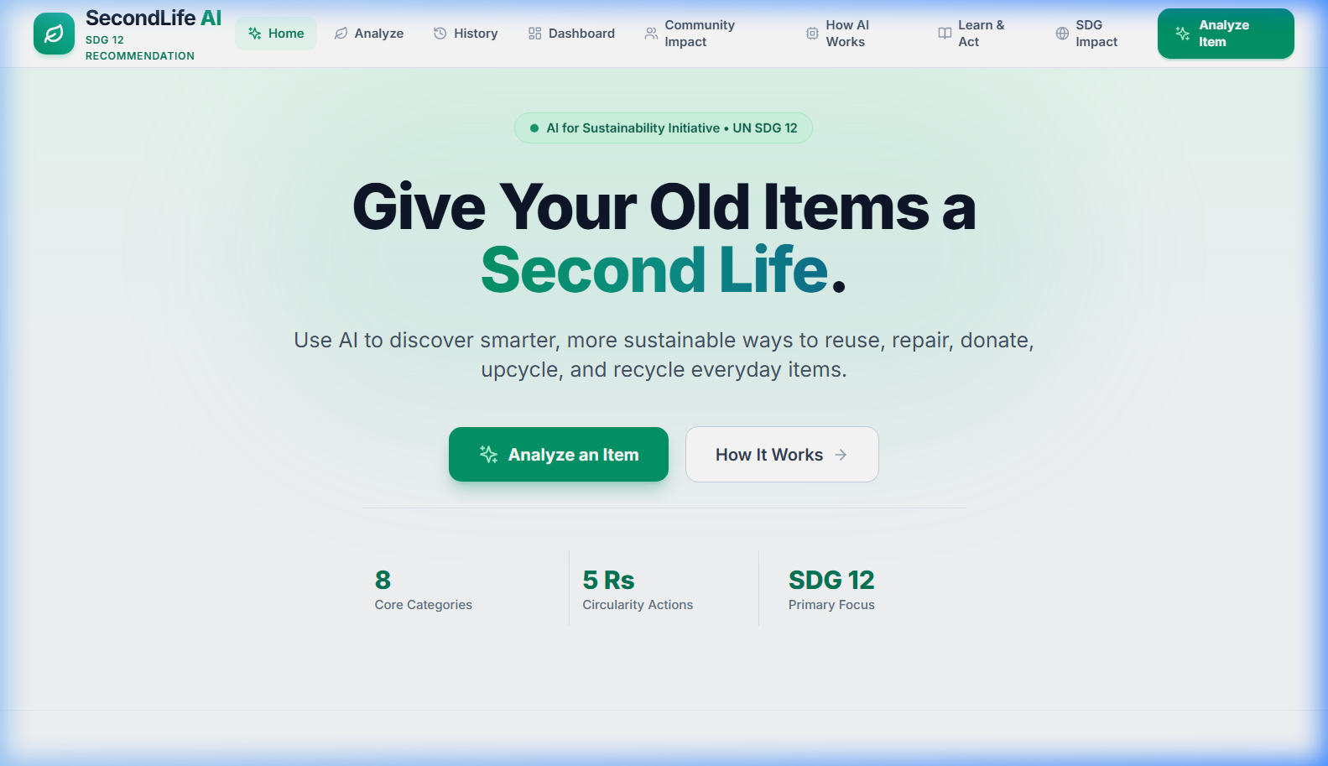
USER INTERFACE & EXPERIENCE
Platform Landing & Navigation Overview
KEY INTERFACE FEATURES
Modern & Accessible Design
• Hero Banner: Quick action buttons for uploading items or viewing SDG impact metrics.
• Fast Navigation: Direct access to Analyzer, 100-Item History, Dashboard, and Educational resources.
• Responsive Layout: Built with Tailwind CSS for seamless mobile and desktop accessibility.

Slide 5
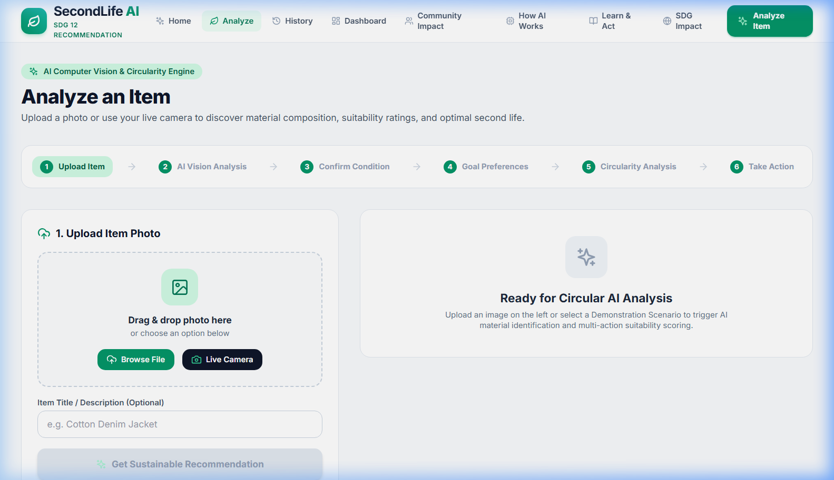
ARTIFICIAL INTELLIGENCE CORE
AI Item Analyzer & Category Correction Engine
AI CLASSIFICATION PIPELINE
Dual Heuristic & Vision Model
• MobileNetV2 Vision Model: Analyzes uploaded image features with PyTorch inference.
• Category Normalization: Maps inputs cleanly into 8 standard target categories.
• Category Correction Modal: Allows user to override AI detection with instant state sync.

Slide 6
ASSET TRACKING & CIRCULAR TRUST
Printable QR Tag & Provenance Certificate
01. QR TAG GENERATION
High-Res QR Server API
• Generates scannable QR tags encoding item ID, title, and provenance link.
• Designed for physical printout on standard label printers to stick onto recycled/donated items.
02. DIGITAL PROVENANCE
Item Passport & History
• Verifies item authenticity, material category, and AI circularity score.
• Builds trust between donors, charities, and second-hand buyers.
03. CIRCULAR HANDOFF
Print & Tag Utility
• Integrated Modal: Features instant 'Print Tag & Certificate' dialog window across Analyze, History, and Item Detail pages.

Slide 7
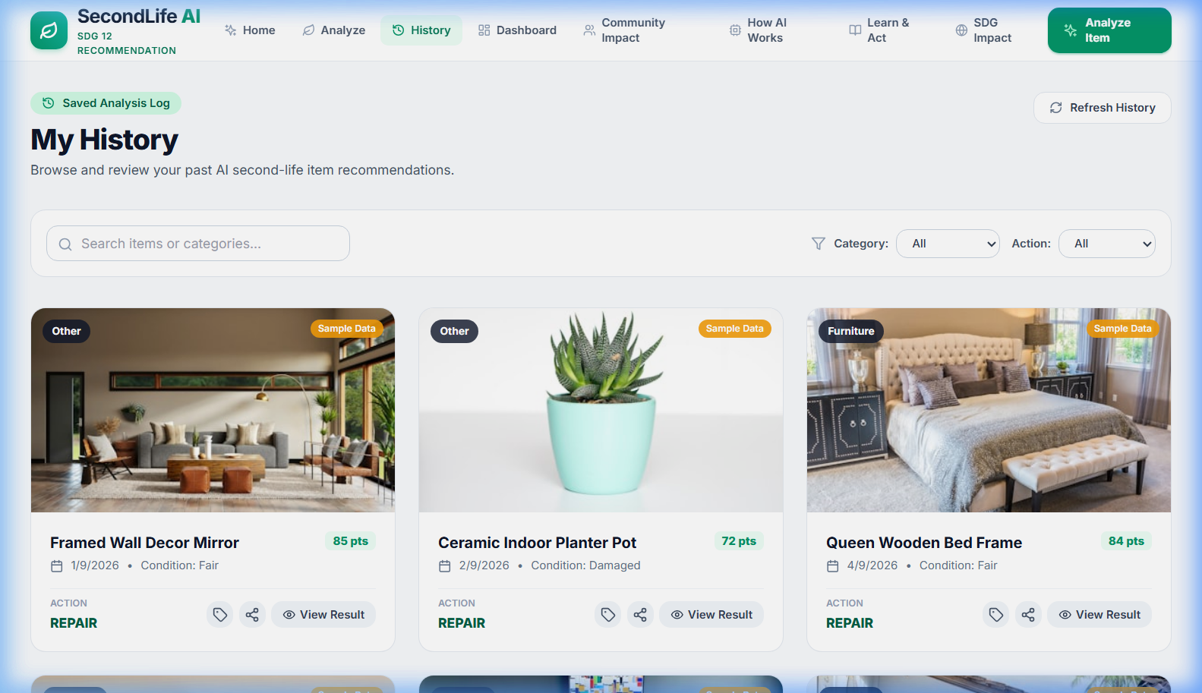
DATA ARCHITECTURE & STORAGE
100-Item Analyzed History & SQLite Backend
DATABASE ARCHITECTURE
Persistent SQLite Database
• Database File: SQLite 3 engine located at backend/secondlife.db.
• 100 Seeded Item Records: Complete with realistic condition balance (Damaged: 28, Fair: 28, Good: 29, Not usable: 11, Excellent: 4).
• Interactive Filtering: Search by keyword, filter by category, or sort by circularity score.

Slide 8
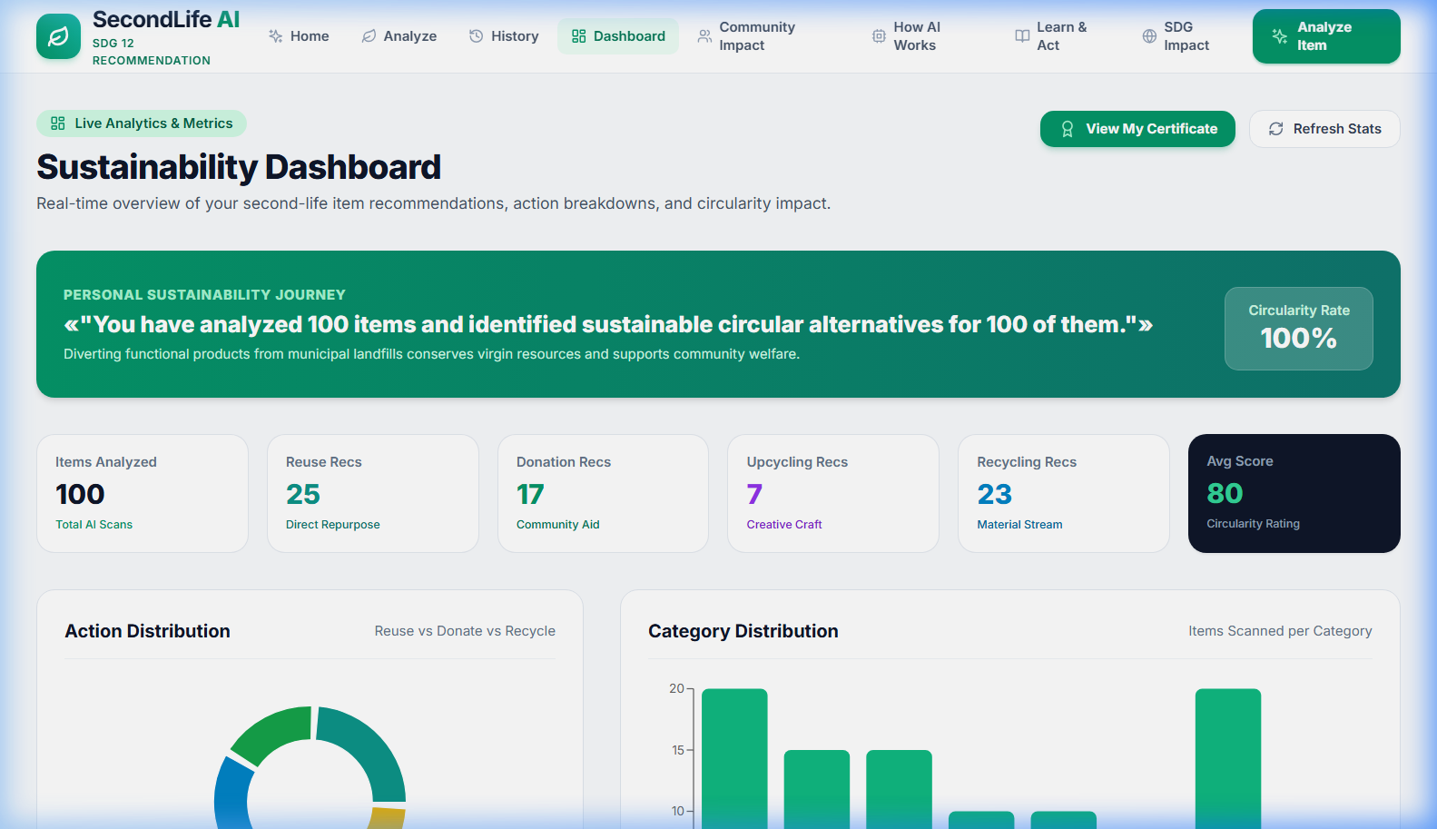
ANALYTICS & METRICS
Sustainability Dashboard & Circularity Scoring
ANALYTICS & METRICS
Circularity Scoring (0-100)
• Circularity Index: Evaluates item reusability, material recyclability, and repair potential.
• Visual KPI Cards: Real-time tracking of total items analyzed, waste diverted, and donations.
• Category Distribution: Interactive visual breakdown across all 8 target categories.

Slide 9
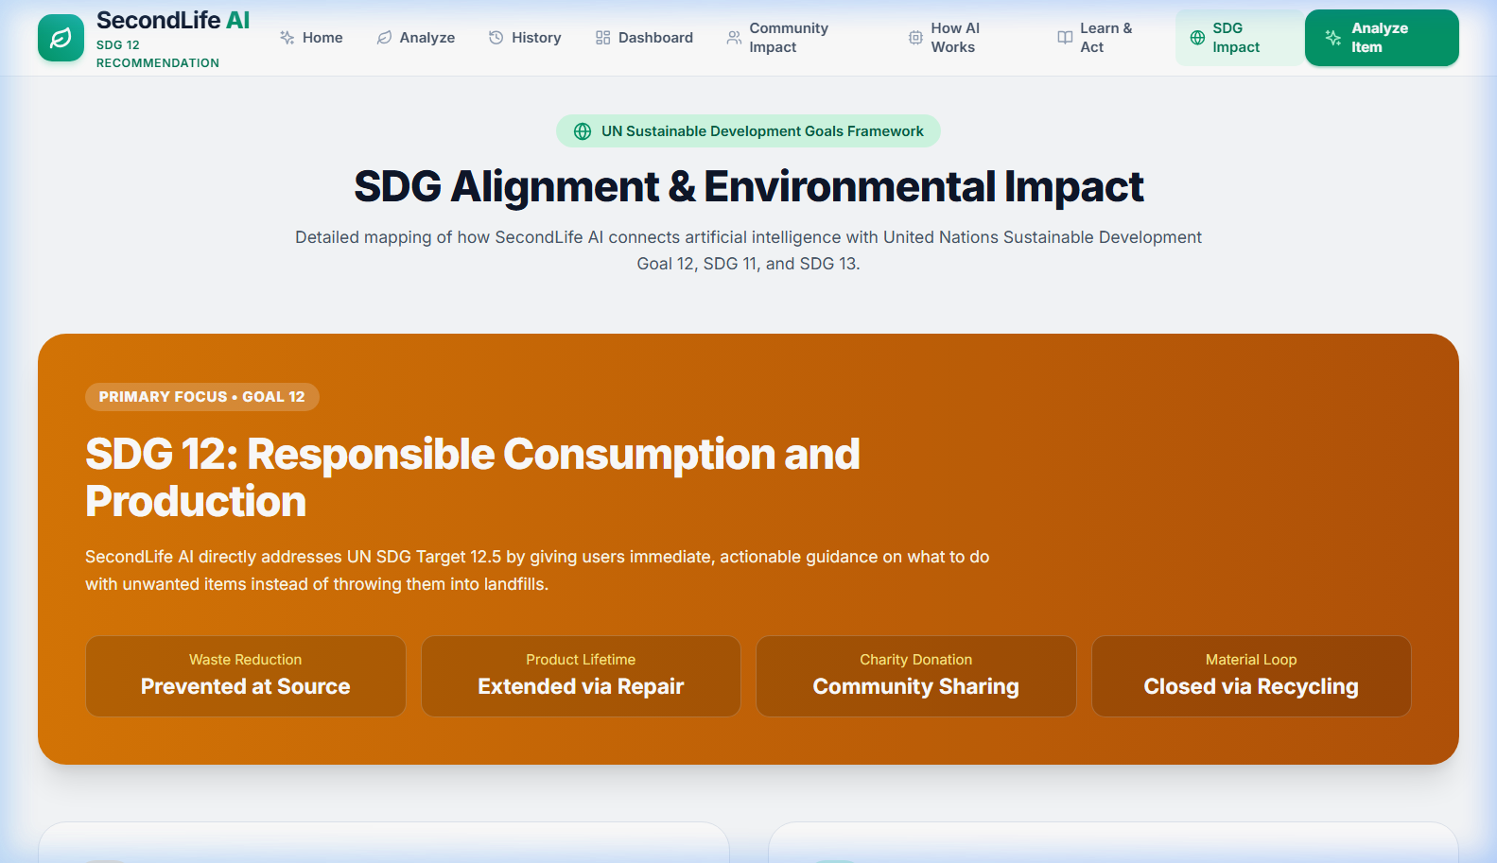
ACADEMIC INTEGRITY & FRAMEWORK
UN Sustainable Development Goals Mapping Page
SDG IMPACT PAGE
Transparent Framework
• Dedicated SDG Page: Full breakdown of SDG 12, SDG 11, and SDG 13 targets.
• Material Energy Savings: Highlights facts like 95% energy saved by recycling aluminum.
• Academic Integrity: Explains qualitative impact scoring without claiming unverified carbon metrics.

Slide 10
TECHNOLOGY & HORIZON
Technical Architecture & Future Roadmap
TECHNOLOGY STACK
• Frontend: React 18, Vite, Tailwind CSS, Lucide Icons, React Router.
• Backend API: FastAPI (Python 3), Uvicorn ASGI Server, CORS Middleware.
• AI Engine: PyTorch MobileNetV2 Vision Model + Word-Boundary Keyword Normalization.
• Database & Services: SQLite 3 Engine (`secondlife.db`), QR Server API Integration.
FUTURE ROADMAP
1. Geolocation Recycling Map: Integrate OpenStreetMap / Leaflet to display nearest drop-off centers.
2. Community Marketplace API: Direct P2P item donation and second-hand exchange listing.
3. IoT Smart Sorting Bins: Connect camera modules to physical waste sorting bins for automatic item identification.

