Slide 1

Machine Learning Based Approach for Accurate Heart Disease Prediction
Course code: CSE5000
Muhammad Abdul Mukit CE18040
Minhajul Islam Tapadar CE18042
Supervised by Mohd. Sultan Ahammad
Dept. of CSE, MBSTU

Slide 2

Table of Contents
Introduction
Motivation
Research Questions
Objectives
Literature Reviews
Dataset and Features
Methodology
Results and Discussions
Limitations and Future Works
Conclusion
References
MUHAMMAD ABDUL MUKIT [CE18040] MINHAJUL ISLAM TAPADAR [CE18042] Dept. of CSE, MBSTU

Slide 3
Introduction
Heart disease is a leading cause of mortality worldwide.
Machine Learning can aids accurate heart disease detection for effective treatment.
Aim to find better machine learning models for early detection of heart diseases.
We'll explore various machine learning algorithms and compare them to find the best model for our dataset.
MUHAMMAD ABDUL MUKIT [CE18040] MINHAJUL ISLAM TAPADAR [CE18042] Dept. of CSE, MBSTU
Notes:
The brain shrinks to some degree and neurons stop functioning.
Hippocampus volume loss. GM volume loss.
The disease may develop 20 years prior to its actual exposure of symptoms.
In CN phase there is no apparent effect.
In MCI phase there are minor symptoms that are noticeable by family and friends. So memory loss.
In AD phase the brain has started to decay. Memory loss, delay in actions, bodily motor functions start to lose control. Loss in cognitive behavior. Eventually tends to fatality.
In USA estimated 5.8 million people have AD. An estimated cost of $290 billion is spent behind the care of AD patients in 2019. It is the 6th leading cause of death for age group >= 65.
According to 2018 WHO data, dementia deaths in Bangladesh is 14340 or 1.85% of total deaths. Bangladesh ranks #145 in the world. The death toll is 1358 per 100,000. There is lack of documentation, report, facility and awareness regarding Alzheimer’s in Bangladesh.

Slide 4
Motivation
The rate of heart disease patients is increasing due to unhealthy lifestyles.
There is a shortage of experts available.
Early detection and accurate diagnosis of heart disease are critical.
Finding of accurate prediction models for heart disease is challenging.
This research can help healthcare professionals make better-informed decisions and improve patient outcomes.
MUHAMMAD ABDUL MUKIT [CE18040] MINHAJUL ISLAM TAPADAR [CE18042] Dept. of CSE, MBSTU
Notes:
The brain shrinks to some degree and neurons stop functioning.
Hippocampus volume loss. GM volume loss.
The disease may develop 20 years prior to its actual exposure of symptoms.
In CN phase there is no apparent effect.
In MCI phase there are minor symptoms that are noticeable by family and friends. So memory loss.
In AD phase the brain has started to decay. Memory loss, delay in actions, bodily motor functions start to lose control. Loss in cognitive behavior. Eventually tends to fatality.
In USA estimated 5.8 million people have AD. An estimated cost of $290 billion is spent behind the care of AD patients in 2019. It is the 6th leading cause of death for age group >= 65.
According to 2018 WHO data, dementia deaths in Bangladesh is 14340 or 1.85% of total deaths. Bangladesh ranks #145 in the world. The death toll is 1358 per 100,000. There is lack of documentation, report, facility and awareness regarding Alzheimer’s in Bangladesh.

Slide 5
Research Questions
Why should use machine learning algorithm instead of traditional methods?
What are the most effective ML algorithms for classifying heart diseases on your Dataset?
How does the selection of different features impact the accuracy of ML algorithms?
How does the size of the dataset impact the accuracy of ML algorithms?
MUHAMMAD ABDUL MUKIT [CE18040] MINHAJUL ISLAM TAPADAR [CE18042] Dept. of CSE, MBSTU

Slide 6
Objectives
To save computational time and increase the accuracy significantly we will use ML models.
To find best algorithm, we will apply various algorithms and compare them .
To see the impact of different features, we will use Filter feature selection technique.
To see how the size of the dataset are affecting our model we will use artificial data.
MUHAMMAD ABDUL MUKIT [CE18040] MINHAJUL ISLAM TAPADAR [CE18042] Dept. of CSE, MBSTU

Slide 7
Literature Reviews
Paper reference | Title | Methods | Findings | Outcome
Devansh Shah et al. 2020 [1]. | Heart Disease Prediction using Machine Learning Techniques. | Naive Bayes Decision Tree Random Forest | Random Forest classifier are the best for Cleveland database of UCI repository of heart disease patients. | Predict Heart Disease With a performance of 91.60% accuracy.
Amanda Gonsalves et al. 2020 [2]. | Prediction of Coronary Heart Disease using Machine Learning: An Experimental Analysis. | SVM Naive Bayes Decision Tree | Naive Bayes Algorithm is the best performing classifier for this dataset. | Predict Coronary Heart Disease With a performance of 71.80% accuracy.
Senthilkumar Mohan et al. 2022 [3]. | Effective Heart Disease Prediction Using Hybrid Machine Learning Techniques. | Combining of Random Forest and Linear Method | Combining of Random Forest and Linear Method proved to be accurate in prediction of heart disease. | Classify Heart Disease with accuracy of 88.45%.
Mr.Santhana et al. 2021 [4]. | Prediction of Heart Disease Using Machine Learning Algorithms. | Naive Bayes Decision Tree | The Decision tree model has predicted the best accuracy for heart disease in this dataset. | Decision Tree got better accuracy of 91.00%.
MUHAMMAD ABDUL MUKIT [CE18040] MINHAJUL ISLAM TAPADAR [CE18042] Dept. of CSE, MBSTU

Slide 8
Dataset and Features Description
The dataset is collected from the kaggle site, which is originally, came from the CDC and is a major part of the Behavioral Risk Factor Surveillance System (BRFSS).
The dataset consists of information from 319,795 individuals, each with 18 features. These features comprise 9 Boolean values, 5 strings, and 4 decimal numbers.
Types | Total Count | Total Percentage
Heart Disease | 27373 | 9%
Healthy Data | 292422 | 91%
Types | Total Count | Total Percentage
Heart Disease | 27373 | 9%
Non Heart Disease | 292422 | 91%
MUHAMMAD ABDUL MUKIT [CE18040] MINHAJUL ISLAM TAPADAR [CE18042] Dept. of CSE, MBSTU

Slide 9
Methodology
Start
Initial dataset
Removing null values
Feature Encoding
Filter Feature Selection Method
Feature
Extraction
Load Data
Data
Pre-processing
Over-sampling Using SMOTE
Creating Artificial
Data
Healthy Data
Logistic Regression
Decision Tress
Random Forest
Naive Bayes
KNN
Gradient Boosting
Prediction
Train /Test : 80/20
Splitting Train and
Test Data
Heart Disease
Performance
Analysis
Classification
Models
MUHAMMAD ABDUL MUKIT [CE18040] MINHAJUL ISLAM TAPADAR [CE18042] Dept. of CSE, MBSTU

Slide 10
Start
Initial dataset
Removing null values
Feature Encoding
Data
Pre-processing
Load Data
Filter Feature Selection Method
Feature
Selection
Over-sampling Using SMOTE
Creating Artificial
Data
Train /Test : 80/20
Splitting Train and
Test Data
Healthy Data
Logistic Regression
Decision Tress
Random Forest
Naive Bayes
KNN
Gradient Boosting
Training Classification
Models
Prediction
Heart Disease
Performance
Analysis

Slide 11
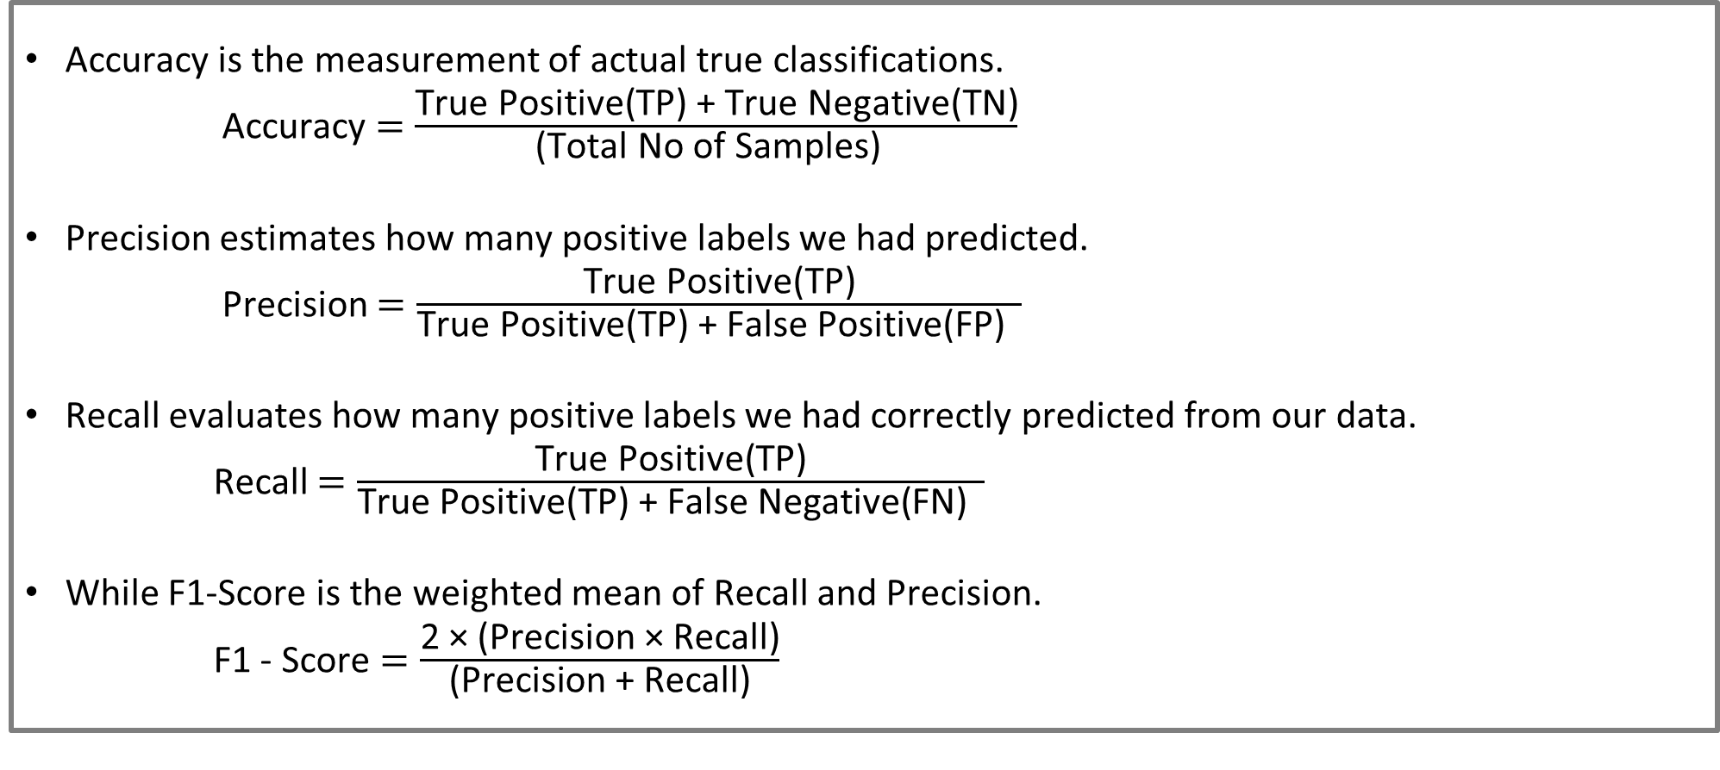
Results and Discussions
Accuracy is the measurement of actual true classifications.
Accuracy $=\frac{\text{True} \text{Positive}\text{(}\text{TP}\text{) + }\text{True} \text{Negative}\text{(}\text{TN}\text{)}}{\text{(}\text{Total} \text{No} \text{of} \text{Samples}\text{) }}$
Precision estimates how many positive labels we had predicted.
Precision $=\frac{\text{True} \text{Positive}\text{(}\text{TP}\text{)}}{\text{True} \text{Positive}\text{(}\text{TP}\text{) + }\text{False} \text{Positive}\text{(}\text{FP}\text{) }}$
Recall evaluates how many positive labels we had correctly predicted from our data.
Recall $=\frac{\text{True} \text{Positive}\text{(}\text{TP}\text{)}}{\text{True} \text{Positive}\text{(}\text{TP}\text{) + }\text{False} \text{Negative}\text{(}\text{FN}\text{) }}$
While F1-Score is the weighted mean of Recall and Precision.
F1 - Score $=\frac{\text{2 }\text{× (}\text{Precision}\text{ × }\text{Recall}\text{)}}{\text{(}\text{Precision}\text{ + }\text{Recall}\text{)}}$
MUHAMMAD ABDUL MUKIT [CE18040] MINHAJUL ISLAM TAPADAR [CE18042] Dept. of CSE, MBSTU

Slide 12
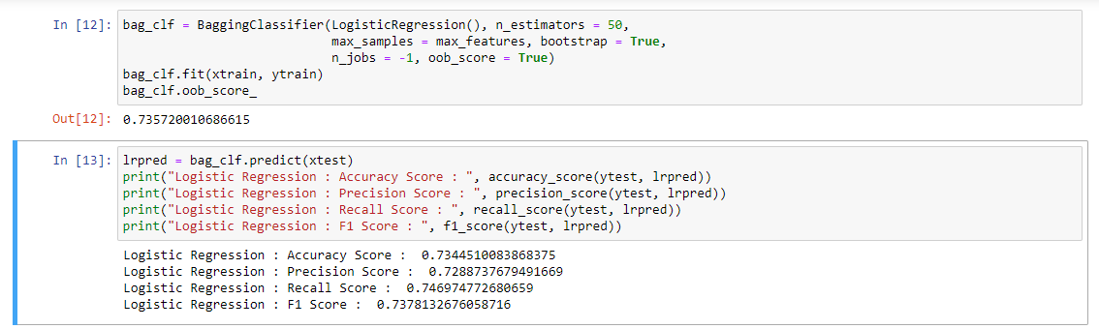
Results and Discussions (Cont.)
Logistic Regression Classifier:
MUHAMMAD ABDUL MUKIT [CE18040] MINHAJUL ISLAM TAPADAR [CE18042] Dept. of CSE, MBSTU

Slide 13
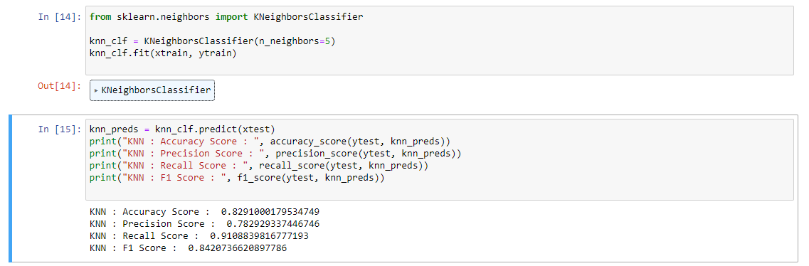
Results and Discussions (Cont.)
KNN Classifier:
MUHAMMAD ABDUL MUKIT [CE18040] MINHAJUL ISLAM TAPADAR [CE18042] Dept. of CSE, MBSTU

Slide 14
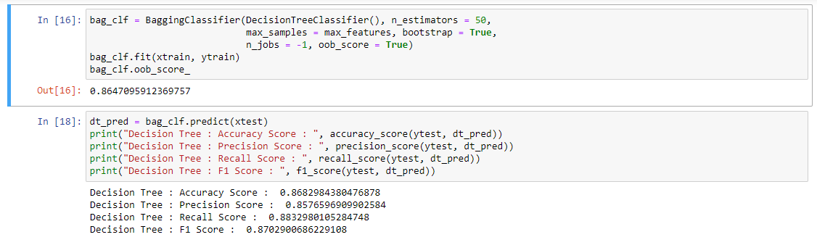
Results and Discussions (Cont.)
Decision Tree Classifier:
MUHAMMAD ABDUL MUKIT [CE18040] MINHAJUL ISLAM TAPADAR [CE18042] Dept. of CSE, MBSTU

Slide 15
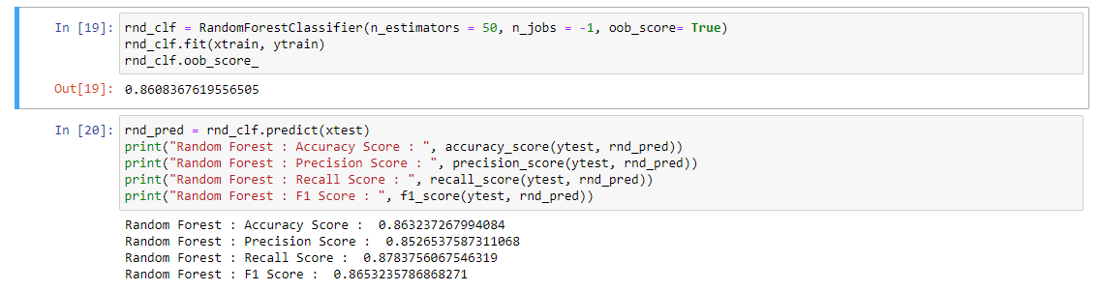
Results and Discussions (Cont.)
Random Forest Classifier:
MUHAMMAD ABDUL MUKIT [CE18040] MINHAJUL ISLAM TAPADAR [CE18042] Dept. of CSE, MBSTU

Slide 16
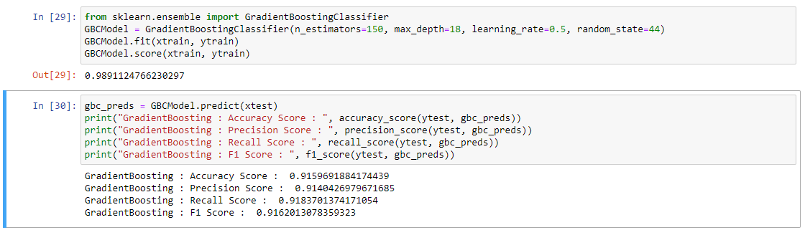
Results and Discussions (Cont.)
Gradient Boosting Classifier:
MUHAMMAD ABDUL MUKIT [CE18040] MINHAJUL ISLAM TAPADAR [CE18042] Dept. of CSE, MBSTU

Slide 17
Results and Discussions (Cont.)
Classifier | TP | FP | FN | TN
Logistic Regression | 43699 | 16256 | 14809 | 42205
Decision Tree | 51611 | 8553 | 6897 | 49908
Naive Beys | 38772 | 15583 | 19736 | 42878
Random Forest | 51350 | 8866 | 7158 | 49595
KNN | 53685 | 14776 | 5214 | 43685
Gradient Boosting | 53732 | 5053 | 4776 | 53408
MUHAMMAD ABDUL MUKIT [CE18040] MINHAJUL ISLAM TAPADAR [CE18042] Dept. of CSE, MBSTU

Slide 18
Results and Discussions (Cont.)
Classifier | Accuracy | Precision | Recall | F1-Score
Logistic Regression | 73.445% | 72.887% | 74.697% | 73.781%
KNN | 82.910% | 78.292% | 91.088% | 84.207%
Decision Tree | 86.829% | 85.765% | 88.329% | 87.029%
Random Forest | 86.323% | 85.265% | 87.837% | 86.532%
Naive Bayes | 69.803% | 71.341% | 66.240% | 68.696%
Gradient Boosting | 91.596% | 91.042% | 91.837% | 91.620%
MUHAMMAD ABDUL MUKIT [CE18040] MINHAJUL ISLAM TAPADAR [CE18042] Dept. of CSE, MBSTU

Slide 19
Results and Discussions (Cont.)
Figure: False Negative count plot for different Classifier
MUHAMMAD ABDUL MUKIT [CE18040] MINHAJUL ISLAM TAPADAR [CE18042] Dept. of CSE, MBSTU

Slide 20
Limitations and Future Works
Limitations:
More accuracy can be achieved .
Only work for Binary classification. Multimodal heart diseases can’t be predicted.
Future Work:
Need to create more hybrid model to improve the accuracy.
Need to develop a hybrid model to classify different types of heart diseases.
MUHAMMAD ABDUL MUKIT [CE18040] MINHAJUL ISLAM TAPADAR [CE18042] Dept. of CSE, MBSTU

Slide 21
Conclusion
Our study focused on early binary heart disease diagnosis using machine learning techniques.
Various classification algorithms were employed, with gradient boosting showing the most promising results with accuracy of 91.596%.
Further research is encouraged to explore the complex relationships between features and the target variable to increase the accuracy.
MUHAMMAD ABDUL MUKIT [CE18040] MINHAJUL ISLAM TAPADAR [CE18042] Dept. of CSE, MBSTU

Slide 22
References
Devansh Shah, Samir Patel, Santosh Kumar Bharti et al. "Heart Disease Prediction using Machine Learning Techniques" SN Computer Science (2020) 1:345 https://doi.org/10.1007/s42979-020-00365-y
Amanda H. Gonsalves ,Fabi Thabtah , Rami Mustafa A. Mohammad , Gurpreet Singh et al. “Prediction of Coronary Heart Disease using Machine Learning: An Experimental Analysis” https://dl.acm.org/doi/10.1145/3342999.3343015
Senthil Kumar Mohan, Chandrasegar Thirumalai and Gautam Srivastva et al. “Effective Heart Disease Prediction Using Hybrid Machine Learning Techniques” IEEE Access 2022.
Santhana, Dr. Geetha Et al. “Prediction of Heart Disease Using Machine Learning Algorithm”.
MUHAMMAD ABDUL MUKIT [CE18040] MINHAJUL ISLAM TAPADAR [CE18042] Dept. of CSE, MBSTU

Slide 23
Thank You ☺

