Slide 1
Lighting A Bulb Project
By Group 04
Group Members :
Rafa Jahan(23-54836-3)
MD.Minhajul Shariar Zaman Alif(23-53176-3)
SM Mushfiqur Rahman (23-55124-3)
Sanjida Akter (23-54146-3)
Rafiul Islam Rifat (23-55141-3)

Slide 2
Table of contents
Introduction
Objectives
Components Required
Circuit Diagram
Working Process
Implementation steps
Observations and Results
Conclusion

Slide 3
Introduction
Electrical circuits are essential in our daily lives, powering everything from household lighting to complex electronic devices. This project focuses on understanding the basics of electrical circuits by demonstrating how to light a bulb using a simple setup. Through this experiment, we will explore the fundamental components required to complete a circuit and analyze how electrical energy is transferred to produce light. This project provides a basic understanding of circuits, which is crucial for more advanced electrical and electronic applications.

Slide 4
Objectives :
To understand the working of a basic electrical circuit.
To construct a simple circuit that successfully lights a bulb.
To identify and explain the roles of different components in the circuit.

Slide 5
Components Required :
Battery: Provides electrical energy.
Bulb: The load that emits light when powered.
Wires: Conduct electricity between components.
Breadboard: (If used) Helps in circuit prototyping without soldering.
Conductor: A material allowing electric flow with low resistor
Inductor: A coil storing energy in a magnetic field
Resistor: A component limiting electric current flow and voltage

Slide 6
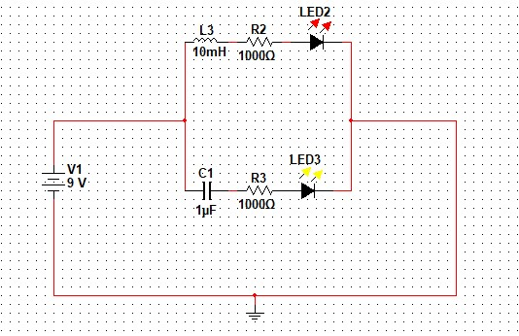
Circuit Diagram :

Slide 7
Working Process :
The battery provides electrical energy.
As it is a DC circuit the current will not pass through the conductor because in DC circuit conductor will act as an open circuit
The current will pass through the inductor because in DC circuit the inductor will act as a short path
The electrical current flows through the wires and reaches the bulb.
The bulb lights up as electrical energy is converted into light and heat energy.

Slide 8
Implementation Steps :
Connect the positive terminal of the battery to one end of the wire.
Connect the other end of the wire to the another end of the terminal.
Attach the bulb’s terminal to one end of the resistor and other end of the terminal of the breadboard
Attach the resistor to one end of the inductor and another end of the bulb
The same other resistor will be attached to one end of the conductor and another end of the another bulb
In the parallel circuit one bulb will be lightened and another bulb will not

Slide 9
Observations & Results :
The bulb successfully lights up when the circuit is completed.
If the bulb does not light up, possible causes include
1. Loose connections
2. Battery not providing sufficient power
3. Bulb damage

Slide 10
Conclusion :
The project shows the fundamentals of an electrical circuit.
It highlights the importance of a complete circuit for current flow.

