Slide 1
ENGI 9839 · SOFTWARE VERIFICATION & VALIDATION · PROJECT PRESENTATION
Verification & Validation of Concurrent State
in a Time-Bounded Auction
AuctionEdge — testing what happens when two bids, two wallets, and a closing clock all move at the same instant.
Md Minhajul Abedin · 202483033 Nabil Hasan · 202488877 19 July 2026

Slide 2
THE PROBLEM
Concurrency bugs are invisible to a single test run
• A unit test proves a function returns the right value — once.
• It can't show what happens when two users hit that function at the same instant.
• Auctions live on exactly that edge: simultaneous bids, a shared wallet, a closing-moment race.
So instead of trusting one technique, we layered six of them — and measured what each one actually caught.
AuctionEdge · ENGI 9839
02 / 16

Slide 3

SYSTEM UNDER TEST
AuctionEdge
A from-scratch, time-bounded auction platform — FastAPI · PostgreSQL · React.
• Place a bid, retract within a fixed window
• System-triggered auto-close
• Bid history with masked identities
• Outbid / won / lost notifications
Live Auctions — frontend screenshot
Drop in the Browse page screenshot here
no-lost-update: final price = highest accepted bid
wallet hold ≤ balance, even under double-spend
AuctionEdge · ENGI 9839
03 / 16

Slide 4
FOUR RESEARCH QUESTIONS
What we set out to answer
RQ1 · RACE CONDITIONS
Does the system serialize concurrent bids correctly and resolve genuine timestamp ties?
RQ2 · MUTATION ADEQUACY
Does the suite actually catch boundary-comparison faults (> vs >=), not just cover the lines?
RQ3 · GENERATED EDGE CASES
Does automated, generated input find cases a hand-written boundary table would miss?
RQ4 · LOCKING STRATEGIES
How does app-level pessimistic locking compare to database SERIALIZABLE isolation?
AuctionEdge · ENGI 9839
04 / 16

Slide 5
LITERATURE REVIEW
The techniques we layered — and where they come from
MUTATION TESTING · [1] [2]
DeMillo et al. proposed injecting small faults to judge a suite’s quality, not the program’s. Jia & Harman’s survey covers the comparison-operator mutation (> ↔ >=) that grounds RQ2.
PROPERTY-BASED & GENERATED INPUT · [3] [4] [5]
State an invariant once; a generator searches for a counterexample. Hypothesis (MacIver et al.) — descendant of Claessen & Hughes’ QuickCheck — drove RQ3 instead of King-style symbolic execution.
CONCURRENCY CONTROL & ISOLATION · [6] [7]
Gray & Reuter’s treatment of locking and deadlock avoidance motivated the fixed lock-ordering rule. Berenson et al.’s ANSI-isolation critique frames the abort-and-retry vs. block contrast tested in RQ4.
EXPLORATORY & TEST-DESIGN FOUNDATIONS · [8] [9] [10]
Whittaker’s tour-based taxonomy framed exploratory testing as mission-driven, not random. Myers et al. and Ammann & Offutt supply equivalence partitioning, BVA, and the coverage-criteria vocabulary.
AuctionEdge · ENGI 9839
05 / 16

Slide 6
METHODOLOGY
Six techniques, five test tiers
Tier | Tests | Technique | Targets
core/ | 114 | White-box, BVA, MCC, equivalence | Pure bidding & wallet logic, no I/O
property/ | 6 | Property-based (Hypothesis) | 4 invariants, ~100 generated cases each
integration/ | 59 | Contract + integration + fuzzing | Real DB, bid→wallet→notify chain
concurrency/ | 5 | Real-thread harness | Race conditions — RQ1 & RQ4
system/ | 4 | Full stack, real Docker network | End-to-end over real HTTP
Plus mutation testing (mutmut), run separately over core/ as the RQ2 adequacy check · 188 tests total
AuctionEdge · ENGI 9839
06 / 16

Slide 7
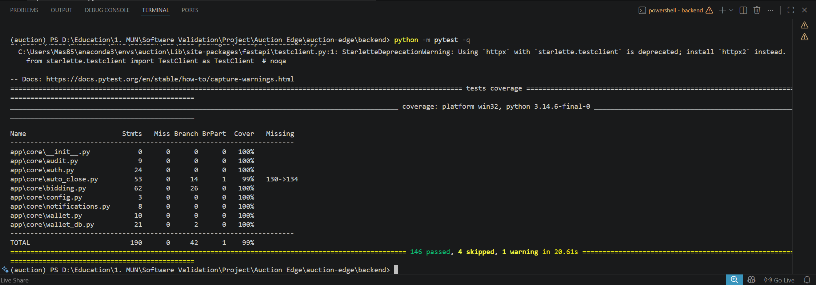
RESULTS
The full suite, all green
188
TESTS, ALL PASSING
99%
BRANCH COVERAGE
100%
MUTATION KILL RATE
AuctionEdge · ENGI 9839
07 / 16

Slide 8
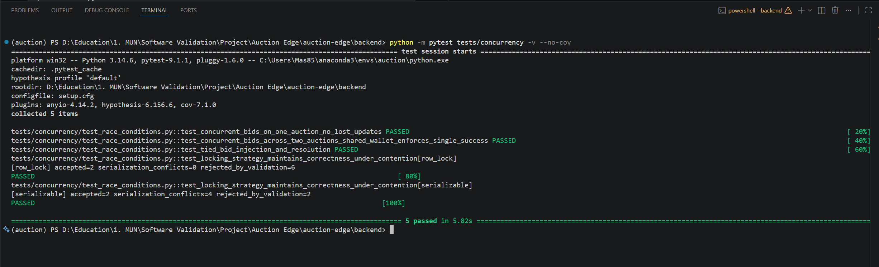
RQ1 — RACE CONDITIONS
No lost updates, no double-spends
• 5 real OS threads bid at once → final price always equals the highest accepted bid
• Same bidder, two auctions, combined value > balance → exactly one bid succeeds
• Injected identical-timestamp bids → resolve to exactly one winner
• Auto-close run twice → exactly one closure logged
AuctionEdge · ENGI 9839
08 / 16

Slide 9
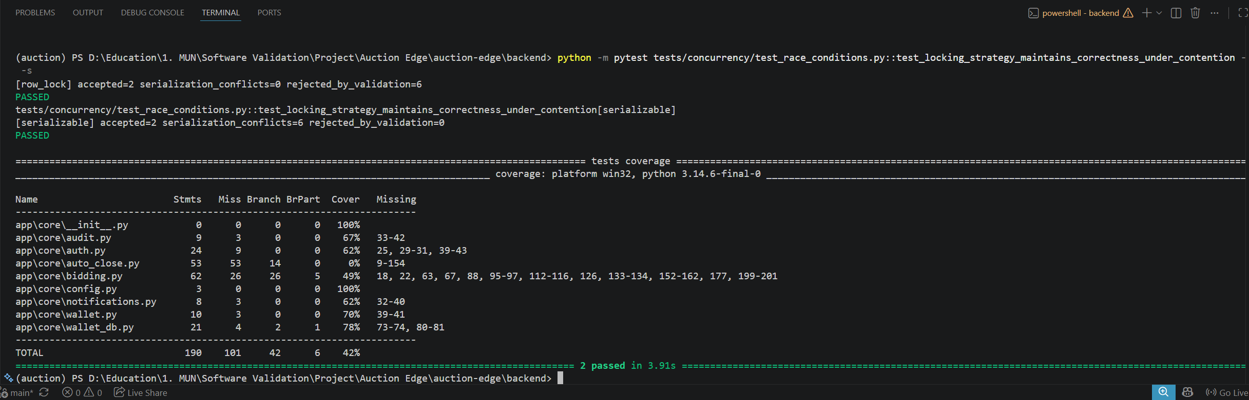
RQ4 — LOCKING STRATEGIES
Row locks vs. SERIALIZABLE isolation
Strategy | Accepted | Conflicts | Clean rejects
row_lock (default) | 2 | 0 every run | 6
serializable | 2 | 4–6 across runs | 0–2
Both stay correct. They differ in mechanism: locking queues and blocks; SERIALIZABLE lets the loser pass validation, then aborts it at commit.
AuctionEdge · ENGI 9839
09 / 16

Slide 10
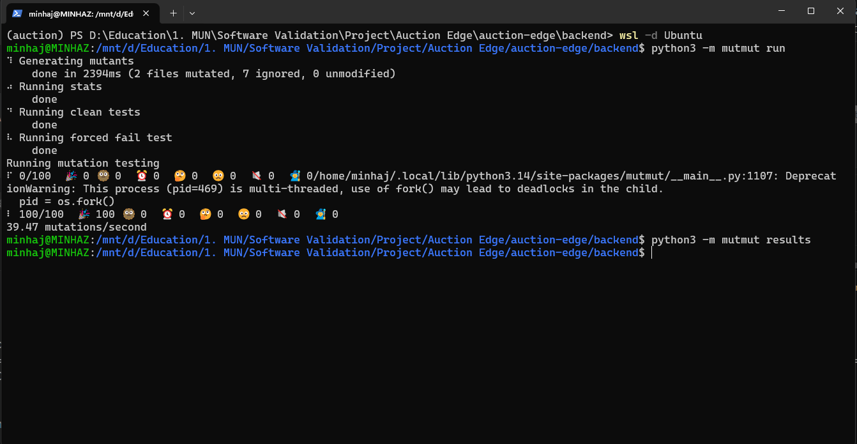
RQ2 — MUTATION TESTING
100 mutants, 0 survivors
100/100
MUTANTS KILLED
Coverage alone can't prove a comparison is checked correctly — a fully branch-covered line can still hide a fault nothing verifies. Mutation testing is what actually tests the tests.
AuctionEdge · ENGI 9839
10 / 16

Slide 11
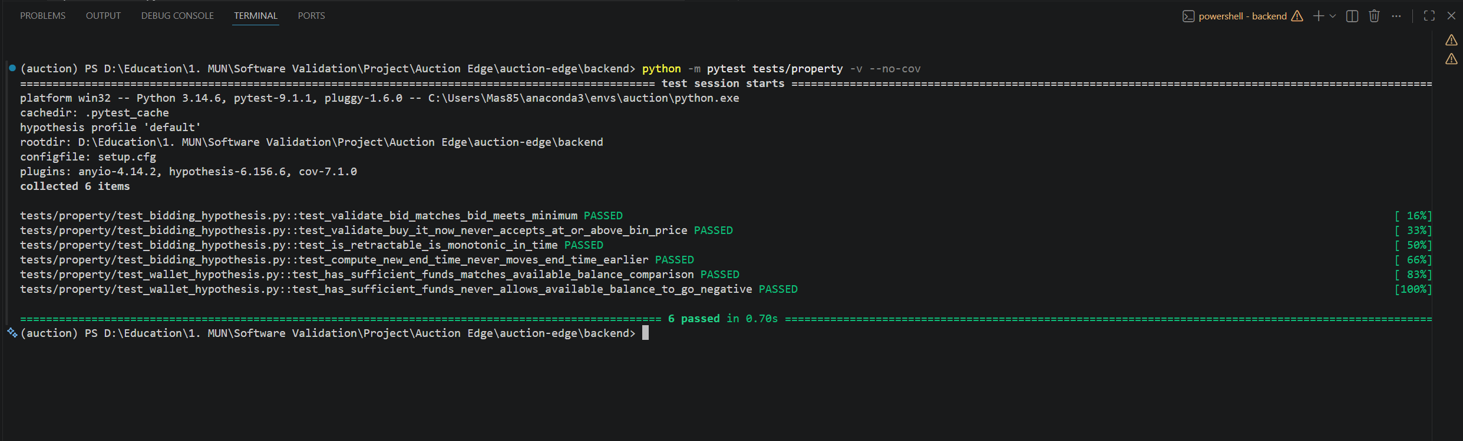
RQ3 — PROPERTY-BASED TESTING
Letting the computer pick the edge cases
6 properties × ~100 auto-generated examples each — 0 counterexamples found across bid validation, Buy-It-Now, retraction monotonicity, and the wallet-hold invariant.
AuctionEdge · ENGI 9839
11 / 16

Slide 12
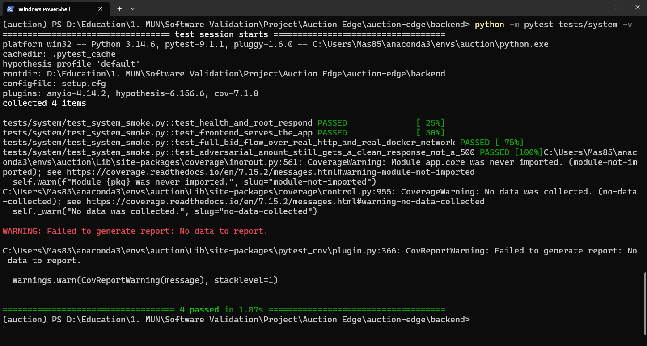
SYSTEM TESTING
The real, deployed stack
Postgres + backend + frontend — three Docker containers, real HTTP, real network.
This tier alone caught a real bug: the placeholder email domain used everywhere else in the suite is correctly rejected by real registration — because it's the only tier that ever calls that endpoint.
AuctionEdge · ENGI 9839
12 / 16

Slide 13
WHAT WE ACTUALLY FOUND
Four real bugs, four different tiers
01 NaN / Infinity crash
HTTP-BOUNDARY FUZZING
Server 500'd on a “valid” JSON number instead of a clean rejection. Fixed & regression-tested.
02 Registration email gap
SYSTEM TESTING
The only tier that ever calls the real /auth/register endpoint.
03 “Pay Now” never disappears
EXPLORATORY TESTING
Button has no idea the auction already closed or was charged.
04 300-char title breaks layout
EXPLORATORY TESTING
Item page has no truncation; Browse page does.
Each bug was invisible to every other tier — different techniques structurally see different faults.

Slide 14
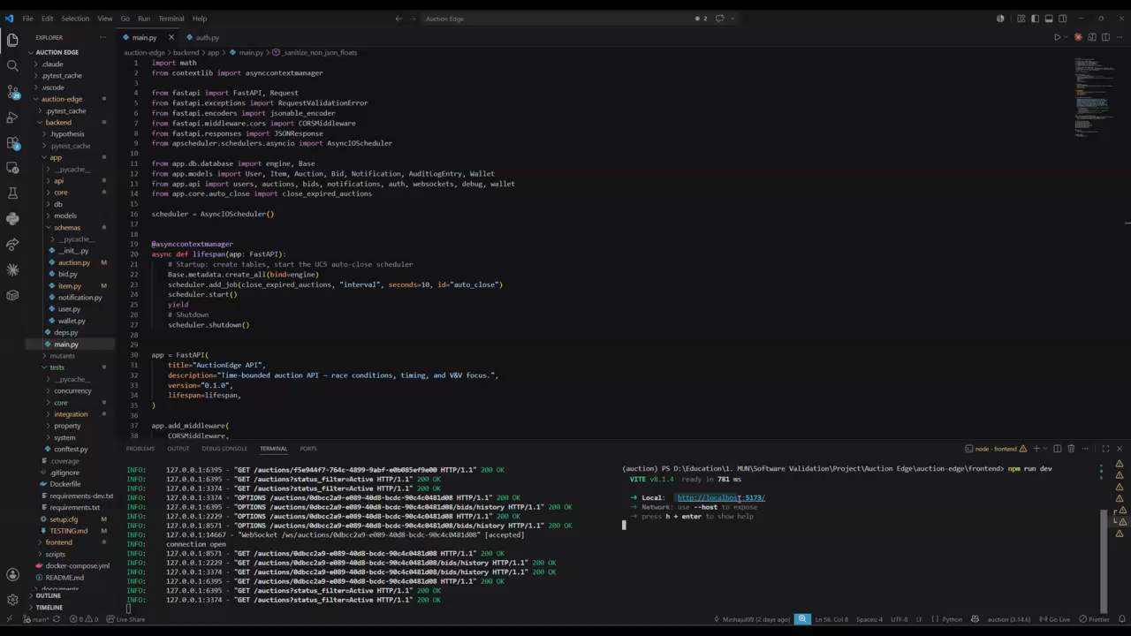
LIVE DEMO
Demo video
AuctionEdge · ENGI 9839
14 / 16

Slide 15
CONCLUSION
Test adequacy is a stronger claim than test coverage
188
TESTS
99%
COVERAGE
100%
MUTATION KILL
4
REAL BUGS FOUND
Six techniques, four research questions, one result: different tools see different faults — layering them is what actually finds bugs. Next: formal specification (TLA+) of the wallet-hold and auto-close invariants.
Thank you.
Questions?

Slide 16
REFERENCES
Bibliography
[1] R. A. DeMillo, R. J. Lipton, and F. G. Sayward, “Hints on test data selection: Help for the practicing programmer,” Computer, vol. 11, no. 4, pp. 34–41, Apr. 1978.
[2] Y. Jia and M. Harman, “An analysis and survey of the development of mutation testing,” IEEE Transactions on Software Engineering, vol. 37, no. 5, pp. 649–678, Sept.–Oct. 2011.
[3] K. Claessen and J. Hughes, “QuickCheck: A lightweight tool for random testing of Haskell programs,” in Proc. 5th ACM SIGPLAN Int. Conf. Functional Programming (ICFP ’00), 2000, pp. 268–279.
[4] J. C. King, “Symbolic execution and program testing,” Communications of the ACM, vol. 19, no. 7, pp. 385–394, July 1976.
[5] D. MacIver, Z. Hatfield-Dodds, and Contributors to Hypothesis, “Hypothesis: A new approach to property-based testing,” Journal of Open Source Software, vol. 4, no. 43, p. 1891, 2019.
[6] J. Gray and A. Reuter, Transaction Processing: Concepts and Techniques. San Francisco, CA: Morgan Kaufmann, 1993.
[7] H. Berenson, P. Bernstein, J. Gray, J. Melton, E. O’Neil, and P. O’Neil, “A critique of ANSI SQL isolation levels,” in Proc. ACM SIGMOD Int. Conf. Management of Data, 1995, pp. 1–10.
[8] J. A. Whittaker, Exploratory Software Testing: Tips, Tricks, Tours, and Techniques to Guide Test Design. Upper Saddle River, NJ: Addison-Wesley, 2010.
[9] G. J. Myers, C. Sandler, and T. Badgett, The Art of Software Testing, 3rd ed. Hoboken, NJ: Wiley, 2011.
[10] P. Ammann and J. Offutt, Introduction to Software Testing, 2nd ed. Cambridge, U.K.: Cambridge University Press, 2016.
AuctionEdge · ENGI 9839
16 / 16

