Slide 1

Project Title – Seasonal Agriculture Performance Analysis
Student Name :- Minhaz Fathmin
College Name- Ajay Binay Institute of Technology
AICTE STU ID : STU65452f3e1f7201699032894

Slide 2

PROBLEM STATEMENT
Agricultural activities are influenced by seasonal variations in environmental conditions, farming practices, resource availability and market conditions. As a result, agricultural performance may differ from one season to another. However, raw agricultural data does not clearly explain how agricultural performance changes across seasons or what patterns can be observed in different seasonal conditions. The problem is to analyze the given agricultural dataset and investigate seasonal differences in agricultural performance by identifying meaningful patterns, trends, relationships and variations within the available data.

Slide 3
Project Description
This project analyzes a dataset of 4,000 farm records across 8 states, 8 crops and 3 seasons (Kharif, Rabi, Zaid) to understand how agricultural performance yield, profit, resource usage and environmental conditions varies by season. The analysis involved data cleaning, exploratory analysis, statistical testing (ANOVA, chi-square) and visualization to identify significant seasonal patterns and deliver evidence based recommendations for seasonal agricultural planning. Key findings include identifying Zaid as the highest risk season across all states and showing that crop choice and water efficiency matter more than yield alone in determining farm profitability.

Slide 4

WHO ARE THE END USERS?
Farmers and agricultural cooperatives planning crop and irrigation strategy by season
State agricultural departments designing seasonal support/subsidy programs
Agricultural policy makers and planners
Agri finance and insurance providers assessing seasonal risk
Researchers and students studying agricultural data patterns

Slide 5

Technology Used
  Python
  Pandas, NumPy :- data cleaning and analysis
  Matplotlib, Seaborn :- visualization
  SciPy (stats) :- ANOVA, chi-square, correlation testing
  Google Colab Notebook :- analysis environment

Slide 6
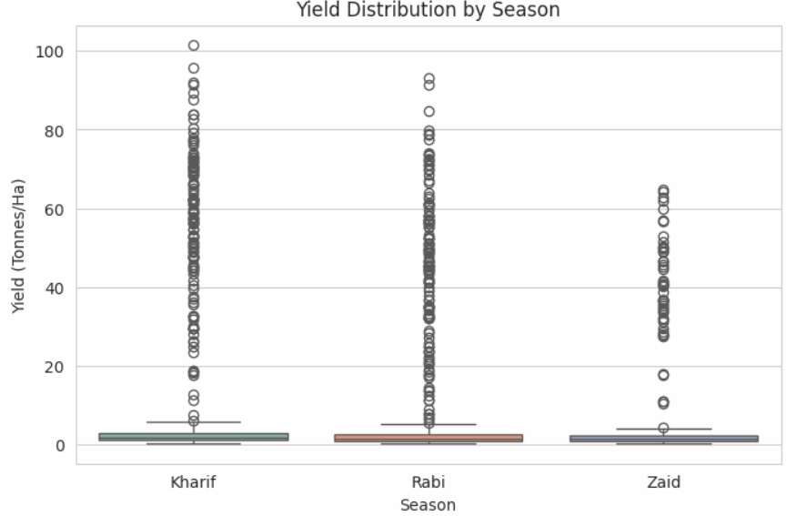
RESULTS
Yield is heavily right skewed across all seasons most farms cluster at
low values (median ~1.7 t/ha) while a small number of high yield farms
(mainly Sugarcane) reach up to 100 t/ha. Zaid has the lowest yield ceiling
of the three seasons.

Slide 7
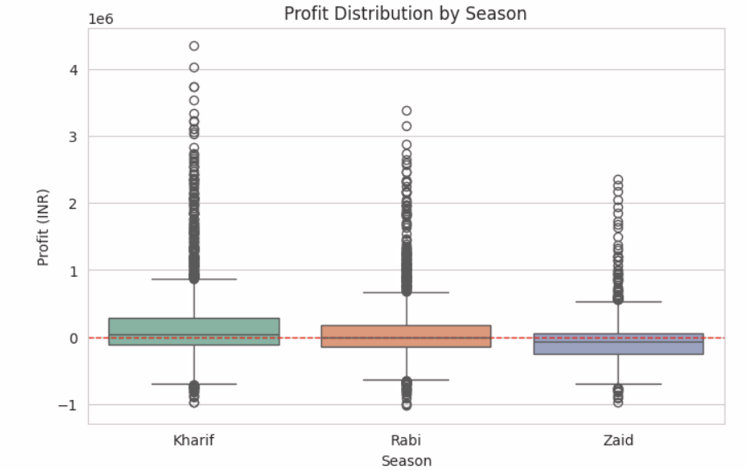
RESULTS
Kharif is the only season with a median profit clearly above the
Break even line Rabi hovers near breakeven while Zaid's typical farm
runs a loss consistent with Zaid having the highest share of
Loss making farms (64.5%).

Slide 8
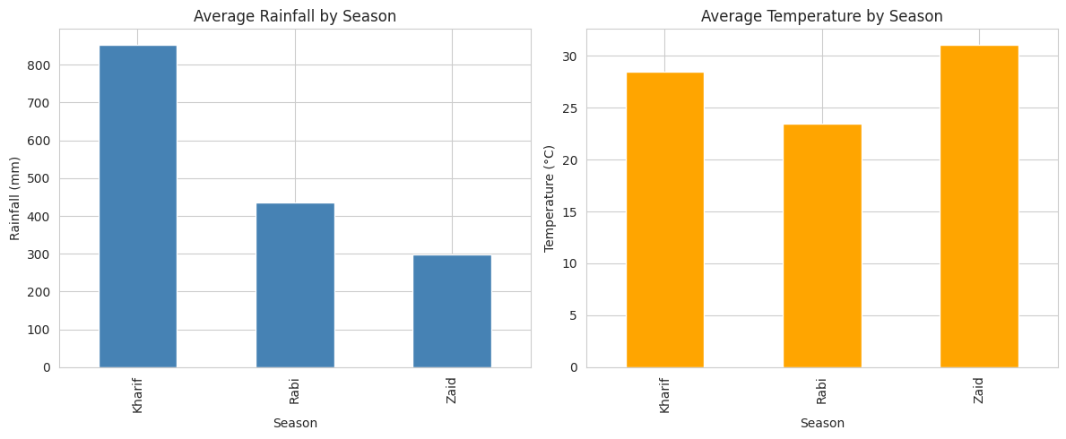
RESULTS
Rainfall declines steadily from Kharif (852 mm) to Rabi (436 mm) to Zaid
(299 mm) while temperature follows the opposite trend dipping in Rabi
(23.5°C) before peaking in Zaid (31°C). This confirms Zaid's identity as
the hot, dry summer season.

Slide 9
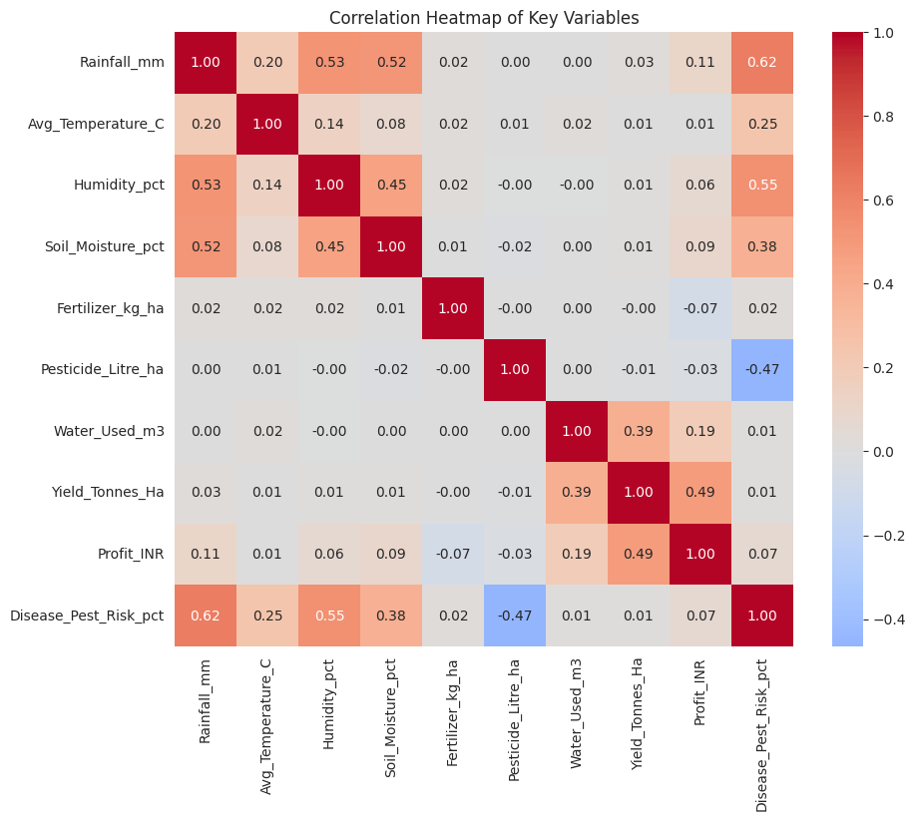
RESULTS
Yield and Profit are moderately correlated (0.49). Disease or Pest Risk is
strongly linked to Rainfall (0.62) and Humidity (0.55) and negatively
linked to Pesticide use (-0.47). Fertilizer shows almost no correlation
with Yield or Profit input quantity alone doesn't explain performance.

Slide 10
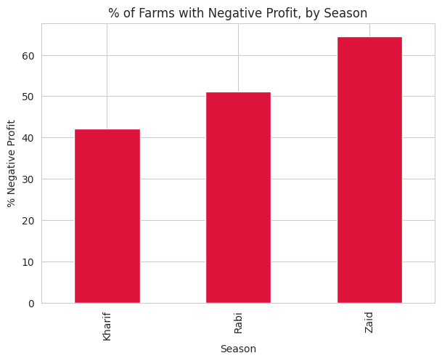
RESULTS
The share of loss-making farms rises sharply by season 42.2% in
Kharif, 51.1% in Rabi and 64.5% in Zaid making Zaid the clearest
priority for financial risk intervention.

Slide 11
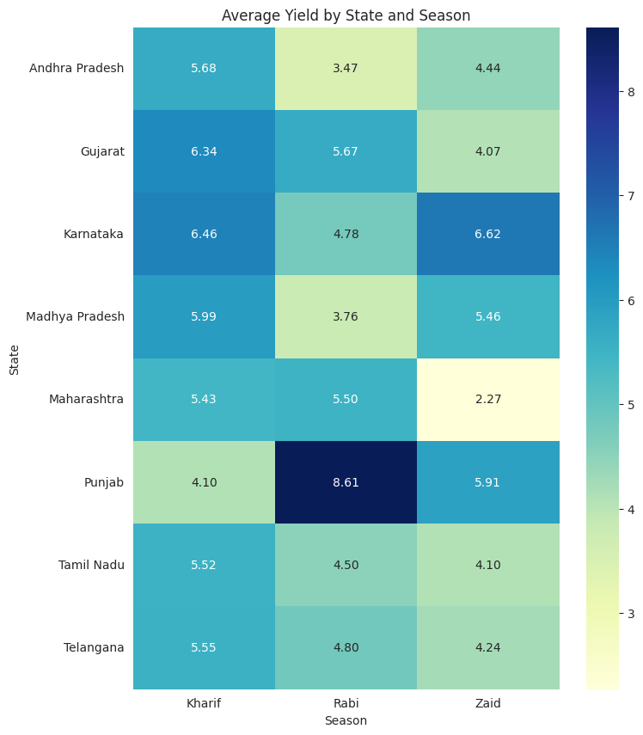
RESULTS
Yield-by-season patterns aren't uniform across states most follow the
Kharif dominant trend but Punjab peaks in Rabi (8.61 t/ha) and Karnataka
peaks in Zaid (6.62 t/ha) showing some states need season specific
planning rather than a one size fits all approach.

Slide 12
Future scope
Extend analysis to include more states orregions for broader generalization
Incorporate market price trends and weather forecasting for predictive planning
Apply outlier robust or non parametric statistical tests given the skew
in yield or profit data
Build a seasonal planning dashboard for real time decision support
Study causal factors (not just correlation) behind Zaid's consistent losses

Slide 13
GitHub Link
https://github.com/Minhaz-04/Seasonal_Agriculture_Performance_Analysis.git

Slide 14

VOIS Course completion certificate -
Course name- Data Visualization

Slide 15
Thank you
.
.

