Slide 1
C5/C9 裂解产品市场洞察
Q3 2026 Outlook · Market Data
01 / PRESENTATION

Slide 2
关键指标
01
02
¥920.97M (+6.2%)
101.47K tons (+3.1%)
总营收
总销量
02 / 06

Slide 3
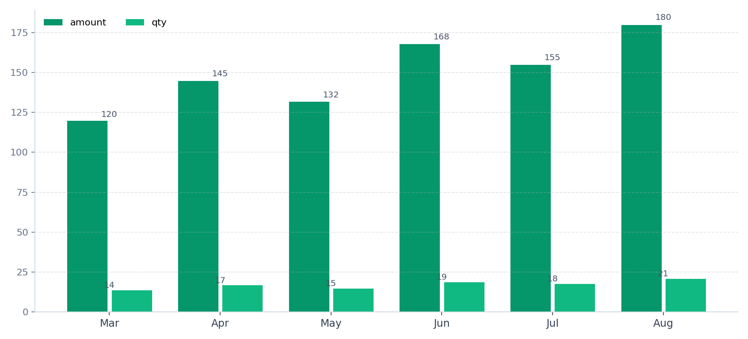
月度趋势与波动
01
Mar — amount: 120; qty: 14
02
Apr — amount: 145; qty: 17
03
May — amount: 132; qty: 15
04
Jun — amount: 168; qty: 19
05
Jul — amount: 155; qty: 18
06
Aug — amount: 180; qty: 21
03 / 06

Slide 4
产品线结构
01
02
¥205.2M Material
¥168.9M Material
C5树脂 · Revenue:
C9 · Revenue:
04 / 06

Slide 5
EXECUTIVE SUMMARY
战略建议
01
02
03
加大 C5 树脂产能
利用率
评估 SIS 扩产
05 / 06

Slide 6
THANK YOU
Thank You
06 / 06

