Slide 1

CASE STUDY:
ACME CORPORATION
A SPEND ANALYTIC REPORT IN EUR(€)
FISCAL YEAR 2021 - 2022
Speaker: Minh Tran, Helsinki, 2023

Slide 2

About me
Notable:
3 years working as M&A consultant and Auditor at PwC.
Knows how to build boats! (well, part of it).
Founded my own restaurant, had tons of food and fun.
Extremely enthusiastic in computer literacy.
Loves Excel, SQL, Python, good food.
Loves public speaking even if preparing for it is scary!
Still loves playing video games during free times.

Slide 3
Highlights
1. Materials and Vendors
2. Trend Analysis
3. “Anomalies”
4. A closer look at leading material consumption
5. Opportunity for saving
6. Q&A

Slide 4
Materials and Vendors (1/2)
Notes:
This chart here represent how significant Metal Bros Shanghai is as a vendor to our subsidiary, amounting 1/3 of 2022’s total procurement expenditure
We will be seeing this name Metal Bros Shanghai a lot more in the next part of the report
Next, we have a look at materials and vendors.

Slide 5
Materials and Vendors (2/2)
Notes:
The Motor IP20 accumulated almost 80% total spent by category across the group. Which makes sense since it is our group’s leading product’s materials
Of which, is dominatingly supplied by Metal Bros Shanghai, at 44%. To put in perspective, come in second, is HH Metal Kft in Hungary with almost 16%

Slide 6
Trend analysis - Spend by Months and Quarters
Notes:
The trend of buying provided by these two charts provided us a peak season between second and third quarter, specifically, in Jul.
Although differs in amount, the trend stays the same between two years.

Slide 7
Trend analysis – Spend by Vendors and Regions
Notes:
Here we get to see the spending by vendors and its regions. We see a particular name yet again, Metal Bros Shanghai, leading in supplying us their materials, that is, the Motor IP20.

Slide 8
Trend analysis – Spend by Subsidiaries
Notes:
ACME Man. Hungary HU
ACME Beijing Ltd CN
ACME A/S DK
ACME Manu. Ltd GB
ACME Pty. Ltd. AU
ACME (S'pore) Pte Ltd SG
ACME France FR
ACME Manufacturing US
ACME Operations A/S DK
ACME Industrifabrik DE
ACME Chicago LLC US
Correspondingly to vendors, here are spend in EUR by subsidiaries. For a subsidiary that just started, the Danish branch is investing greatly in its production line, making its way to be Europe’s HQ.
It’s worth noticing that ACME Beijing’s procurement far exceeded any other subsidiaries.
It is within expectation since this subsidiary is the Asian’s industry lead.

Slide 9
Local vs Global Vendors: Status
Notes:
On to the next section: anomalies!

Slide 10
“Anomalies” in Quantity Ordered
Notes:
Some particularly interesting data shown here in terms of quantity of materials. ACME Manufacturing US has ordered approximately 1000 units in 2022, compared to last year.
Almost 4,000% increase! What happened?

Slide 11
“Anomalies” in Quantity Ordered
Notes:
I have verified with our data engineer that these numbers are, without being amended, extracted directly from ACME group’s ERP system
There are two possible reasons:
1. vendor Cheney Industrials had a huge discount on their product, from average of 330 EUR per unit to 3 EUR per unit, in which case, I commend the team for purchasing an abundant amount of stocks that should last for a long time.
2. However, it’s likely that it’s an input mistake, two mistakes, to be precise, and they canceled each other out. If quantity purchase was 10 units, and PPU is 334 per unit, together they added correctly to the amount spent that is 3.6k USD or 3.3k EUR.
I personally think this is the case, because if we have purchased 1k units, there’s no reason to continue ordering in the next months. Not to mention logistic issues.

Slide 12
A closer look at: Motor IP 20 5.5kW
Notes:
Here we can observe how significantly more expensive Shanghai’s vendor’s PPU is, compare to other vendors that supply the same material. Which honestly, shouldn’t happen but since it is not within our investigative scope of work, we are going to leave it at it for the “what’s happening” and focus more on Prescriptive “what can we do” kind of analysis

Slide 13
Average PPU and Quantity supplied for IP20
Notes:
This is the data that support the previous chart, compliment by quantity supplied to our subsidiaries.
Hypothetically speaking, if we are to supply ACME Beijing with few of these vendors whose PPU are significantly smaller than Shanghai Vendor, what will happen?
I invite you to have a look at the world map’s distribution channels that are currently accessible to ACME subsidiaries
------------------ (after coming back)
By multiplying quantity ordered and average PPU of different vendors in 2021 and 2022, I have came up with very interesting data. It is worth mentioning that I have added a mark up of 15% transportation cost per order, which is in line with industry standard that ACME practices

Slide 14
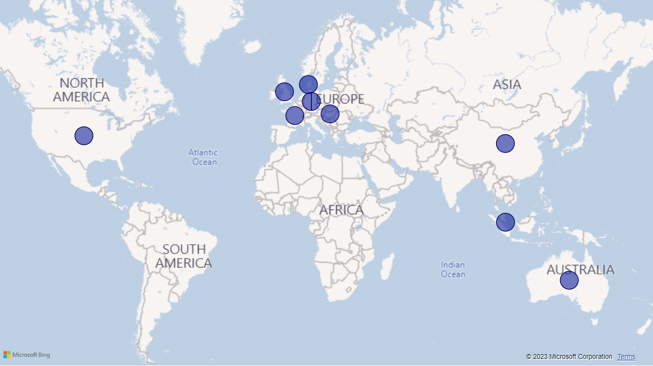
World Map of distribution channel
Notes:
Here we see the geographical stretch of current distribution channel on a global scale.
In this scenario, I have aggregated an average PPU for 5 particular vendors:
Singapore
Australia
Denmark
Germany
Hungary
Let’s go back to the previous slide

Slide 15
Opportunities: Estimated saved by Percentage

Slide 16
Opportunities: Estimated saved by EUR
Notes:
Going forward, with newly obtained information, are the suggested plans and course of actions

Slide 17
Suggested Action Plans
1. Re-negotiate vendor contract with Metal Bros Shanghai.
2. Re-negotiate vendor contracts with vendors from DK, DE, HU.
3. Consider a hybrid vendor selection.
4. Make sure ACME Manufacturing US reports are free from errors.
Notes:
I left out Australian vendors to minimize the stretch on human resources spent on negotiating contracts, especially since the saving is significantly less than the other 3
In scenarios that any of the vendors are unavailable due to unforeseen circumstances, it is ideal that we would be able to select other vendor to make sure we constantly have materials for production. A non exclusive, discussed prices with no quantity commitment would serve us best to min-max the situation.
Even though it doesn’t have that big of an impact on a group-scale, it is still a required practice to be precise, especially when audit season is coming. We are lucky this case since it did not skew our data and accounting entries, but going forward, this must not happen, assuming that it’s a human error

Slide 18
Thank you!
Q&A
A SPEND ANALYTIC REPORT
*Aggregated data in different currencies available upon request

