Slide 1



Frugal: Efficient and Economic Embedding Model Training with Commodity GPUs
Minhui Xie, Shaoxun Zeng, Hao Guo, Shiwei Gao, Youyou Lu
Tsinghua University
Renmin University

Slide 2
Background: Embedding Models
Embedding Models
Widely used in the core commercial business of modern web companies
Recommendation, ads, searching
Learning on sparse high-dimensional feature space (ID features)
User IDs, item IDs or Graph Learning (node/edge IDs)
Predicted probability
P
Deep neural network
Shim Layer: EMB layer
1
1
1
1
User ID
User recently
watched video IDs
Candidate video IDs

Slide 3
Background: Embedding Models
Embedding Models
Widely used in the core commercial business of modern web companies
Recommendation, ads, searching
Learning on sparse high-dimensional feature space (ID features)
User IDs, item IDs or Graph Learning (node/edge IDs)
Embedding Table
Predicted probability
RDMA WRITE
P
EMB
vectors
+
Pooling
Deep neural network
ID
EMB vec
Video
EMB table
EMB layer
User EMB Tbl
Video
EMB Tbl
Video
EMB Tbl
1
1
1
1
User ID
User recently
watched video IDs
IDs
Candidate video IDs
1
1

Slide 4
Background: EMB model training with multi-GPU caching
EMB models show memory intensity, caching hot EMBs in GPUs
NVIDIA HugeCTR
Ugache^{SOSP’23}, WholeGraph^{SC’22} , GNNLab ^{EuroSys’22}, etc.
Embedding Cache
GPU-HBM
RDMA WRITE
Predicted probability
P
All to All
Deep neural network
🔥
……
🔥
Hot EMBs
Cache
Cache
EMB layer
User EMB Tbl
Video
EMB Tbl
GPU₀
GPU₇
Video
EMB Tbl
CPU-DRAM
1
1
1
1
Full EMB
Tables
User EMB Tbl
Video
EMB Tbl
Video
EMB Tbl
User ID
User recently
watched video IDs
Candidate video IDs

Slide 5



Motivation: Commodity GPUs
Commodity GPUs (e.g., RTX 3090)
Opportunity: Sufficient and more cost-effective (4.0x↑) computing power
Already applied to many DL systems (Mobius^{ASPLOS’23}, FlexGen^{ICML’23}, PowerInfer^{SOSP’24}, etc..)
 | Datacenter GPU (A30 24 GB) | Commodity GPU (RTX 3090 24GB)
Tensor FP16 FLOPS | 165 TFLOPS | 142 TFLOPS
Price | 5,800 $ | 1,250 $
FLOPS/$ | 35 $/TFLOPS | 8 $/TFLOPS

Slide 6
Motivation: EMB Model Training on Commodity GPUs
Performance of EMB Model Training on RTX 3090 GPU
Compared to datacenter A30 GPUs (with similar TFLOPS), throughput dropped by up to 37%
37%
EXP Configuration:
4 GPUs linked with PCIe 4.0x16
System: HugeCTR
Workload: Recommendation

Slide 7
Analysis: EMB Model Training on Commodity GPUs
Why can't similar TFLOPS translate into similar training performance?
The reason is limited communication resources of Commodity GPUs！

Slide 8
Analysis: EMB Model Training on Commodity GPUs
Why can't similar TFLOPS translate into similar training performance?
limited collective communication bandwidth
NCCL all_to_all bandwidth
46%
The collective communication BW of commodity GPUs is only 54% of that of datacenter GPUs.

Slide 9
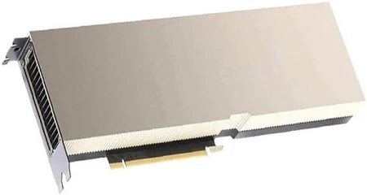

Root Cause: Poor communication of commodity GPUs
Commodity GPUs: NO PCIe P2P support due to hardware limitation
DRAM
CPU
CPU
①
②
Bounced Buffer
PCIe Bus
PCIe Bus
GPU₀
GPU₁
GPU₂
GPU₃
GPU₀
GPU₁
GPU₂
GPU₃
NVLink (if configured)
Datacenter GPU
（Support PCIe P2P)
Commodity GPU
(NO PCIe P2P Support)

Slide 10
Limited communication resources is the main bottleneck, which prevents commodity GPUs from fully reaping their advantages.

Slide 11
Analysis: EMB Model Training on Commodity GPUs
Why can't similar TFLOPS translate into similar training performance?
Reason II : CPU involvement overhead when fetching non-local paramters
DC GPUs
GPU
GPU
Commodity GPU
CPU
GPU
GPU

Slide 12
Frugal: Key Idea
Observation: Communication between commodity GPUs must go through DRAM.
Core Idea: DRAM maintains the latest version of all EMBs, avoiding visiting other GPUs on the critical path.
GPU₀
Large communication overhead
0
GPU₀
GPU₁
GPU₂
0
1
2
NO CC overhead
GPU_{1/2} proactively flush EMBs
(non-critical path)
DRAM
3
4
5
6
Passively waiting for queries
(on the critical path)
GPU₁
GPU₂
1
2
DRAM
0
1
2
3
4
5
6
Existing systems
Frugal
0
Hot EMBs
3
Cold EMBs
Key problem: how to maintain the consistency* of EMBs on DRAM with low overhead?
* We maintain strong consistency (synchronous training)

Slide 13


Frugal: Key Idea
Naïve solution to maintaining consistency: Write-through cache? Yet, high overhead!
Asynchronous flushing: Prioritize flushing EMB with upcoming reads based on training predictability
Naïve
Foreground
[ F ]
[ B ]
[ D0 ] [ D1 ] [ D2 ]
[ F ]
[ B ]
[ D2 ] [ D3 ]
Long stall
Step 0
Step 1
Frugal
Background
[ F ]
[ B ]
[ D2 ]
[ F ]
[ B ]
[ D2 ] [ D3 ]
Async flushing
Foreground
[ D2 ] [ D0 ] [ D1 ]
Step 0
Step 1
[ F ] Forward
[ B ] Backward
[D1] Update DRAM

Slide 14
Frugal: Key Idea
Naïve solution to maintaining consistency: Write-through cache? Yet, high overhead!
Asynchronous flushing: Prioritize flushing EMB with upcoming reads based on training predictability
Naïve
Foreground
[ F ]
[ B ]
[ D0 ] [ D1 ] [ D2 ]
[ F ]
[ B ]
[ D2 ] [ D3 ]
Long stall
Step 0
Step 1
Prioritise
Frugal
Background
[ D2 ] [ D0 ] [ D1 ]
[ D2 ] [ D3 ]
Async flushing
Foreground
[ F ]
[ B ]
[ F ]
[ B ]
Step 0
Step 1
[ F ] Forward
[ B ] Backward
[D1] Update DRAM
Performance improvement

Slide 15
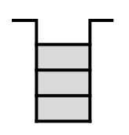


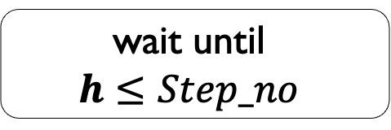

Frugal Architecture
Training Processes
GPU₀
GPU₁
GPU₂
GPU₃
$$\min\left\{R set\right\}, W set=∅$$
Sample
queue
Update staging queue
$$+∞,{R set=∅ \left| \right| W set=∅ }$$
wait until
$$h≤Step_no$$
PQ.AdjustPriority
PQ.Push
PQ.Pop
$h=$PQ.Top()
Flushing
threads
Concurrent PQ
Priority-based proactively flushing algorithm
Parallel flushing
Host memory
Controller Process

Slide 16

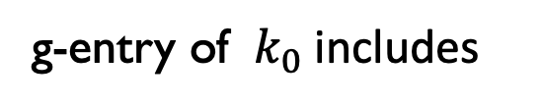




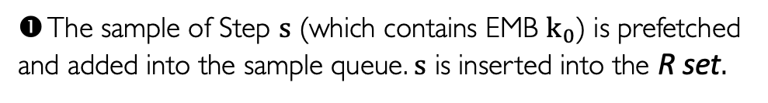

Design 1: Priority-based Proactively Flushing
Maintaining additional metadata (called g-entry) to calculate priorities.
Record <Step_no> that will
read this EMB in the future
❶ The sample of Step $s$ (which contains EMB $k_{0}$) is prefetched and added into the sample queue. $s$ is inserted into the R set.
Rr set: [ ]
W set: [ ]
$$s$$
g-entry of ${ k}_{0}$includes
❷ Step $s$is finished. Add $s$ and $Δ$ into W set.
$$< ,Δ>$$
❸ When updates are flushed into DRAM, moving 𝑠 out of W set.
Record <Step_no, gradient> of
the stagged EMB flushing
Priority definition
Blocking training if
$$\min\left\{R set\right\}, if W set=∅$$
PQ.Top()$≤$Next Step_no
Priority =
This indicates that the parameters involved in the next step have updates
that have not yet been written to DRAM.
$$+∞, if{R set=∅, or W set=∅ }$$

Slide 17
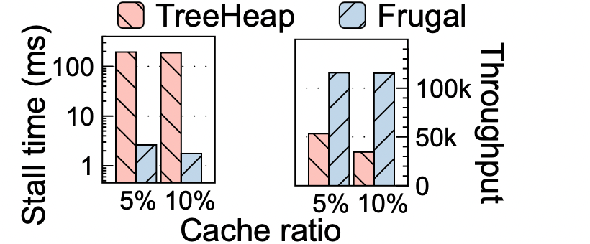
Design II: Parallel Flushing
Parallel Flushing (reducing training blocking)
Priority queue’s performance is critical
Enqueue/AdjustPriority → Backward Time
Dequeue → Stall Time
However, traditional heaps have inadequate perf.
Training Processes
Sample
queue
Update staging queue
PQ.AdjustPriority
PQ.push
Concurrent PQ
Flushing
threads
PQ.pop
PQ.top
Directly using a simple tree heap may result in a 100 ms stall,
reducing throughput by half.

Slide 18
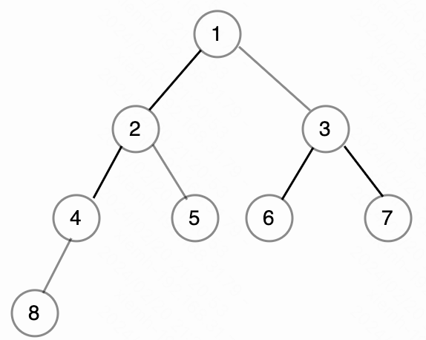
Design II: Parallel Flushing
Parallel Flushing (reducing training blocking)
Priority queue’s performance is critical
Enqueue/AdjustPriority → Backward Time
Dequeue → Stall Time
However, traditional heaps have inadequate perf.
Time complexity：O(log 𝑁)
N is in the same order of magnitude as the EMB count
Concurrency: Severe near-root conflicts, insufficient scalability
Training Processes
Sample
queue
Update staging queue
PQ.AdjustPriority
PQ.push
Concurrent PQ
Flushing
threads
PQ.pop
PQ.top
Severe near-root conflicts
O(log 𝑁)

Slide 19


Design II: Parallel Flushing
Our observation 1: the priority values range within a finite set
Range from 0 to 𝑚𝑎𝑥_𝑠𝑡𝑒𝑝
Here 𝑚𝑎𝑥_𝑠𝑡𝑒𝑝 is the maximum number of training steps.
Our observation 2: the priority of a specific item never decreases
Recall the definition of priority
$$\min\left\{R set\right\}, if W set=∅$$
R set and W set record the training step, which monotonically increase as the training progresses.
Priority =
$$+∞, if{R set=∅, or W set=∅ }$$

Slide 20

Design II: Parallel Flushing
Two-level concurrent priority queue
Level 1: Priority index (Observation 1)
Level 2: Each slot in priority index pointing to a hashtable, with a same priority value
Advantages
Low time complexity: All Ops (Push/Pop/AdjustPriority) are O(1)
High concurrency: HashTable is more concurrency-friendly compared to a tree
OPT: scan range compression
Using Observation 2
scan
Lower
bound
Upper
bound
Priority
Index
0
1
2
3
……
max
step
$$∞$$
Push
G-entry hashtable
with a same priority
AdjustPriority
Pop

Slide 21
Frugal Implementation
The implementation is based on PyTorch and applied to the training of recommendation models and knowledge graph models.
Model layer
Recommendation
Knowledge Graph
Deep learning
framework layer
PyTorch
DGL-KE
EMB Lookup
EMB Update
GPU₀
GPU₁
GPU₂
Commodity GPUs
System layer
DRAM
Frugal
CUDA

Slide 22
Experimental setup
Hardware Platform
CPU | 2 * Intel Xeon Gold 6130 CPUs
DRAM | 8 * 64 GB DDR4 DIMMs (4 per node)
Datacenter GPUs | 4 * NVIDIA Tesla A30 (24GB memory available)
Commodity GPUs | 8 * NVIDIA RTX 3090 (24GB memory available)
 | Datacenter GPU (A30 24 GB) | Commodity GPU (RTX 3090 24GB)
Tensor FP16 FLOPS | 165 TFLOPS | 142 TFLOPS
Price | 5,800 $ | 1,250 $
FLOPS/$ | 35 $/TFLOPS | 8 $/TFLOPS

Slide 23
Experimental setup
Workload:
Recommendation Model (Facebook DLRM^{[1]})
Knowledge Graph (TransE^{[2]})
 | Dataset | #Vertexes | #Edges | #Relations | Model Size
KG | FB15k | 592k | 15 k | 1.3 k | 52 MB
 | Freebase | 338M | 86.1 M | 14.8 k | 68.8 GB
 | WikiKG | 87M | 504 M | 1.3 k | 34 GB
 | Dataset | #Features | #IDs | #Samples | Model Size
REC | Avazu | 22 | 49 M | 40 M | 5.8 GB
 | Criteo | 26 | 34 M | 45 M | 4.1 GB
 | CriteoTB | 26 | 882 M | 4.37 B | 110.3 GB
[1] Naumov, Maxim, et al. Deep learning recommendation model for personalization and recommendation systems.
[2] Bordes, Antoine, et al. Translating Embeddings for Modeling Multi-relational Data.

Slide 24
Competitor Systems
Vanilla training systems:
PyTorch for training recommendation models
DGL-KE for training knowledge graphs
Training systems with multi-GPU caching
HugeCTR: recommendation model training system introduced by NVIDIA
DGL-KE-cached: a multi-GPU caching variant of DGL-KE
Variant of Frugal
Frugal-Sync: a write-through strategy to synchronously flush updates to host memory.

Slide 25
Overall performance: Knowledge Graph
8 RTX 3090 GPUs
Datasets:
Throughput (items/s)
Frugal consistently achieves significantly higher training throughput 1.2-1.5×, and 4.1-7.1×.
Boost performance more on the larger dataset (Freebase or WikiKG) since a larger ID space allows more optimization room for asynchronous flushing
Simply using existing multi-GPU caching on commodity GPUs can cause throughput decrease.

Slide 26

Overall performance: Recommendation Model
8 RTX 3090 GPUs
Datasets:
Throughput (items/s)
Frugal consistently achieves significantly higher training throughput compared to PyTorch and HugeCTR, respectively reaching 4.9-7.4× and 6.1-8.7×.

Slide 27
Effect of Priority-based Proactively Flushing
Stall Time
Training Throughput
8 RTX 3090 GPUs
Priority-based proactively flushing algorithm can reduce the training stall time by 34-101×, improve the end-to-end throughput by 3.5-5.3×, compared to SyncFlushing.

Slide 28
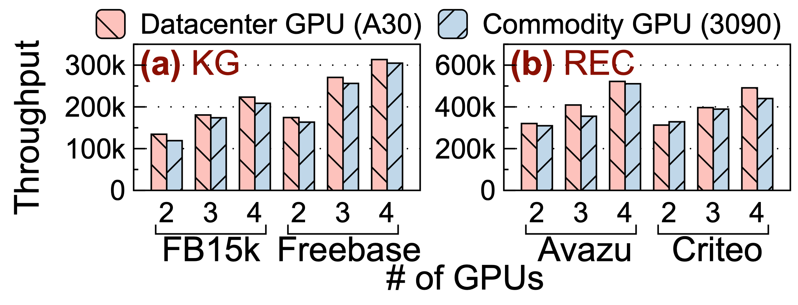
Cost efficiency of Frugal
4 RTX 3090 GPUs v.s. 4 A30 GPUs
Frugal achieves comparable throughput (89-97%) to datacenter GPUs.
Considering the price difference, Frugal improves the cost-performance ratio by 4.0-4.3×.

Slide 29
Conclusion
Commodity GPU are well suited for low computational demands of memory-intensive embedding models.
Opportunities: cheap and sufficient computing
Challenges: poor communication resources
Our solution: Frugal
Proactive Flushing: avoid communication in the critical path
Parallel Flushing: speedup priority-related operations by tailoring PQ data structure
Open-sourced in https://github.com/thustorage/Frugal

Slide 30
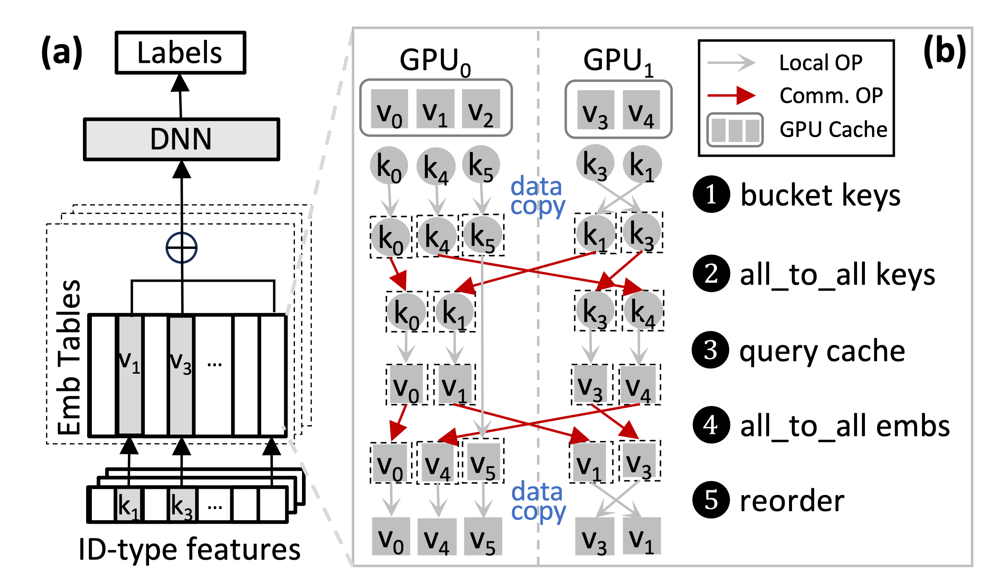
Backup: All-to-all comm. in multi-GPU caching

Slide 31


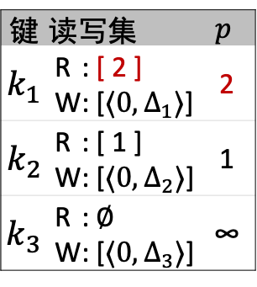

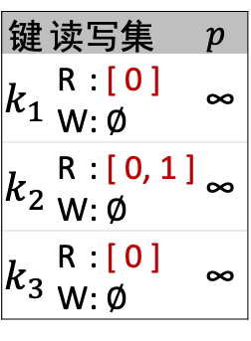
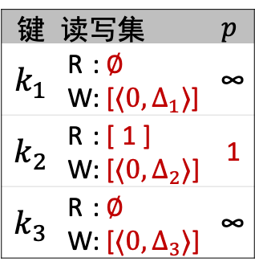





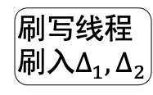
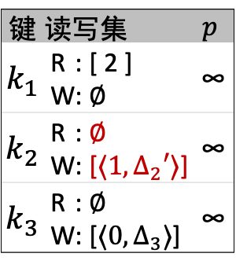
Frugal – 关键技术（1）例子
训练过程
预取窗口长度为2
Step 0
Step 1
Step 2
rank 0
rank 0
rank 0
$k_{2}$
$${ k}_{3}$$
$k_{2}$
$${ k}_{1}$$
rank 1
rank 1
rank 1
$${ k}_{1}$$
$${ k}_{1}$$
Step 0 训练
Step 1 训练
向后预取
Step 0&1
队首优先级=∞
∞ > Step 0，训练
在R集中删除Step 0
在W集中记录更新
向后预取
Step 2
队首优先级=1
1 ≯ Step 1，等待
刷写线程
刷入$Δ_{1}, Δ_{2}$
队首优先级=∞
∞ > Step 0，训练
键 | 读写集 | $$p$$
$${ k}_{1}$$ | Rr: [ 0 ] W: ∅ | ∞
$k_{2}$ | Rr: [ 0, 1 ] W: ∅ | ∞
$${ k}_{3}$$ | Rr: [ 0 ] W: ∅ | ∞
键 | 读写集 | $$p$$
$${ k}_{1}$$ | Rr: ∅ W: [$⟨0, Δ_{1}⟩$] | ∞
$k_{2}$ | Rr: [ 1 ] W: [$⟨0, Δ_{2}⟩$] | 1
$${ k}_{3}$$ | Rr: ∅ W: [$⟨0, Δ_{3}⟩$] | ∞
键 | 读写集 | $$p$$
$${ k}_{1}$$ | Rr: [ 2 ] W: [$⟨0, Δ_{1}⟩$] | 2
$k_{2}$ | Rr: [ 1 ] W: [$⟨0, Δ_{2}⟩$] | 1
$${ k}_{3}$$ | Rr: ∅ W: [$⟨0, Δ_{3}⟩$] | ∞
键 | 读写集 | $$p$$
$${ k}_{1}$$ | Rr: [ 2 ] W: ∅ | ∞
$k_{2}$ | Rr: [ 1 ] W: ∅ | ∞
$${ k}_{3}$$ | Rr: ∅ W:[$⟨0, Δ_{3}⟩$] | ∞
优先级队列
被延后
Step 1
Step 2
rank 0
rank 0
$k_{2}$
$${ k}_{1}$$
rank 1
rank 1
$${ k}_{1}$$
❻
❼
❽
❾
❿
队首优先级=∞
∞ > Step 1，训练
在R集中删除Step 1
在W集中记录更新
队首优先级=∞
∞ > Step 2，训练
训练结束，
刷入所有更新
键 | 读写集 | $$p$$
$${ k}_{1}$$ | Rr: [ 2 ] W: ∅ | ∞
$k_{2}$ | Rr: ∅ W: [$⟨1, Δ_{2}′⟩$] | ∞
$${ k}_{3}$$ | Rr: ∅ W: [$⟨0, Δ_{3}⟩$] | ∞

