Slide 1



PetPS: Supporting Huge Embedding Models with Persistent Memory
Minhui Xie, Youyou Lu, Qing Wang,
Yangyang Feng, Jiaqiang Liu, Kai Ren, Jiwu Shu
Tsinghua University
Kuaishou

Slide 2
Background: Embedding Models
Embedding Models
Widely used in the core commercial business of modern web companies
Recommendation, ads, searching
Learning on sparse high-dimensional feature space
User IDs, item IDs, user-item interactions
Predicted probability
P
Deep neural network
Shim Layer: EMB layer
1
1
1
1
User ID
User recently
watched video IDs
Candidate video IDs

Slide 3
Background: Embedding Models
Embedding Models
Widely used in the core commercial business of modern web companies
Recommendation, ads, searching
Learning on sparse high-dimensional feature space
User IDs, item IDs, user-item interactions
Embedding Table
Predicted probability
RDMA WRITE
P
EMB
vectors
+
Pooling
Deep neural network
ID
EMB vec
Video
EMB table
EMB layer
User EMB Tbl
Video
EMB Tbl
Video
EMB Tbl
1
1
1
1
User ID
User recently
watched video IDs
IDs
Candidate video IDs
1
1

Slide 4
Background: Production Serving System for EMB Models
Model
updates
Labels
PS
Shard 1
PS
Shard 2
PS
Shard N
O(1) GB
DNN
Model
Parallel
…
Pooling
O(10) TB
…
Emb
Table 0
Emb
Table 1
Emb
Table M
Inference
Server
Inference
Server
Inference
Server
Data
Parallel
…
DNN
DNN
DNN
ID Inputs
Model structure
Architecture of a serving system

Slide 5
Background: Production Serving System for EMB Models
Model
updates
Labels
PS
Shard 1
PS
Shard 2
PS
Shard N
O(1) GB
DNN
Model
Parallel
Pooling
…
O(10) TB
…
Emb
Table 0
Emb
Table 1
Emb
Table M
Inference Server
Inference
Server
Inference
Server
Data
Parallel
Pull needed
embeddings
Pooling
DNN
…
DNN
DNN
ID Inputs
ID Inputs
Labels
Model structure
Architecture of a serving system

Slide 6
Background: Production Serving System for EMB Models
Model
updates
Labels
PS
Shard 1
PS
Shard 2
PS
Shard N
O(1) GB
DNN
Model
Parallel
Hash Index
Mem Pool
…
Pooling
❶ Indexing
❷ Gathering
O(10) TB
…
IDs
Embs
Emb
Table 0
Emb
Table 1
Emb
Table M
Inference Server
Inference
Server
Inference
Server
Data
Parallel
Pull needed
embeddings
Pooling
DNN
…
DNN
DNN
ID Inputs
ID Inputs
Labels
Model structure
Architecture of a serving system

Slide 7
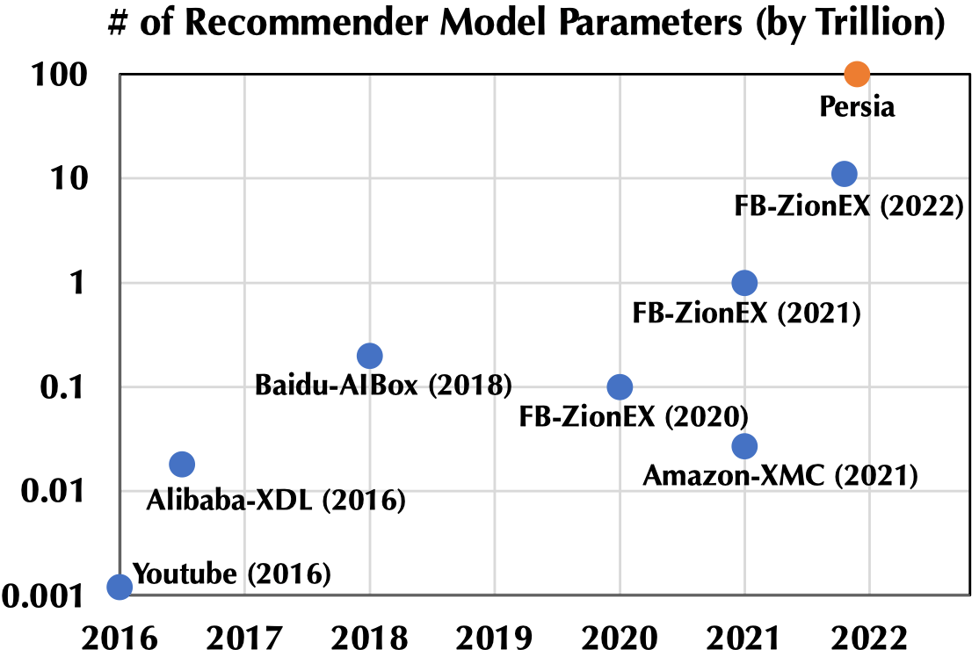
Background: Scaling up EMB Models
Modern models are scaling to 100 Trillion parameters
More parameters tend to bring better accuracy
Model capacity growth rate: 10x per year
The problems of DRAM parameter servers become increasingly acute
High storage costs
At Kuaishou, tens of thousands of dedicated PSs, causing both high CapEx and OpEx
Considerable recovery time
~3 min for loading a 2 TB model from HDFS (with 100 Gbps NIC)
[R1] Persia: A Hybrid System Scaling Deep Learning Based Recommenders up to 100 Trillion Parameters

Slide 8
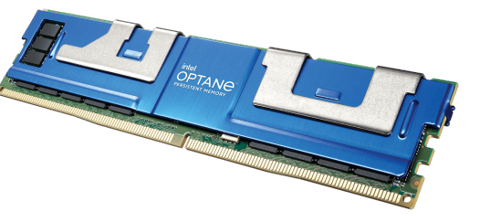
Opportunity: Persistent Memory (PM)
PM brings both opportunities and challenges to PSs !
Opportunities
More capacity at lower cost
Instant recovery
Challenges
High PM read latency : PM endure 3x higher latency
CPU bottleneck
Serve 8x more parameter requests on slower media, but with the same CPU resources
 | PM | DRAM
Capacity | Up to 512 GB | Up to 128 GB
Price | $4 / GB | $7.6 / GB
Volatility | Non-volatile | Volatile
Read Lat. | 300 ns | 100-200 ns
Write Lat. | 150 ns | 100-200 ns

Slide 9
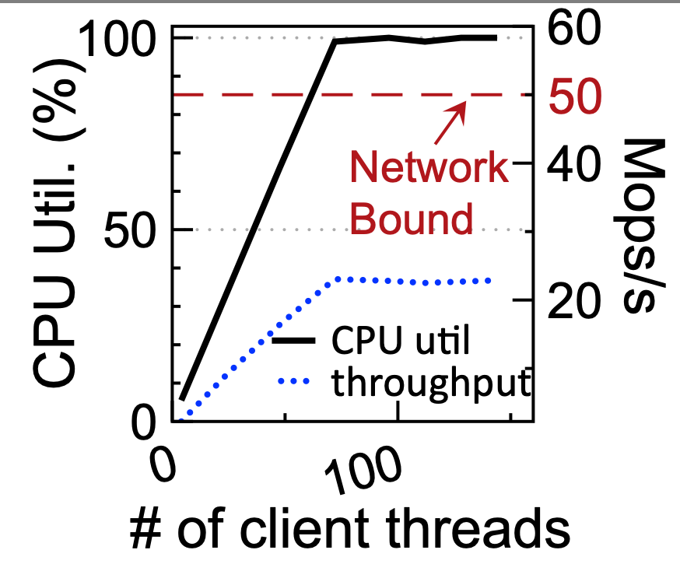
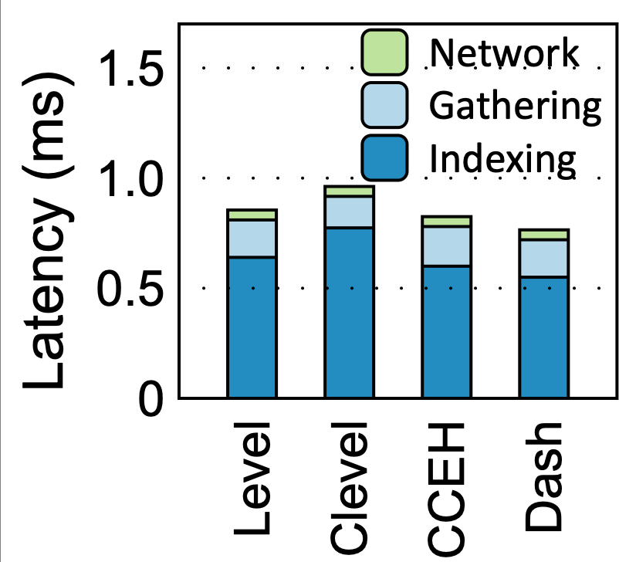
Motivation
Profiling a parameter server on PM
Existing PM hash indexes : LevelHash[OSDI’18], Clevel[ATC’20], CCEH[FAST’19], Dash[VLDB’20]
2 x Intel Xeon Gold 6240M CPU (36 logical cores)
6 x 256GB Intel Optane DIMMs (12GB/s writes, 36 GB/s reads)
2 x 100Gbps Mellanox CX-5 NIC
Throughput v.s. CPU utilization
CPU time breakdown
Throughput
*Index is Dash
CPU is the performance bottleneck
Both Indexing and Gathering consumes a lot of CPU cycles

Slide 10
Outline
Background & Motivation
PetPS: Supporting Huge Embedding Models with PM
Evaluation
Conclusion

Slide 11



PetPS – Overview
PetPS
DRAM
Request Pool
Pull
ID₀
ID₁
ID₂
① Indexing - PetHash
Emb₀: <ptr₀, size₀>
PetHash
Mem Pool
Emb₁: <ptr₁, size₁>
PM
Emb₂: <ptr₂, size₂>
② Gathering - NIC Gathering
NIC
DMA Engine
Emb₀
Emb₁
Emb₂
Pull
Inference Server

Slide 12
PetPS – Overview
PetPS
DRAM
Design 1: Indexing - PetHash
Request Pool
Pull
ID₀
ID₁
ID₂
① Indexing
Emb₀: <ptr₀, size₀>
PetHash
Mem Pool
Emb₁: <ptr₁, size₁>
PM
Design 2: Gathering -
NIC Gathering
Emb₂: <ptr₂, size₂>
② NIC Gathering
NIC
DMA Engine
Emb₀
Emb₁
Emb₂
Pull
Inference Server
Inference Server

Slide 13
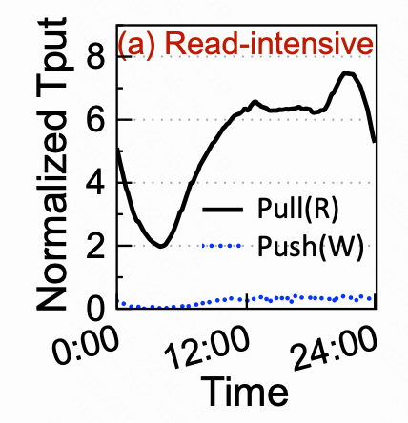
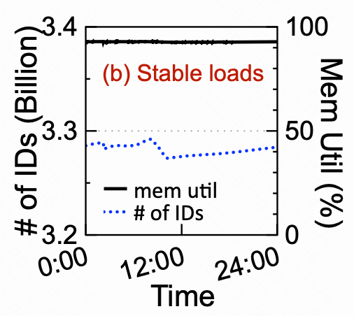
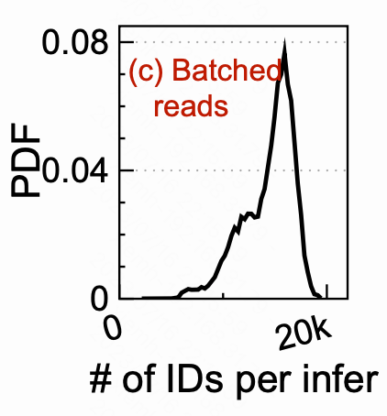

Design 1: PetHash – a PM index optimized for EMB
Problem: existing PM hash indexes are unaware of EMB workloads
Existing PM hash indexes
EMB workload characteristics
×
optimized for writes
98% requests of PSs are reads
optimized for frequent rehashing
×
PS loads are stable
assume a single read/write in a request
×
batch size =15k in a request
Our observation:
Index should be redesigned to minimize PM access by
embracing the unique workload characteristics of EMB models.

Slide 14
Design 1: PetHash – a PM index optimized for EMB
Workload characteristic
PetHash design
Stable loads, no rehashing
Single-level structure
home bucket
PetHash:
Read/Write operations
Concurrency control
Check our paper for details
Bucket:
Header
Slot
Slot
…
Slot
14Byte
4Byte
1Byte
64bit
16bit
48bit
Header:
FP
Version
Overflow
Slot:
ID
Size
EMBptr
Can locate any slot in any bucket with O(1) time

Slide 15

Design 1: PetHash – a PM index optimized for EMB
Workload characteristic
PetHash design
Skewed key distribution
Hotness-aware placement
Read / Write
home bucket
Migration
theard
Client
PetHash:
hot kv
hotness info
Try to place hot KVs in their own home buckets.

Slide 16
Design 1: PetHash – a PM index optimized for EMB
Workload characteristic
PetHash design
Large batch size in a request
Prefetching
for i in range(batch_size):
PetHash.lookup (keys[i])
if i != batch_size-1:
prefetch (home_bucket(keys[i+1]))
With a high probability, indexing of the next key
can be fully satisfied by the CPU cache

Slide 17
PetPS – Overview
PetPS
DRAM
Design 1: Indexing - PetHash
Request Pool
Pull
ID₀
ID₁
ID₂
① Indexing
Emb₀: <ptr₀, size₀>
PetHash
Mem Pool
Emb₁: <ptr₁, size₁>
PM
Design 2: Gathering -
NIC Gathering
Emb₂: <ptr₂, size₂>
② NIC Gathering
NIC
DMA Engine
Emb₀
Emb₁
Emb₂
Pull
Inference Server
Inference Server

Slide 18
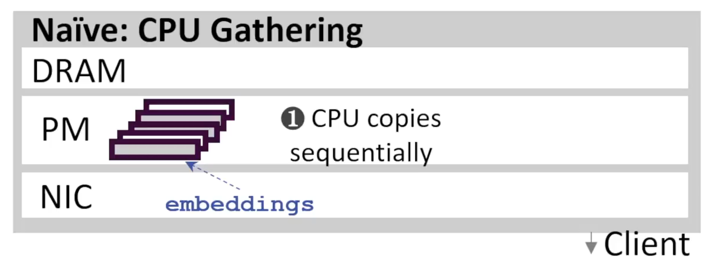
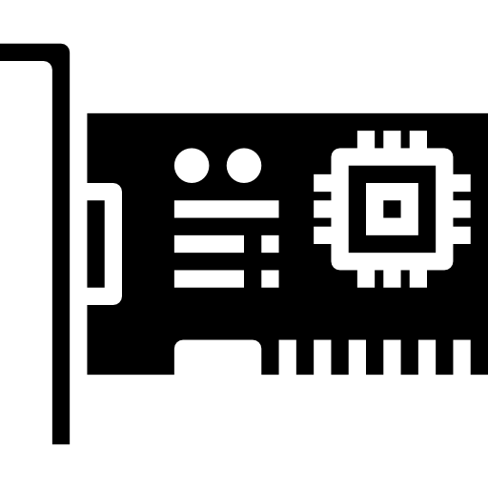

Design 2: NIC Gathering
Problem: CPU gathering on PM wastes CPU cycles
CPU copies EMBs on PM sequentially when gathering.
High access latency of PM is fully exposed in CPU pipeline.
Our observation:
Datacenter NICs have the scatter-gather DMA (SG-DMA) functionality, which can be re-purposed for gathering EMBs on PM.
SG-DMA descriptor
SG-DMA
descriptor
src₁: (addr₁, len₁)
src₂: (addr₂, len₂)
src₃: (addr₃, len₃)
dst : addr
CPU
NIC
SG-DMA
Memory
SG-DMA processing flow
Gather DMA

Slide 19
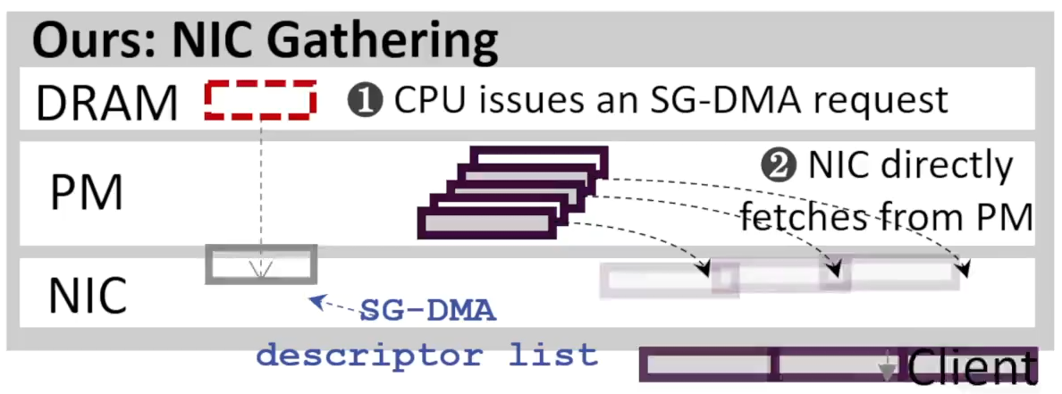
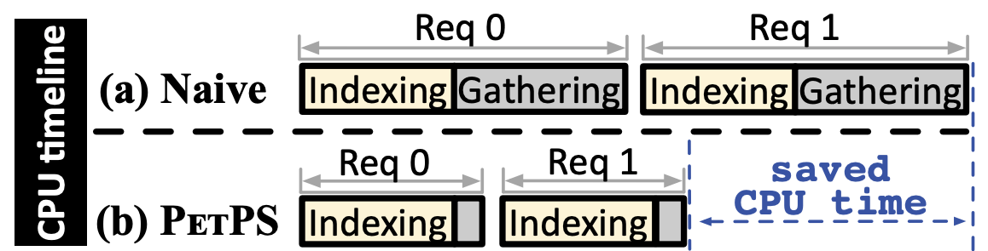
Design 2: NIC Gathering
Offload gathering to NIC
Remove PM access latency from CPU pipeline
CPU efficient High throughput
Challenge: Parameter consistency
Update
EMB parameter
DMA
Inconsistency

Slide 20


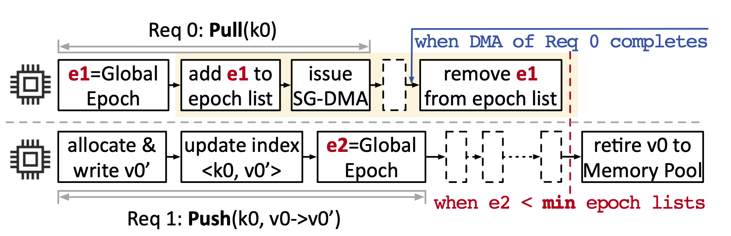
Design 2: NIC Gathering
How to protect consistency of EMBs being DMAed?
Copy-on-write & Epoch-list based reclaimation
Copy-on-write
Ensure that there is no write operations
to the EMB parameters being DMAed
Reader:
Epoch-list based reclaimation
Ensure that there is no free operations
to the EMB parameters being DMAed
v₀
0
0
0
0
0
v₀
0
0
0
0
0
v₁
1
1
1
1
1
v₁
1
1
1
1
1
v₀
Check our paper for details

Slide 21
Outline
Background & Motivation
PetPS: Supporting Huge Embedding Models with PM
Evaluation
Conclusion

Slide 22

Experimental setup
Hardware Platform
CPU | 2 x Intel Xeon Gold 6240M CPU (18 physical/36 logical cores)
PM | 6 x 256GB Intel Optane DIMMs (12GB/s writes, 36 GB/s reads)
NIC | 2 x 100Gbps Mellanox ConnectX-5 NIC
Synthetic Workload (YCSB)
Zipfian ($α=0.99$)
100 billion parameters
embedding dimension = 128
Production Workload (Kuaishou)
Day-long trace with 6 million samples
100 billion parameters
embedding dimension = 128
Competitors
PSLite | Parameter server implementation from MXNet
DashPS | Replace PSLite’s index with SOTA PM hash index, Dash [VLDB’20]
KuaiPS | Kuaishou in-house implementation of DRAM PS

Slide 23
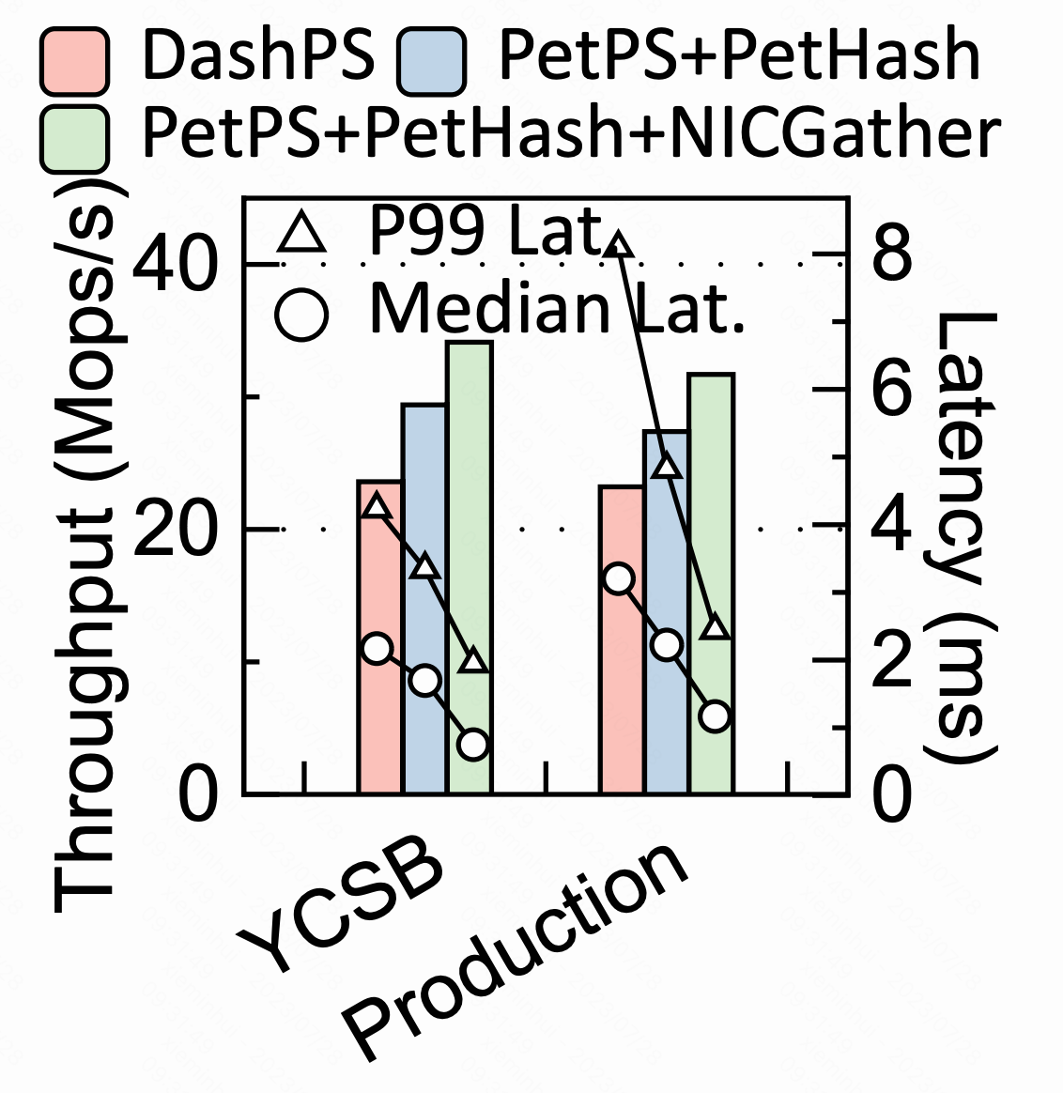
Overall Performance
Throughput
Performance breakdown
1.3x
1.4x
PetPS
Throughput: 1.3-1.7x gains
Latency: 2.6-3.1x median latency reduction, 2.2-3.3x P99 latency reduction

Slide 24
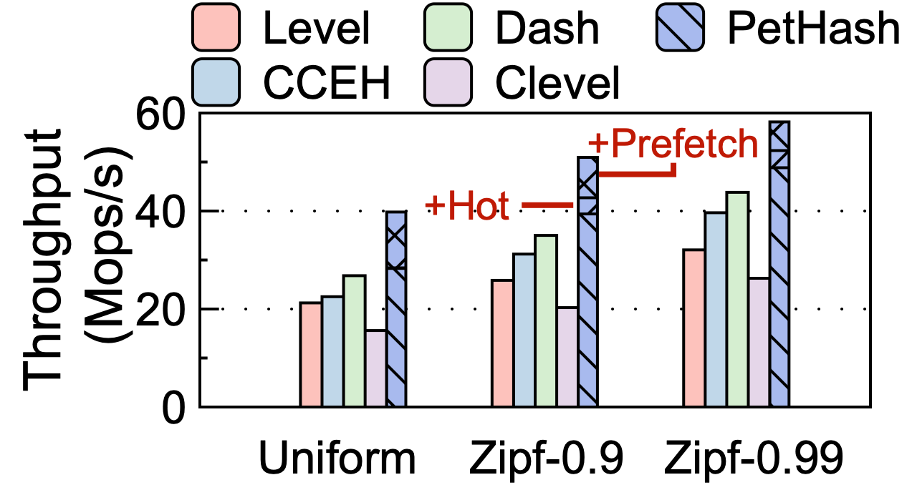
PetHash Performance
Indexing Throughput
Avg Read Bytes per OP
Bytes
PetHash
Gets 1.3-2.5x throughput gains compared with previous PM indexes
Reduces PM read bytes by up to 2x

Slide 25
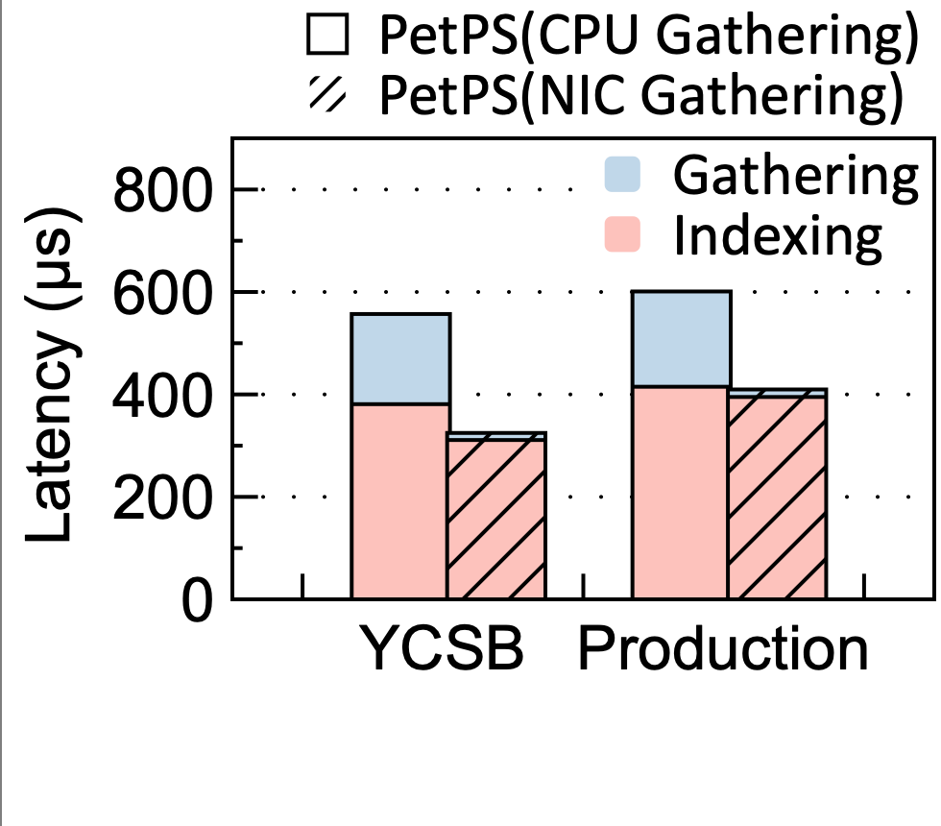
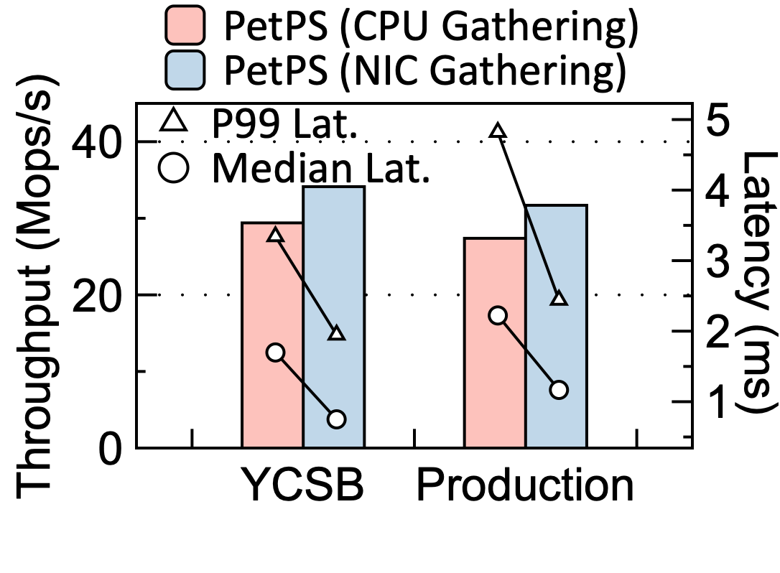
NIC Gathering Performance
CPU time breakdown
End-to-end performance
NIC Gathering
reduces 12.8x CPU gathering time (from 180µs to 14µs)
improves the peak throughput by 1.2x, reduces median latency by 2.3x

Slide 26
NIC Gathering Performance (Cont.)
30% decline of throughput !
NIC Gathering on DRAM ？
Bottlenecked by NIC DMA
Indexing time on PM
Indexing time on DRAM
The throughput of DMA has a ceiling ,
and offloading too much limits the performance !

Slide 27
Comparison with DRAM PS
Compared with PS on DRAM, PetPS on PM reaches
similar or even lower latency and only 12% lower throughput
30% fewer TCO, according to our cost analysis ^{[R1]}
[R1] Kuaishou: Storage Upgrade for Short Video Services.
https://www.intel.com.au/content/www/au/en/customer-spotlight/stories/kuaishou-customer-story.html

Slide 28
Conclusion
PM brings both opportunities and challenges to PS
Opportunities: cheap and large capacity, instant recovery
Challenges: high PM read latency, heavy CPU burden
Our solution: PetPS
Indexing: PetHash, a workload-aware index, trying to minimize PM accesses
Gathering: safely offloading gathering to NIC to improve CPU efficiency
Takeaway
With proper system designs, PM PS can achieve similar latency and much better cost efficiency compared to DRAM
Offloading gathering to NIC is not free lunch

Slide 29
Thanks & QA
PetPS: Supporting Huge Embedding Models with Persistent Memory
Open-source code: https://github.com/thustorage/PetPS
Contact Information: xmh19@mails.tsinghua.edu.cn

Slide 30
PetPS – Overview
PetPS
Core 1
Core 2
DRAM
Design 1: Indexing - PetHash
Request Pool
Pull
ID₀
ID₁
ID₂
① Indexing
Emb₀: <ptr₀, size₀>
PetHash
Mem Pool
Emb₁: <ptr₁, size₁>
PM
Design 2: Gathering -
NIC Gathering
Emb₂: <ptr₂, size₂>
② NIC Gathering
NIC
DMA Engine
Emb₀
Emb₁
Emb₂
Pull
Inference Server
Inference Server

Slide 31
PetPS – Overview
PetPS
Core 1
Core 2
DRAM
Request Pool
Pull
ID₀
ID₁
ID₂
① Indexing
Emb₀: <ptr₀, size₀>
PetHash
Mem Pool
Emb₁: <ptr₁, size₁>
PM
Emb₂: <ptr₂, size₂>
② NIC Gathering
NIC
DMA Engine
Emb₀
Emb₁
Emb₂
Pull
Inference Server
Inference Server

Slide 32
Design 1: PetHash – a PM index optimized for EMB
Workload characteristic
PetHash design
Stable loads, no rehashing
Single-level structure
home bucket
PetHash:
Bucket:
Header
Slot
Slot
…
Slot
14Byte
4Byte
1Byte
64bit
16bit
48bit
Header:
FP
Version
Overflow
Slot:
ID
Size
EMBptr
Can locate any slot in any bucket with O(1) time

Slide 33
Design 1: PetHash – a PM index optimized for EMB
Single-level structure
a single level of buckets (256 bytes each)
home bucket: hash(ID) % # buckets
home bucket
PetHash:
Bucket:
Header
Slot
Slot
…
Slot
14Byte
4Byte
1Byte
64bit
16bit
48bit
Header:
FP
Version
Overflow
Slot:
ID
Size
EMBptr

Slide 34
Design 1: PetHash – a PM index optimized for EMB
Single-level structure
Bucket header
FP, for SIMD search
Verson, for concurrency control
Overflow, recording the number of displaced KVs
PetHash:
Bucket:
Header
Slot
Slot
…
Slot
14Byte
4Byte
1Byte
64bit
16bit
48bit
Header:
FP
Version
Overflow
Slot:
ID
Size
EMBptr

Slide 35
Design 1: PetHash – a PM index optimized for EMB
Single-level structure
Bucket header
FP, for SIMD search
Version, for concurrency control
Overflow, recording the number of displaced KVs in this bucket
Check our paper for details
PetHash:
Bucket:
Header
Slot
Slot
…
Slot
14Byte
4Byte
1Byte
64bit
16bit
48bit
Header:
FP
Version
Overflow
Slot:
ID
Size
EMBptr

Slide 36
Design 1: PetHash – a PM index optimized for EMB
KV operations
Insert
Start probing from the home bucket, stop until find a not-full bucket
insert KV to it
Overflow counters of probed buckets are increased atomically
Insert
home bucket
PetHash:
Full?
Yes!
Overflow++
Full?
Yes!
Overflow++
Full?
NO!
Insert to it

Slide 37
Design 1: PetHash – a PM index optimized for EMB
KV operations
Read / Update
Start from home bucket, and probe buckets until
the key is found, or
encounters a bucket whose Overflow = 0
Read / Update
home bucket
PetHash:
miss
Overflow≠0
Overflow≠0
Overflow=0
Read / Update
home bucket
PetHash:
found
Overflow≠0

Slide 38


Design 2: NIC Gathering
Copy-on-write
Ensure that there is no write operations to the EMB parameters being DMAed
Writer : Update <ID, EMB₀> to <ID,EMB_{1>}
Reader : Read ID
PetHash
① ptr₁= PetHash.read(ID)
① ptr₀= PetHash.read(ID)
② NIC gathering ptr₁
② NIC gathering ptr₀
ptr₀:
③ PetHash.update(ID, ptr₁)
0
0
0
0
0
④ free ptr₀ to memory pool
ptr₁:
1
1
1
1
1
① ptr₁= malloc len(EMB₁) bytes from memory pool
We must ensure that there is no free operations to the EMB parameters being DMAed
② copy EMB₁ to ptr₁

Slide 39
Design 2: NIC Gathering
Epoch-list based reclaimation
Ensure that there is no free operations to the EMB parameters being DMAed
System maintains a shared counter, Epoch (E), which increases as time goes
Each reader thread maintains a thread-local epoch list
each of the list protects an on-going DMA
insert current E to the list before DMA, and remove it upon the completion
Each writer thread can free old EMB if and only if
its epoch < min all epoch lists

Slide 40
Design 2: NIC Gathering
Epoch-list based reclaimation
Ensure that there is no free operations to the EMB parameters being DMAed
Writer : Update ID: EMB₀->EMB₁
Reader : Read ID
① ptr₁= malloc len(EMB₁) bytes
- e₁ = current epoch
- insert e₁ to epoch list
① ptr₀= PetHash.read(ID)
② copy EMB₁ to ptr₁
② NIC gathering ptr₀
③ PetHash.update(ID, ptr₁)
④ free ptr₀ to memory pool
remove e₁ to epoch list
- e₂ = current epoch
- wait until e₂ < min all epoch lists

Slide 41
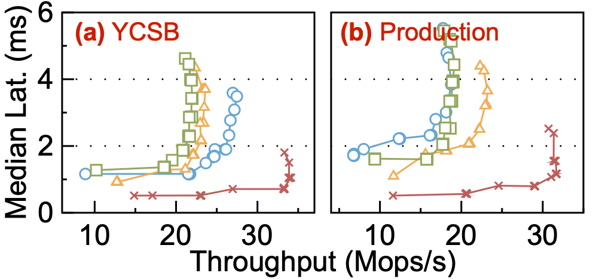
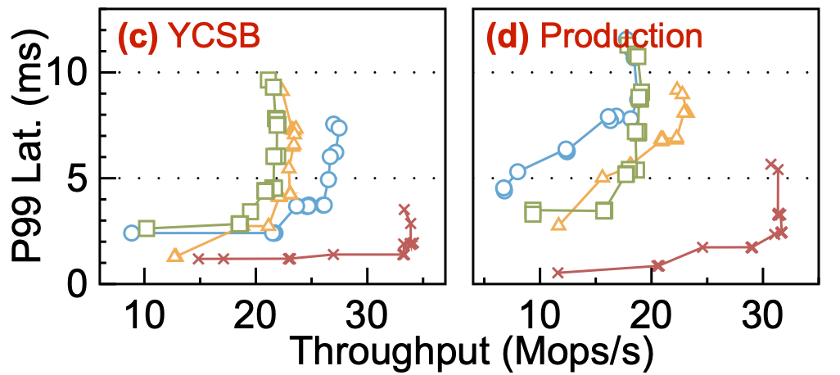
Overall Performance
Throughput v.s. Latency
Performance breakdown
PetPS
Throughput: 1.3-1.7x gains
Latency: 2.6-3.1x median latency reduction, 2.2-3.3x P99 latency reduction

