Slide 1
Welcome to our .net forum website project
Gv : luong tran hy hien

Slide 2
OVERVIEW
IN THIS PROJECT WE USE :
_ ASP.NET AS SERVER-SIDE LANGUAGE .
_ sqL Server
_ Entity framework

Slide 3
overview
An internet forum is an online discussion site where people can hold conversations in the form of posted messages .
Structure:
This project can be divided into categories for the relevant discussions .
Under the categories are posts that user create and public to the site .

Slide 4
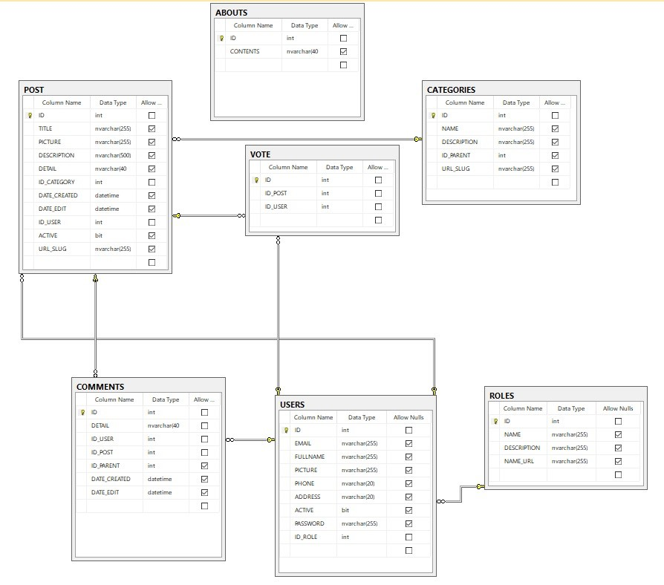
The database

Slide 5
About role
Admin > Mod > user .
The administrators manage the technical details required for running the site , they may promote (and demote) members to/from moderators . (give role to user) .
Admin has full access .
Mod has half access .

Slide 6
Main features
Login system .
Profile management .
Creating posts .
Creating threads ( categories )
Unlock/active posts from admin/mod .
Commenting posts .
Vote for posts .
Editing posts, categories .
Authentication system .

Slide 7
Demo some features

Slide 8
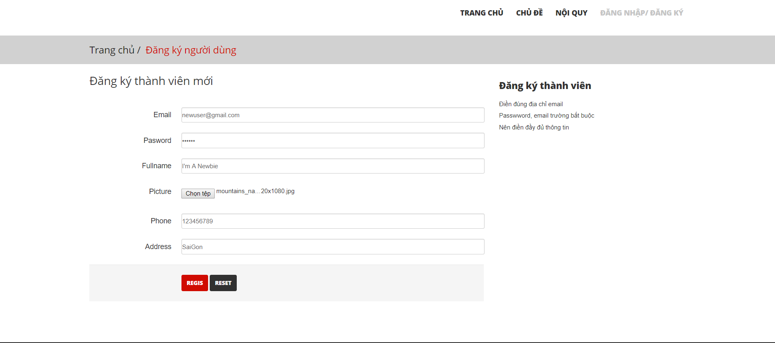
Sign up and login

Slide 9
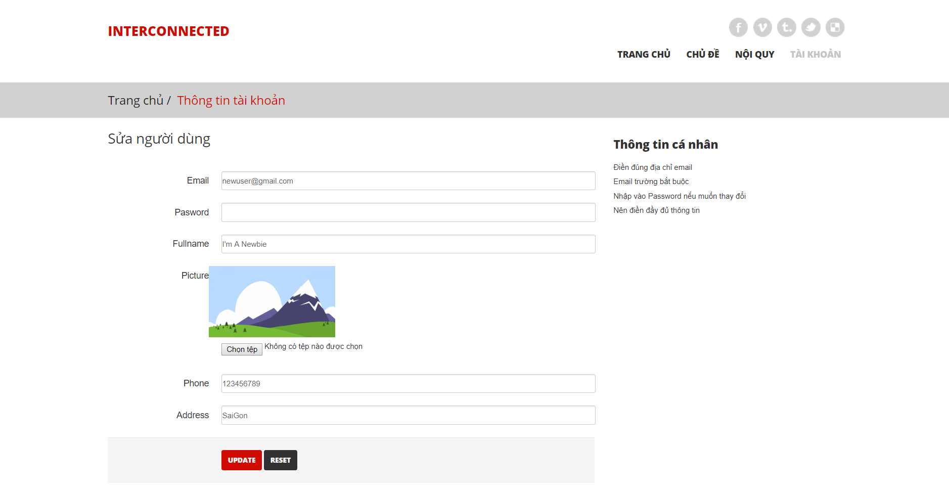
Sign up and login

Slide 10
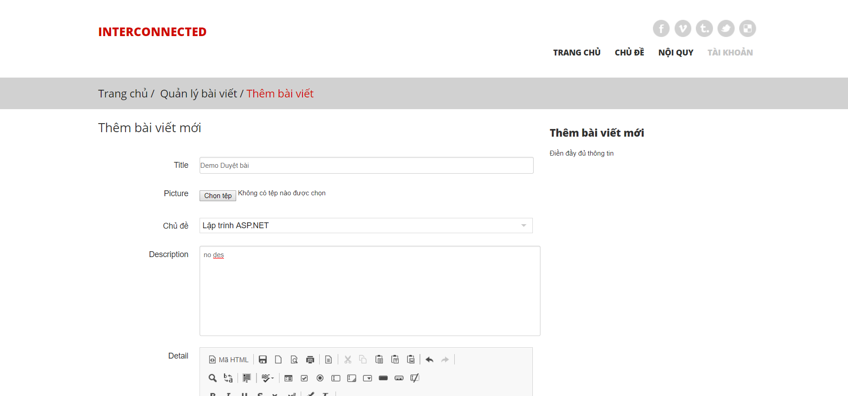
Create post

Slide 11
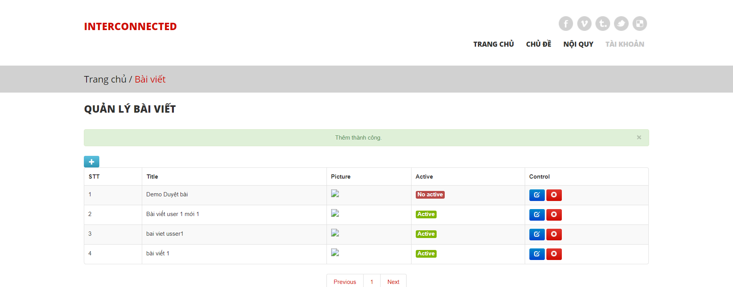
Create post

Slide 12
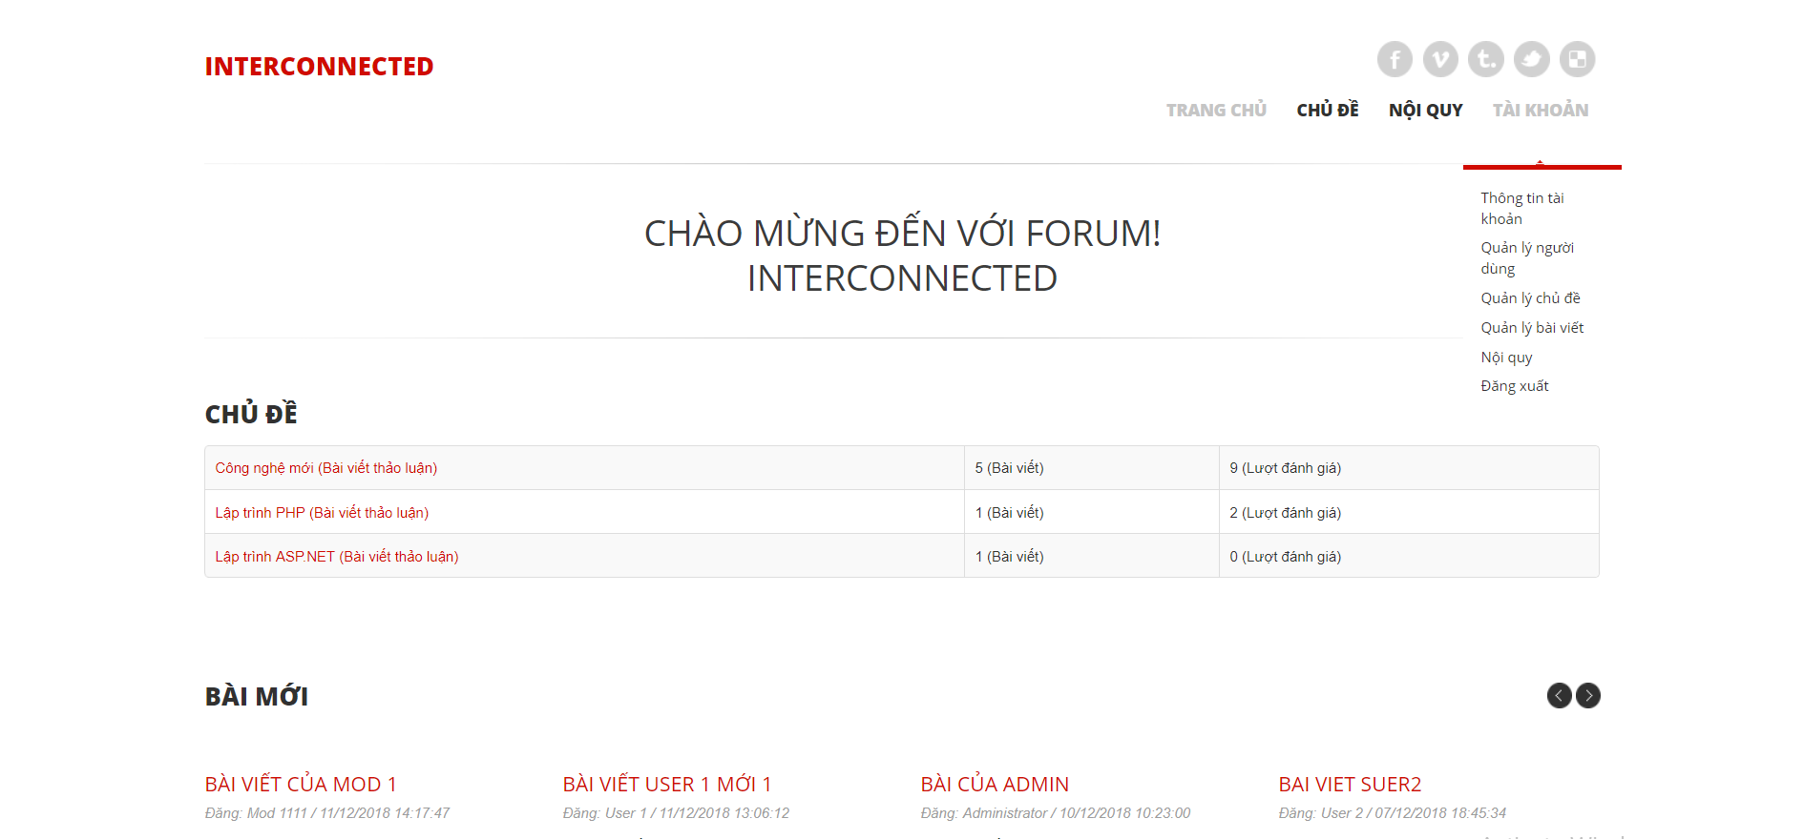
Active post

Slide 13
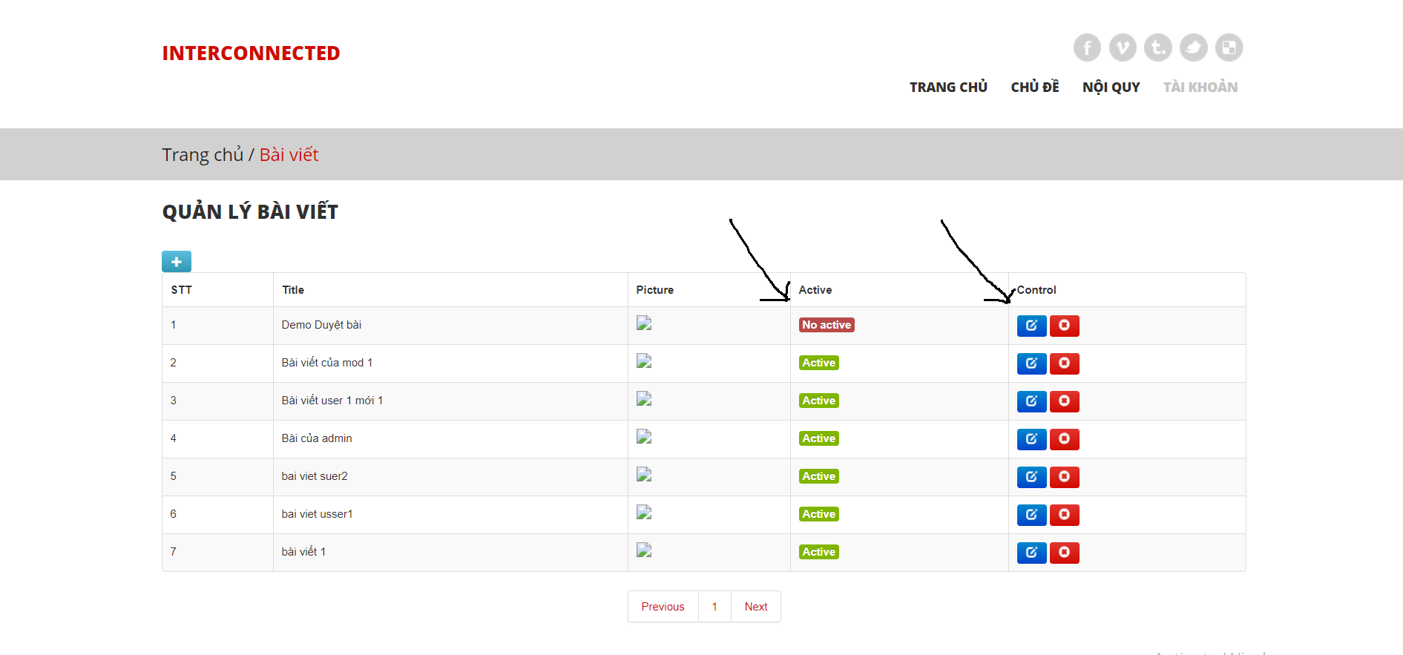
Active post

Slide 14
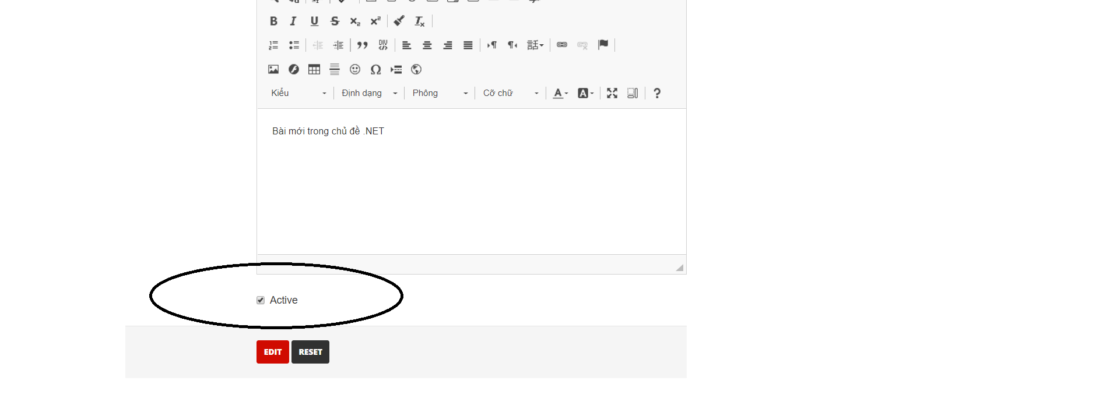
Active post

Slide 15
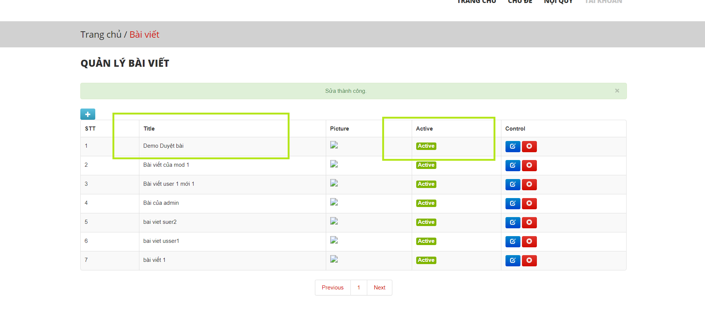
Active post

Slide 16
Thanks for watching
End slide

Slide 17
Team 09 members
Cao Cảnh Linh 42.01.104.078
Nguyễn Minh Vương 42.01.104.195
Nhan Thái Dương 42.01.104.217
Nguyễn Cát Tường 42.01.104.156
Huỳnh Phú Thành 42.01.104.161

