Slide 1
Keylogger Problem
NAAN MUDHALVAN
Mini Gnana Sekaran
2021115062

Slide 2
AGENDA
Introduction
Problem Statement
Project Overview
End Users
Solution and Value Proposition
Technical Implementation
Results
Conclusion

Slide 3
INTRODUCTION
Keyloggers are a particularly insidious type of spyware that can record and steal consecutive keystrokes (and much more) that the user enters on a device. The term keylogger, or “keystroke logger,” is self-explanatory: Software that logs what you type on your keyboard. However, keyloggers can also enable cybercriminals to eavesdrop on you, watch you on your system camera, or listen over your smartphone’s microphone.

Slide 4
PROBLEM STATEMENT
Keyloggers, a form of malicious software, surreptitiously record keystrokes, compromising user privacy and security. Beyond capturing keystrokes, they enable unauthorized access to webcams and microphones, posing significant threats to individuals and organizations. Addressing this menace requires proactive cybersecurity measures to detect, prevent, and respond to keylogger infiltration, safeguarding digital assets and personal information from exploitation.

Slide 5
PROJECT OVERVIEW
The Keylogger Defense project aimed to address the pervasive threat posed by keyloggers, a form of malicious software designed to covertly record keystrokes and compromise user privacy. By developing proactive cybersecurity measures, the project sought to detect, prevent, and respond to keylogger infiltration, thereby safeguarding individuals and organizations from potential exploitation.
OBJECTIVES
Detection: Implement effective mechanisms to identify keylogger activity on devices.
Prevention: Deploy strategies to prevent keylogger infiltration and mitigate potential risks.
Response: Establish protocols to promptly address and mitigate keylogger incidents.
Education: Educate users about keylogger risks and prevention strategies.

Slide 6
Cont…
Challenges:
Sophisticated Techniques: Addressing evolving keylogger techniques required continuous adaptation.
User Compliance: Encouraging user adoption of security best practices posed challenges.
Resource Constraints: Limited resources necessitated prioritization of project tasks.

Slide 7
End User Categorization
Individual Users:
Individuals prioritizing personal cybersecurity.
Users safeguarding sensitive data like passwords, financial information, and private conversations.
Parents ensuring children's online safety through monitoring.
Corporate Users:
Employers overseeing employee activities for security and productivity.
IT administrators protecting corporate networks from internal threats.
Organizations adhering to data protection regulations.

Slide 8
Cont..
Government Agencies:
Law enforcement agencies monitoring communications for investigative purposes.
Government entities managing national security and cybersecurity initiatives.
Educational Institutions:
Schools educating students on cybersecurity risks and best practices.
Research institutions investigating cyber threats like keyloggers.
Software Developers:
Developers creating security tools to detect and prevent keylogger attacks.

Slide 9
SOLUTION AND VALUE PROPOSITION
Solution:
The Keylogger project aims to develop a comprehensive and robust security solution to address the diverse needs of end users, specifically focusing on the following aspects:
Detection and Prevention: Implementing advanced algorithms and heuristics to detect and prevent keylogger activities across various platforms and devices.
User-Friendly Interface: Designing an intuitive user interface that allows for easy configuration and monitoring while maintaining high security standards.
Real-Time Monitoring: Providing real-time monitoring capabilities for individuals, employers, administrators, and organizations to track activities and prevent potential security breaches.
Educational Resources: Offering educational materials and resources to increase awareness and promote responsible technology use, particularly in educational institutions and among individual users.

Slide 10
Cont..
Value Proposition
The Keylogger project brings several value propositions to its end users, tailored to meet their distinct needs and concerns:
Enhanced Security: Ensuring individuals, corporate users, and government agencies of enhanced security against keylogger threats, thereby safeguarding sensitive information and ensuring regulatory compliance.
User Empowerment: Empowering end users with the tools and knowledge to monitor, detect, and prevent keylogger activities, bolstering their confidence in online security.
Data Protection: Providing a robust defense mechanism for businesses and individuals to protect confidential data and confidential communications from unauthorized access.
Compliance and Risk Mitigation: Assisting organizations in meeting regulatory requirements and mitigating the risks associated with keyloggers, thereby minimizing potential cybersecurity incidents.
Research and Development: Facilitating the work of security professionals, researchers, and software developers by offering insights, data, and resources to advance the understanding of keyloggers and enhance defense mechanisms.

Slide 11
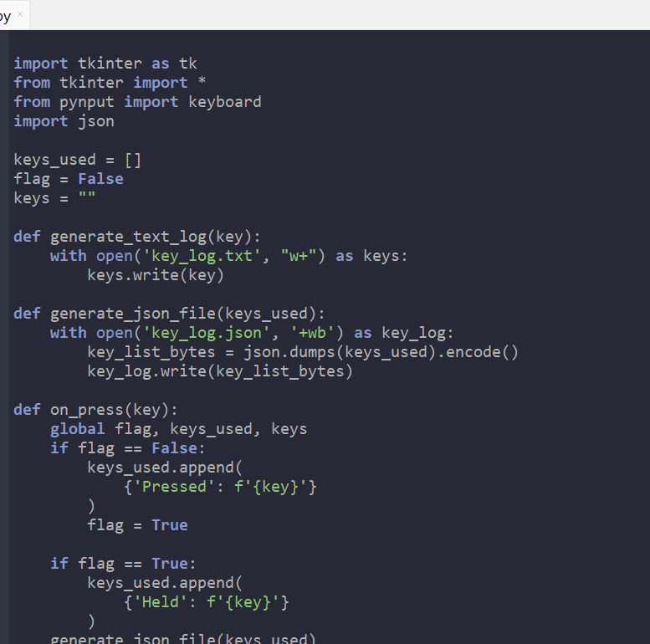
TECHNICAL IMPLEMENTATION

Slide 12
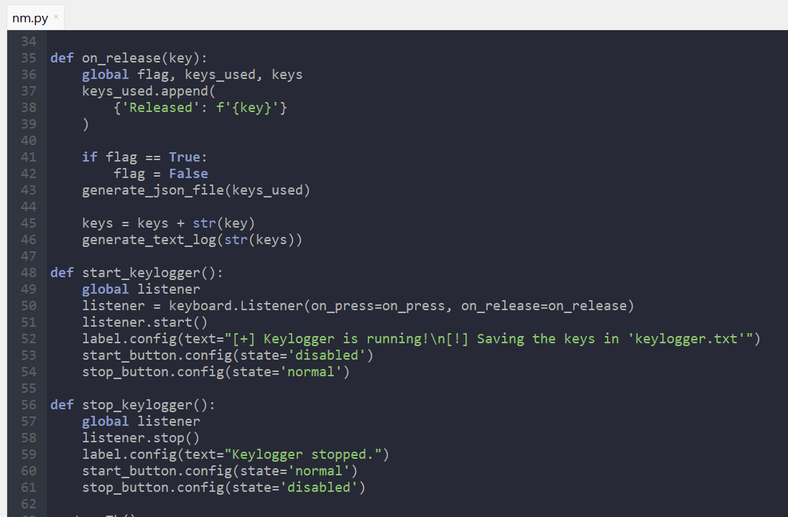
Cont…

Slide 13
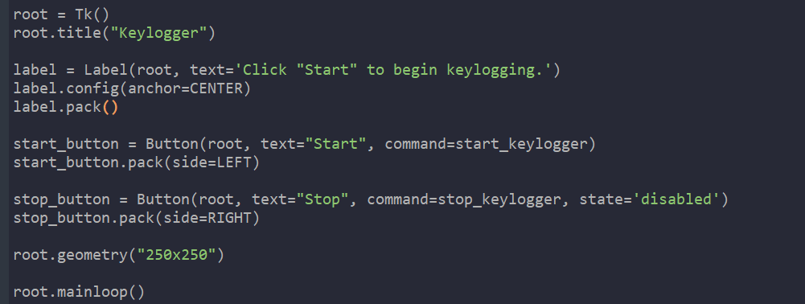
Cont…

Slide 14
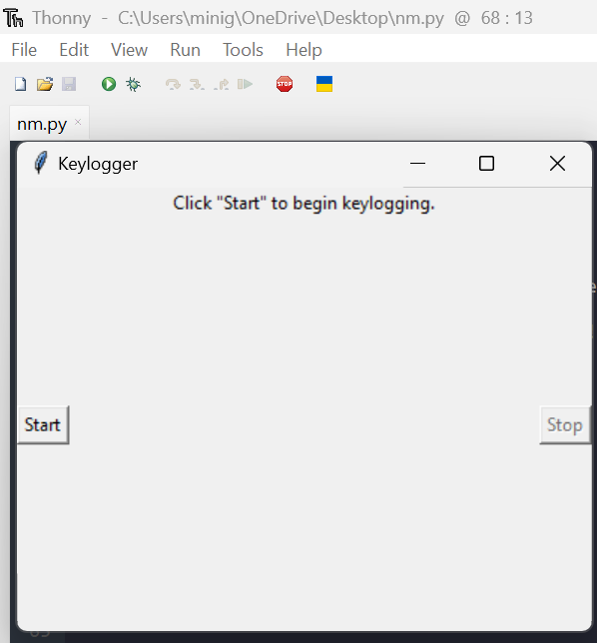
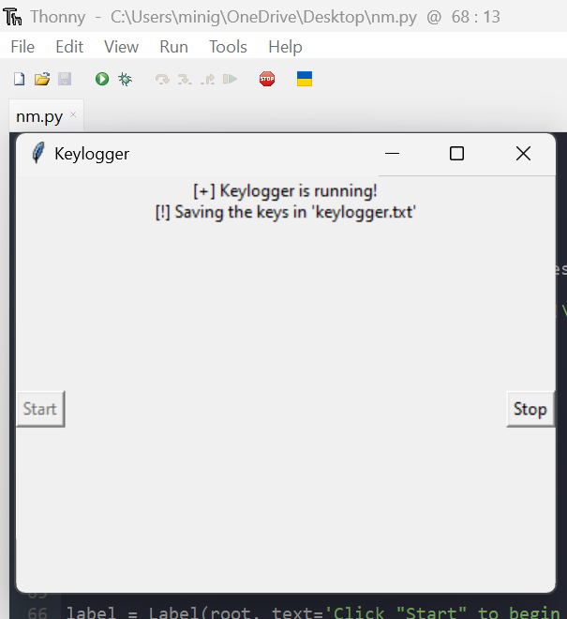
Results

Slide 15


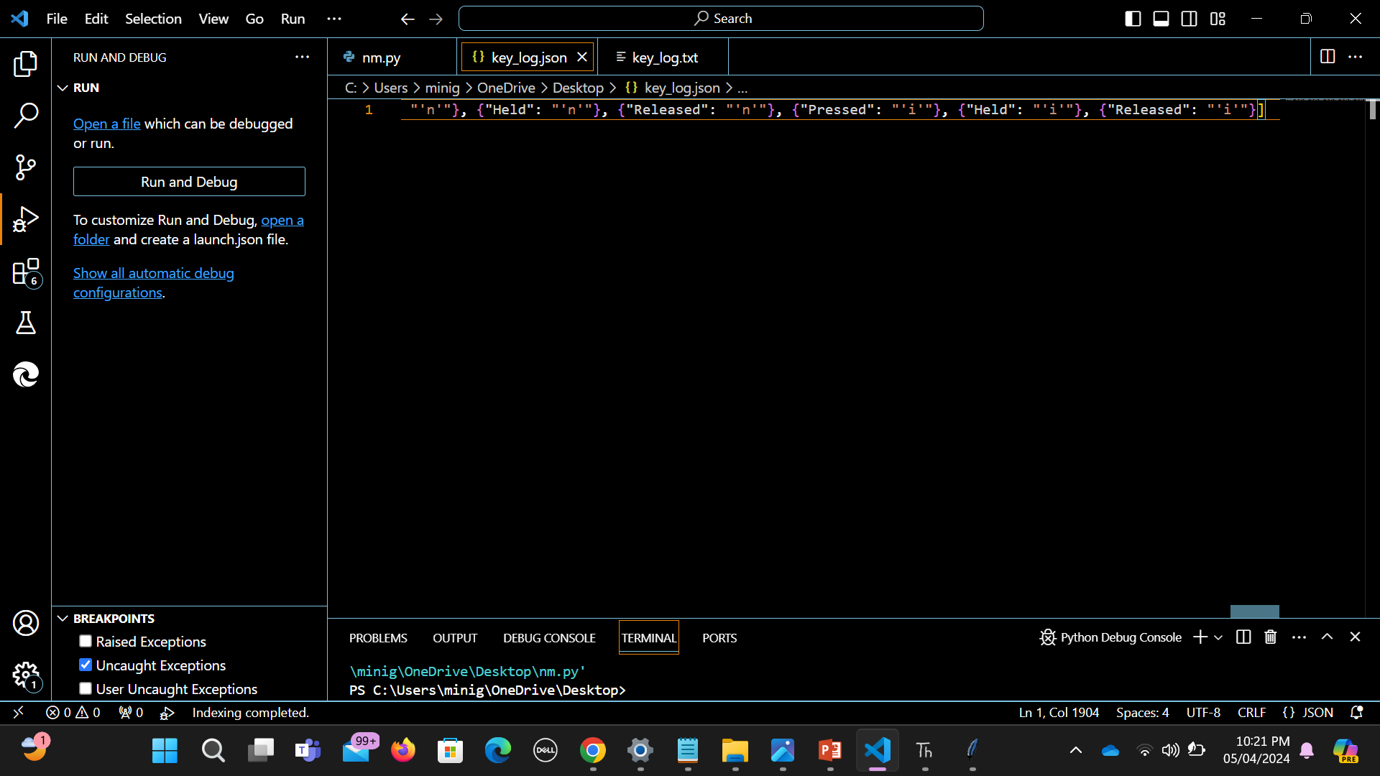
Cont…

Slide 16
Conclusion
The Keylogger project has significantly improved defense against malicious software threats by implementing advanced detection algorithms, proactive prevention measures, and efficient response protocols. Through user education initiatives, awareness about keylogger risks has been raised, empowering individuals and organizations to protect their digital assets effectively. Moving forward, continued vigilance and collaboration will be crucial in maintaining cybersecurity resilience against evolving threats.

