Slide 1
Team 1
Mini project
Team Members:
A
B
C
D
E

Slide 2
The Problem:
Inconvenience: Watering plants manually can be time-consuming and inconvenient, particularly for people who are busy or away from home frequently.
Inconsistent watering: It can be difficult to maintain a consistent watering schedule manually, which can lead to over or under watering of plants
Water waste: Manually watering plants can sometimes result in water waste due to overspray or runoff.
Plant health: Inconsistent watering or over/under watering can lead to poor plant health.
(Use floating tile to specify them)

Slide 3
Our Solution(+Value Proposition??):
Automated Domestic Irrigation System-”Go the green way”
A fail-proof, easy to operate and resource-efficient solution to regulate the soil moisture level of the garden and maintain the general health of plants.
(ADD Logo and/or images)

Slide 4
How it works:

Slide 5
How it works:
Control unit

Slide 6
How it works:
Sensor unit

Slide 7
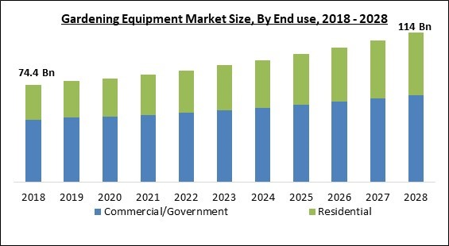
Market Evaluation
The Global Gardening Equipment Market size is expected to reach $114 billion by 2028, rising at a market growth of 5.0% CAGR during the forecast period.
The Home sector is valued at ₹ 3,538 billion in 2020 and it is forecast to reach ₹ 5,807 billion by 2025 at a CAGR of 10.4% in the period.
The mass market players accounted for 61.0% of sector sales in 2020​
​

Slide 8
Conclusion
The domestic irrigation system will improve the efficiency of watering the garden and reduce water usage. The system would consist of a network of sprinklers or drip lines, controlled by the central control unit, to efficiently distribute water to plants and lawns. The sensor-based irrigation system will also reduce the amount of time and effort required in maintaining the garden.. Overall, the domestic irrigation system project would help improve the sustainability and aesthetic of the community.

