Slide 1
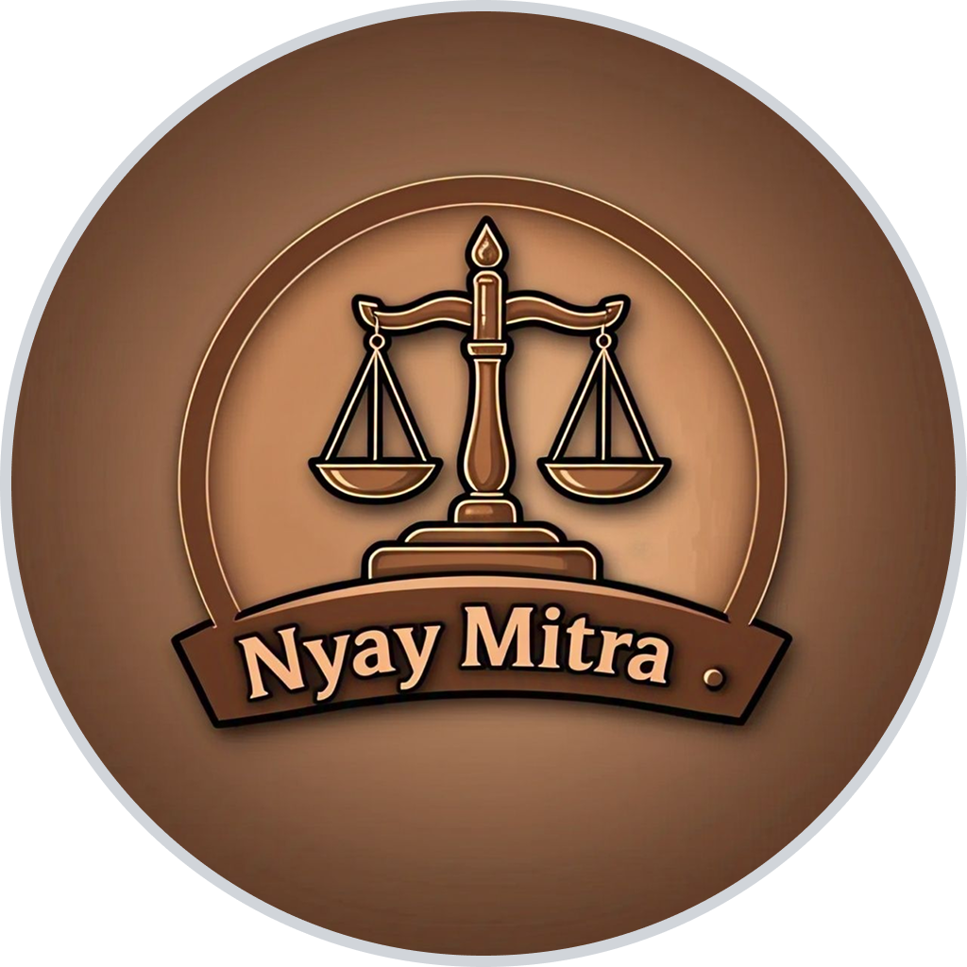
AI DRIVEN LEGAL APP: Nyay Mitra न्याय मित्र
Group 13:
Arshak Muhammed P K Sayooj . V
Devakrishna A.S
Ajina

Slide 2
INTRODUCTION
In the modern legal landscape, understanding the complexities of laws and legal procedures can be challenging for the general public. Many individuals face difficulties in identifying the relevant legal provisions applicable to their complaints. To bridge this gap, we propose an AI-driven legal application that provides users with precise legal information, including the sections of law applicable to their complaints. This app aims to enhance accessibility to legal knowledge and empower users with accurate legal insights.

Slide 3
PROBLEM STATEMENT
Many people struggle to determine which legal sections apply to their grievances, often leading to delays, misinformation, and costly legal consultations. The legal system is vast and complex, making it difficult for individuals to navigate without professional assistance. An AI-driven solution that can analyze complaints and suggest the relevant legal provisions will significantly improve accessibility to legal information and ensure informed decision-making.

Slide 4
OBJECTIVE
To develop an AI-powered legal application that assists users in identifying the relevant legal sections associated with their complaints. To provide an easy-to-use platform for individuals seeking preliminary legal insights before consulting a lawyer. To enhance legal awareness and reduce dependency on legal professionals for basic legal queries. To ensure accuracy and reliability through AI-driven legal databases and natural language processing (NLP).

Slide 5
PROPOSED METHODS
Natural Language Processing (NLP) for Complaint Analysis Implement AI models trained on legal texts to understand and classify user complaints. Use NLP techniques to extract key information from user inputs and match it with legal sections. Legal Knowledge Base Create a structured legal database containing various laws, sections, and case references. Continuously update the database with new amendments and legal precedents. AI-Powered Legal Section Recommendation Develop a machine learning model to predict the most relevant legal sections based on the complaint. Provide detailed explanations of the recommended legal provisions.

Slide 6
PROPOSED METHODS
User-Friendly Interface Design an intuitive and accessible UI for users to input complaints and receive legal insights. Implement multi-language support to ensure inclusivity .

Slide 7
SOFTWARE REQUIREMENTS SPECIFICATION
Functional Requirements Complaint Processing – AI analyzes complaints and identifies relevant legal sections. Legal Knowledge Base – Maintains an up-to-date database of laws and amendments. User Support – Voice translation for fast retrieval of outputs.
Non-Functional Requirements Security & Privacy – Encrypt user data and ensure legal compliance. Performance & Scalability – Fast response time and ability to handle high traffic. User Experience – Intuitive UI with voice translation.

Slide 8
System Features AI-Powered Legal Assistant – Automated legal section identification. Search & Query System – Advanced search for laws and legal provisions. Latest legal news – Explore latest news regarding laws and judgments.
System Constraints Legal Data Limitations – Accuracy depends on available legal data. Language Processing Challenges – Handling ambiguous or complex complaints. Regulatory Compliance – Must adhere to country-specific legal regulations.

Slide 9
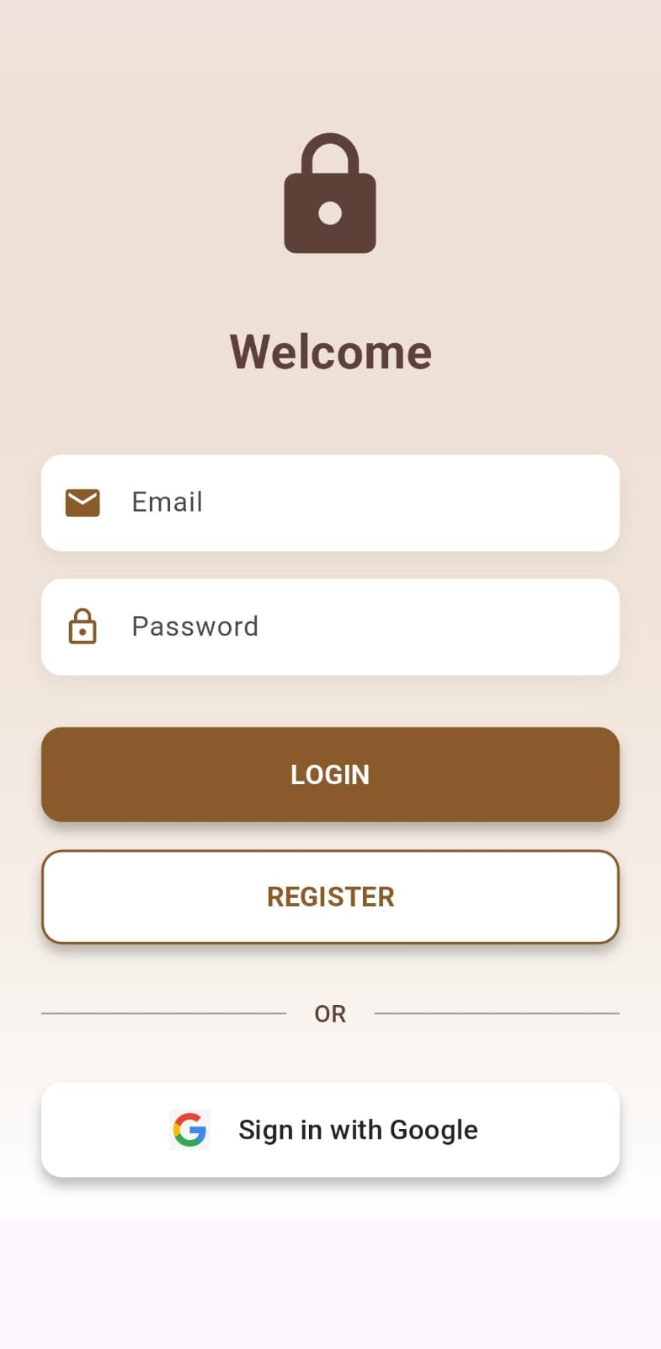
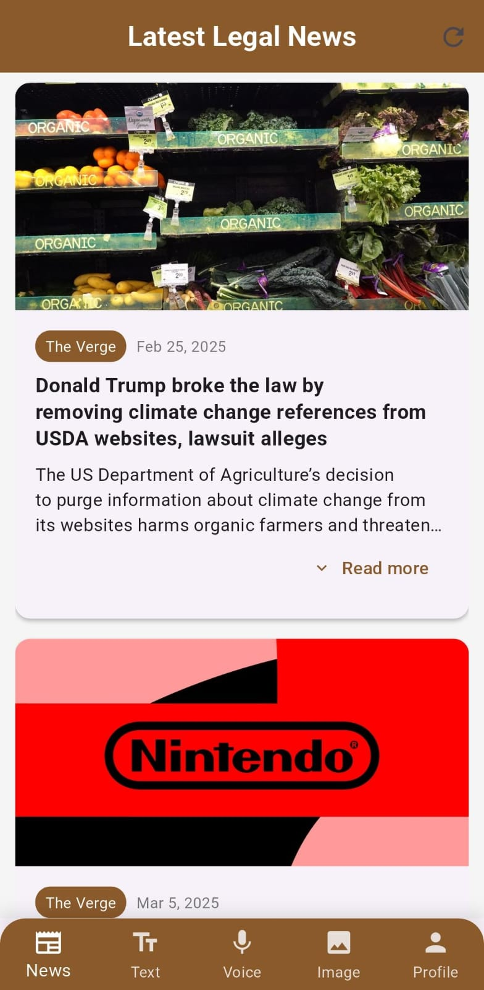
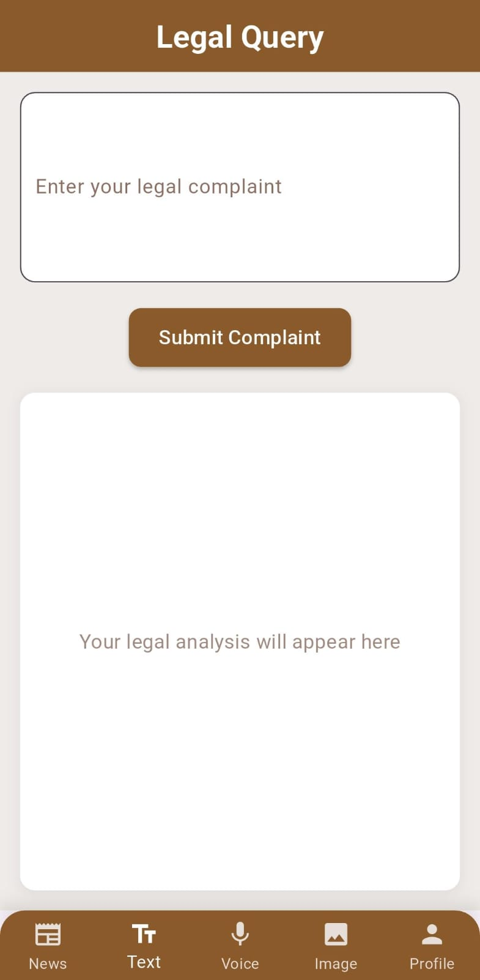
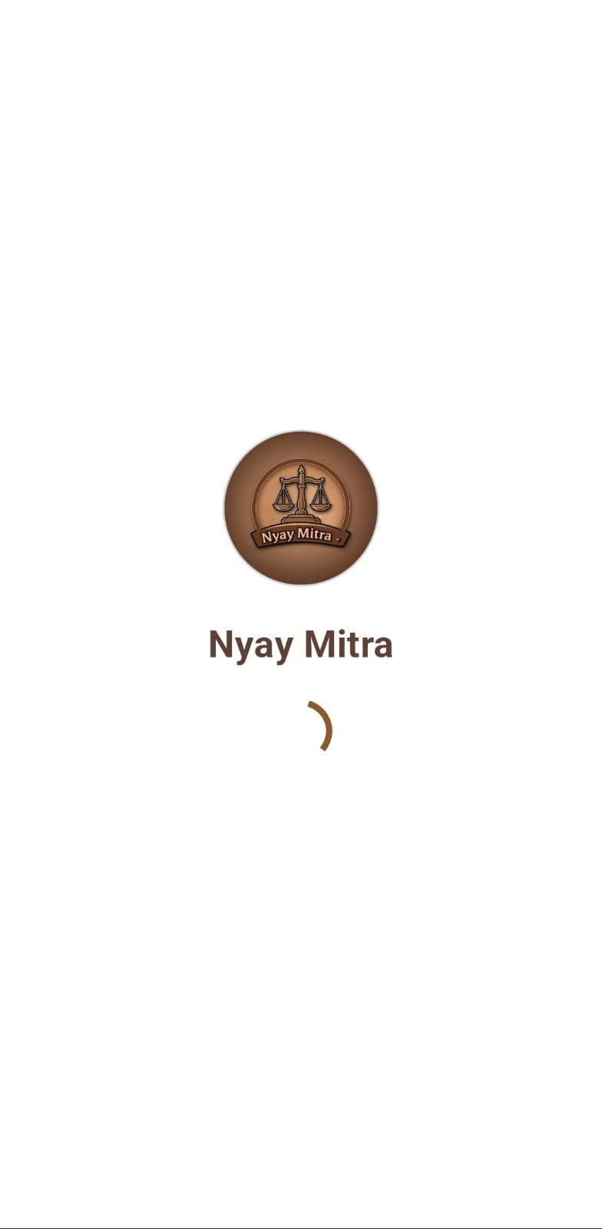
IMPLEMENTATION STATUS

Slide 10
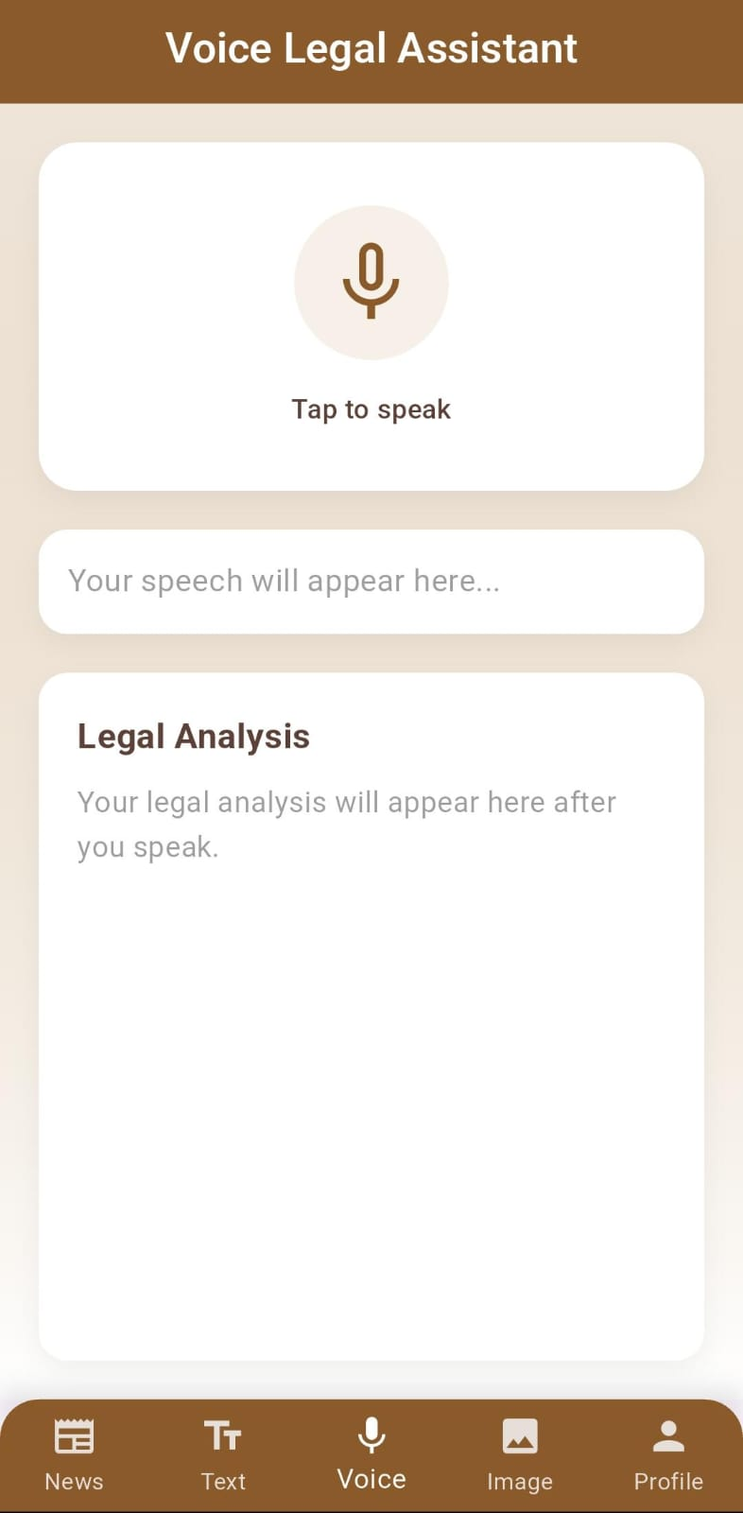
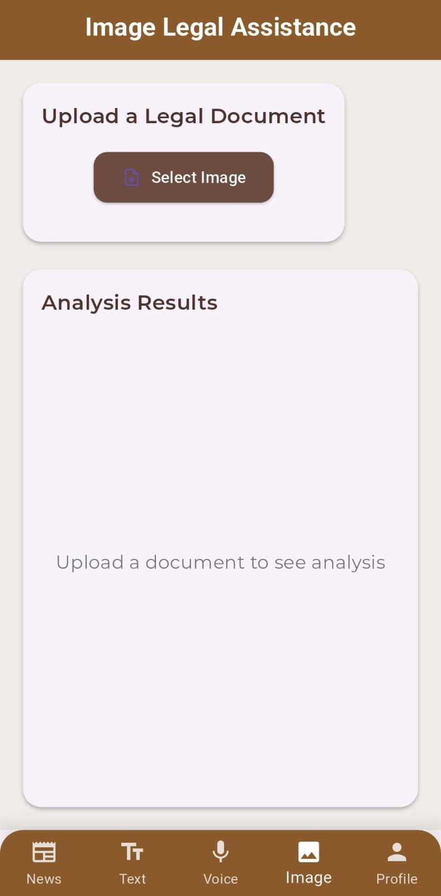
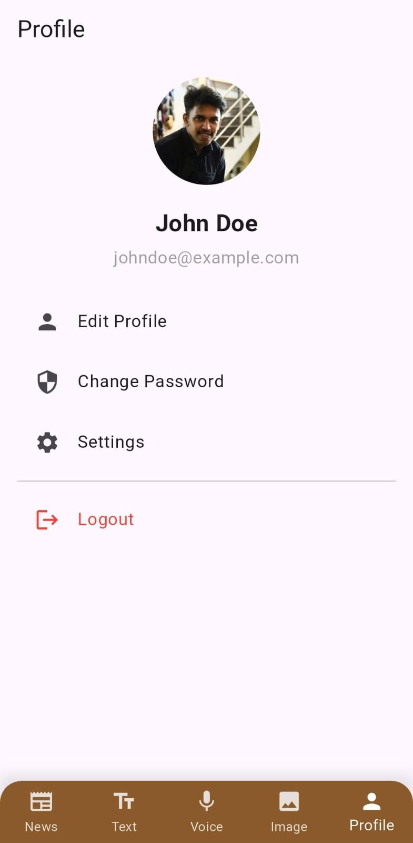

Slide 11
PROJECT TIMELINE
Date | Task | Description
Jan 5,2025 | Project Planning | Defined app features, selected team (Ajina, Deva, Sayooj, Arshak).
Jan 12,2025 | Tech Stack Finalized | Chose Flutter for frontend, Firebase for backend.
Jan 18,2025 | Github Repo Setup | Created GitHub repo, divided coding tasks among team members.
Jab 24,2025 | Basic UI Design | Designed Ul wireframes in Figma
Feb 2,2025 | Login & Authentication | Integrated Firebase Google Sign-In & Email/Password auth.
Feb 8,2025 | Text-based Query Input | Implemented text input field for legal queries.

Slide 12
Date | Task | Description
Feb 14,2025 | Voice Input Feature | Added speech-to-text using Google ML Kit for voice queries.
Feb 21,2025 | Image Input Feature | Integrated image upload & OCR-based text extraction.
Feb 27,2025 | Backend Integration | Connected extracted data with legal database for response.
Mar 15,2025 | Profile Section Update | Added the logout function.

Slide 13
Performance Matrix
TEST RESULTS
Confusion Matrix
Metric | Value
Accuracy | 83.33%
Precision | 100.00%
Recall | 83.33
F1 Score | 90.91%
 | Actual positive | Actual negative
Predicted positive | 10(TP) | 2(FN)
Predicted negative | 0(FP) | 0(TN)

Slide 14
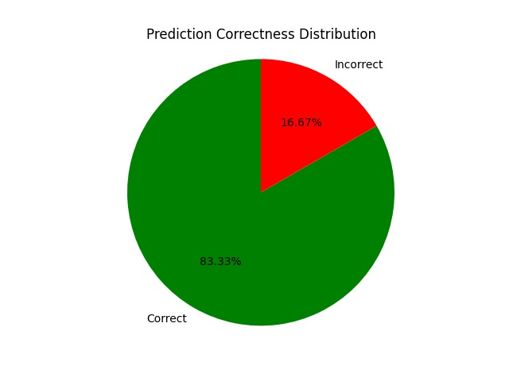

Slide 15
System Model Scalability
✅ Scalability Aspects of Nyay Mitra:
Modular Design: Each input method (Text, Voice, Image) is a separate module and can scale independently.
API-based Architecture: Uses Gemini API and external services, which scale automatically with usage.
Platform Independence: Built with Flutter – supports Android, iOS, and web with minimal changes.
Stateless Processing: No backend database is currently used, so multiple users can interact in real time without session conflicts.
Pluggable Features: Can easily add new features (like case filing, history tracking) as modules without affecting the core app.

Slide 16
Future Enhancements
🌱 Planned Additions:
User Query History Storage (using Firebase or SQLite)
Regional Language Support (Malayalam, Hindi, etc.)
Chat-based UI for conversational queries
Case Filing Tracker for FIR/complaints
Offline Mode for basic legal info without internet
Push Notifications for legal news & case updates
Admin Dashboard for analytics and content management

Slide 17
Appendices
📎 Appendix A: Glossary
IPC: Indian Penal Code
BNS: Bharatiya Nyaya Samhita
OCR: Optical Character Recognition
NLP: Natural Language Processing
UI/UX: User Interface / User Experience
📎 Appendix B: References
Indian Penal Code, 1860
Code of Criminal Procedure, 1973
Bharatiya Nyaya Samhita, 2023
Google Gemini API Docs
News API Documentation

Slide 18
CONCLUSION
The AI-driven legal app aims to simplify legal understanding by providing accurate information about relevant legal sections based on user complaints. By leveraging NLP and a structured legal database, it enhances accessibility, reduces dependency on legal professionals for basic queries, and ensures informed decision-making. With robust security, scalability, and compliance measures, the app empowers individuals with essential legal knowledge while maintaining data privacy. This innovative solution bridges the gap between legal complexities and public awareness, making legal assistance more accessible and efficient.

