Slide 1
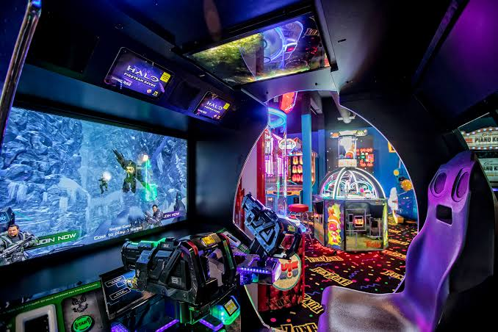
Buddies Hub
MINI PROJECT GROUP NO - 10
Group Members: Muskan Gupta - 32 Hrishita Kumar - 57 Shreya Manjucha - 64
Dr. Arun Kulkarni - (Guide)

Slide 2
Buddies Hub - Online Gaming Site
Our project is aimed at developing a website for online gaming.
Playing games is a surefire way to engage students, but making games can be just as absorbing. Game design and development builds art, math, and coding skills, and offers students an outlet to show what they know. We as a students will embark on creative, energizing experiences that'll get them thinking in new, exciting ways.
We have made sure to include features such as scoreboard and voice assistance that will keep the players engaged.
So keeping this in mind we have chosen to make four games from different domains which will help the players in all round development .

Slide 3
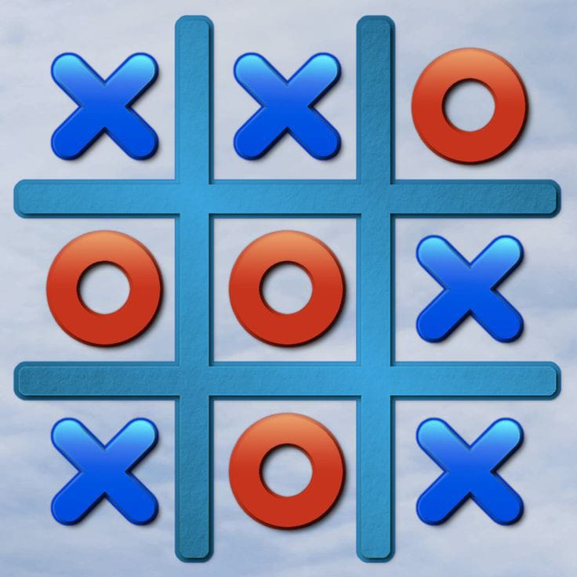
Multiplayer and Artificial Intelligence: Tic - Tac - Toe
Tic-Tac-Toe are one of the most famous games to which the moves are not left to chances, rather than pure mathematics and logical reasoning.
We had made this game previously in Sem 3 using Java and now in Sem 5 we will be enhancing it.
This game can be played in two modes:
Play with Computer – We are implementing this using Artificial Intelligent
Play with Friend – We are using Web socket programming so that anybody can play that game using their own remote machine.
We are going to implement this game using Java Script (Sem 5) and Computer Networks (Sem 4) and Database Management System(Sem 3)

Slide 4
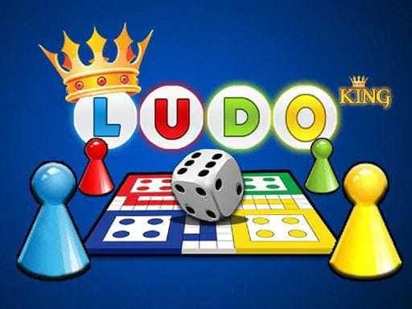
Multiplayer Game : Ludo
Board games like Ludo have been around us for several years now. We all have played some or the other board games while growing up. With the increasing popularity of online games, you can now play Ludo online anytime, anywhere.
Ludo game allow kids to think creatively and create an opportunity to connect and open up. This is an excellent opportunity for kids who are shy or quiet types. Your kids can learn and display creativity in the game. Ludo can help them develop a strong sense of individuality too that allows them to feel fulfilled and being noticed.
For some who children who may have disabilities, it can be a way for them to social and make friends if they are restricted.
We are going to implement it using Java Script and DBMS

Slide 5

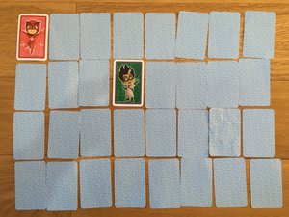
FunBrain-Educational Games
Scramble
Memory Game
Your child will learn not just commonly used everyday words, but he can use a dictionary to find meanings of several ‘difficult’ words, too. By playing the game regularly, his vocabulary improves over time.
You will observe that once your child begins to play this game, her response time improves.
Regularly playing these types of games can help improve children’s short and long-term memory and help the brain process information quicker.
Also, games capture players’ imagination helping them to stay focused on certain tasks and builds their perseverance to achieve a goal.

Slide 6
Conclusion And Future Work
To make games from different domains
To develop a gaming app
To include web socket in all games
To will conduct game tournaments
To communicate with the players through chat box
Thus we are aiming to create a professional gaming website where people can enjoy and also learn along with having fun
Therefore, our project model is B2C business model.

Slide 7
Thank You

