Slide 1
DIGITAL CITIZEN REFLECTION
0:00–1:00
A news post worth checking
"City buses will be free next month"
FICTIONAL EXAMPLE · CROPPED SCREENSHOT
What would you check before forwarding?
01
Notes:
0:00–1:00
Imagine a friend sends a cropped screenshot saying city buses will be free next month. This example is fictional. You want to help friends with transport costs, so you are tempted to forward it. What would you check first? The screenshot has no date and no original announcement. Digital Citizen Reflection helps us describe that habit, compare relevant evidence, and choose a realistic change. Today I will show the four steps, then you can reflect privately. You can use a fictional example throughout.
Presenter cue: Pause for the opening question. Do not ask for personal disclosures.

Slide 2
DIGITAL CITIZEN REFLECTION
1:00–2:00
Evidence and its limits
WHO survey: 11% showed signs of problematic social media use
Almost 280,000 young people, ages 11, 13 and 15. Surveyed in 2022.
UNESCO: a framework for judging information
Guidance helps us ask better questions. A specific claim still needs its own evidence.
WHO (2024) and UNESCO media literacy resources. Sources in speaker notes.
02
Notes:
1:00–2:00
The activity uses original sources and puts their limits beside the findings. WHO reported signs of problematic social media use in eleven percent of the young people surveyed in 2022. The study covered almost 280,000 participants aged eleven, thirteen, and fifteen across forty-four countries and regions. That gives useful population context. It cannot diagnose one person or define a safe number of minutes for everyone. UNESCO's media literacy resources offer another kind of evidence: guidance for thinking critically about information. Guidance can help us decide how to check a post, but it does not establish whether that post is true.
Presenter cue: Point out the difference between a population finding and educational guidance.
Sources
WHO, published 25 September 2024: https://www.who.int/europe/news/item/25-09-2024-teens--screens-and-mental-health
UNESCO, Media and Information Literacy, checked 4 October 2026: https://www.unesco.org/en/media-information-literacy

Slide 3
DIGITAL CITIZEN REFLECTION
2:00–3:00
The four-step framework
1
Observe
What happens, in what context?
2
Evaluate
What does the evidence support?
3
Identify
What risk matters? What benefit stays?
4
Act
What will I try, check, and review?
03
Notes:
2:00–3:00
The same four steps work across attention, privacy, news, and AI tools. Observe means describing something you actually do, and when it happens. Evaluate means looking at a source, its date, who it covers, and its limitations. Identify means naming a risk while keeping sight of a benefit you value. Act means choosing one realistic change, a way to check what happens, and a date to review it. The page suggests a review seven days ahead, but you can change it. The aim is a useful action plan rather than a score or a judgment about the person.
Presenter cue: Name each step slowly. Transition to the live page. Keep slides 4–7 available as the screenshot backup.

Slide 4
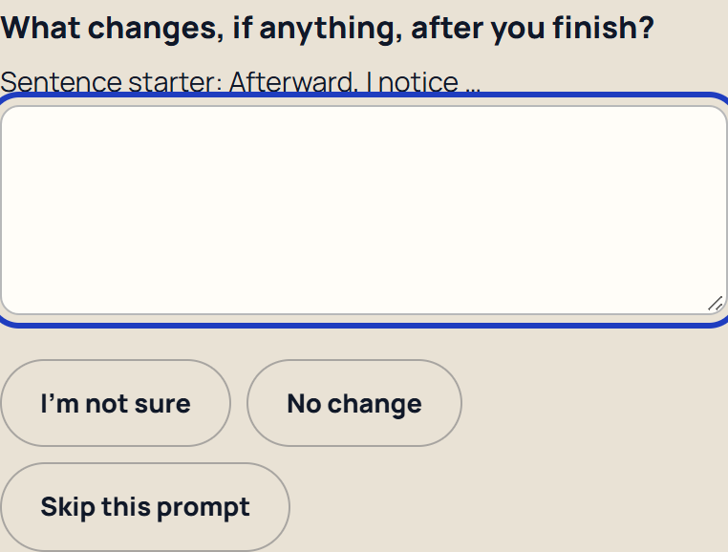
DIGITAL CITIZEN REFLECTION
3:00–4:00
Observe: the news-sharing habit
FICTIONAL NEWS EXAMPLE
A cropped bus-news screenshot has no date or original announcement.
Help me answer offers smaller prompts when requested.
Screenshot backup of the working activity
04
Notes:
3:00–4:00
Our fictional post has no date or original link. We can describe that without calling it true or false. In Observe, I select News and information and load the fictional example. If the question about what I notice feels difficult, Help me answer offers smaller prompts. For example: what changes, if anything, afterward? I can skip, say I am not sure, or report no change. A draft uses only the words I supply; I review it before using it.
Presenter cue: Live: load the news example. Open Help me answer beside What do you notice afterward, show its first prompt, then close it. Keep the fictional answer. Backup: show the requested-help excerpt.

Slide 5
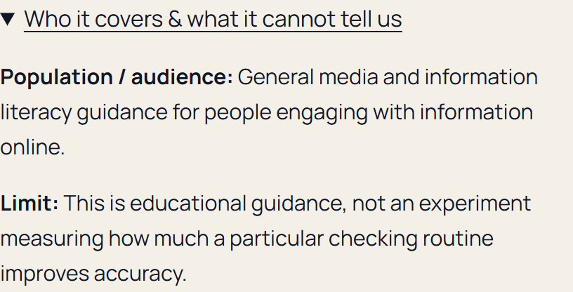
DIGITAL CITIZEN REFLECTION
4:00–5:00
Evaluate: what supports the claim?
FICTIONAL NEWS EXAMPLE
An original source and a date
Media literacy guidance helps us look for missing context.
Neither card verifies this fictional bus claim.
Screenshot backup of the working activity
05
Notes:
4:00–5:00
In Evaluate, the relevant sources help me think about checking information. I can see the publisher and date, then open the population and limitation section. UNESCO's guidance asks me to engage critically with information. It does not verify our fictional transport claim. I would still need a dated announcement from the transit agency, with the details and conditions. This is why comparing a finding with its limits matters. A trustworthy source can guide a process without answering every question about a particular post.
Presenter cue: Live: choose Next step. Expand Who it covers & what it cannot tell us on the UNESCO literacy card. Read the evidence response. Backup: point to the expanded source card in the screenshot.
Sources
UNESCO: https://www.unesco.org/en/media-information-literacy
UNESCO generative AI guidance: https://www.unesco.org/en/articles/guidance-generative-ai-education-and-research

Slide 6
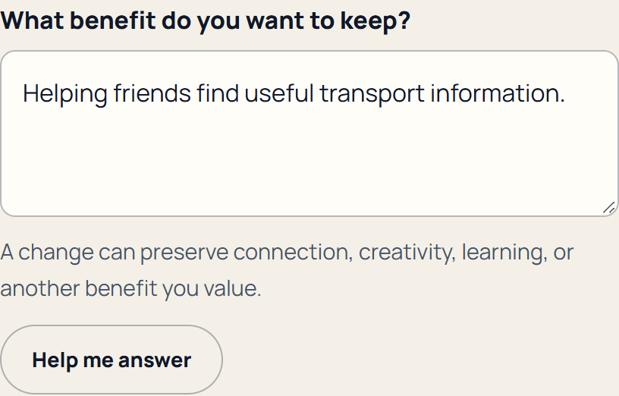
DIGITAL CITIZEN REFLECTION
5:00–6:00
Identify: the risk and the benefit
FICTIONAL NEWS EXAMPLE
Risk
Sharing a claim without evidence
Benefit to preserve
Helping friends find useful transport information
Screenshot backup of the working activity
06
Notes:
5:00–6:00
Now I identify the risk: passing along a claim before I have evidence for it. That can mislead people making plans. The benefit is still worth keeping. I want to help friends find useful transport information. Naming both makes the change more realistic. I do not have to stop sharing news to improve how I share it. The form lets participants select a risk or describe their own, and it asks them to write the benefit they want to preserve.
Presenter cue: Live: choose Next step. Point to the selected risk and benefit. Backup: read those two fields from this slide.

Slide 7
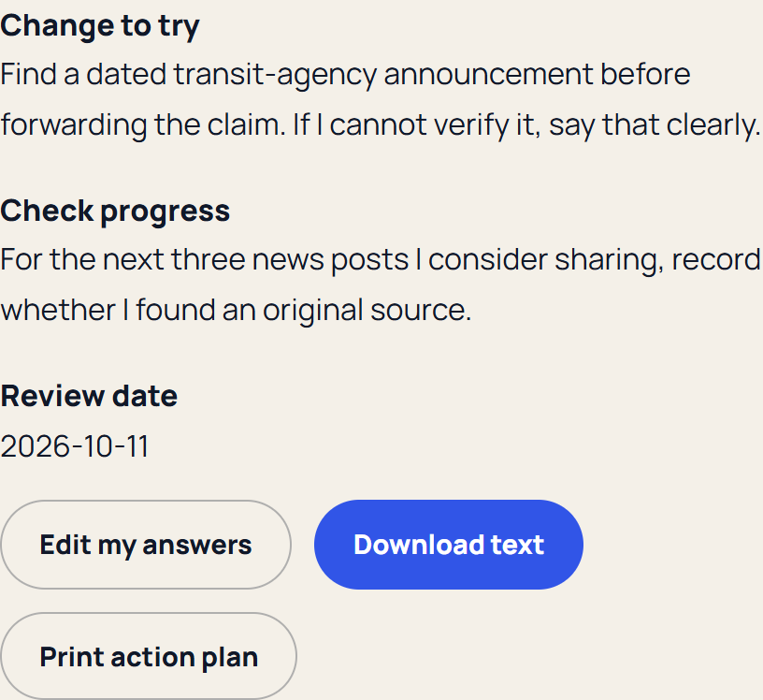
DIGITAL CITIZEN REFLECTION
6:00–7:00
Act: a change we can check
FICTIONAL NEWS EXAMPLE
Find a dated transit-agency announcement before forwarding.
For the next three posts, record whether an original source was available.
Review in seven days.
Screenshot backup of the working activity
07
Notes:
6:00–7:00
The change is specific: find a dated transit-agency announcement before forwarding the claim. If I cannot verify it, I will say that clearly. The check is also specific: for the next three news posts I consider sharing, note whether I found an original source. I can review that in seven days. The summary stays editable. I can download a text copy or print it. Answers remain temporary unless I enable Save on this device. Saving uses this browser only, so a shared device needs care. Clear reflection removes the draft and the current answers.
Presenter cue: Live: choose Act, point to change/check/date, then Build my action plan. Download the text once, then return to the summary. Keep Save on this device unchecked. Backup: show the finished-plan excerpt and describe edit, download and print.

Slide 8
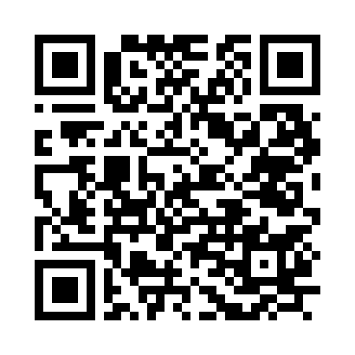
DIGITAL CITIZEN REFLECTION
7:00–9:00
Your two-minute reflection
Choose one habit or a fictional example
Attention / Social privacy / News / AI tools
Use the page, paper, or your own notes
What risk matters? What benefit stays?
What change could you try and check?
mini34.github.io/
digital-citizen-reflection/
08
Notes:
7:00–9:00
Take two minutes for your own reflection. Use the page, the worksheet, or your own notes. Pick one habit or a fictional example. Keep names and private details out. Name a risk and a benefit to preserve. Choose one small change and a check you can observe. You can keep this private and finish later.
Presenter cue: Point to the QR and printed address. Use up to 30 seconds for instructions, then allow 90 seconds privately. At 8:45 give a fifteen-second notice. Offer the paper worksheet if phones or Wi-Fi are unavailable.

Slide 9
DIGITAL CITIZEN REFLECTION
9:00–9:25
Development lessons
Source limits belong beside findings
Saving private answers needs a choice
Prepared prompts keep the participant in control
09
Notes:
9:00–9:25
Building the activity made source limits and privacy choices concrete. The helper waits for an invitation and leaves the participant in control. Testing also covered going back, recovering drafts, keyboard use, and blocked storage.
Presenter cue: Describe the demonstrated source, privacy, and helper decisions. Keep the talk within the checkpoint.

Slide 10
DIGITAL CITIZEN REFLECTION
9:25–10:00
One change, then a review
Observe. Evaluate. Identify. Act.
Keep the benefit. Try the change.
Review what actually happened.
Activity, worksheet, and resources
mini34.github.io/digital-citizen-reflection/
10
Notes:
9:25–10:00
The takeaway is a process you can repeat: observe, evaluate, identify, and act. Keep the benefit you value, try one realistic change, and review what actually happened. The worksheet has the same four steps. Scan the QR or use the address for the activity and resources. The presentation link will keep working when the activity returns to the portfolio. Thank you.
Presenter cue: Show the worksheet and QR. End by 10:00. Do not imply an automatic retirement date.

