Slide 1
SIGNAL & SELF
0:00–1:00
Digital Citizen Reflection
Turning online habits into evidence and action
Mina Soliman
Signal & Self
01
Notes:
0:00–1:00
Think about the last thing you shared, watched, or asked an AI tool. What made it useful? What made you hesitate? Online habits can help us connect and learn, while also affecting our attention, privacy, and the information other people receive. This project gives us a way to examine one specific habit and make a small change we can actually test. It works with an example or your own observation. Today we will use a fictional news post, then you will have time to think about a habit of your own. You do not need to share personal details.
Presenter cue: Pause briefly after the opening questions. Keep this slide up for the first minute.

Slide 2
SIGNAL & SELF
1:00–2:00
Evidence and its limits
WHO survey: 11% showed signs of problematic social media use
Almost 280,000 young people, ages 11, 13 and 15. Surveyed in 2022.
UNESCO: a framework for judging information
Guidance helps us ask better questions. A specific claim still needs its own evidence.
WHO (2024) and UNESCO media literacy resources. Sources in speaker notes.
02
Notes:
1:00–2:00
The activity uses original sources and puts their limits beside the findings. WHO reported signs of problematic social media use in eleven percent of the young people surveyed in 2022. The study covered almost 280,000 participants aged eleven, thirteen, and fifteen across forty-four countries and regions. That gives useful population context. It cannot diagnose one person or define a safe number of minutes for everyone. UNESCO's media literacy resources offer another kind of evidence: guidance for thinking critically about information. Guidance can help us decide how to check a post, but it does not establish whether that post is true.
Presenter cue: Point out the difference between a population finding and educational guidance.
Sources
WHO, published 25 September 2024: https://www.who.int/europe/news/item/25-09-2024-teens--screens-and-mental-health
UNESCO, Media and Information Literacy, checked 4 October 2026: https://www.unesco.org/en/media-information-literacy

Slide 3
SIGNAL & SELF
2:00–3:00
The four-step framework
1
Observe
What happens, in what context?
2
Evaluate
What does the evidence support?
3
Identify
What risk matters? What benefit stays?
4
Act
What will I try, check, and review?
03
Notes:
2:00–3:00
The same four steps work across attention, privacy, news, and AI tools. Observe means describing something you actually do, and when it happens. Evaluate means looking at a source, its date, who it covers, and its limitations. Identify means naming a risk while keeping sight of a benefit you value. Act means choosing one realistic change, a way to check what happens, and a date to review it. The page suggests a review seven days ahead, but you can change it. The aim is a useful action plan rather than a score or a judgment about the person.
Presenter cue: Name each step slowly. Transition to the live page. Keep slides 4–7 available as the screenshot backup.

Slide 4
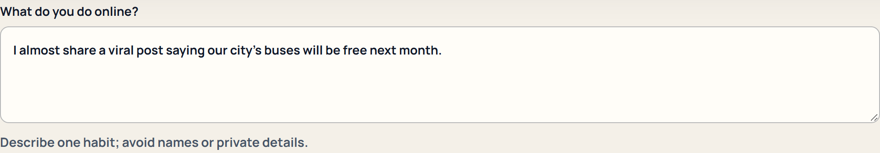
SIGNAL & SELF
3:00–4:00
Observe: the news-sharing habit
FICTIONAL NEWS EXAMPLE
A friend posts a cropped screenshot claiming city buses will be free next month.
The date and original announcement are missing.
Screenshot backup of the working activity
04
Notes:
3:00–4:00
Here is our fictional example. A friend shares a cropped screenshot saying our city's buses will be free next month. I might want to forward it because free transport would matter to people I know. In Observe, the important detail is that the screenshot has no date or original link. I have described the situation without claiming the news is either true or false. The page labels this as a fictional example. I can edit it, or start my own reflection.
Presenter cue: Live: open the activity, select News & information, and choose Use fictional example. Read the observation, context, and notice. Backup: use this actual page excerpt and read the same observation.

Slide 5
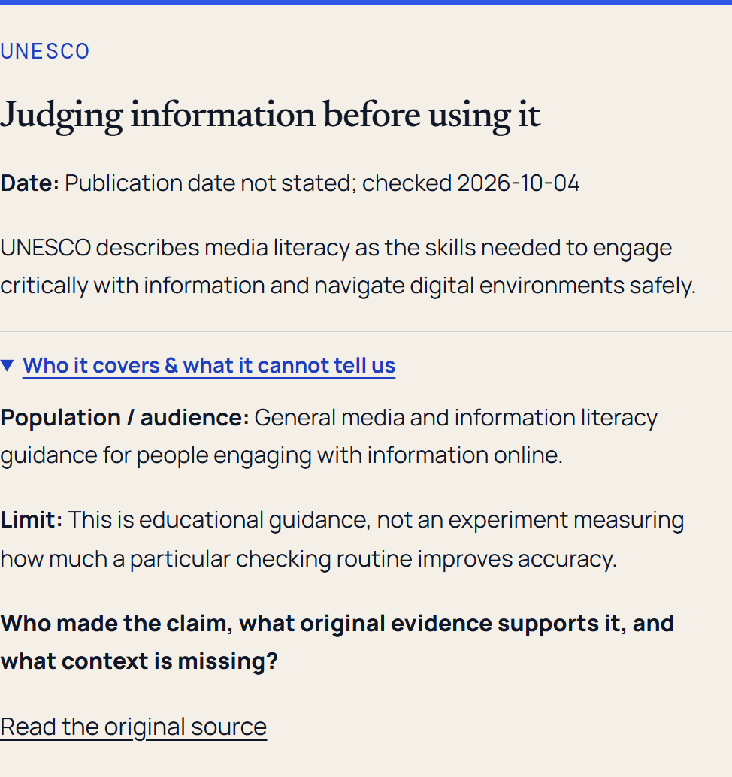
SIGNAL & SELF
4:00–5:00
Evaluate: what supports the claim?
FICTIONAL NEWS EXAMPLE
An original source and a date
Media literacy guidance helps us look for missing context.
Neither card verifies this fictional bus claim.
Screenshot backup of the working activity
05
Notes:
4:00–5:00
In Evaluate, the relevant sources help me think about checking information. I can see the publisher and date, then open the population and limitation section. UNESCO's guidance asks me to engage critically with information. It does not verify our fictional transport claim. I would still need a dated announcement from the transit agency, with the details and conditions. This is why comparing a finding with its limits matters. A trustworthy source can guide a process without answering every question about a particular post.
Presenter cue: Live: choose Next step. Expand Who it covers & what it cannot tell us on the UNESCO literacy card. Read the evidence response. Backup: point to the expanded source card in the screenshot.
Sources
UNESCO: https://www.unesco.org/en/media-information-literacy
UNESCO generative AI guidance: https://www.unesco.org/en/articles/guidance-generative-ai-education-and-research

Slide 6
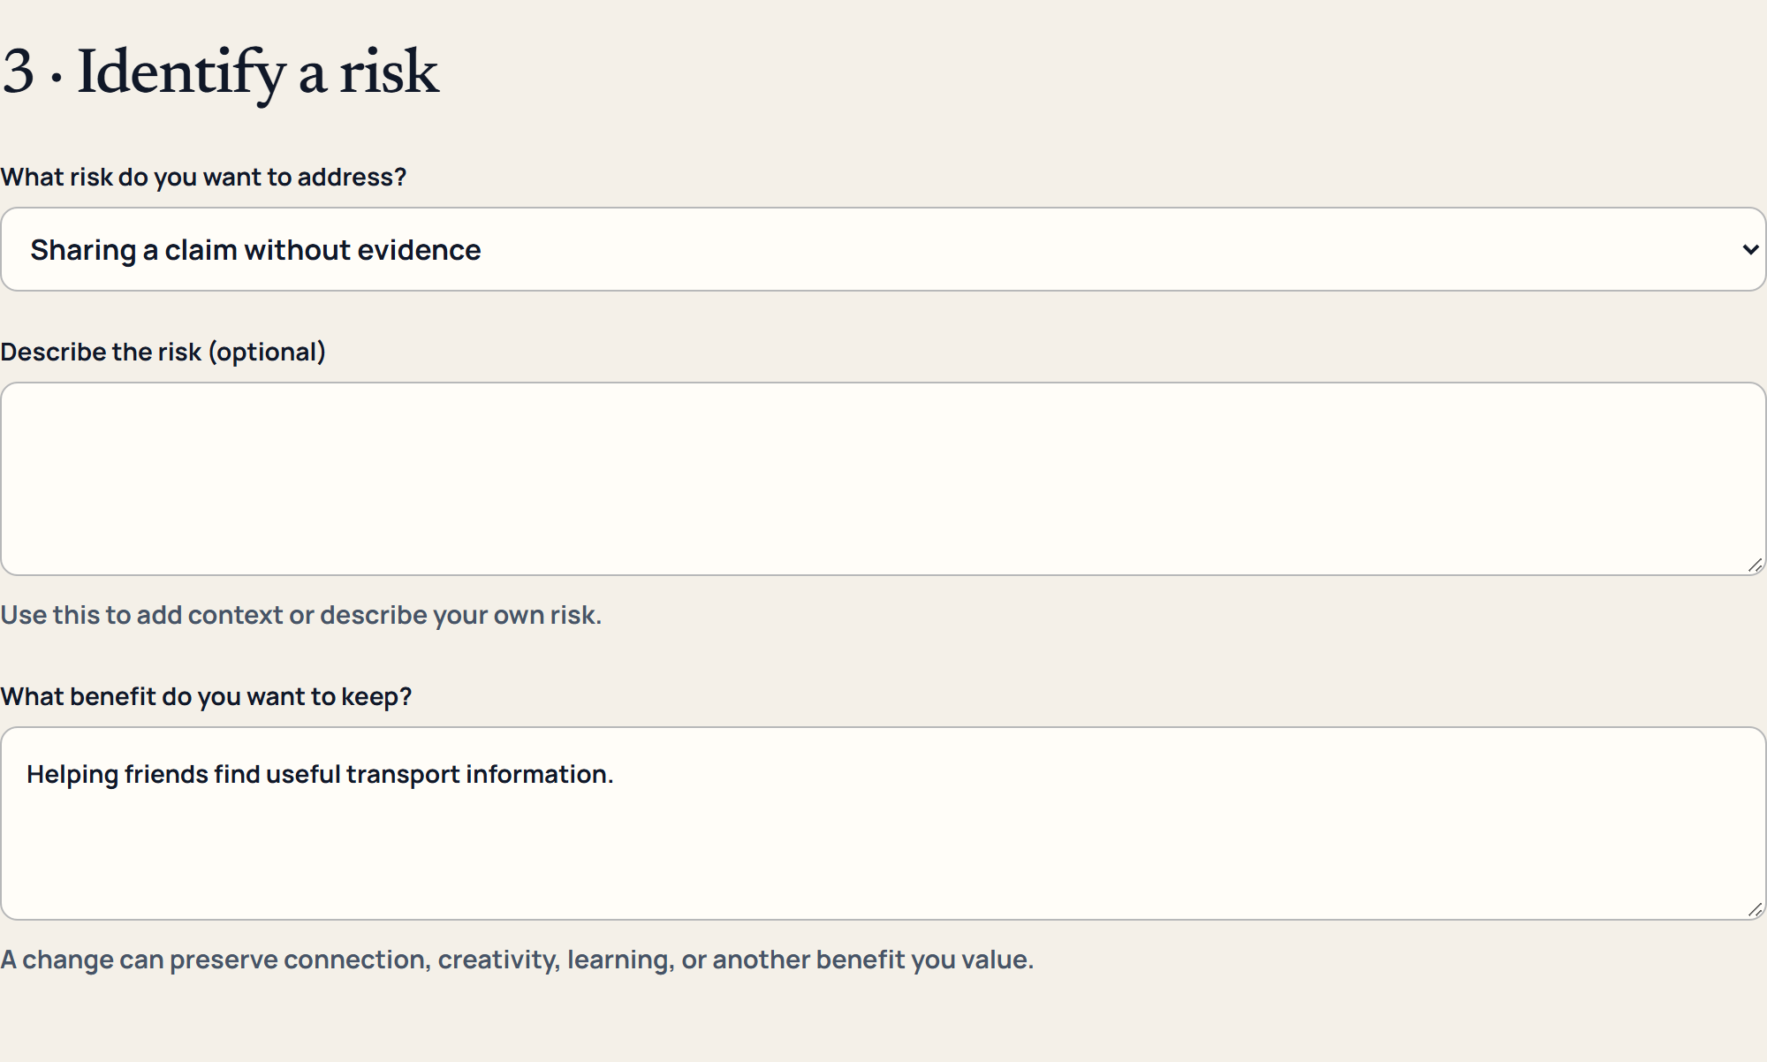
SIGNAL & SELF
5:00–6:00
Identify: the risk and the benefit
FICTIONAL NEWS EXAMPLE
Risk
Sharing a claim without evidence
Benefit to preserve
Helping friends find useful transport information
Screenshot backup of the working activity
06
Notes:
5:00–6:00
Now I identify the risk: passing along a claim before I have evidence for it. That can mislead people making plans. The benefit is still worth keeping. I want to help friends find useful transport information. Naming both makes the change more realistic. I do not have to stop sharing news to improve how I share it. The form lets participants select a risk or describe their own, and it asks them to write the benefit they want to preserve.
Presenter cue: Live: choose Next step. Point to the selected risk and benefit. Backup: read those two fields from this slide.

Slide 7
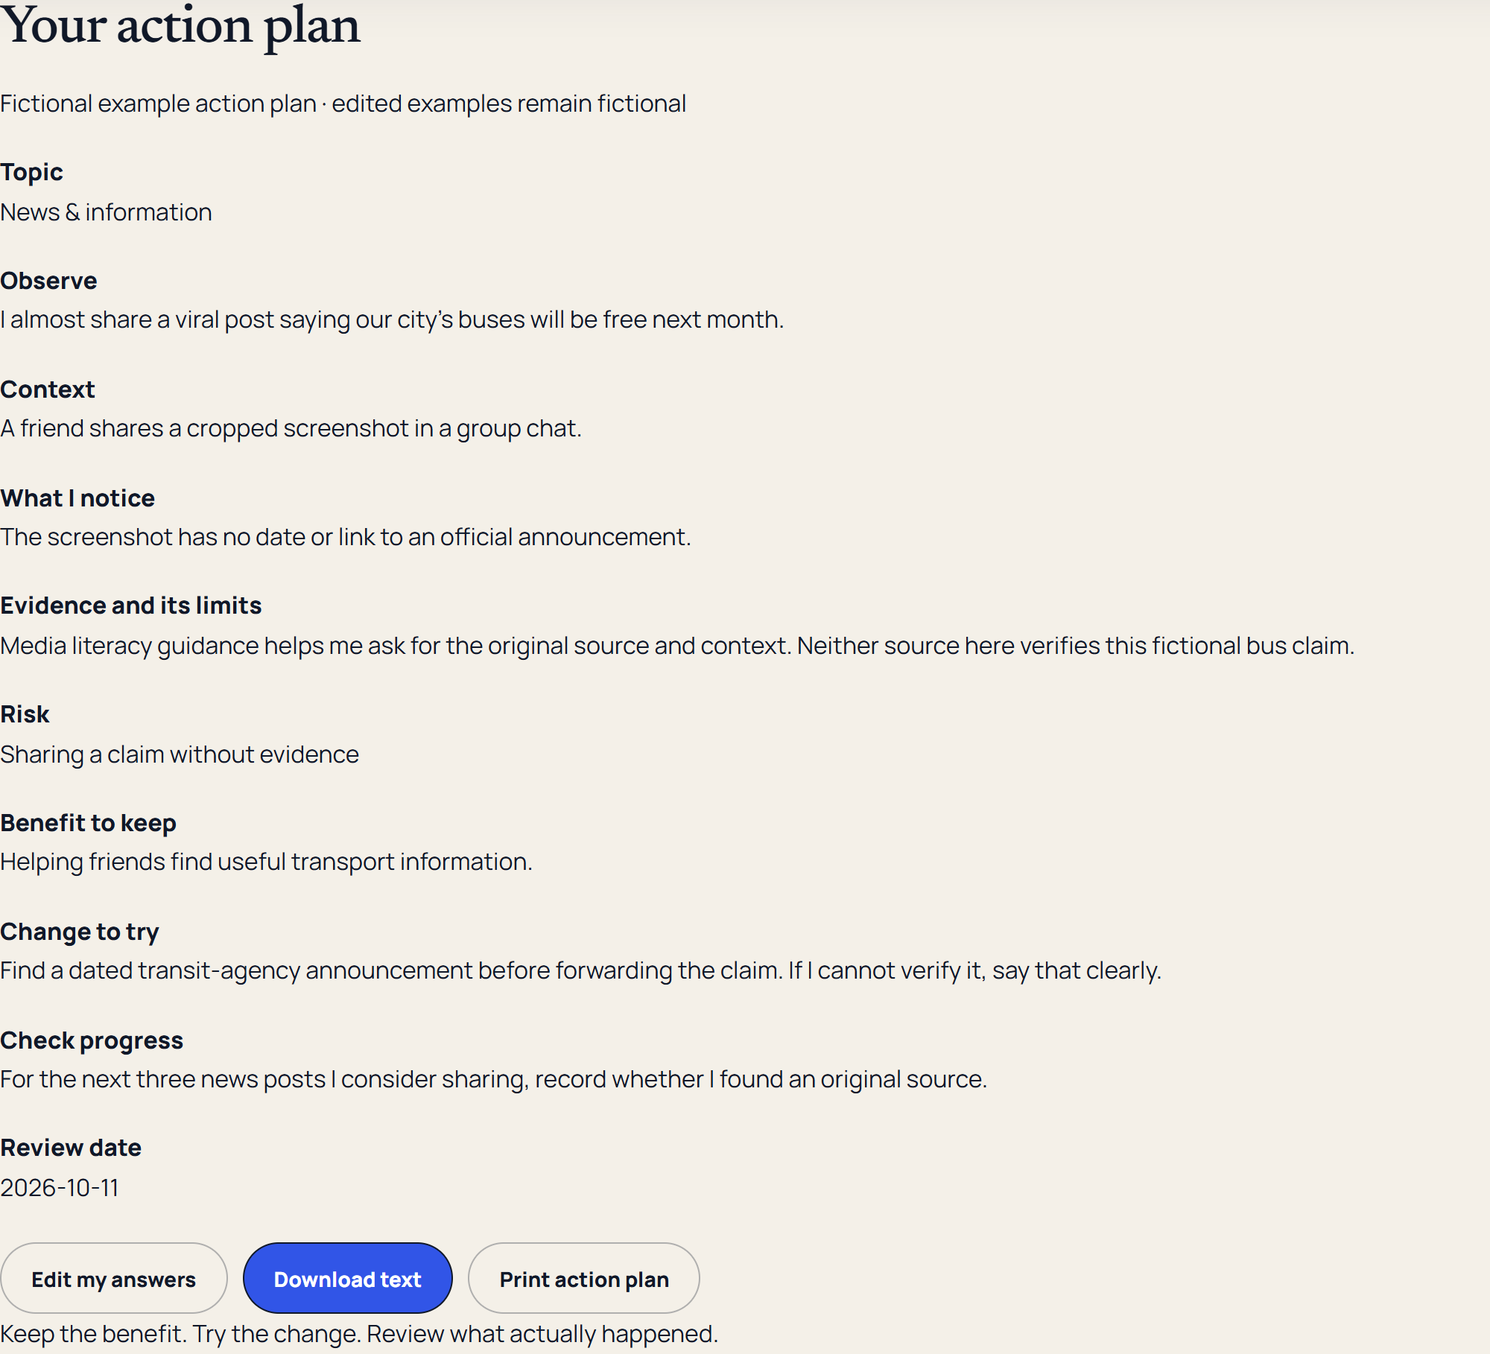
SIGNAL & SELF
6:00–7:00
Act: a change we can check
FICTIONAL NEWS EXAMPLE
Find a dated transit-agency announcement before forwarding.
For the next three posts, record whether an original source was available.
Review in seven days.
Screenshot backup of the working activity
07
Notes:
6:00–7:00
The change is specific: find a dated transit-agency announcement before forwarding the claim. If I cannot verify it, I will say that clearly. The check is also specific: for the next three news posts I consider sharing, note whether I found an original source. I can review that in seven days. The summary stays editable. I can download a text copy or print it. Answers remain temporary unless I enable Save on this device. Saving uses this browser only, so a shared device needs care. Clear reflection removes the draft and the current answers.
Presenter cue: Live: choose Next step, point to change/check/date, then Build my action plan. Briefly show Edit my answers, Download text, Print action plan, and the unchecked saving control. Backup: show the completed summary screenshot. Avoid opening personal drafts.

Slide 8
SIGNAL & SELF
7:00–9:00
Your two-minute reflection
Choose one habit or one fictional example
Screen time and attention / Social media and privacy
News and information / AI-assisted tools
Write the risk, the benefit, and one change you could try.
How would you check it? When would you review it?
08
Notes:
7:00–9:00
Take two minutes for your own reflection. Use the page, the worksheet, or your own notes. Pick one habit or a fictional example. Keep names and private details out. Name a risk and a benefit to preserve. Choose one small change and a check you can observe. You can keep this private and finish later.
Presenter cue: Use 30 seconds to introduce the activity, then allow 90 seconds of quiet reflection. At 8:45, give a gentle fifteen-second notice. Do not ask participants to post their answers publicly.

Slide 9
SIGNAL & SELF
9:00–9:25
Development lessons
Sources need their limits beside them
Private answers need a deliberate save choice
Draft recovery and keyboard access need testing
09
Notes:
9:00–9:25
The development work made three decisions concrete. Source cards need clear limitations. Private reflection needs an explicit choice about saving. And accessibility includes what happens when someone goes back, reloads a draft, or cannot use browser storage. Those decisions shape whether a participant can complete the activity.
Presenter cue: Describe the demonstrated design decisions. Add personal experiences only if Mina has confirmed them.

Slide 10
SIGNAL & SELF
9:25–10:00
One change, then a review
Observe. Evaluate. Identify. Act.
Keep the benefit. Try the change.
Review what actually happened.
mini34.github.io/signal-and-self/
10
Notes:
9:25–10:00
The takeaway is a repeatable process: observe a habit, evaluate the evidence, identify a risk and a benefit, then act. Keep the benefit you value, try one change, and review what actually happened. The worksheet has the same four steps. The activity is part of Signal & Self, using the submitted website link. Thank you.
Presenter cue: Show the worksheet and website address. End by 10:00. The existing public link will gain the activity after the reviewed change is published.

