Slide 1
Graphics with PICO-8
A #gamedev-interest presentation

Slide 2
Outline
PICO-8 Background
Building a graphics engine
  2d Wireframe
  3d Wireframe
  Perspective
  Shading
Further techniques

Slide 3

What is PICO-8?
Fantasy Console
Minimalist Game Development Platform

Slide 4
PICO-8 API
circ
circfill
rect
rectfill
spr
sspr
line
map
mget
mset
music
sfx
btn
btnp
sin
cos
time
rnd

Slide 5
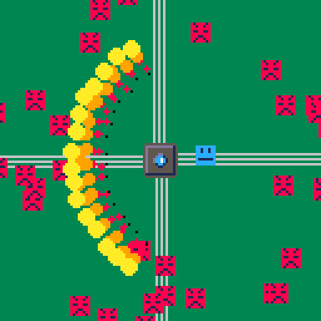
What Doesn’t PICO-8 Have?

Slide 6
What Doesn’t PICO-8 Have?

Slide 7
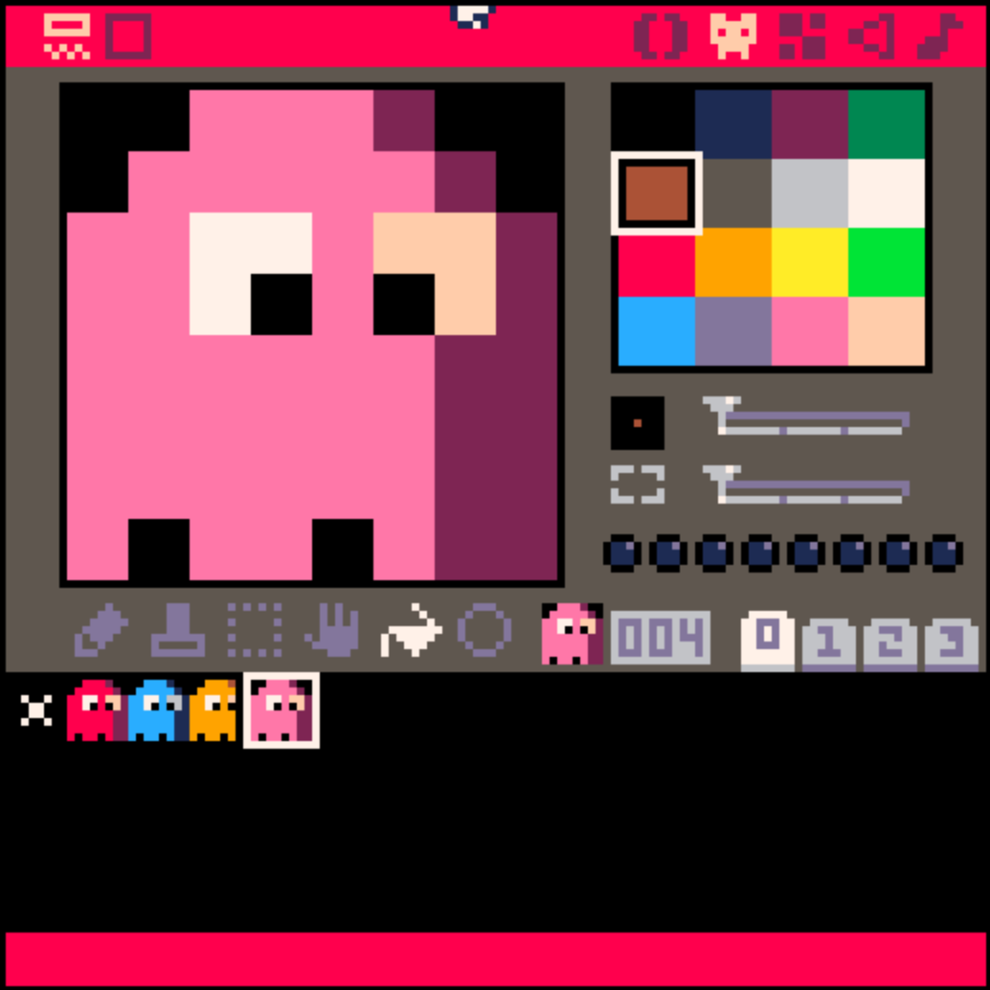
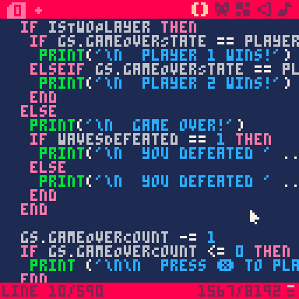
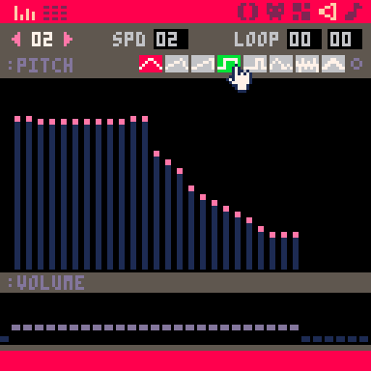
What is PICO-8?
Game Engine
Code Editor
Graphics Editor
Audio Editor

Slide 8
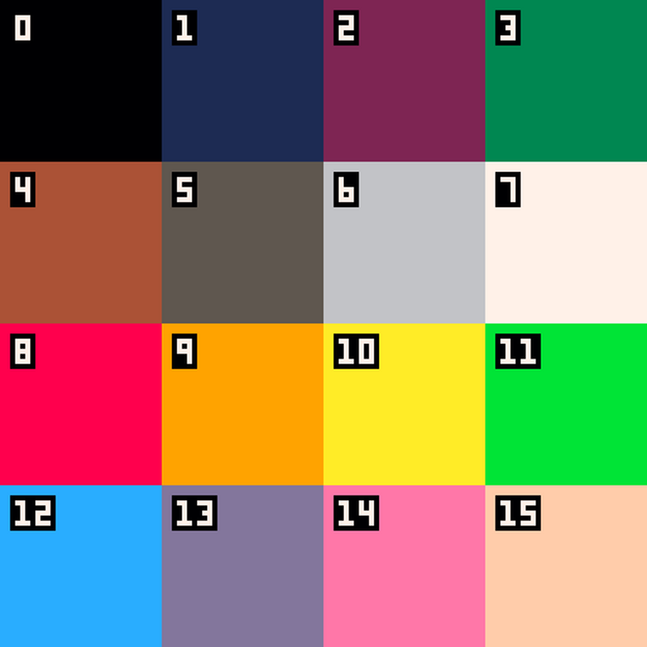
PICO-8 “Hardware” Limitations
128x128 pixel display
16 colors
4 channel, 8-bit audio
256 8x8 sprites
Limited memory, CPU,
and code

Slide 9
PICO-8 “Hardware” Limitations
128x128 pixel display
16 colors
4 channel, 8-bit audio
256 8x8 sprites
Limited memory, CPU,
and code

Slide 10
What is PICO-8?
Game Engine
Code Editor
Graphics Editor
Audio Editor

Slide 11
What is PICO-8?
Minimalist Game Development Platform
Retro Games
Pixel Art
Chiptune
Hardware limitations

Slide 12
What is PICO-8?
Fantasy Console
Game Development Platform
Retro Games
Pixel Art
Chiptune
Hardware limitations

Slide 13
PICO-8 API
circ
circfill
rect
rectfill
spr
sspr
line
map
mget
mset
music
sfx
btn
btnp
sin
cos
time
rnd

Slide 14

What is a Game Jam?
Competition
Make a video game in a limited time frame
24 – 48 hours
3 hours – 1 month
Theme

Slide 15
Why is this fun?
Constraints breed creativity
Challenge
Low Pressure
Solves Too-Many Options

