Slide 1
Graphics with PICO-8

Slide 2
Goals
Understand the magic behind computer graphics
Use the PICO-8 environment to implement a graphics engine

Slide 3
Outline
PICO-8 Background
Building a graphics engine
  2d Wireframe
  3d Wireframe
  Perspective
  Shading
  Texture Mapping
Advanced techniques

Slide 4

What is PICO-8?
Minimalist Game Development Platform
Everything you need to make a game, but nothing more

Slide 5
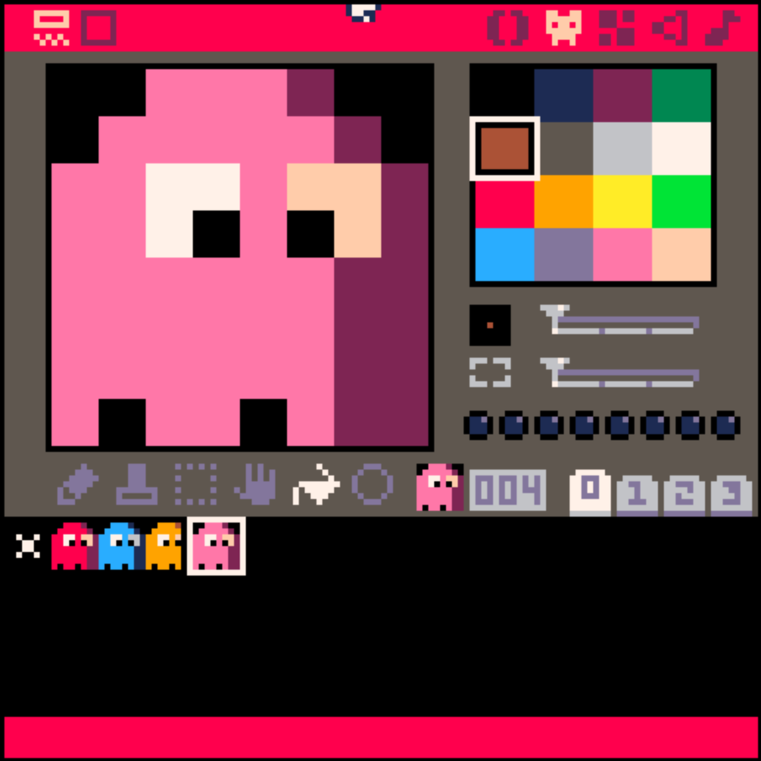
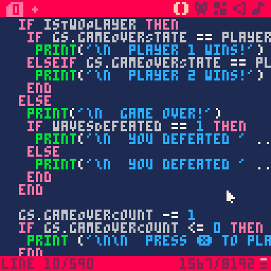
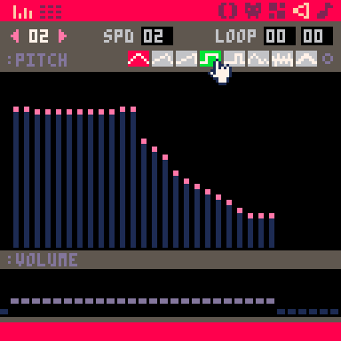
PICO-8 Features
Game Engine
Code Editor
Graphics Editor
Audio Editor

Slide 6
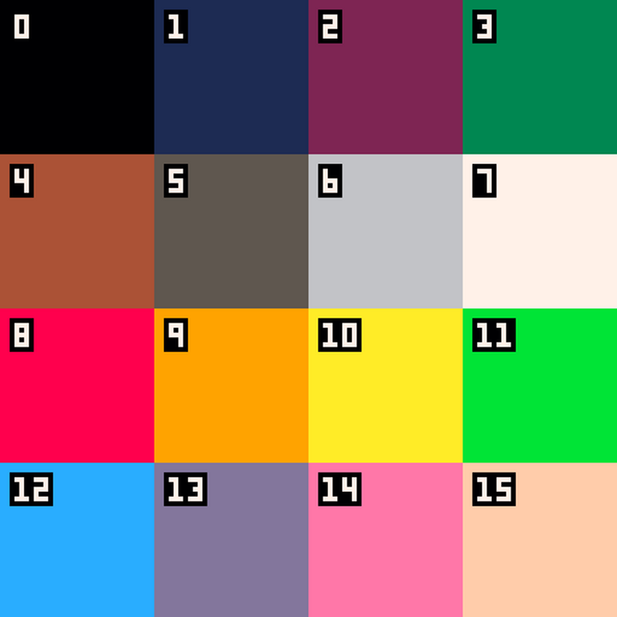
PICO-8 Limitations
128x128 pixel display
16 colors
Limited memory, CPU,
and code

Slide 7
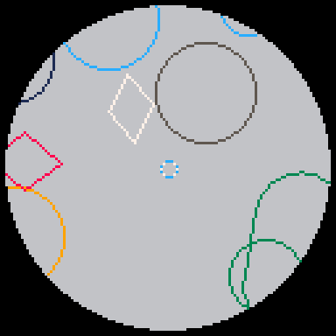
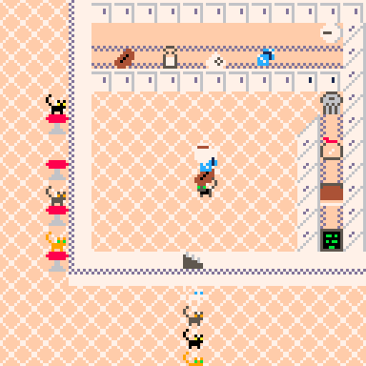
PICO-8 2D Support
Sprites
Graphics Primitives
  Lines
  Rectangles
  Ovals

Slide 8
Does PICO-8 Have a Particle System?

Slide 9
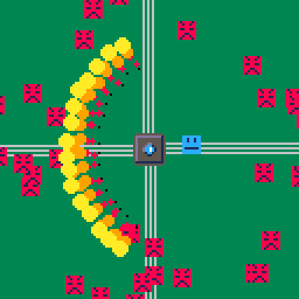
No! You have to build one

Slide 10
Does PICO-8 Have a Physics Engine?

Slide 11
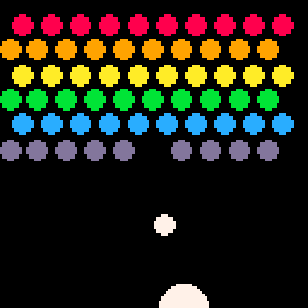
No! You have to build one!

Slide 12
Does PICO-8 Have a 3-D
Graphics Engine?

Slide 13
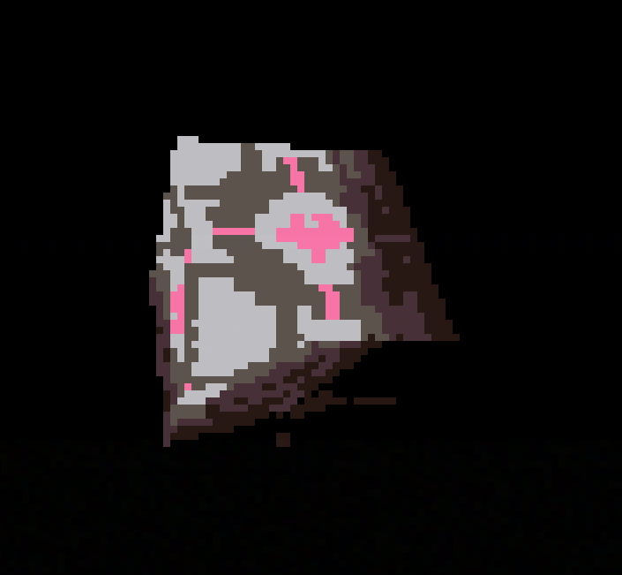
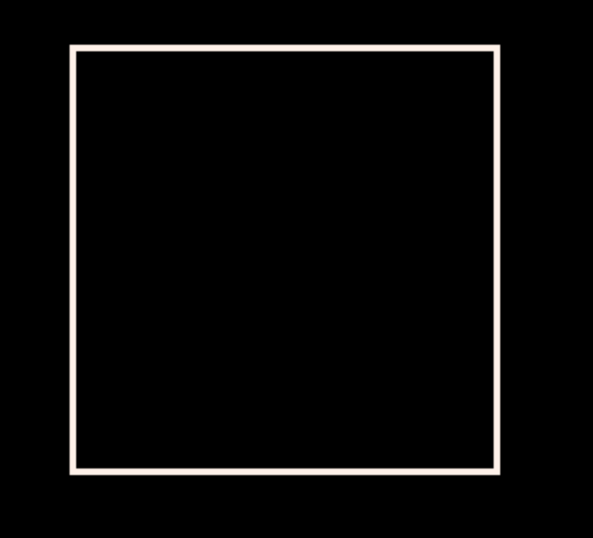
No! Let’s Build One!

Slide 14
PICO-8 API
line
pset
sin
cos

Slide 15
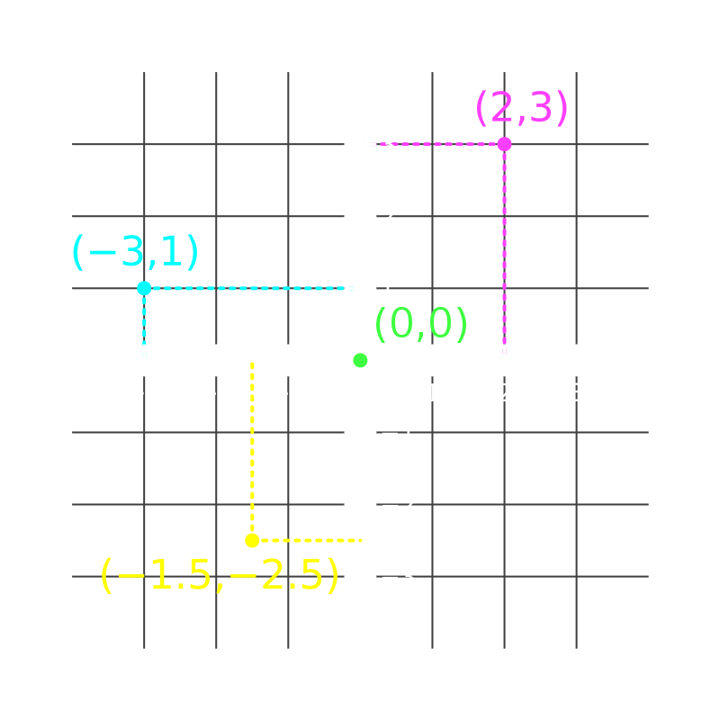
Coordinates
https://www.informit.com/articles/article.aspx?p=31554

Slide 16
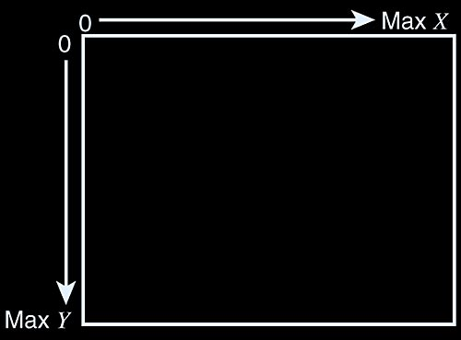
Screen Coordinates
https://www.informit.com/articles/article.aspx?p=31554

Slide 17
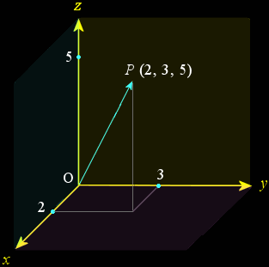
Vectors
https://www.google.com/url?sa=i&url=https%3A%2F%2Fstackoverflow.com%2Fquestions%2F45165313%2Fquaternion-from-vector-x-y-z-components-in-qt&psig=AOvVaw3lP8i-ybzv6t_Y6B4HMT13&ust=1715446069288000&source=images&cd=vfe&opi=89978449&ved=0CBQQjhxqFwoTCOC5uePEg4YDFQAAAAAdAAAAABAE

Slide 18
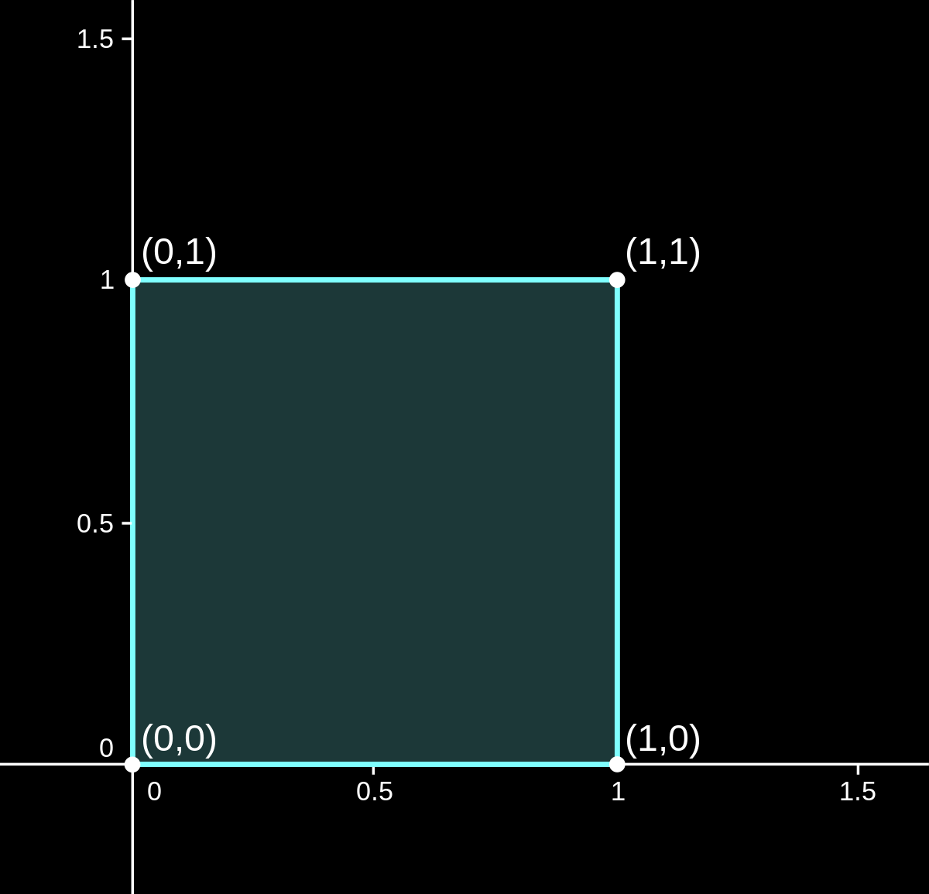
Unit Square
https://www.google.com/url?sa=i&url=https%3A%2F%2Fen.wikipedia.org%2Fwiki%2FUnit_square&psig=AOvVaw39yB23xFGP7e8Pn6KL4ND8&ust=1715426469638000&source=images&cd=vfe&opi=89978449&ved=0CBQQjhxqFwoTCKC61t37goYDFQAAAAAdAAAAABAE

Slide 19
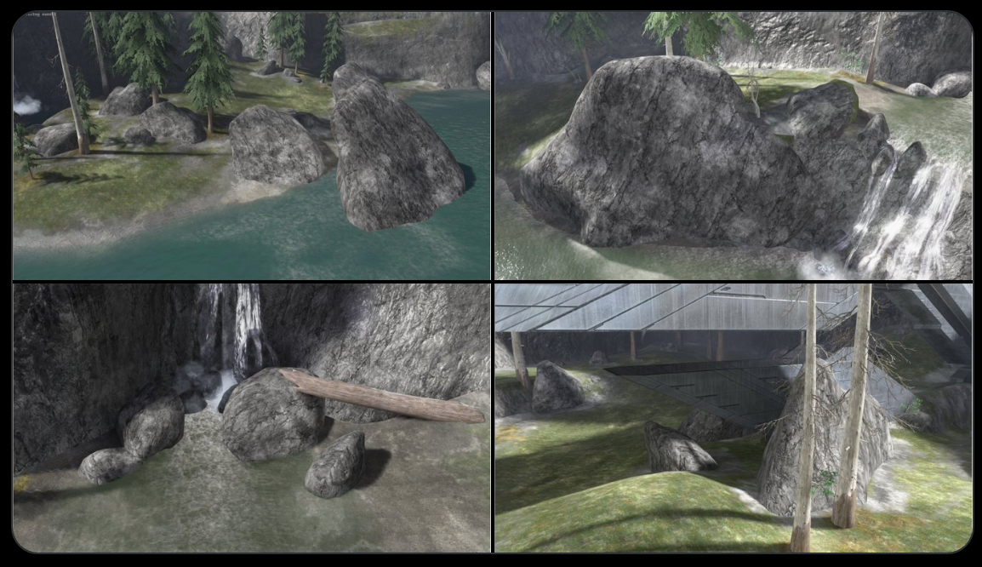
Transformations
https://x.com/RejectedShotgun/status/1758589302840168865

Slide 20
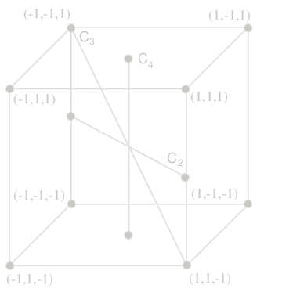
Unit Cube
https://www.researchgate.net/figure/The-figure-shows-the-vertices-and-corresponding-coordinates-of-the-cube-described-in-the_fig2_43164708

Slide 21
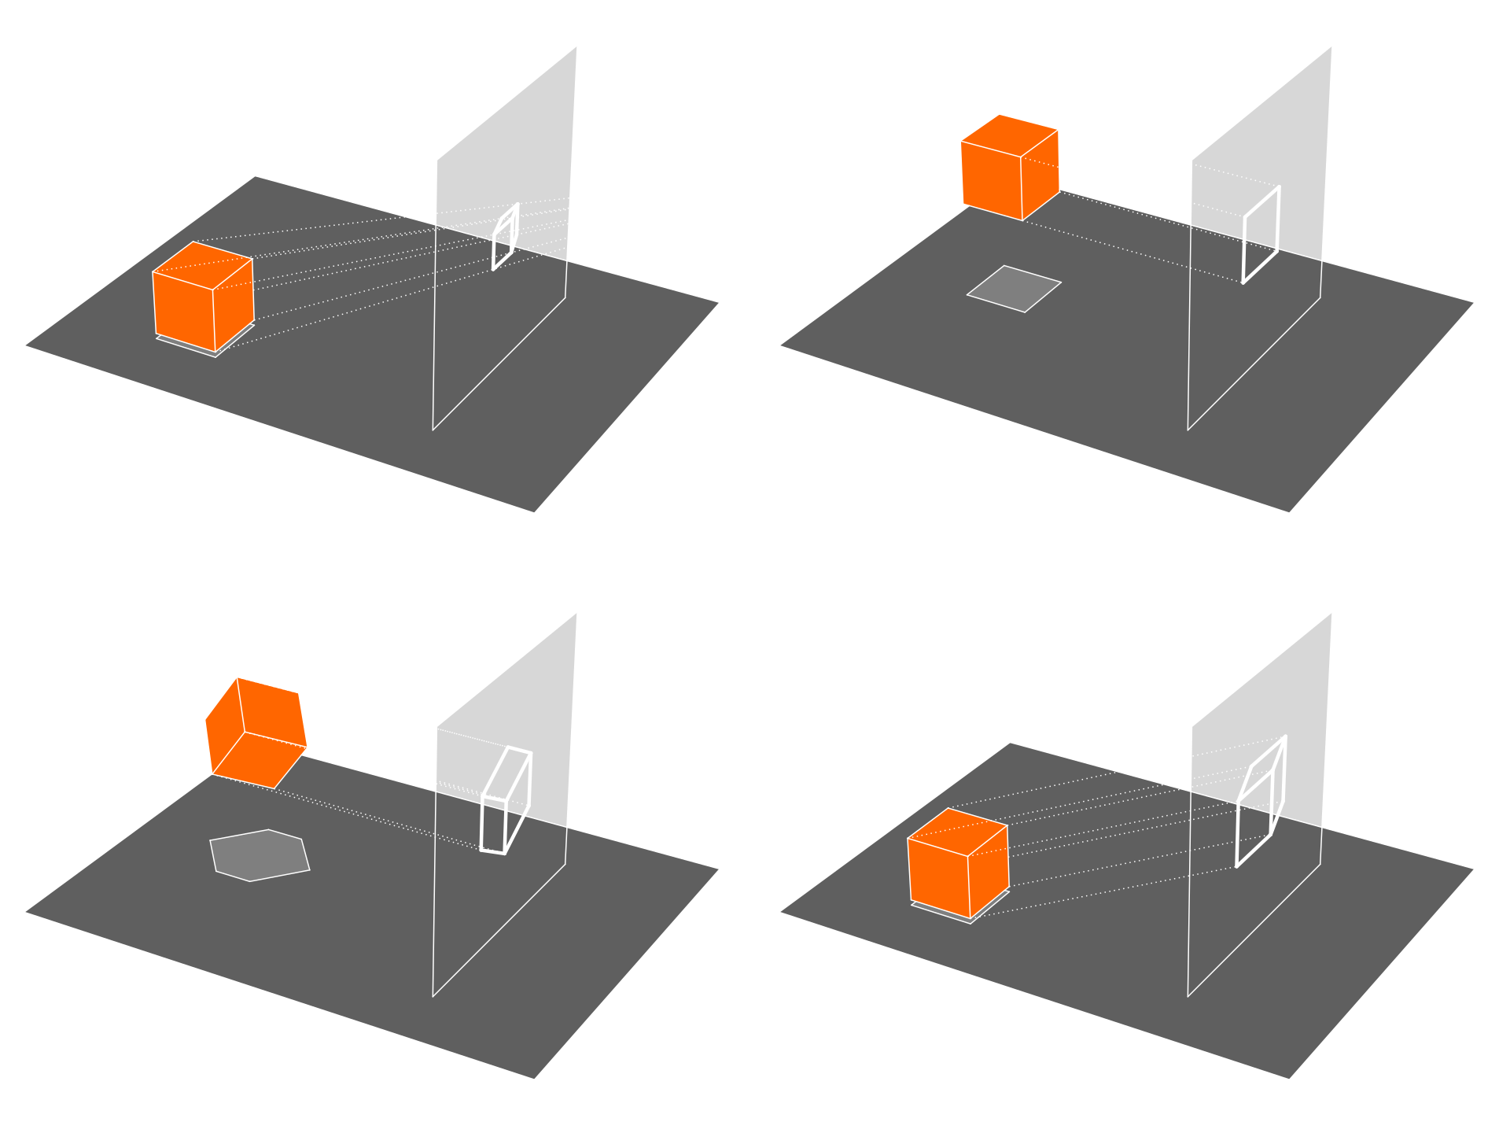
Orthographic Projection
https://en.wikipedia.org/wiki/Orthographic_projection#/media/File:Various_projections_of_cube_above_plane.svg
Licensed under https://creativecommons.org/licenses/by-sa/4.0/

Slide 22
Orthographic Projection
https://en.wikipedia.org/wiki/Orthographic_projection#/media/File:Various_projections_of_cube_above_plane.svg
Licensed under https://creativecommons.org/licenses/by-sa/4.0/

Slide 23
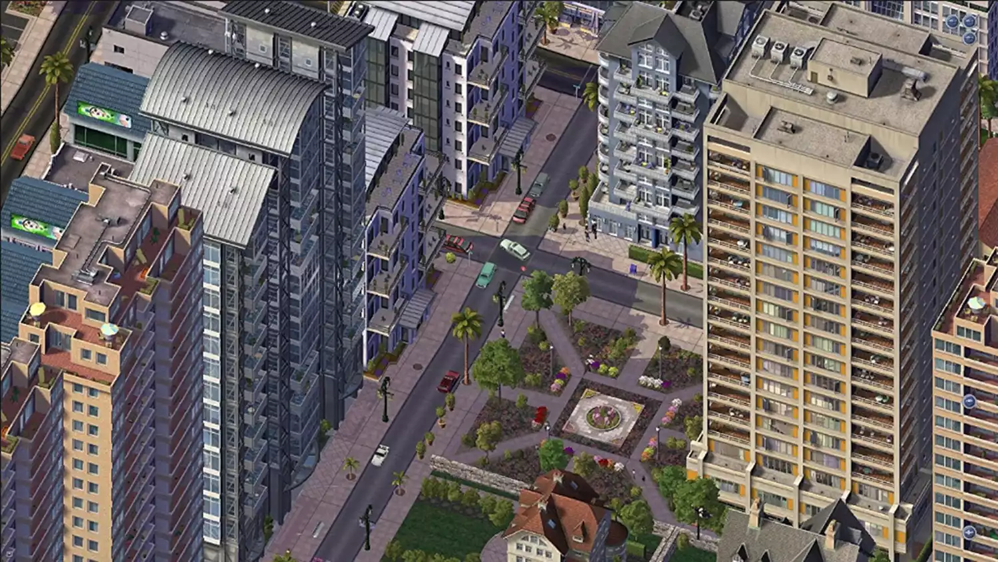
Orthographic Projection
https://www.lifewire.com/simcity-4-starting-new-city-840147

Slide 24
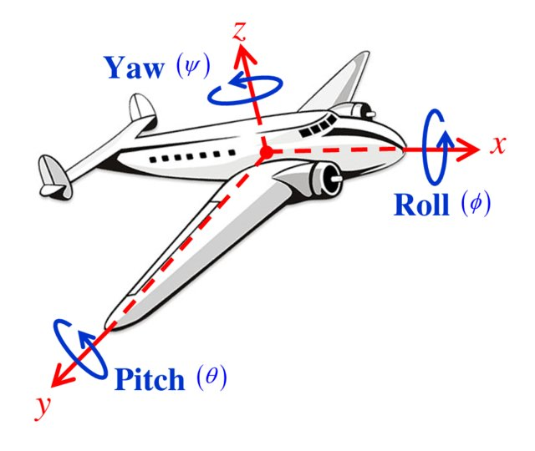
Euler Angles
https://math.stackexchange.com/questions/4316838/are-euler-angle-figures-wrong

Slide 25
Perspective Projection
https://en.wikipedia.org/wiki/Orthographic_projection#/media/File:Various_projections_of_cube_above_plane.svg

Slide 26
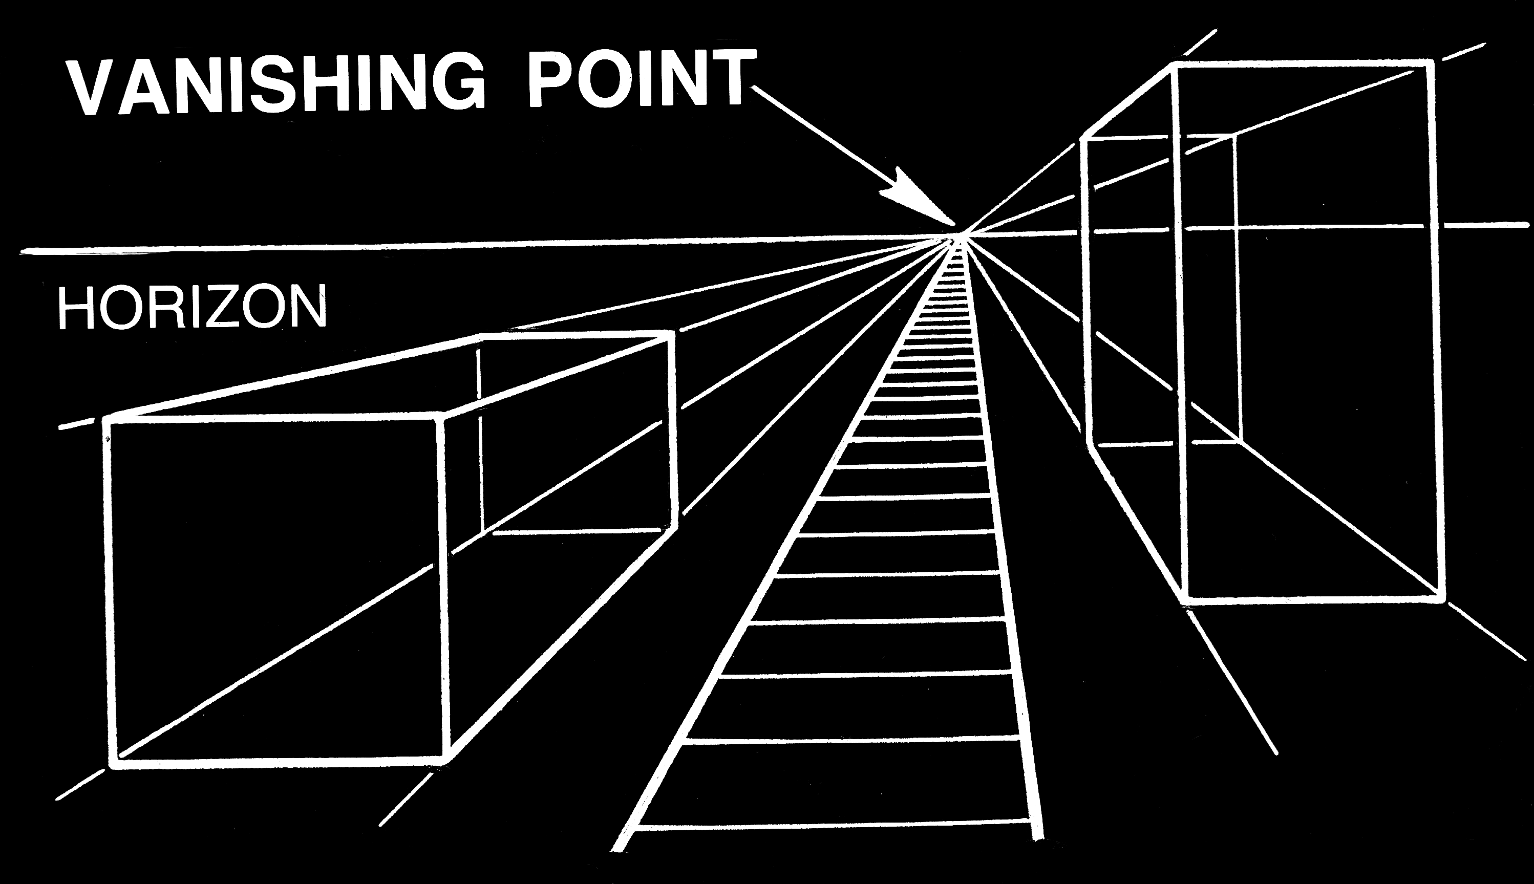
Perspective Projection
https://commons.wikimedia.org/wiki/File:Vanishing_Point_(PSF).png

Slide 27
Projection
https://en.wikipedia.org/wiki/Orthographic_projection#/media/File:Various_projections_of_cube_above_plane.svg

Slide 28
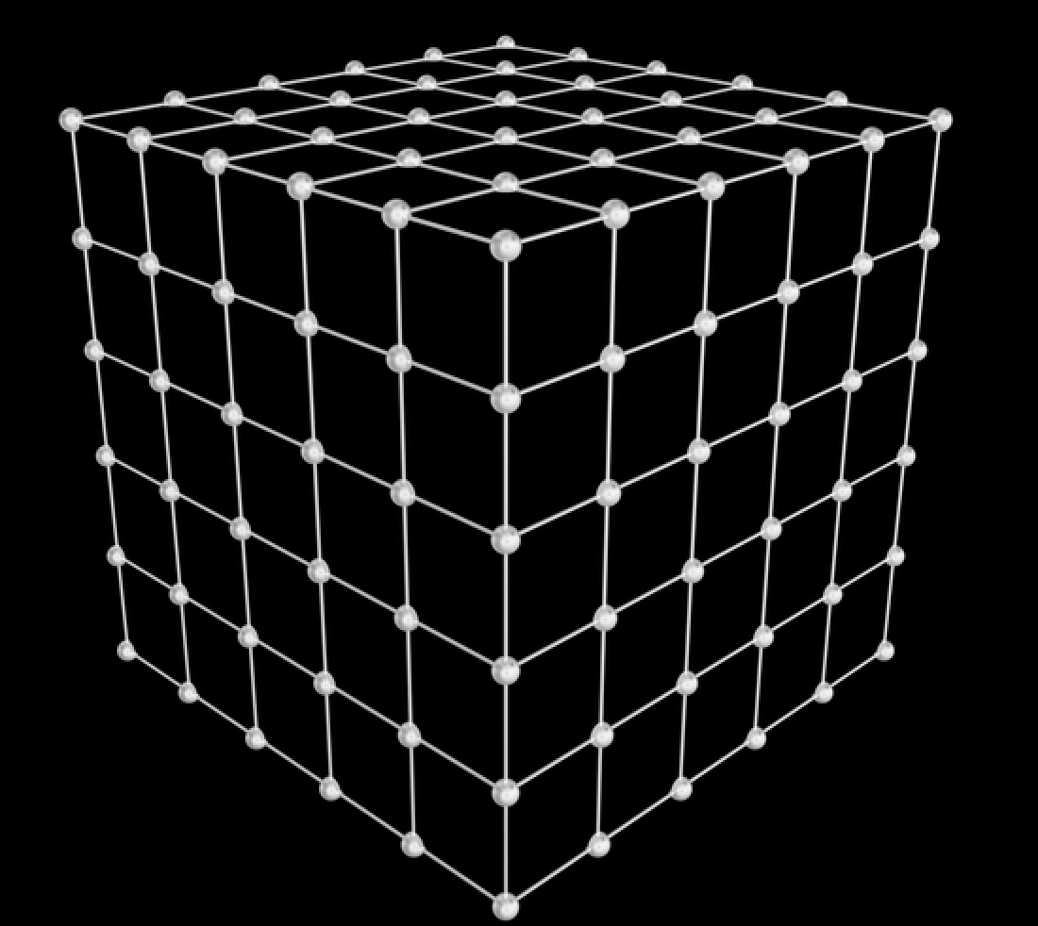
Filling a Polygon
https://www.pixelsquid.com/png/cube-grid-patterned-black-3078631786566128952?image=G03

Slide 29
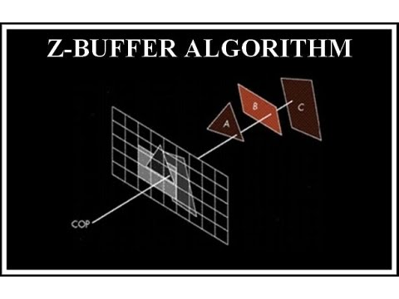
Depth Sorting
https://www.google.com/url?sa=i&url=https%3A%2F%2Fm.youtube.com%2Fwatch%3Fv%3DTsjYPu7piY0&psig=AOvVaw2OWGL02_CEBJEh1xm-jUFU&ust=1715446203188000&source=images&cd=vfe&opi=89978449&ved=0CBQQjhxqFwoTCLCvuqvFg4YDFQAAAAAdAAAAABAE

Slide 30
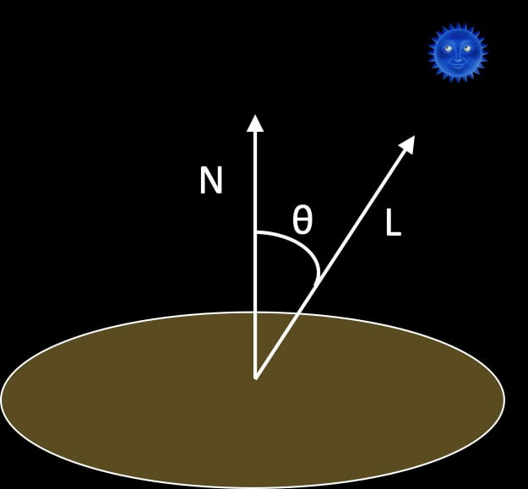
Flat Shading
https://sites.nova.edu/mjl/graphics/lighting/flat-and-smooth-shading/

Slide 31
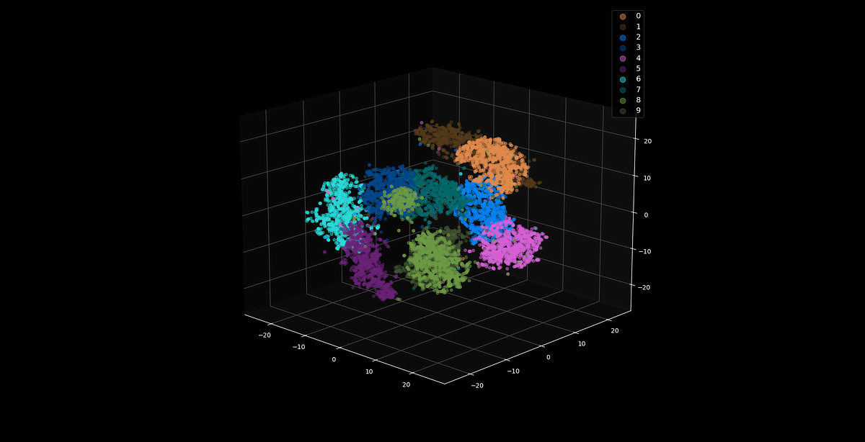
Dot Product Application - AI
https://www.bing.com/images/search?view=detailV2&ccid=yTdlVCsT&id=F5757D83BDF65E8EF3F67F8F4E20C729042B6603&thid=OIP.yTdlVCsTzQ3gThYK2UHyfwHaDy&mediaurl=https%3a%2f%2fmiro.medium.com%2fmax%2f1200%2f1*yBT_wK_lGPuuVvKgAuAtYg.png&cdnurl=https%3a%2f%2fth.bing.com%2fth%2fid%2fR.c93765542b13cd0de04e160ad941f27f%3frik%3dA2YrBCnHIE6Pfw%26pid%3dImgRaw%26r%3d0&exph=614&expw=1200&q=vector+embedding&simid=608008803984090565&FORM=IRPRST&ck=974C25F8412B51DA76F4BFD53A9E1C40&selectedIndex=76&itb=0&ajaxhist=0&ajaxserp=0

Slide 32
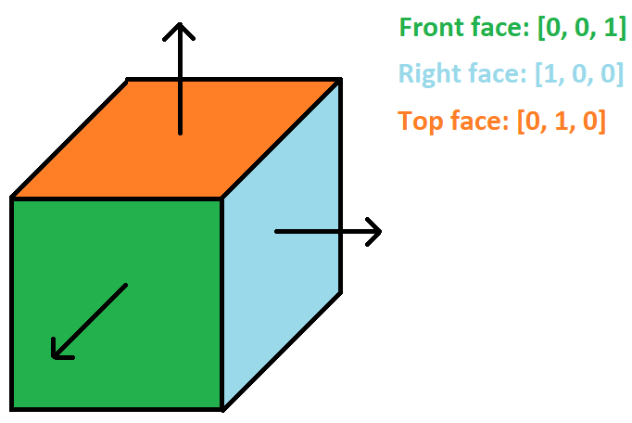
Normals
https://www.mbsoftworks.sk/tutorials/opengl4/014-normals-diffuse-lighting/

Slide 33
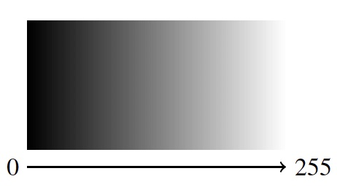

Continuous Color vs. Discrete Color
Dot product gives a value between -1 and 1
Map this value to a color
https://creativecomputing.ca/04/4_1_Grayscale_Colour.html

Slide 34
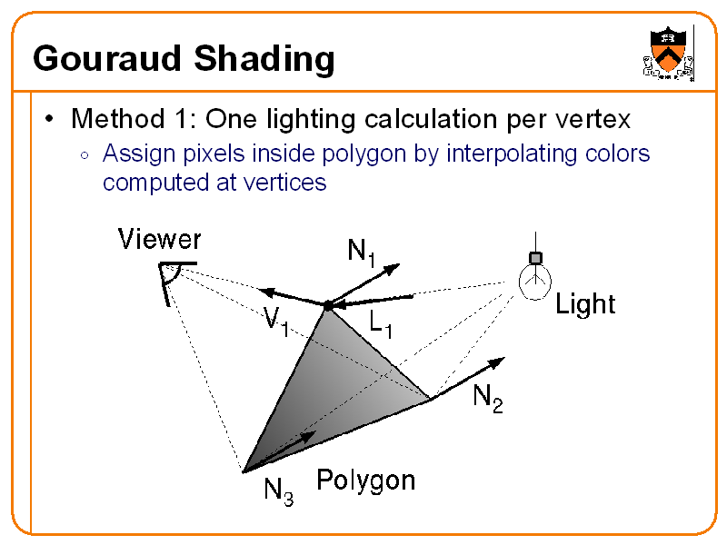
Gouraud Shading
https://www.cs.princeton.edu/courses/archive/fall00/cs426/lectures/scan/sld033.htm

Slide 35
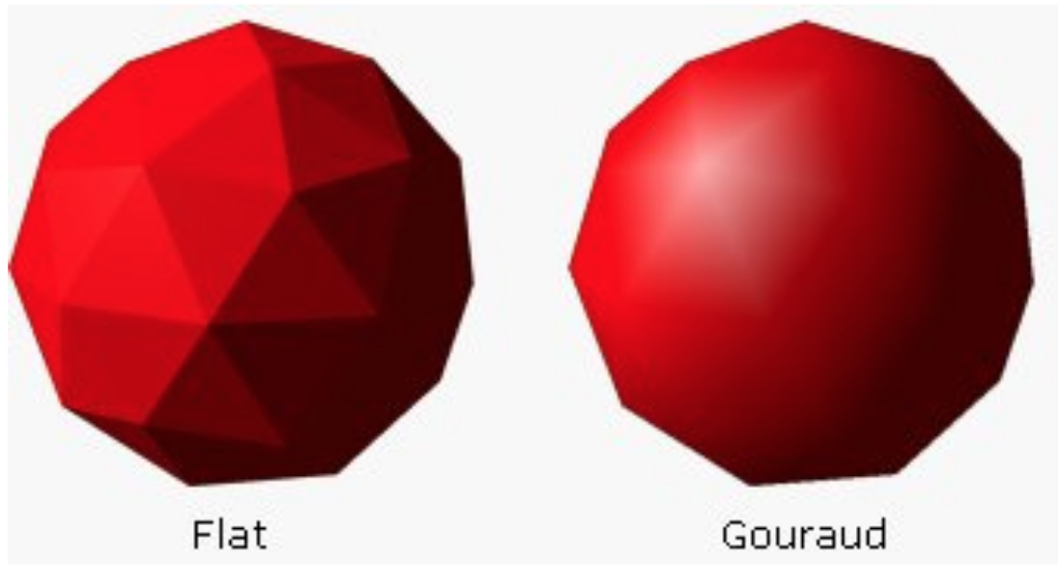
Gouraud Shading
https://computergraphics.stackexchange.com/a/10846

Slide 36
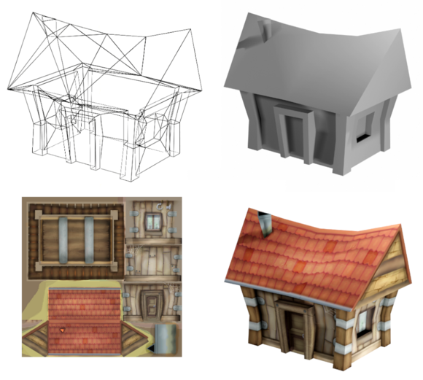
Texture Mapping
https://en.wikipedia.org/wiki/Texture_mapping

Slide 37

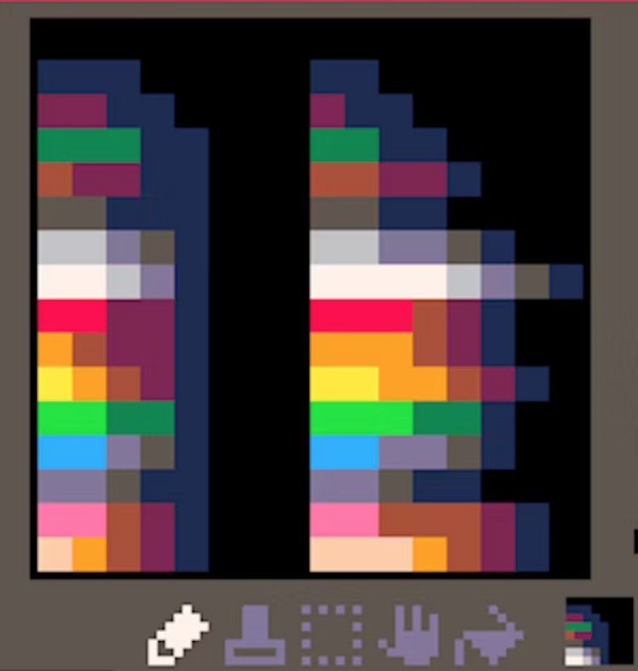

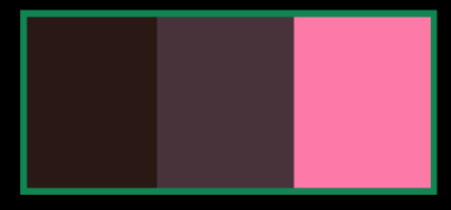
Discrete Color Part 2
https://hackernoon.com/pico-8-lighting-part-1-thin-dark-line-8ea15d21fed7

Slide 38
Limitations
Shadows
Transparency
Reflections

Slide 39
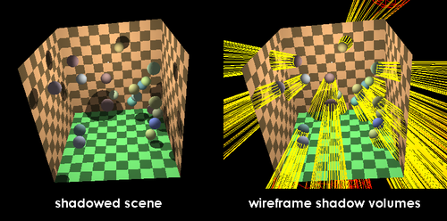
Shadows
https://www.google.com/url?sa=i&url=https%3A%2F%2Fen.wikipedia.org%2Fwiki%2FShadow_volume&psig=AOvVaw2B6zZ1mybI4l4YQVbp-QLd&ust=1715427785110000&source=images&cd=vfe&opi=89978449&ved=0CBQQjhxqFwoTCMDSmfGAg4YDFQAAAAAdAAAAABAR

Slide 40
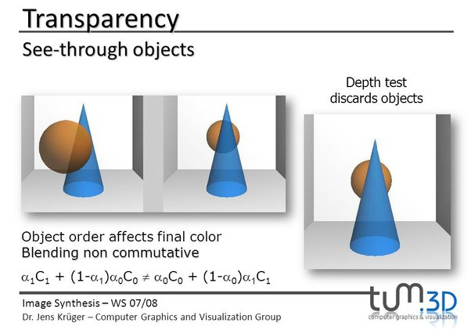
Transparency
https://slideplayer.com/slide/8625660/

Slide 41
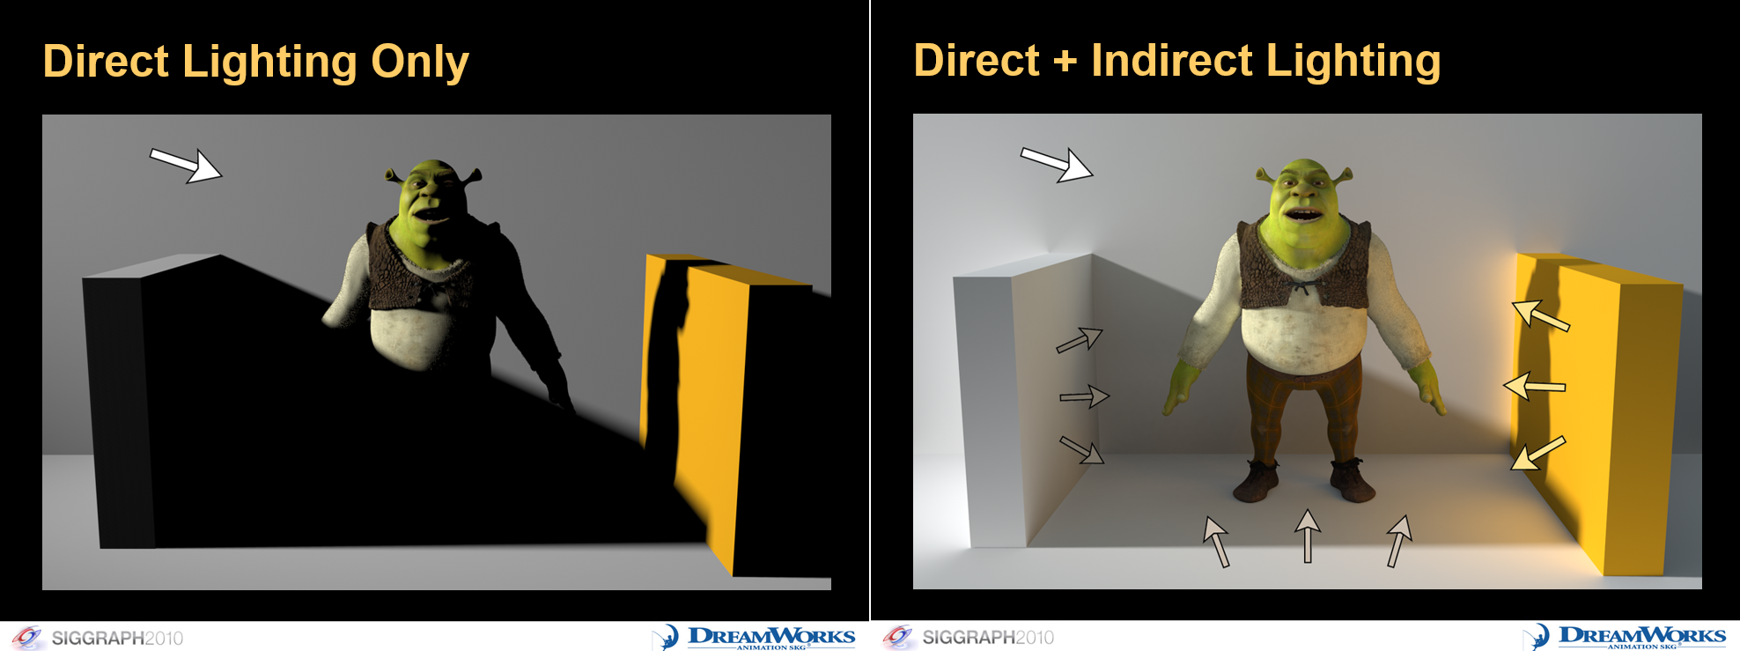
Indirect Lighting
https://colinbarrebrisebois.com/2015/11/06/finding-next-gen-part-i-the-need-for-robust-and-fast-global-illumination-in-games/

Slide 42
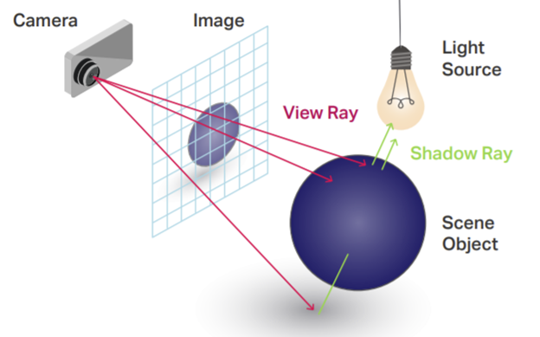
Ray Tracing
https://www.google.com/url?sa=i&url=https%3A%2F%2Fgfxspeak.com%2Ffeatured%2Fthe-levels-tracing%2F&psig=AOvVaw2pSGmr_wULe4yoLc2EoYXS&ust=1715427700508000&source=images&cd=vfe&opi=89978449&ved=0CBQQjhxqFwoTCIis6q6Ag4YDFQAAAAAdAAAAABAE

Slide 43
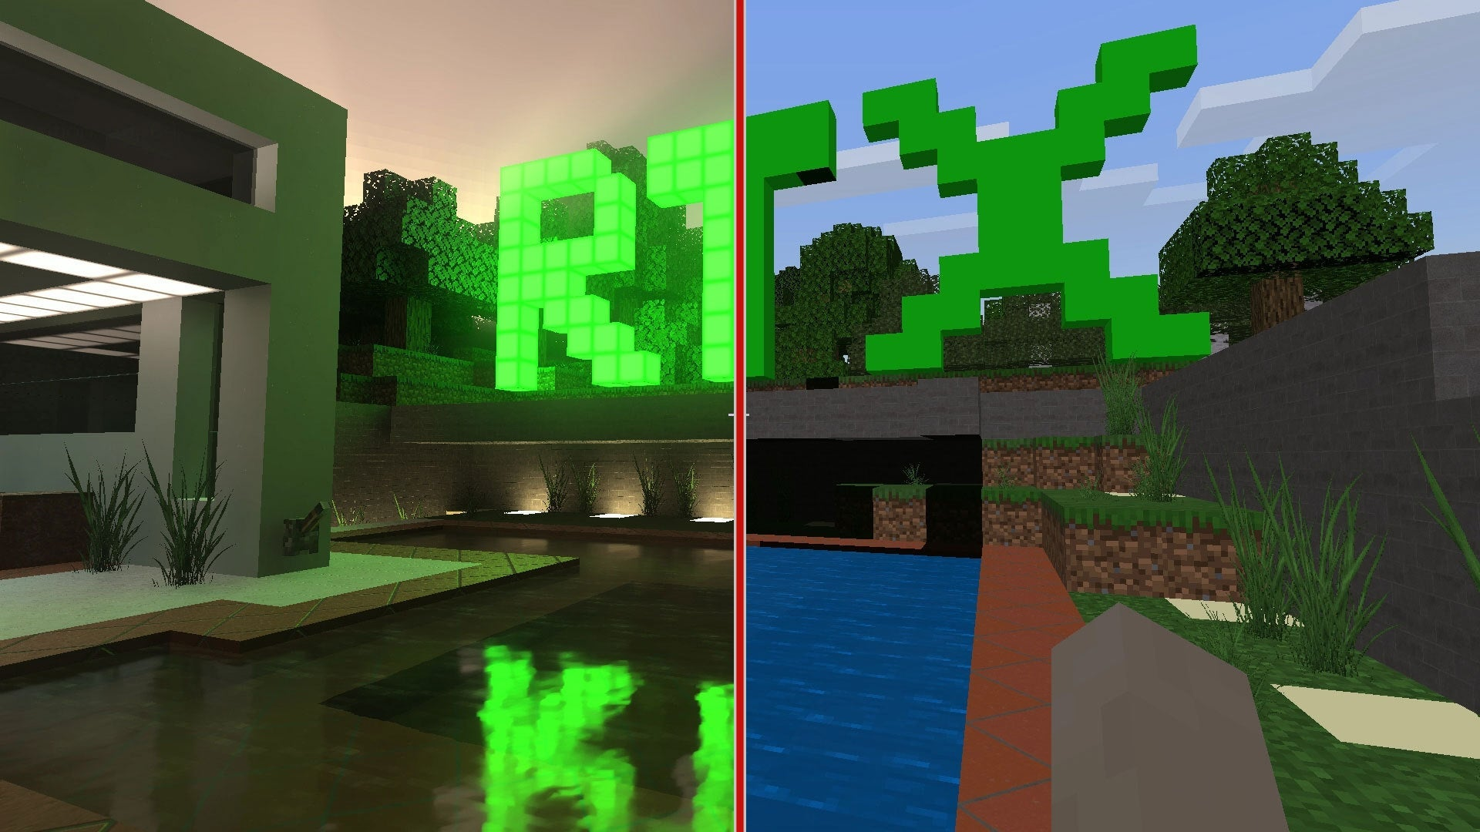
Ray Tracing
https://www.ign.com/articles/what-is-ray-tracing

Slide 44
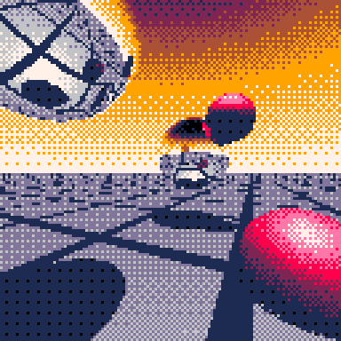
Ray Tracing
https://www.lexaloffle.com/bbs/?pid=59480

Slide 45
Questions?
https://www.lexaloffle.com/bbs/?pid=59480

