Slide 1
깊은기도

Slide 2
오직 예수이기를 완전 복음이기를
어떤 상황속에도 성령충만하기를
Oh let it be only Christ. I pray this for all my life.
No matter what comes my way,
Your Spirit I need always.

Slide 3
아픈 눈물흘러도 기쁜 일이생겨도
변함 없는고백은 오직 예수이기를
In joy or in times of pain,
I pray this will never change.
Oh, let it be only Christ. I pray this for all my life.

Slide 4
죽음 앞에있어도 찬양 할수있기를
축복 속에있어도 자만 하지않기를
And when death is at my door,
I pray I can praise You more.
And when blessings come my way,
I pray I will not be proud.

Slide 5
모든것 사라지고 홀로 있을때에도
오직 예수그분만 내안에계시기를
When all things now disappear,
Alone, I’m left standing there,
I pray only Jesus be,
Within me, Jesus alone.

Slide 6
주여나의삶속에

Slide 7
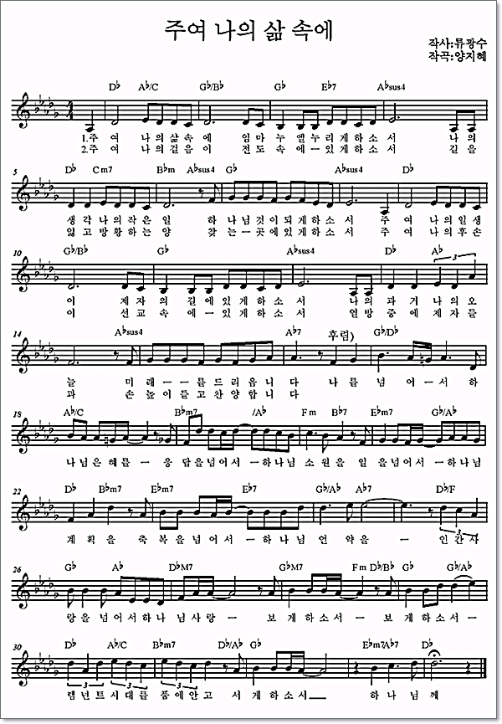
Oh Lord, In my life I pray to enjoy Immanuel each day. All my
Thoughts and everything I do, May every part of me belong to you. For all my life may

Slide 8
be Found on the road of our disciples, Lord with my past and my present
day . My future all my life, Lord have your way Far above my self the

Slide 9
Grace of God is higher. Above the answers, it is the Lord’s desire. And past all my work, it is the
plan of God. Beyond the blessings it is your covenant. The love of

Slide 10
God transcending the love of man. Lord help me to see. Lord open my eyes
Embracing the Remnant age in my heart. May I stand before. Before You, Lord

Slide 11
2. Oh Lord, may my every step, walk the path of testifying Christ. Would you
Lead me to the place where I can find the wand’ring sheep lost and blind. I pray, my children after

Slide 12
Me, In world missions would forever be. With disciples throughout the
world. I raise my hands and praise your Holy name. Far above my self the

Slide 13
Grace of God is higher. Above the answers, it is the Lord’s desire. And past all my work, it is the
plan of God. Beyond the blessings it is your covenant. The love of

Slide 14
God transcending the love of man. Lord help me to see. Lord open my eyes
Embracing the Remnant age in my heart. May I stand before. Before You, Lord

Slide 15
렘넌트를축복합니다

Slide 16
너희는 하나님의 축복받을 나라
너희는 하나님의 축복받을 자
You are God’s holy people
Blessed among the nations
You are God’s precious children
Blessed in all creation

Slide 17
너희는 하나님의 구원받은 자녀
너희는 내일을 치유할 남은 자
You are God’s child of promise
Blessed by His salvation
You are God’s chosen Remnant
Heal the world, go Remnant

Slide 18
법률이 고치지 못하는
의사가고치지 못하는 병
정치가고치지 못하는 그 병
Solving the problems the Law can’t solve
Healing the sickness the doctors can’t heal
Curing the pain leaders cannot cure for sure

Slide 19
나일강과 애굽을 살리러가라
블레셋 앗수르 아람을 살리러가라
You are the Remnant, Egypt you will revive
Aram, Philistia, Assyria, go give them new life

Slide 20
바벨론과 로마를 살리러가라
렘넌트여 어디로 가든지 살리러가라
You are the Remnant, save Babylon and Rome
No matter where you go you must know
You are the Remnant

Slide 21
너희는 하나님의 능력 입은 나라
너희는 하나님의 부름 받은 자
You have God’s mighty power
Strong among the nations
You have God’s special calling
Above all creation

Slide 22
너희는 하나님의 영에 감동된 자
너희는 미래 살릴 남은 자 렘넌트
You have God’s Holy Spirit
Sealed by His salvation
You are God’s chosen Remnant
Save the world, go Remnant

Slide 23
왕이 하지 못한 능력의 일
제사장이 못한 능력의 배경
선지자가 못한 그 능력의 길
Jesus has the power no king could have
Jesus solved the sin that no priest ever could
Like no other prophet He opened the way

Slide 24
나일강과 애굽을 살리러가라
블레셋 앗수르 아람을 살리러가라
You are the Remnant, Egypt you will revive
Aram, Philistia, Assyria, go give them new life

Slide 25
바벨론과 로마를 살리러가라
렘넌트여 어디로 가든지 살리러가라
You are the Remnant, save Babylon and Rome
No matter where you go you must know
You are the Remnant

