Slide 1
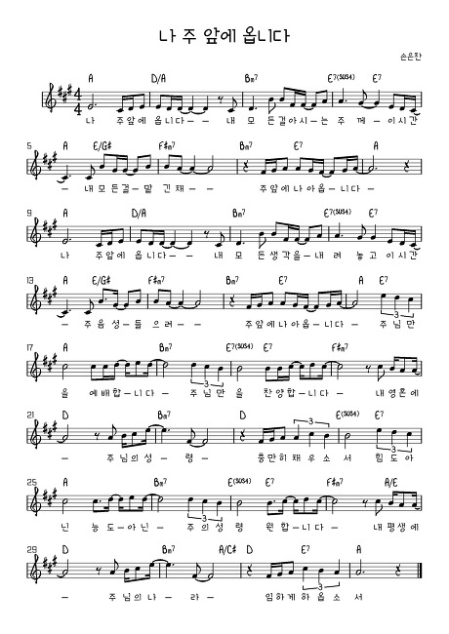
I come before You Oh Lord, I lay my everything my whole life. Take my all,
I place it in Your hands, Lord, as I come before you now.

Slide 2
I come before You Oh Lord, I lay all of my thoughts down at Your feet. I desire
to listen to Your voice, Lord, as I come before You now. I worship
You, worship You alone. I give You praise, praise Your name alone. Lord fill my soul

Slide 3
Full of Your Spirit, give me the fullness of You. Filled not by
Might and not by power, but by Your Spirit I desire. For all my life,
Lord let Your kingdom, come be established in me.

