Slide 1
MINI S A
NM ID:au962821104057 REG NO:962821104057 GMAILID:minisa1503@gmail.com
Final Project

Slide 2
PROJECT TITLE
IMAGE RECOGNITION WITH RESNET101 MODEL
This project employs the ResNet101 convolutional neural network architecture for Image recognition tasks. By leveraging the TorchVision package in PyTorch, the pre-trained ResNet101 model is utilized to identify objects within images. Through the combination
of image preprocessing techniques and normalization, the model is fine-tuned to achieve accurate object recognition. The project aims to demonstrate the effectiveness of deep learning in computer vision applications, showcasing the power of convolutional neural networks in identifying objects with high precision and efficiency.
3/21/2024 Annual Review

Slide 3

AGENDA
Introduction: Overview of Image Recognition
The Power of Deep Learning: Understanding CNNs Leveraging Pretrained Models: Introduction to ResNet101
TorchVision: Simplifying Deep Learning with PyTorch Implementation Steps:Loading and Preprocessing Images Loading Pretrained ResNet101 Model Evaluation and Testing Results and Performance Analysis
Conclusion: Demonstrating the Effectiveness of Deep Learning in Image Recognition
●
●
●
●
●
●
3/21/2024 Annual Review

Slide 4
PROBLEM STATEMENT
●
Develop an efficient and accurate image recognition system capable of identifying objects within
images.
●
The system should leverage deep learning techniques, specifically utilizing the ResNet101 Convolutional Neural Network(CNN) architecture pretrained on the ImageNet dataset.
●
The goal is to create a solution that can accurately classify objects in various images, demonstrating the capability of modern deep learning approaches in computer vision tasks.
●
The system should be implemented using PyTorch with the TorchVision package for model loading, preprocessing, and evaluation.
●
Additionally, the solution should showcase the potential for transfer learning by fine-tuning the pretrained ResNet101 model on a specific dataset or task to achieve optimal performance.

Slide 5
PROJECT OVERVIEW
●
Our project focuses on creating a smart system that can recognize objects in images with high accuracy.
●
We're using the power of deep learning, specifically a technique called convolutional neural networks (CNNs), to achieve this.
●
Our secret weapon is a pretrained model called ResNet101, which has already learned a lot about different objects from a massive dataset called ImageNet.
●
To make things easier, we're using a handy tool called TorchVision, which helps us work with deep learning models in PyTorch, a popular deep learning framework.
●
With TorchVision, we can quickly load our pretrained model, preprocess our images, and evaluate our results.

Slide 6

WHO ARE THE END USERS?
●
The end users of our image recognition system could be diverse, ranging from everyday consumers to professionals in various fields.
●
Everyday consumers might find our system helpful for organizing and searching through their photo collections or for automatically tagging images on social media platforms
●
Additionally, professionals in industries such as healthcare, agriculture, and manufacturing could use our system for tasks like image analysis
●
Essentially, anyone who needs to quickly and accurately identify objects in images can benefit from our system.
●
By simplifying the process of object recognition and providing reliable results, our system has the potential to save time and improve efficiency in a wide range of applications
3/21/2024 Annual Review

Slide 7
YOUR SOLUTION AND ITS VALUE PROPOSITION
Solution:
Our solution is a smart system that can recognize objects in images using advanced technology called deep learning by CNN
We've trained our system to understand what different objects look like by showing it lots of pictures.
Now, it can look at any new picture and tell us what objects are in it, like dogs, cats,birds and other images.
●
●
Value Proposition:
Our system saves time and effort by quickly identifying objects in images, making tasks like organizing photos or analyzing data much easier.
It's like having a helpful assistant that can understand pictures and give us information about them.
●
7

Slide 8
THE WOW IN YOUR SOLUTION
●
Accurate Object Recognition: Our solution excels in accurately identifying objects within images, leveraging the power of deep learning to achieve high precision in classification tasks.
●
Efficiency and Speed: With its ability to process large volumes of visual data quickly, our system streamlines tasks that would traditionally require manual effort, saving time and boosting productivity.
●
Versatility: From personal use cases like organizing photo collections to professional applications such as image analysis, our solution adapts to various contexts, offering value across different domains.
●
User-Friendly Interface: Despite its advanced capabilities, our system is designed with simplicity in mind, offering an intuitive user experience that makes it accessible to a wide range of users, regardless of their technical expertise
8

Slide 9
MODELLING
●
Pre-trained Model Selection: We choose ResNet101 as our model because it's been trained on a vast dataset called ImageNet, which contains millions of images spanning thousands of object categories. This pre-training enables ResNet101 to already have a good understanding of what different objects look like.
●
Loading the Model: We load the pre-trained ResNet101 model into our system using TorchVision,
●
PyTorch: PyTorch serves as the backbone of our modeling process. It provides a flexible and dynamic computational graph, making it easy to train complex neural network architectures
TorchVision: TorchVision offers a collection of pre-trained models, including ResNet101.TorchVision provides utilities for image transformation, dataset handling, and evaluation metrics, simplifying the overall modeling workflow.
Other Supporting Libraries: Depending on the specific requirements of our project, we may also use additional libraries such as PIL (Python Imaging Library) for image processing tasks.
●
●
9

Slide 10
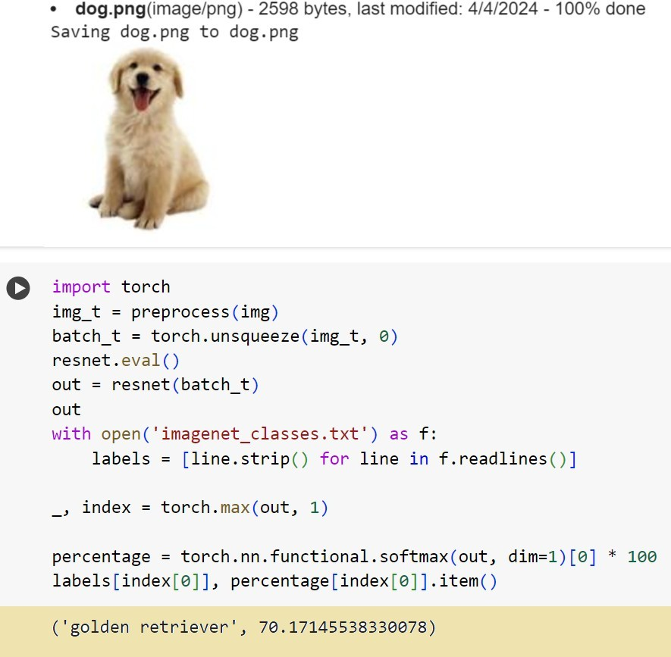
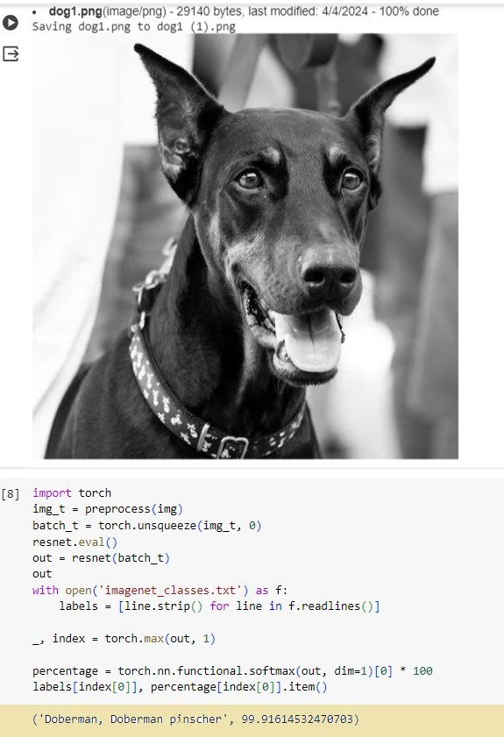
RESULTS
10

Slide 11
THANK YOU

