Slide 1
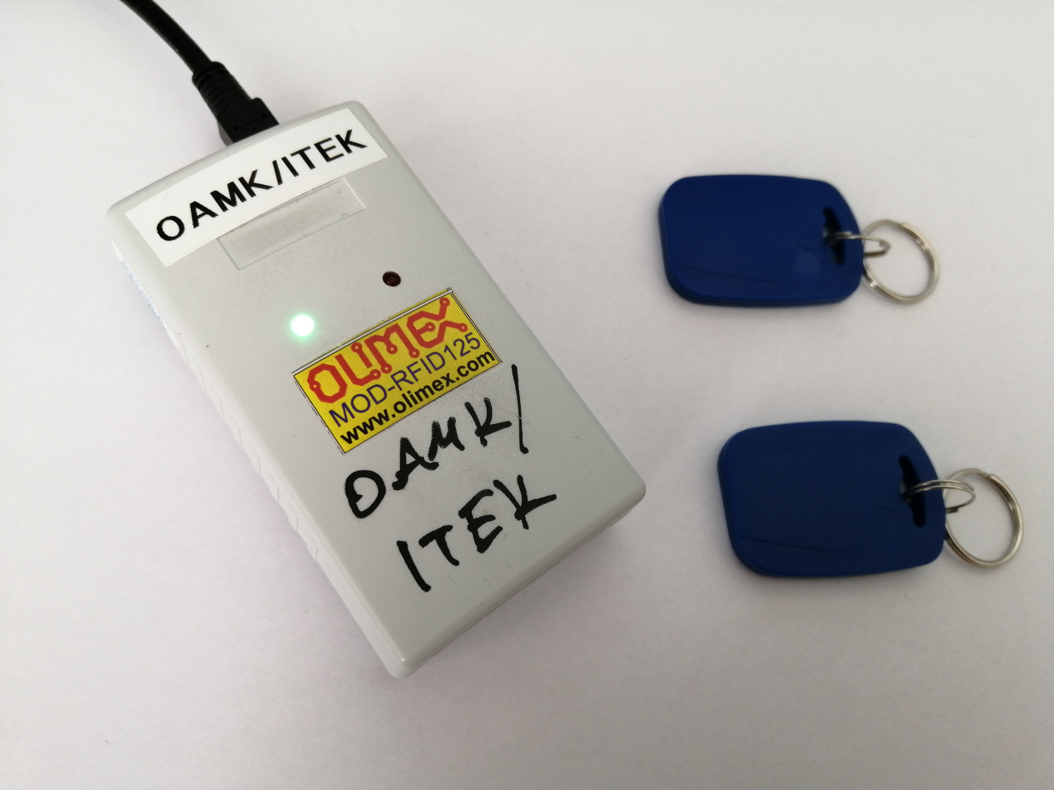
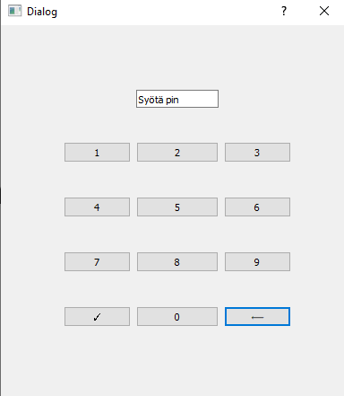
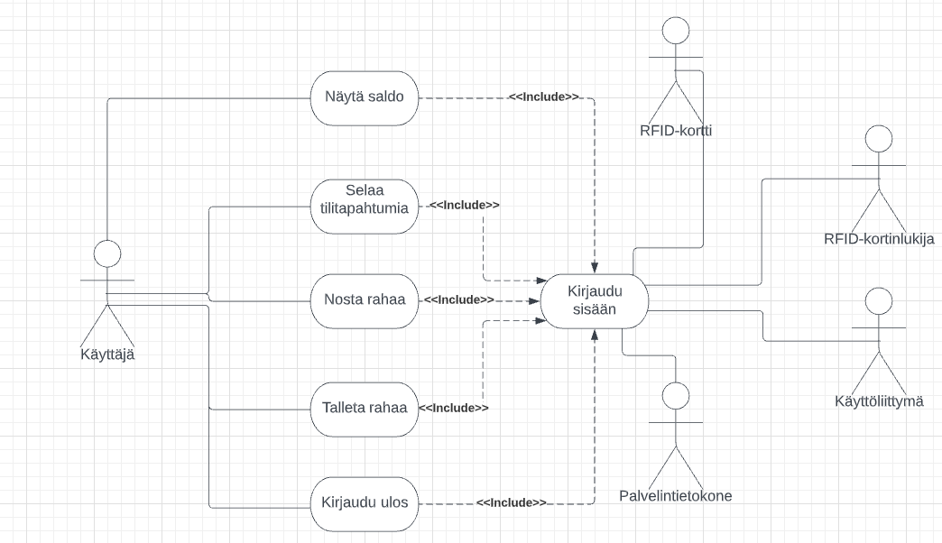
Automated Teller Machine (ATM)
Ilari Tuovinen, Santtu Peteri, Paavo Päiväniemi, Jarno Liedes, TVT21SPO
Information Technology, Software Development, Group 17
Introduction
The aims of this project were to make a demo version of an automated teller machine, which could work like any ordinary everyday ATM bank device. Every group member has their own unique tasks in the project.
Objectives
The core objectives for this project include reading data from the debit card, login to the personal account which is linked to database and to do basic ATM tasks including reviewing account transactions, cash withdrawal and deposit actions. Authentication token has encryption which requires a reboot after definite period of time. ATM program works in harmony with RestAPI which is connected to database where all the important information is stored.
FIGURE 1. Use Case Diagram
Methods
The ATM is created in environment based on Qt-Creator, C++, which is linked to MySQL database via Rest API. It requires the newest version of Windows to work properly. Card reading is executed in Qt environment from a serial port by using RFID –card reader. Rest API uses open-source Node.js runtime environment and is used to communicate with the MySQL database. User needs a debit card that is linked to their personal bank account and a 4-digit password is also required.
FIGURE 2. Pincode Input
Results
The card reader can pick up a credit card number and the user has to enter his personal password. This gives access to the user’s private bank account. All the basic ATM tasks are now available including account balance, transfer and deposit actions, account transactions and log out.
FIGURE 3. MOD-RFID125 – Card Reader
Conclusions
After all the research and base work in connecting database to the RestAPI, individual tasks were assigned between all the group members which were integrated into a functioning ATM. Sharing project in Git allowed easy access to everyone’s work and combining DLL’s to EXE in Qt’s environment was overall a pleasant experience.
References
1. MOD-RIF125 – card reader user’s manual Source:
https://www.olimex.com/Products/Modules/RFID/MOD-RFID125-BOX/resources/MOD-RFID125-BOX.pdf
Software Application Project
ECTS Credits: 15
Date of Publication: 2022, Spring
Instructors: Jukka Jauhiainen, Pekka Alakuulas, Miisa Tanner

