Slide 1
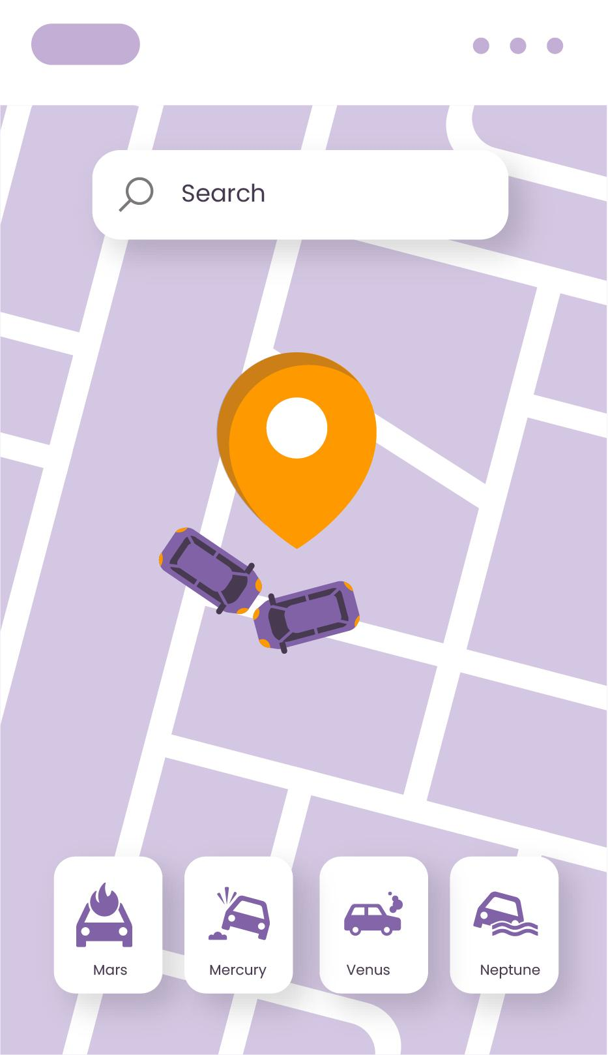
Road Traffic Accident Alert System Software LifeLane
REPORT!

Slide 2
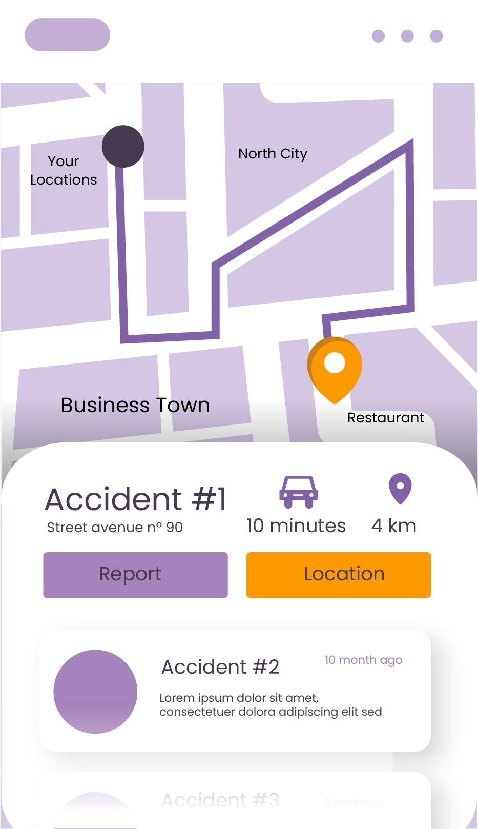
Ideators
REPORT!
TUSHAR KARDAM
ALIASGAR HUSAIN
PRATIK TIWARI
VEDANT WADIBHASME
HIMANSHU DAYARAMANI

Slide 3
Table Of Contents
SLIDES | CONTENTS
1 | Problem Statement
2 | Solution Overview
3 | Technical Uniqueness
4 | Operating Sensors (Hardware)
5 | GPS Helmet (Hardware)
6 | Marketing and Outreach plan
7 | Monetization Strategy
8 | Conclusion
9 | Questions

Slide 4
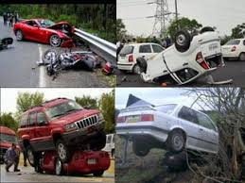
Problem Statement
High Accident Rates: Over 150,000 deaths annually in India due to road accidents.
Communication Gaps: Families often remain uninformed during emergencies.
Rural Area Limitations: Villages face delays in receiving accident aid.
Lack of Safety Gear: Drivers often lack helmets, seat belts, and basic safety tools.
Insurance and Legal Issues: Post-accident processes like insurance claims are complicated.

Slide 5
Solution Overview
Features Breakdown
Real-Time Updates: Keeps both users and families informed instantly after accidents.
SMS Alerts for Villages: Provides accident notifications to non-smart-phone users in rural areas.
Safety Kit Subscriptions: Offers paid access to helmets, gloves, and other essential safety gear.
Insurance & Aid: Simplifies access to health and accident insurance for users and their families.
Traffic Penalty Payments: Allows users to pay fines directly through the app.

Slide 6
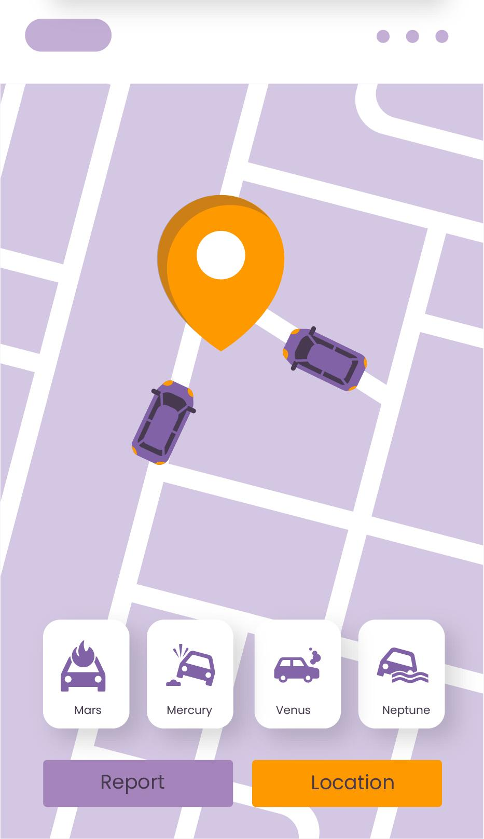
Product infographic
Oberving vehicles
Signal ahead
Alerting driver
Traffic detection
Path Finder
Accident Ahead

Slide 7
Technical Uniqueness
Emergency Response: Auto-detect accidents via sensors and alert emergency services and family with live GPS.
AI Driver Monitoring: Detects fatigue or distraction, sending alerts to drive safely or take breaks.
Health Data Integration: Monitors vitals (heart rate, stress) via wearable devices, triggering health alerts if needed.
Road Condition Alerts: Provides real-time notifications on road hazards, weather, and traffic ahead.
Safety Reminders: Sends alerts for vehicle maintenance, tire pressure, and oil checks.
Voice-Activated Mode: Enables hands-free control of the app with voice commands.
Driver Score System: Scores driving habits, offering insurance discounts for safe driving.

Slide 8
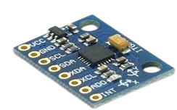
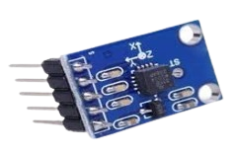
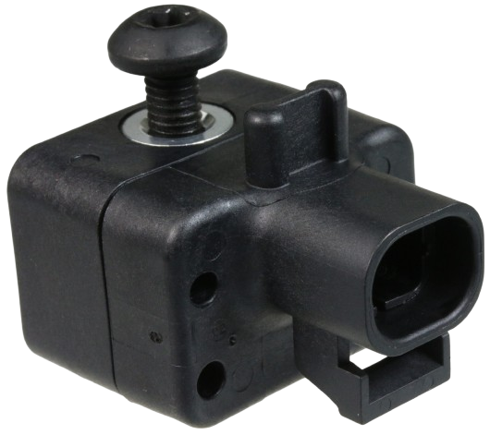
Operating Sensors (Hardware)
Detection Though Sensors
Gyroscopic Sensor Accelerometer Sensor Airbag Sensor
Gyroscope: This sensor measures abrupt rotations(like rolling over or spinning).
It detects these abrupt changes in orientation, updating the data on app.
Accelerometer: This sensors detects sudden changes in acceleration and deceleration when the vehicle stops abruptly or is hit.
Airbag sensor: Detects collisions and deploy airbags at the right time.
Systems like AEB(Automatic Emergency Braking) and ADAS(Advance driver assistance systems) could help prevent imminent collisions also enhancing the overall driving experience and safety

Slide 9
GPS Helmet (Hardware)
GPS Navigation: Links to Google Maps for real-time, turn-by-turn guidance.
Gesture Control: Swipe feature allows hands-free management of navigation and music.
Crash Detection: Impact sensors detect accidents and trigger emergency alerts.
Emergency Alerts: Notifies emergency contacts with location details after a crash.
Voice Commands: Voice-enabled for hands-free control of helmet features.
Battery Monitoring: Displays battery status and alerts the rider when recharging is needed.
Radiation-Free Design: Engineered to minimize exposure to electromagnetic radiation, ensuring rider safety.

Slide 10
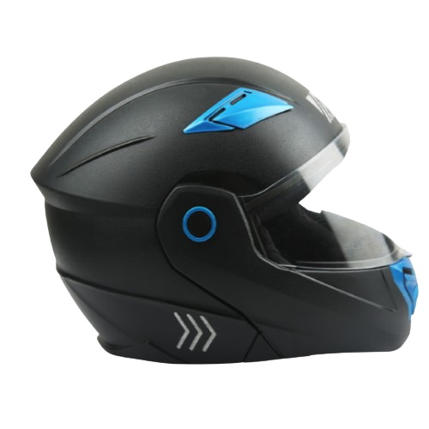
Helmet structure
Additional-face protective layer
Air vent
Free hand Swipe
LED indicator

Slide 11
Marketing & Outreach Plan
Targeted Ads: Online and social media marketing for drivers, safety awareness.
Partnerships: Partnering with insurance companies, government traffic departments, or NGOs focused on road safety.
Referral Programs: Encourage users to refer others with rewards (e.g., discounts or free months of safety kit subscriptions).

Slide 12
Monetization Strategy
How Will the App Make Money?
Subscription for Safety Kits.
Commission on Insurance.
Premium features for advanced driving data insights.
Tie-ups with traffic authorities for fine payment service fees.

Slide 13
Conclusion
Our road safety solution integrates a smart software app and an advanced GPS helmet to enhance driver safety and provide quick emergency response. The app features real-time accident detection, AI monitoring, rural SMS alerts, insurance options, and roadside assistance. The GPS helmet offers navigation, gesture control, crash detection, emergency notifications, voice commands, battery monitoring, and a radiation-free design. Together, they create a seamless and efficient system to promote safe driving and ensure immediate aid when needed.

Slide 14
THANKS!
Do you have any questions?
lifelane123@gmail.com
Visit our official Website: Click Here
PPT designed and prepared by Pratik,
Website created by Aliasgar,
Content providers Vedant, Tushar & Himanshu
Credits:
Microsoft Office 2019
Suggestions provided by ChatGPT
Template by Slidesgo
Icon by Flaticon
Image by Google

Slide 15
Potential Queries
1) Apps like Raksha App, 112 India, Acko insurance, and DriveUSafe have similar features. How is your App any different?
Solution: That’s true. But we are trying to provide the user with every possible feature in just one app. Secondly, the user gets to engage with several features that are not yet recognized by any other app like SMS service in villages, Instant alert, AI powered feature for better guidance, The Score System and so on.
2) What if your app mistakenly sent any fake alert causing misunderstanding among services and families?
Solution: The user gets to cancel any alert within a frame of time.
3) What about privacy and security?
Solution: We will ensure that the app is 100% secured and fully encrypted. We will update the app fixing bugs and software related issues on the regular basis.
4) How will you convince people to use your app?
Solution: We will promote our app among traffic authorities to launch awareness campaigns. Conduct events so that the app could gain recognition.

