Slide 1

Snake.io bot
Topics
- Introduction
- Summary of first attempt
- Analysis / Consideration of possible methods
- Future plan

Slide 2

Introduction: The game
Snake.io
  Simple PVP game
  Snake controlled by a mouse
  Eat food to get longer and wider
  Die if you run into another snake or the map boundary
  Unity game compiled for webgl
    C# → C++ → WASM

Slide 3
Screen record

Slide 4
The brain
Heuristic based model
  Lots of ifs
  Attempt to codify learned experience of the game
  Not easy but potentially higher ceiling than RL
  Easy to get started
V1: passive
  Just acquire food and avoid enemies

Slide 5
State analysis
Before making decisions, we need accurate data
Inject JS
  canvas.getContext(‘webgl’).readPixels
Computer vision
  cv2.inRange: hsv filter
  cv2.findContours
    Our player always near the center
    Size filter for food vs enemies

Slide 6
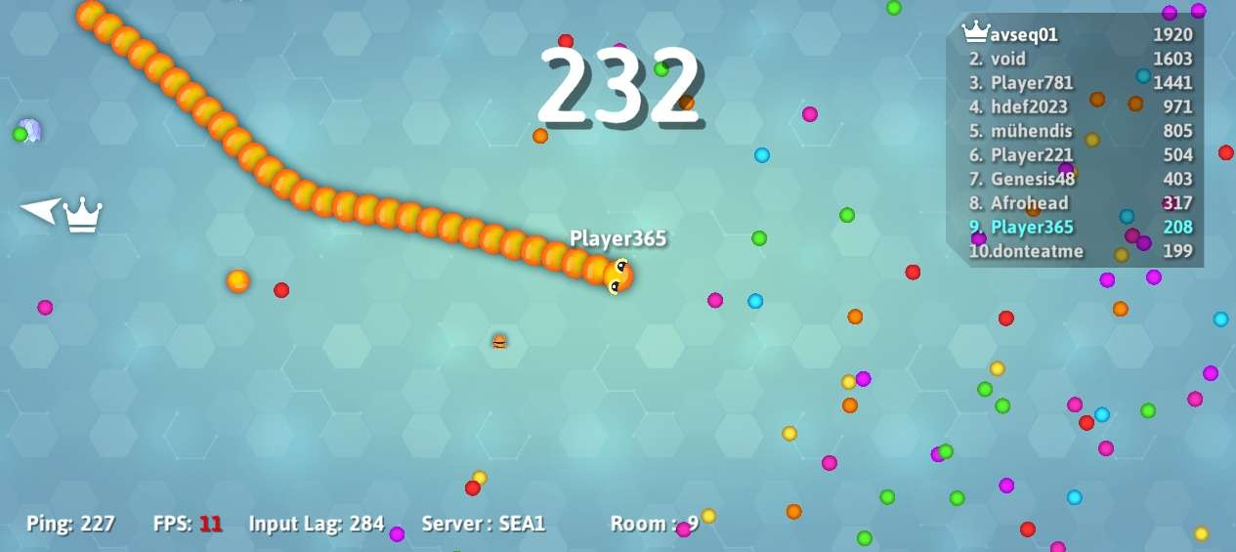
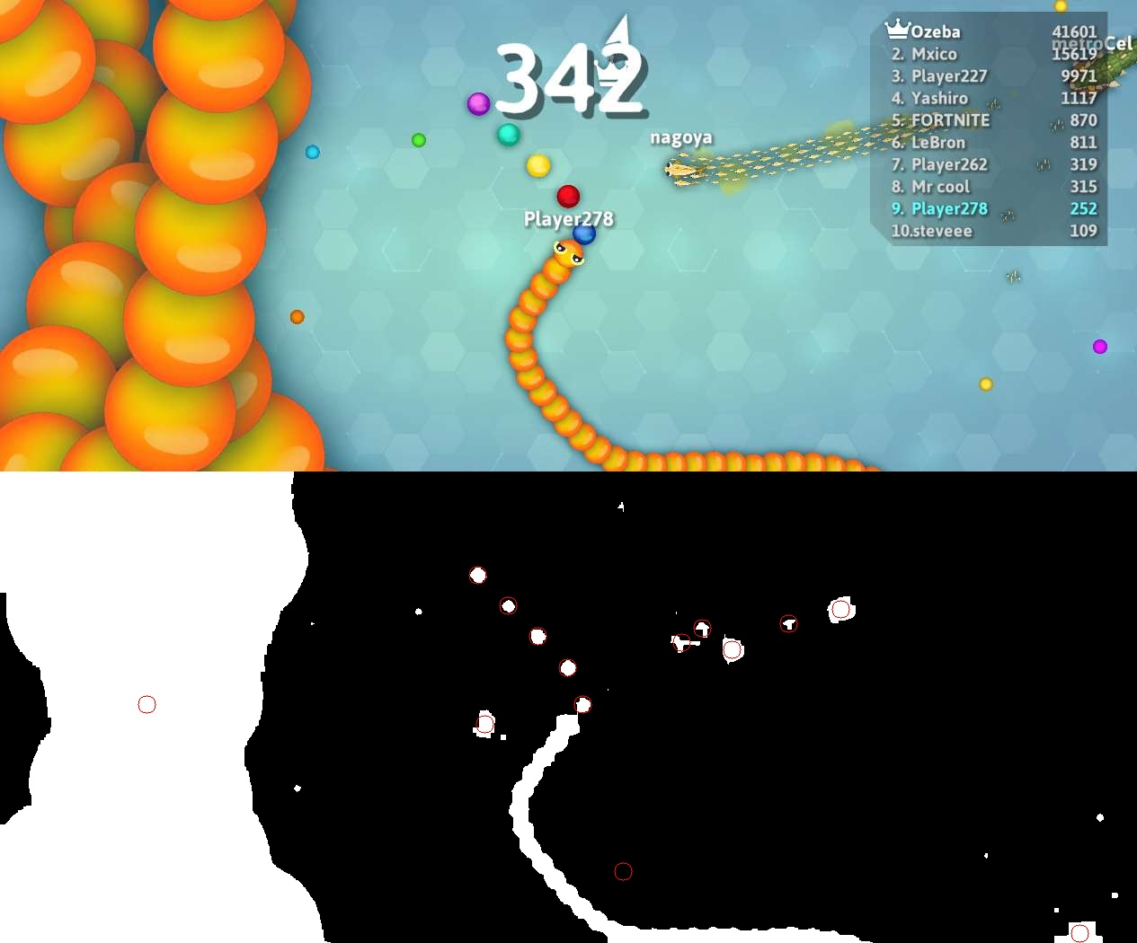
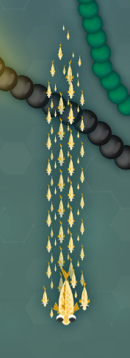
State analysis: Hang-ups
Crop out all text
  Causes Blindspots
Speed: 2-8 fps
Fish skin
Tuning filters
Eroding
Overall, more effective than expected

Slide 7
Harness
Playwright
  Microsoft’s package for web automation
  Launches a browser, can execute js and interact (clicking, moving mouse)
Initialization:
  When to start the bot?
  tesseract-ocr:
    Look for words that only appear once in the lobby

Slide 8
Current Heuristic
Go to nearest food that isn’t on the other side of an enemy or heading towards an enemy
Scoring function: time alive
Biggest problems:
  What to do if there is no such food?
  No memory: episodic (AIAMA: Russel & Norvig)
  Inputs are tricky
    Minimum turning radius / “snake spine”
Does not perform well

Slide 9
Examples
Snake spine
Amnesia

Slide 10
How we could fix it
Odometry
  Only way to provide memory
  Will almost certainly drift over time
  Deal-breaker

Slide 11

Other options
RL!!
  Where to train
  Real-time only
  Less exciting for me
Slither.io
  Exposes information:

