Slide 1
INTRO to DATA SCIENCE Lecture 3: knn classification

Slide 2
last time: - intro to machine learning & typical problems - multiple regression - feature selection via backwards elimination questions?
Recap

Slide 3
I. classification problems iI. Building effective classifiers exercises: III. the knn classification model
agenda

Slide 4
I. Classification problems
INTRO TO DATA SCIENCE

Slide 5
Classification problems
continuous categorical
supervised ??? ???
unsupervised ??? ???
Notes:
Q: Where does classification belong in this diagram?
Making predictions or extracting structure?
Quantitative data or qualitative data?

Slide 6
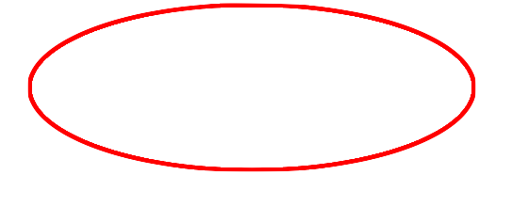
Classification problems
continuous categorical
supervised regression classification
unsupervised dimension reduction clustering
Notes:
Supervised learning problem w/ categorical target variables
→ What do these terms mean?

Slide 7
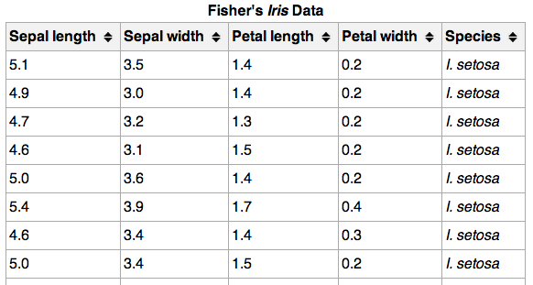
Classification problems
Here’s (part of) an example dataset:
Notes:
variables = columns, observations/records = rows

Slide 8
Classification problems
Here’s (part of) an example dataset:
{
independent
variables
Notes:
4 independent vars (cts)
Note: vars = columns, records = rows

Slide 9
Classification problems
Here’s (part of) an example dataset:
{
{
independent
variables
class
labels
(qualitative)
Notes:
Class label = target variable, the thing we want to predict

Slide 10
Classification problems
Q: What does “supervised” mean?
Notes:
Q: any ideas?

Slide 11
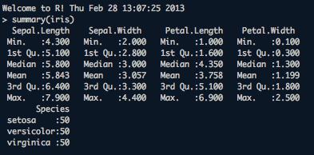
Classification problems
Q: What does “supervised” mean?
A: We know the labels.

Slide 12
Classification problems
Q: How does a classification problem work?
Notes:
Q: how are we going to use the data?

Slide 13
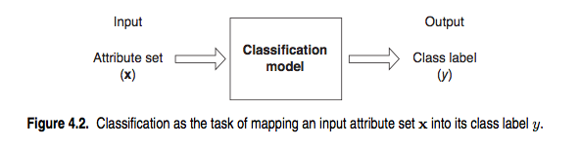
Classification problems
Q: How does a classification problem work?
A: Data in, predicted labels out.
source: http://www-users.cs.umn.edu/~kumar/dmbook/ch4.pdf

Slide 14

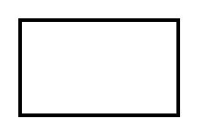
Classification problems
Q: What steps does a classification problem require?
model
dataset

Slide 15
Classification problems
Q: What steps does a classification problem require?
1) split dataset
model
dataset
Notes:
this split is random & uneven…70/30 is a good place to start
We’ll talk about the reason for this in just a minute.

Slide 16

Classification problems
Q: What steps does a classification problem require?
1) split dataset
2) train model
training set
model
dataset

Slide 17

Classification problems
Q: What steps does a classification problem require?
1) split dataset
2) train model
3) test model
training set
model
test set
dataset

Slide 18

Classification problems
Q: What steps does a classification problem require?
1) split dataset
2) train model
3) test model
4) make predictions
training set
model
test set
new data
dataset
Notes:
Q: how is the new data different?
A: we don’t know the labels…predicting these labels = purpose of our model

Slide 19

Classification problems
Q: What steps does a classification problem require?
1) split dataset
2) train model
3) test model
4) make predictions
NOTE
This new data is called out of sample
data.
We don’t know the labels for these OOS records!
training set
model
test set
new data
dataset
Notes:
Q: how is the new data different?
A: we don’t know the labels → predicting these labels = purpose of our model

Slide 20
II. Building effective classifiers
INTRO TO DATA SCIENCE

Slide 21
Building effective classifiers
Q: What types of prediction error will we run into?
training set
model
test set
new data
dataset
Notes:
Think in terms of our diagram.

Slide 22
Building effective classifiers
Q: What types of prediction error will we run into?
1) training error
training set
model
test set
new data
dataset

Slide 23
Building effective classifiers
Q: What types of prediction error will we run into?
1) training error
2) generalization error
training set
model
test set
new data
dataset
Notes:
also called test-set error

Slide 24
Building effective classifiers
Q: What types of prediction error will we run into?
1) training error
2) generalization error
3) OOS error
training set
model
test set
new data
dataset
Notes:
Recall OOS = out of sample

Slide 25
Building effective classifiers
Q: What types of prediction error will we run into?
1) training error
2) generalization error
3) OOS error
NOTE
We want to estimate
OOS prediction error so we know what to expect from our model.
training set
model
test set
new data
dataset

Slide 26
Training error
Q: Why should we use training & test sets?

Slide 27
Training error
Q: Why should we use training & test sets?
Thought experiment:
Suppose instead, we train our model using the entire dataset.

Slide 28
Training error
Q: Why should we use training & test sets?
Thought experiment:
Suppose instead, we train our model using the entire dataset.
Q: How low can we push the training error?

Slide 29
Training error
Q: Why should we use training & test sets?
Thought experiment:
Suppose instead, we train our model using the entire dataset.
Q: How low can we push the training error?
We can make the model arbitrarily complex (effectively
“memorizing” the entire training set).

Slide 30
Training error
Q: Why should we use training & test sets?
Thought experiment:
Suppose instead, we train our model using the entire dataset.
Q: How low can we push the training error?
We can make the model arbitrarily complex (effectively
“memorizing” the entire training set).
A: Down to zero!

Slide 31
Training error
Q: Why should we use training & test sets?
Thought experiment:
Suppose instead, we train our model using the entire dataset.
Q: How low can we push the training error?
We can make the model arbitrarily complex (effectively
“memorizing” the entire training set).
A: Down to zero!
NOTE
This phenomenon
is called
overfitting.

Slide 32
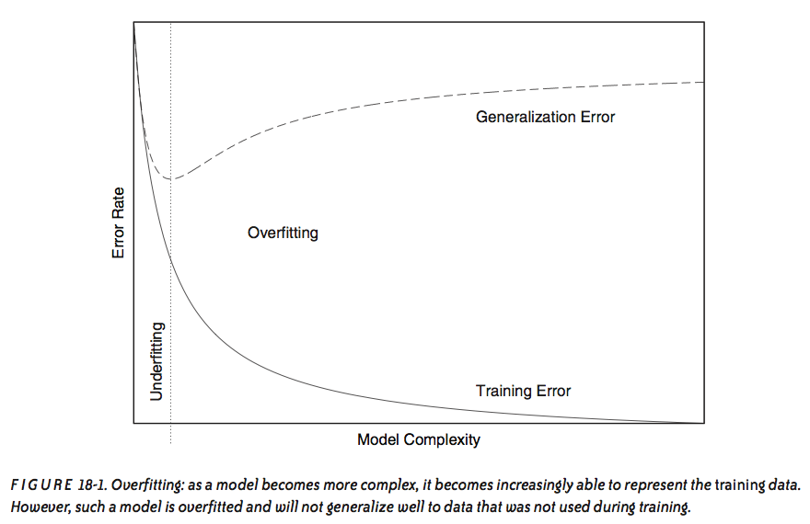
Overfitting
source: Data Analysis with Open Source Tools, by Philipp K. Janert. O’Reilly Media, 2011.

Slide 33
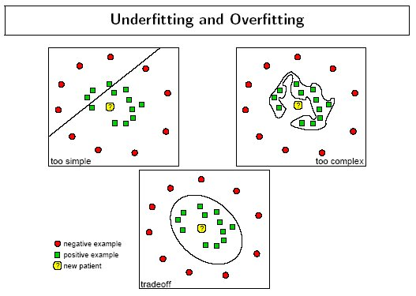
Overfitting - example
source: http://www.dtreg.com
Notes:
vocab: “decision boundary”

Slide 34
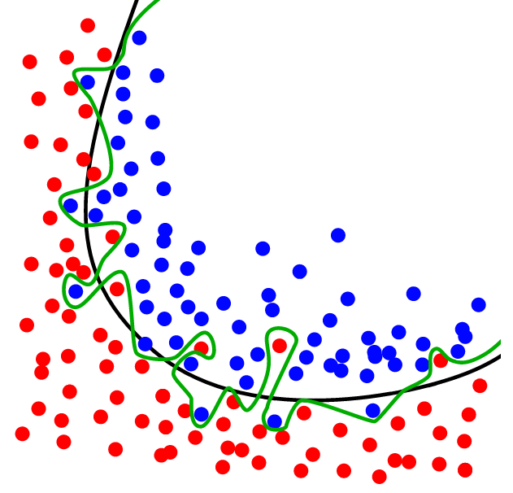
Overfitting - example
source: http://www.dtreg.com

Slide 35
Training error
Q: Why should we use training & test sets?
Thought experiment:
Suppose instead, we train our model using the entire dataset.
Q: How low can we push the training error?
We can make the model arbitrarily complex (effectively
“memorizing” the entire training set).
A: Down to zero!
A: Training error is not a good estimate of OOS accuracy.
NOTE
This phenomenon
is called
overfitting.
Notes:
Need to use genlzn error to get a better estimate.
Recall “useful things” paper: we don’t have direct access to our objective function

Slide 36
Generalization error
Suppose we do the train/test split.

Slide 37
Generalization error
Suppose we do the train/test split.
Q: How well does generalization error predict OOS accuracy?

Slide 38
Generalization error
Suppose we do the train/test split.
Q: How well does generalization error predict OOS accuracy?
Thought experiment:
Suppose we had done a different train/test split.

Slide 39
Generalization error
Suppose we do the train/test split.
Q: How well does generalization error predict OOS accuracy?
Thought experiment:
Suppose we had done a different train/test split.
Q: Would the generalization error remain the same?

Slide 40
Generalization error
Suppose we do the train/test split.
Q: How well does generalization error predict OOS accuracy?
Thought experiment:
Suppose we had done a different train/test split.
Q: Would the generalization error remain the same?
A: Of course not!

Slide 41
Generalization error
Suppose we do the train/test split.
Q: How well does generalization error predict OOS accuracy?
Thought experiment:
Suppose we had done a different train/test split.
Q: Would the generalization error remain the same?
A: Of course not!
A: On its own, not very well.

Slide 42
Generalization error
Suppose we do the train/test split.
Q: How well does generalization error predict OOS accuracy?
Thought experiment:
Suppose we had done a different train/test split.
Q: Would the generalization error remain the same?
A: Of course not!
A: On its own, not very well.
NOTE
The generalization error gives a
high-variance estimate
of OOS accuracy.
Notes:
Bias-variance tradeoff!
(Training error is biased estimate of OOS prediction error)

Slide 43
Generalization error
Something is still missing!
Notes:
Q: any ideas at this point what we can do to improve our estimate?

Slide 44
Generalization error
Something is still missing!
Q: How can we do better?

Slide 45
Generalization error
Something is still missing!
Q: How can we do better?
Thought experiment:
Different train/test splits will give us different generalization errors.

Slide 46
Generalization error
Something is still missing!
Q: How can we do better?
Thought experiment:
Different train/test splits will give us different generalization errors.
Q: What if we did a bunch of these and took the average?

Slide 47
Generalization error
Something is still missing!
Q: How can we do better?
Thought experiment:
Different train/test splits will give us different generalization errors.
Q: What if we did a bunch of these and took the average?
A: Now you’re talking!

Slide 48
Generalization error
Something is still missing!
Q: How can we do better?
Thought experiment:
Different train/test splits will give us different generalization errors.
Q: What if we did a bunch of these and took the average?
A: Now you’re talking!
A: Cross-validation.

Slide 49
Cross-validation
Steps for n-fold cross-validation:
Notes:
Draw n-fold partition on the whiteboard

Slide 50
Cross-validation
Steps for n-fold cross-validation:
1) Randomly split the dataset into n equal partitions.

Slide 51
Cross-validation
Steps for n-fold cross-validation:
1) Randomly split the dataset into n equal partitions.
2) Use partition 1 as test set & union of other partitions as training set.
Notes:
Q: partitions = equally-sized subsets st. none intersect & union of all partitions is the entire set

Slide 52
Cross-validation
Steps for n-fold cross-validation:
1) Randomly split the dataset into n equal partitions.
2) Use partition 1 as test set & union of other partitions as training set.
3) Find generalization error.

Slide 53
Cross-validation
Steps for n-fold cross-validation:
1) Randomly split the dataset into n equal partitions.
2) Use partition 1 as test set & union of other partitions as training set.
3) Find generalization error.
4) Repeat steps 2-3 using a different partition as the test set at each iteration.

Slide 54
Cross-validation
Steps for n-fold cross-validation:
1) Randomly split the dataset into n equal partitions.
2) Use partition 1 as test set & union of other partitions as training set.
3) Find generalization error.
4) Repeat steps 2-3 using a different partition as the test set at each iteration.
5) Take the average generalization error as the estimate of OOS accuracy.

Slide 55
Cross-validation
Features of n-fold cross-validation:

Slide 56
Cross-validation
Features of n-fold cross-validation:
1) More accurate estimate of OOS prediction error.

Slide 57
Cross-validation
Features of n-fold cross-validation:
1) More accurate estimate of OOS prediction error.
2) More efficient use of data than single train/test split.
- Each record in our dataset is used for both training and testing.
Notes:
Q: How often is each record used for training/testing?
A: Each record used for training n-1 times, used for testing exactly once

Slide 58
Cross-validation
Features of n-fold cross-validation:
1) More accurate estimate of OOS prediction error.
2) More efficient use of data than single train/test split.
- Each record in our dataset is used for both training and testing.
3) Presents tradeoff between efficiency and computational expense.
- 10-fold CV is 10x more expensive than a single train/test split
Notes:
10 is a typical value for n, can also do n = total number of records (leave-one-out CV)

Slide 59
Cross-validation
Features of n-fold cross-validation:
1) More accurate estimate of OOS prediction error.
2) More efficient use of data than single train/test split.
- Each record in our dataset is used for both training and testing.
3) Presents tradeoff between efficiency and computational expense.
- 10-fold CV is 10x more expensive than a single train/test split
4) Can be used for model selection.
Notes:
(we won’t talk about this today)

Slide 60
IIi. knn classification
INTRO TO DATA SCIENCE

Slide 61
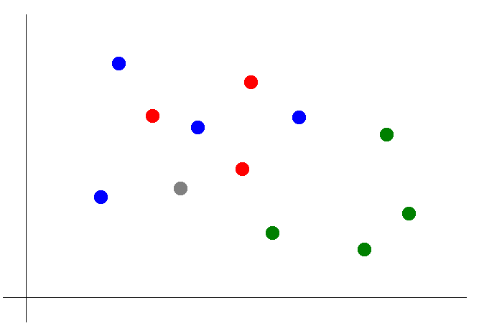
Knn classification - basics
Suppose we want to predict the color of the grey dot.

Slide 62
Knn classification
Suppose we want to predict the color of the grey dot.
1) Pick a value for k.
k = 3

Slide 63
Knn classification
Suppose we want to predict the color of the grey dot.
1) Pick a value for k.
2) Find colors of k nearest neighbors.
k = 3

Slide 64
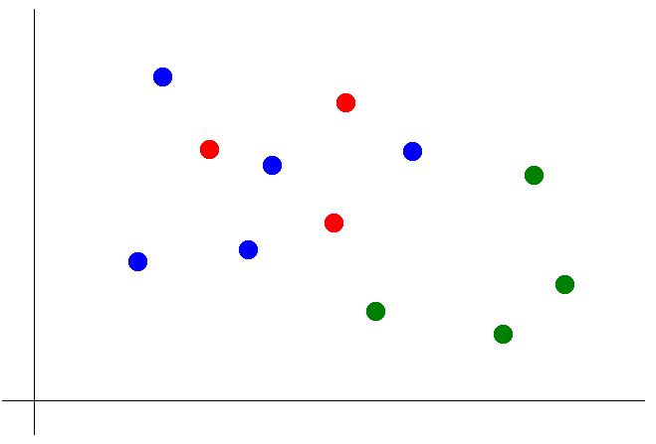
Knn classification
Suppose we want to predict the color of the grey dot.
1) Pick a value for k.
2) Find colors of k nearest neighbors.
3) Assign the most common color
to the grey dot.

Slide 65
Knn classification
Suppose we want to predict the color of the grey dot.
1) Pick a value for k.
2) Find colors of k nearest neighbors.
3) Assign the most common color
to the grey dot.
OPTIONAL NOTE
Our definition of “nearest” implicitly uses the
Euclidean distance function.
Notes:
We will have more to say about distance functions later

Slide 66
Exercise – k nearest neighbors classification in r
Key objectives
R functions
- knn classification using train/test sets - knn {class}
Notes:
~20 min
Use same dataset as last time (pace.txt)
Use whiteboard to demonstrate log-log transf

Slide 67
Assignment – knn with n-fold cross-validation
Key objectives
Extend the script we used in class to implement knn classification on the iris dataset using n-fold cross-validation.
(bonus: split code into functions)
for example:
knn.nfold <- function(n, … ) {
# create n-fold partition of dataset
# perform knn classification n times
# n-fold generalization error = average over all iterations
}

Slide 68
DISCUSSION
INTRO TO DATA SCIENCE

