Slide 1
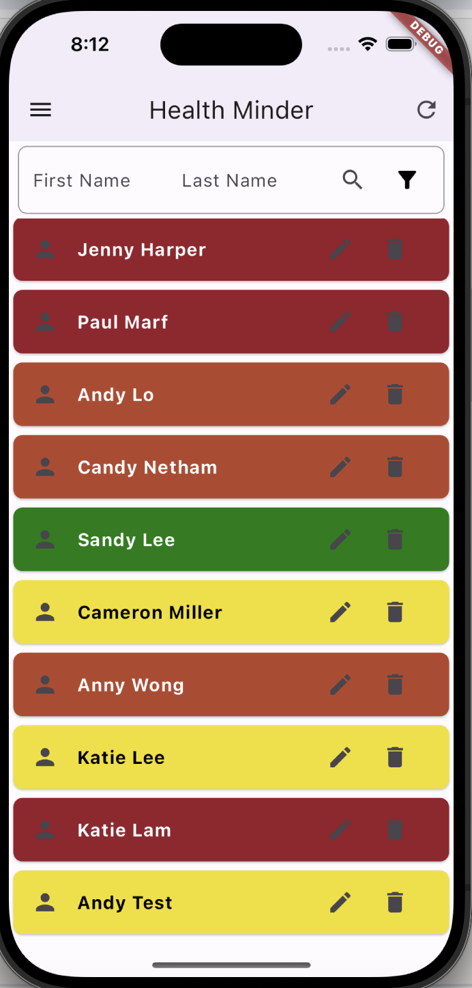
MAPD722- Health Minder
Team 6
Pui Yee Ng, Cole Anam
04-09-2024

Slide 2



Introduction
This app will allow health care providers to create patients and their clinical data, view patient data to track and monitor patient records. Health care providers can view the detailed clinical data for an individual patient in this app. Also, health care providers can find out any patients in critical condition through this app.
View/Add/Edit/Delete
Patients Details
Health Care Providers
Patients' Clinical Data

Slide 3



Technology
Front End UI Design
flutter_test
API Interacting between front-end and backend Database
Testing Package
Backend Database for Permanent Data Storage

Slide 4
Work Contribution List
Pui Yee Ng | Cole Anam | Work Together
State Management(Provider for Patient & Clinical Data) | Add Patients Function | The UI and the navigation
List All Patients with health condition colour indicators | List All Patient's Clinical Data with health condition colour indicators
Display Patient's Details function | Add Clinical Data Function
Filter Patients by Name | Filter Patients with Critical Condition Function
Edit Patients Info Function | Edit Clinical Data Function
Delete Patient's Record and the respective Clinical Data Function | Delete Clinical Data record function
Duplicate Patient Checking before Patient Creation | Input Validation
Backend API and Database Refinement | Test Cases Implementation

Slide 5
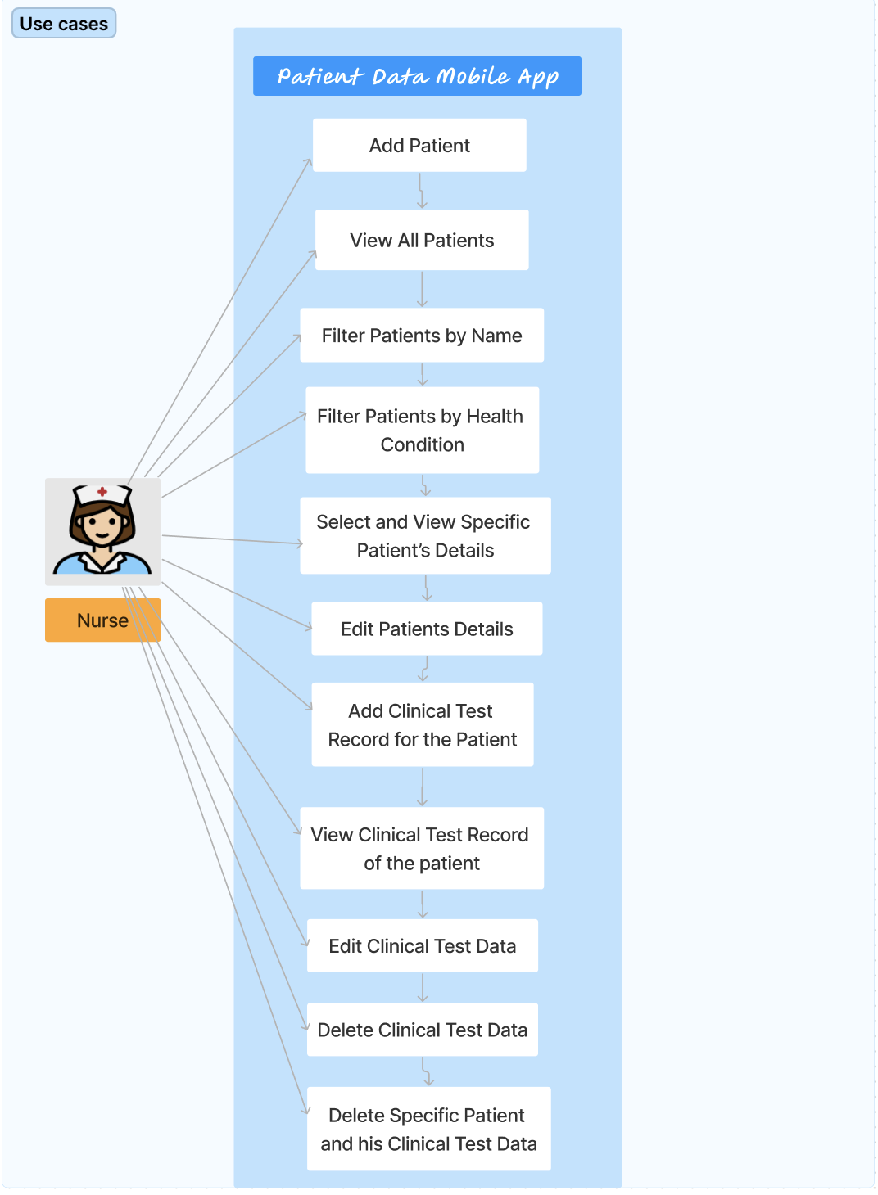
Use Case Diagram

Slide 6
Demo

Slide 7
Questions

