Slide 1
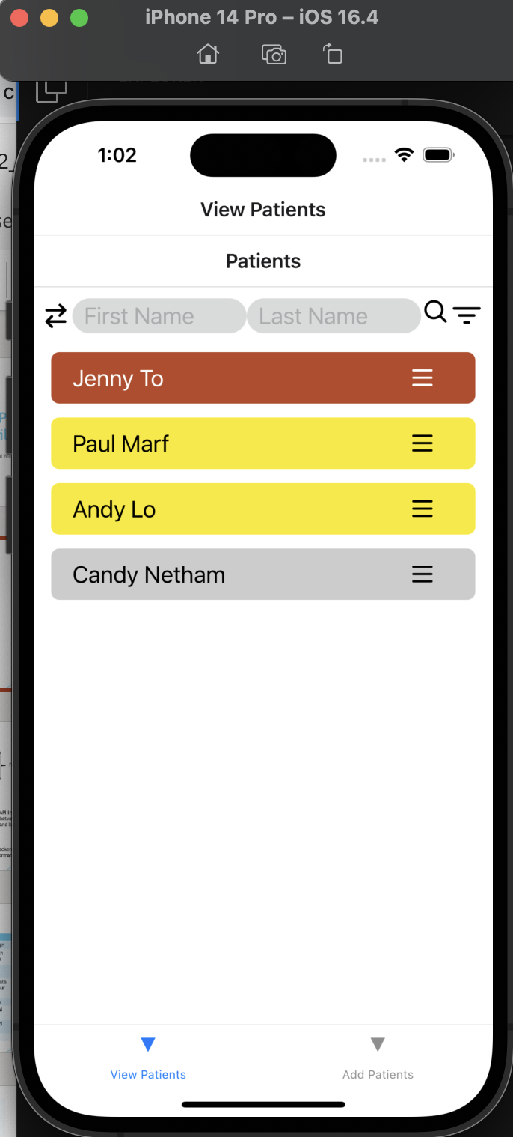
MAPD712- Patient Data Mobile App
Team 7
Pui Yee Ng, Cole Anam
12-06-2023

Slide 2



Introduction
This app will allow health care providers to create patients and their clinical data, view patient data to track and monitor patient records. Health care providers can view the detailed clinical data for an individual patient in this app. Also, health care providers can find out any patients in critical condition through this app.
View/Add/Edit/Delete
Patients Details
Health Care Providers
Patients' Clinical Data

Slide 3





Technology
Front End UI Design
API Interacting between front-end and backend Database
Testing Framework
Backend Database for Permanent Data Storage

Slide 4
Work Contribution List
Pui Yee Ng | Cole Anam | Work Together
Mongo DB Atlas Deployment | Clinical Data Schema Design | The UI and the navigation
Patient Schema Design | List All Patients with health condition colour indicators | Cole: Patient & clinical data card designs
Add Patients Function | Display Patient's Details function | Pui Yee: Form Design (add records, edit records)
Search Patients by Name Function | List All Patient's Clinical Data with health condition colour indicators
Edit Patients Info Function | Add Clinical Data Function
Edit Clinical Data Function | Filter Patients with Critical Condition Function
Delete Patient's Record and the respective Clinical Data Function | Delete Clinical Data record function
Test Cases Implementation

Slide 5
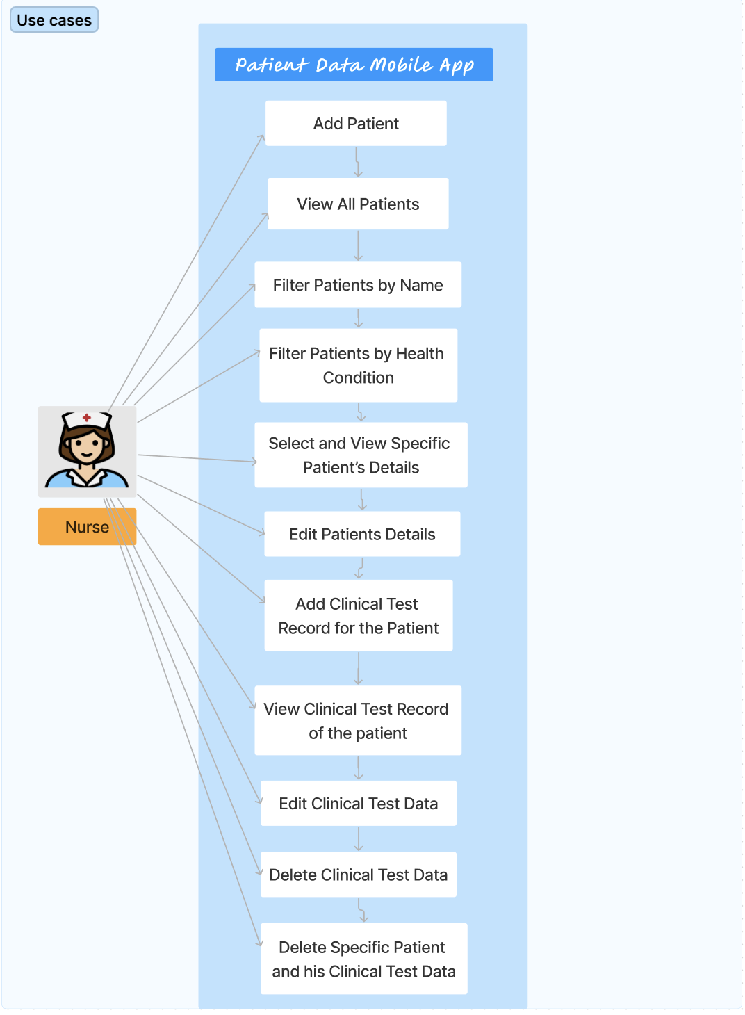
Use Case Diagram

Slide 6
Demo

Slide 7
Challenges
Refactoring the code
Handling Patients' health condition
Considering the user experience of the app, on View/Add/Edit/Delete patients or clinical data

Slide 8
Questions

