Slide 1


MAPD713 - Patient Data REST API
Team 7
Pui Yee Ng, Cole Anam
12-07-2023

Slide 2
Project Description
This REST API service allows health care providers to manage patient clinical data. This includes viewing patient's general information, detailed clinical data for individual patients, and calculating a patient's health condition.

Slide 3






Technology
Cloud Service to host our API Service
Coded REST API
Test the API by making requests
API Service Deployed to Render Cloud
API Interacting between front-end and backend Database
Testing Framework for API Test Cases
Backend Database for Permanent Data Storage

Slide 4
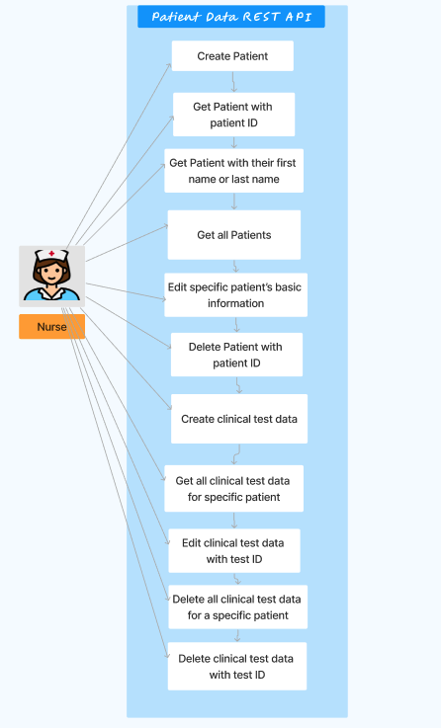
Use Case Diagram

Slide 5
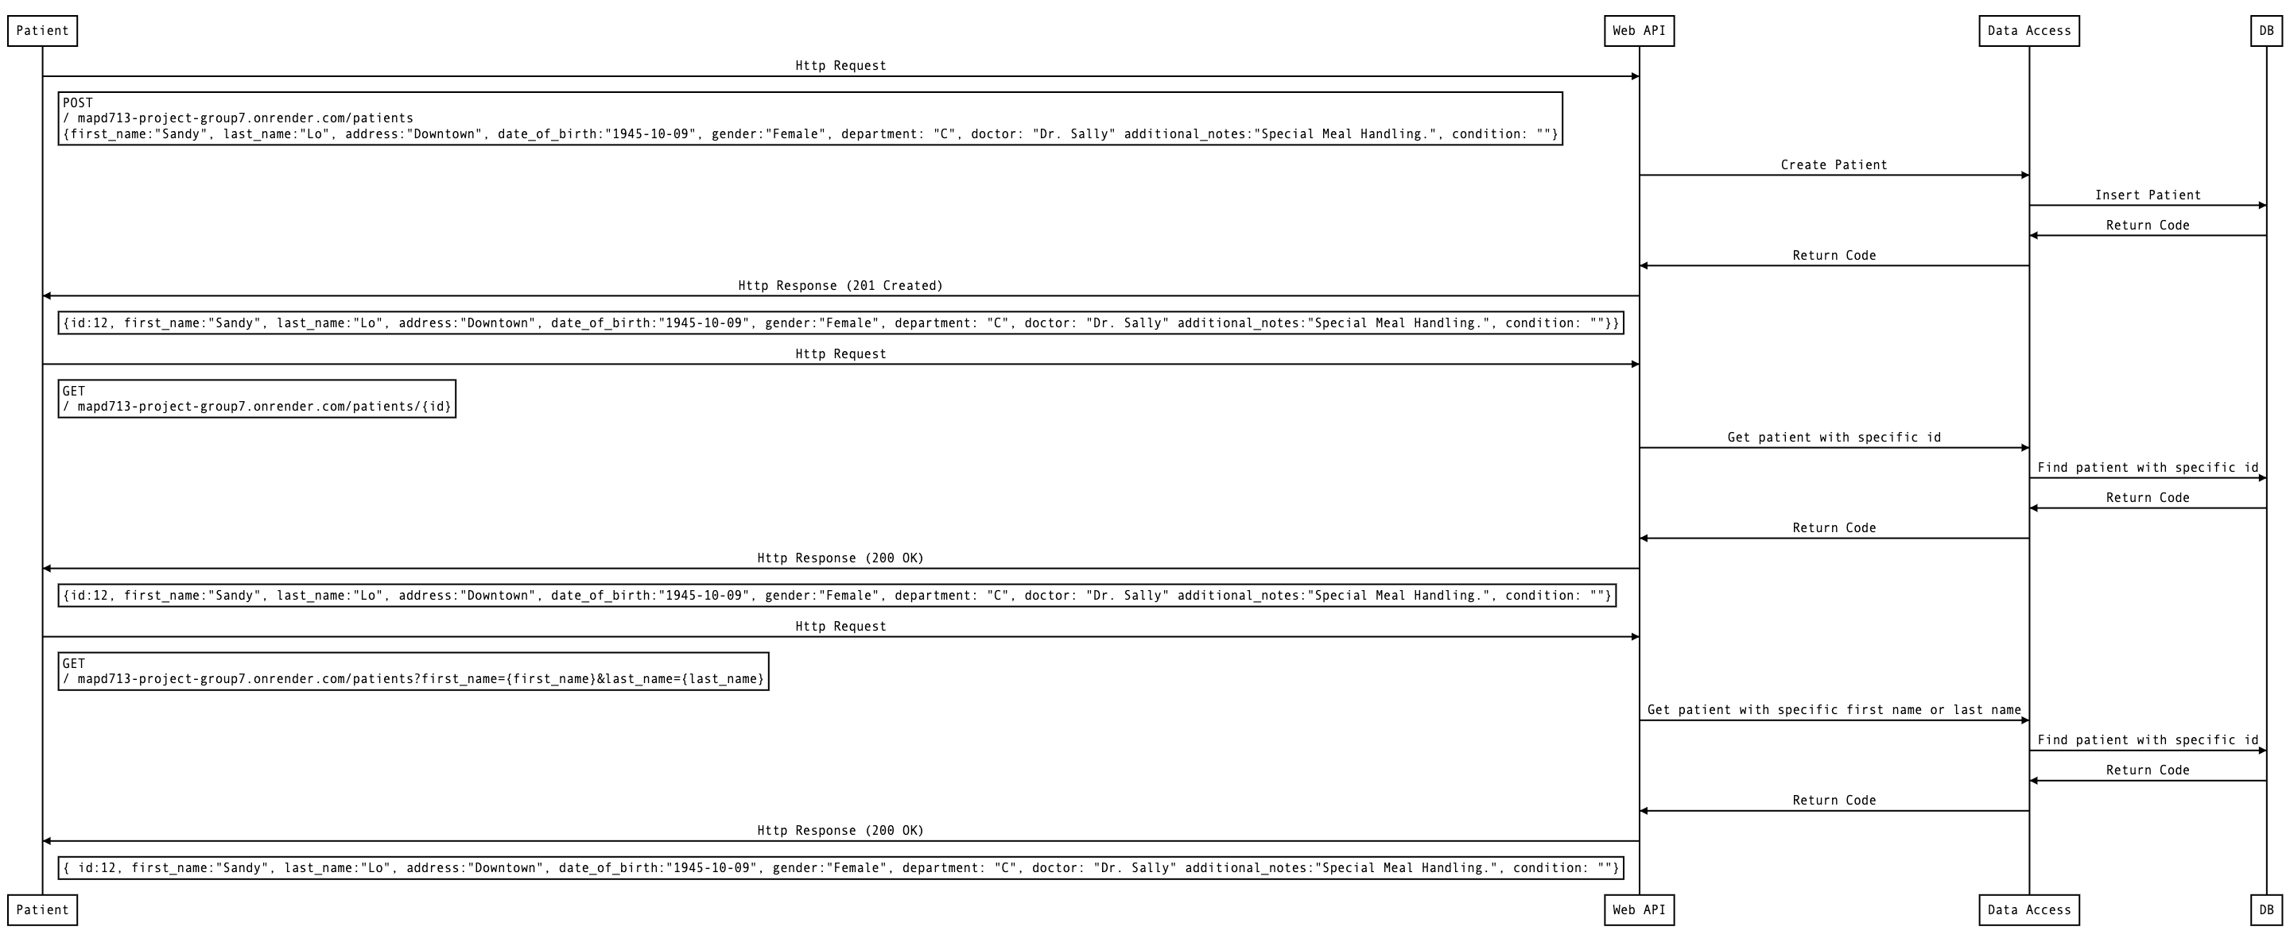
Sequence Diagram (1)

Slide 6
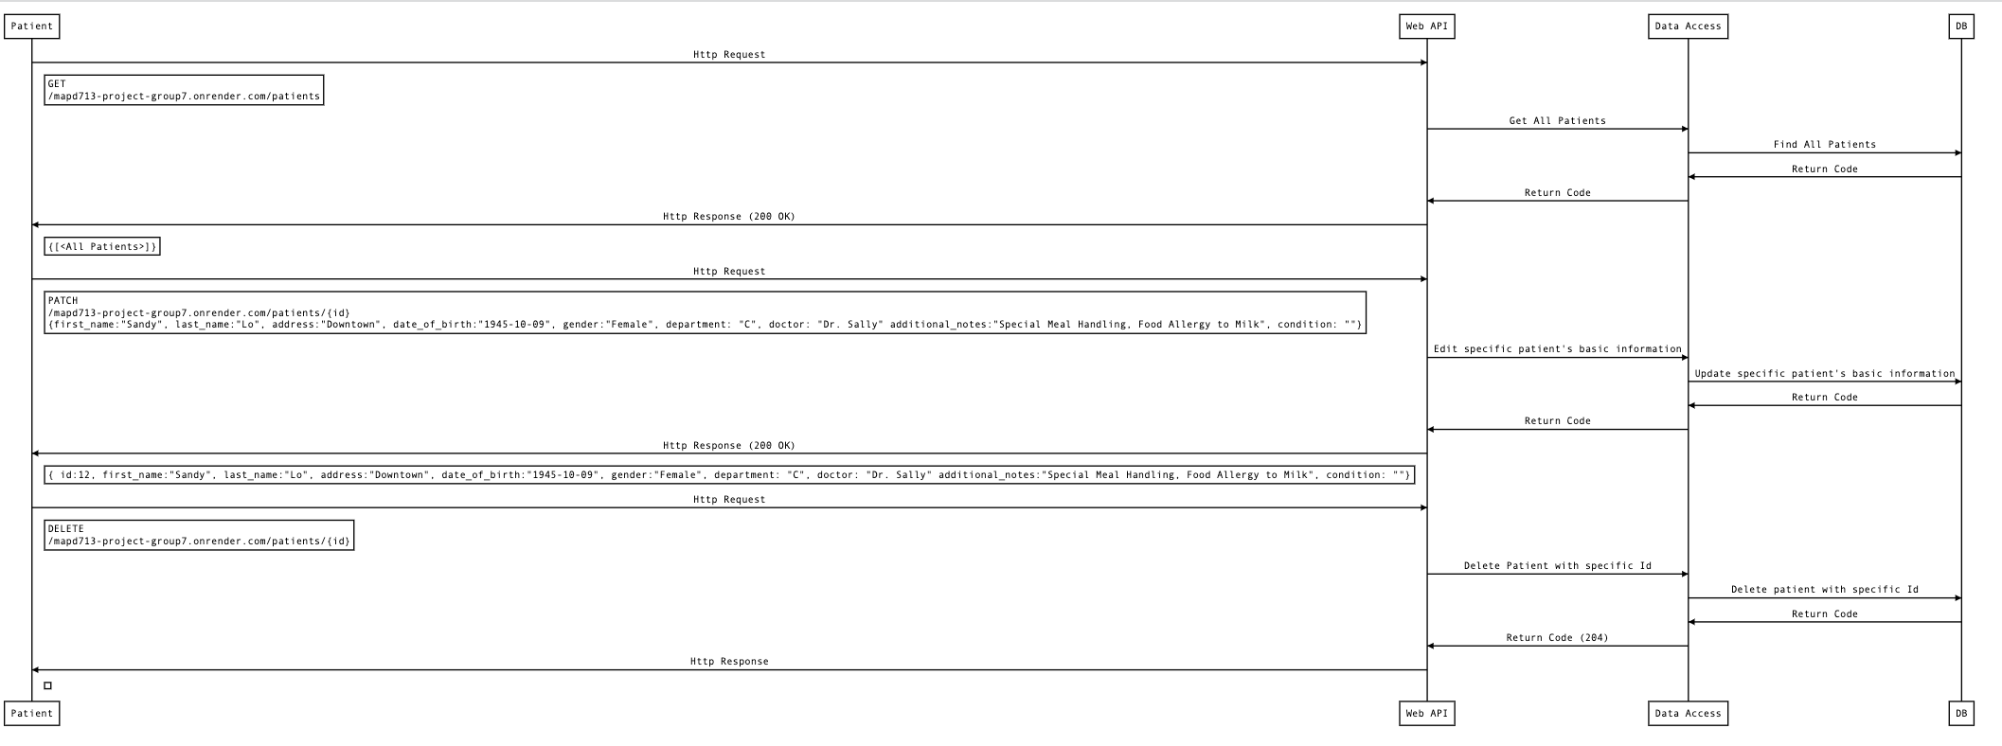
Sequence Diagram (2)

Slide 7
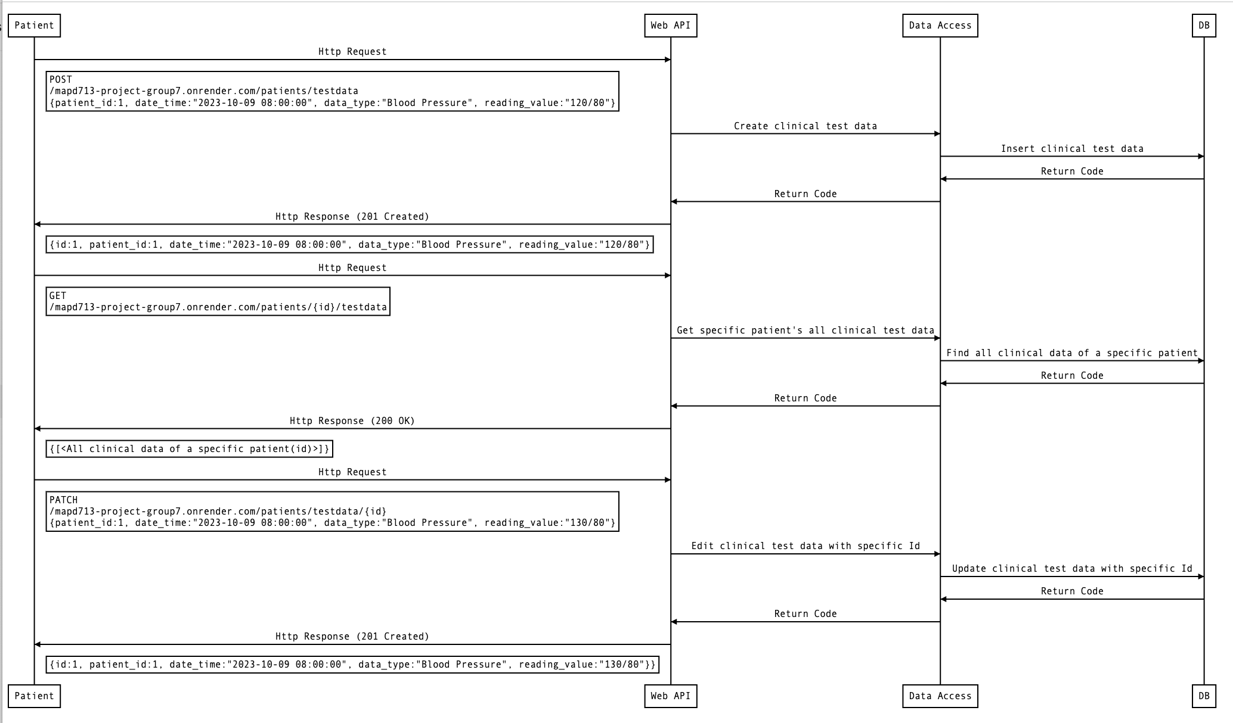
Sequence Diagram (3)

Slide 8
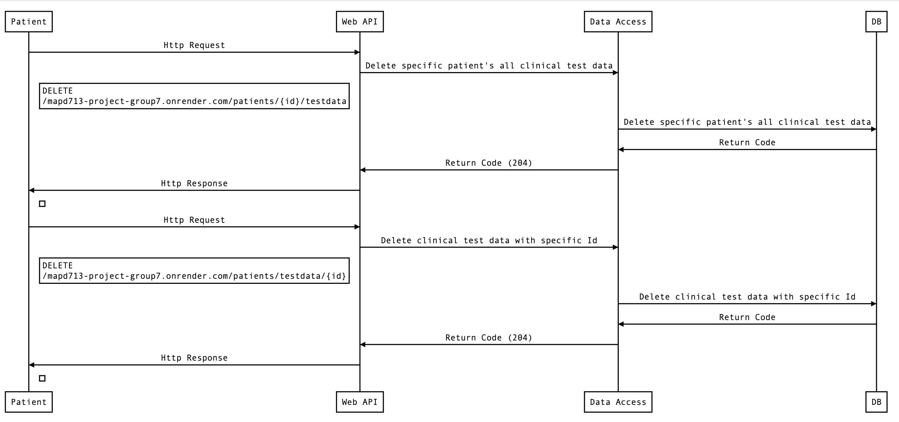
Sequence Diagram (4)

Slide 9
Work Contribution List
Pui Yee Ng | Cole Anam | Work Together
Mongo DB Atlas Deployment | Clinical Data Schema Design | Render Cloud Deployment
Patient Schema Design | List All Patients Info API
Add Patient Info API | Get Specific Patients Info API
Filter Patients by Name API | List all Clinical Data of specific patient API
Edit Patients Info by Patient's ID API | Add Clinical Data API
Delete Specific Patient’s Record | Edit Patients’ Clinical test Data Records by test ID
Delete all Test Data for a specific patient | Delete Specific Clinical Data Record by ID
Test Cases Implementation

Slide 10
Demo

