Slide 1
RSA ENcryption
Presented by Aaron, Dan, Mario, and Sean

Slide 2
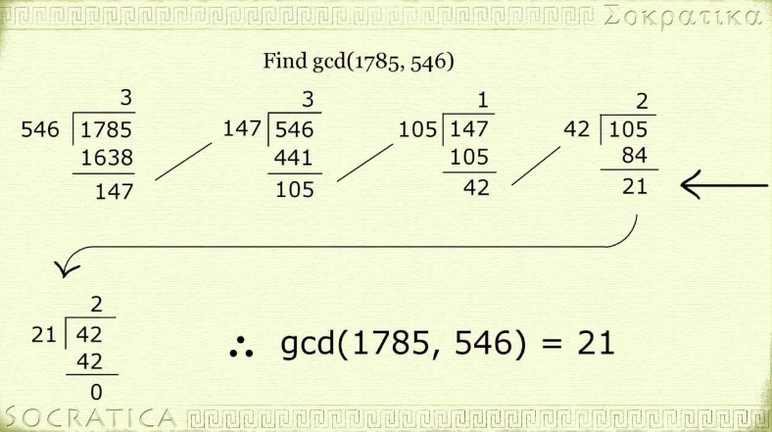
The euclidean algorithm

Slide 3
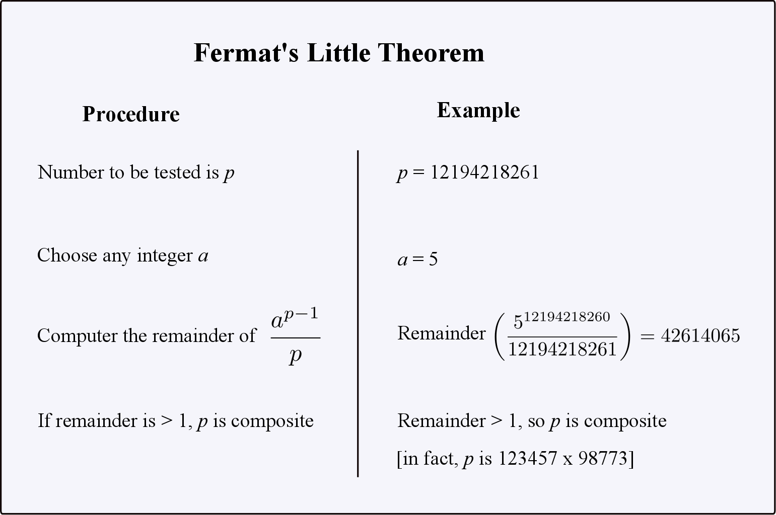
Fermat’s Little theorem

Slide 4
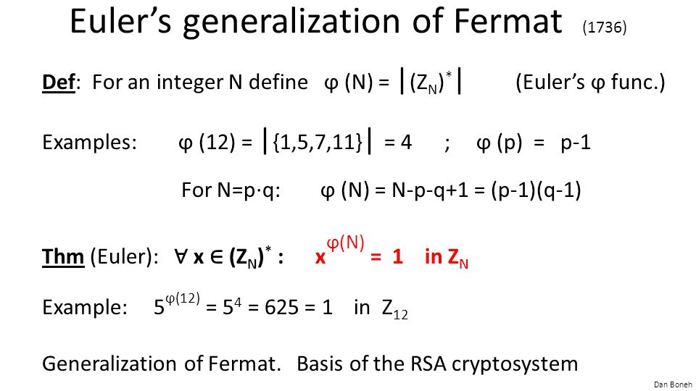
Euler’s generalization

Slide 5
Public key cryptography
In public key cryptography there are two keys
Public key: This key is used to encrypt messages and is made available to the world.
Private key: This key is not made known to the world and is used to decrypt messages

Slide 6
RSA
RSA encryption breaks an input message into manageable pieces that are converted to numbers and then encrypted before being sent to the receiver and decrypted.
RSA is a public key encryption.

Slide 7
RSA variables
p = a large prime
q = a large prime
n = p * q
e: gcd(e, phi(n)) = 1
d: e * d = 1 mod phi(n)

Slide 8
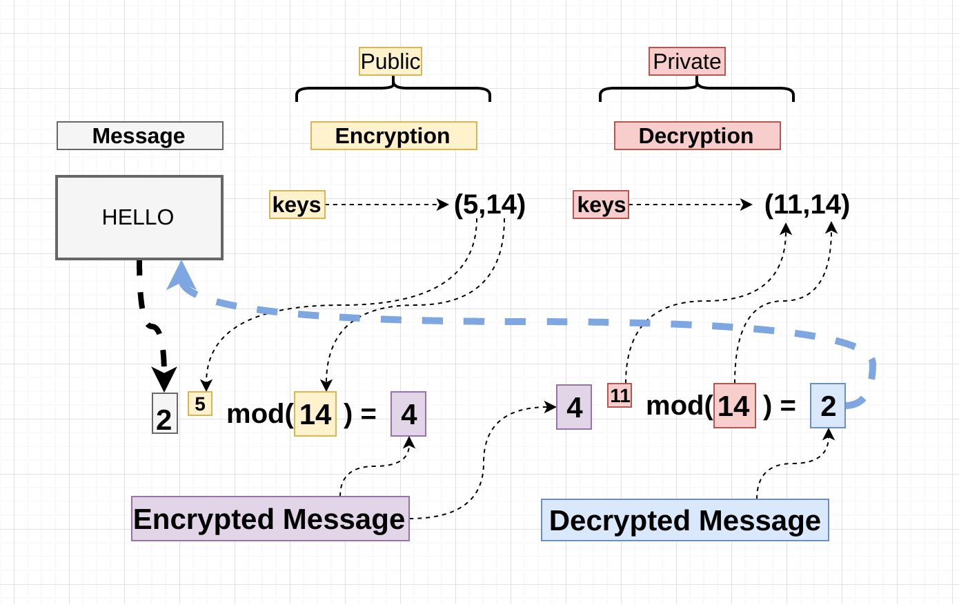
RSA explained

Slide 9
How to crack rsa
One way to break RSA is to factor N. This is very difficult to do with large values for p and q since factoring a large number is very inefficient.

Slide 10
Quantum computing
A quantum computer could instantly break RSA.
Quantum computers aren’t limited to two states, because they have quantum superposition.
According to physicist David Deutsch, this parallelism allows a quantum computer to work on a million computations at once, while your desktop PC works on one.

Slide 11
Shor’s algorithm
Given an integer n find its prime factors.
If a quantum computer with a sufficient number of qubits could operate without succumbing to noise and other quantum decohernece phenomena, Shor’s algorithm could be used to break public-key cryptography schemes such as RSA
RSA is based on the assumption that factoring large numbers is computationally intracable.

