Slide 1
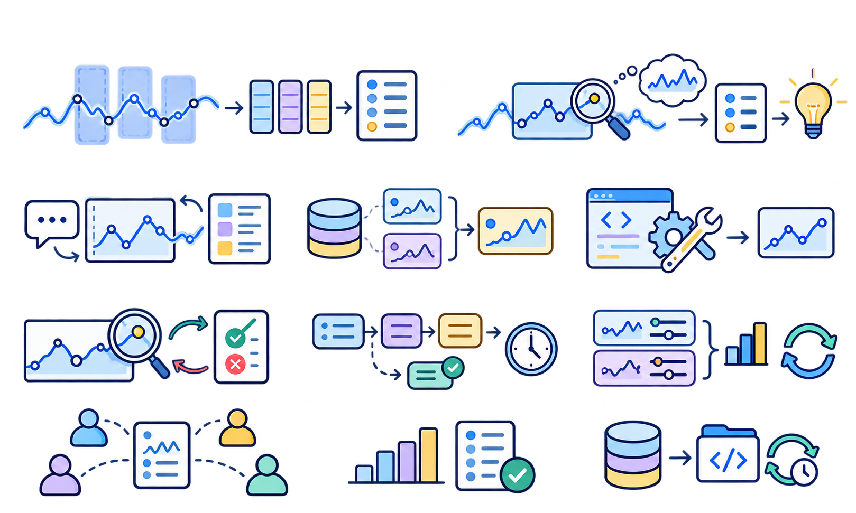

Research Landscape of Time-Series Agent Systems
Model-side contributions, harness mechanisms, and evaluation resources
Model-Side
Contributions
Representation & Alignment
Learning & Reasoning
Time-LLM
Towards Time-Series Reasoning
LLM4TS
STRIDE
Representation · Alignment
Understanding · Adaptation
LLMTime
OpenForecaster
ChatTS
AURA-4B
Harness Mechanisms for Time-Series Agent Systems
1
Interface &
Interaction
2
Memory &
Context
3
Tools &
Execution
4
Control, Verification
& Feedback
5
Planning &
Workflow
6
Optimization &
Evolution
7
Coordination &
Scaling
Structured Analysis Interfaces
Retrieval & Context Construction
Model & Code Execution
Review & Adjudication
Workflow Construction
Reflection & Experience Updates
Debate & Evidence Aggregation
TS-Agent
Agentic RAG for TSA
TimeCopilot
Argos
ClimateAgent
TimeClaw-EEL
TS-Debate
TimeART
TimeCAP
TimeSeriesScientist
AnomaMind
DCATS
FLAIRR-TS
MAS4TS
TSAG
From News to Forecast
MoiraiAgent
TSQAgent
MOSAIC
CastFSR
Competition Agents
TESSA
ZARA
GenAutoML
Oil-Well Explainable Agent
Nexus
CRAFTER
FactorMAD
MERIT
Adaptive Interaction &
Observation
Temporal Experience &
Evidence Memory
Domain Tools & Simulation
Validation & Acceptance Gates
Operational Analysis
Pipelines
Search & Adaptive
Optimization
Coordinated
Decision Systems
SAGE-Sleep
FinMem
AgriWorld
Grid-Agent
HFMD Structured Agents
MetaCaster
FinCon
ARTIST
MemCast
Open-TI
HydroAgent
SIREN
EvoTS-Agent
TradingAgents
TimeRLM
ForecastCompass
GridMind
Neuro-Agentic Control
Smart Energy Agent
MarsTSC
CoLLMLight
LLM-TSFD
TIEM
PPG Physiological Agent
BatteryLake
S2S-FDD
ATLAS
Fin-Analyst
Evaluation & Infrastructure
Benchmarks & Evaluation Resources
Infrastructure & Task Protocols
Benchmarks, datasets, simulators and
task protocols for time-series agents
TemporalBench
TSAQA
TSQBench
TimeSeriesExamAgent
AION
TFRBench
MMTS-Bench
TimeSage-MT
FutureSim
ModernTSF
TraceBench
TimeSeriesGym
TS-Skill
WorldReasoner
TimeClaw-Harness
Selected works grouped by relevant contributions. Subgroups provide descriptive reading aids; placements highlight selected mechanisms rather than exclusive paper categories.

