Slide 1






Time-Series Agent system
A module-level construction view
Time-Series Agent construction
Modules compose across tasks
Time-Series Agent
instantiate
Paper cards
New task agent
LLM + harness
and temporal data
claims, evidence,
module tags
Reusable harness
configuration
observe
select module
evaluate
General Harness
adapt
Time-Series Harness
benchmark
Task contract
tools, memory,
control, planning
temporal state,
operations, validation
forecasting, anomaly,
augmentation, decisions
Module-level paper card
One paper may contribute several modules
Task semantics and benchmark protocols remain explicit
Figure 1. A module-level construction view of a Time-Series Agent. The LLM supplies language and reasoning; the General Harness provides reusable runtime mechanisms; the Time-Series Harness Module supplies temporal state, operations, grounding, and task contracts. A paper card records the claim, evidence locator, module layer, task family, and BibTeX entry.
Notes:
Time-Series Agent survey figure adapted from the user-supplied RSI visual template. The layout, typography, and visual hierarchy are retained while the content is rewritten for the LLM + General Harness + Time-Series Harness Module framework. Editable PowerPoint objects remain available for later grouping and revision.

Slide 2
Survey organization
Sections
§ 1 Introduction
System definition
Construction questions
§ 2 What Is a
Time-Series Agent?
Review scope
Paper-card evidence
§ 3 LLM-Side
Contributions
Temporal representation
Alignment and reasoning
LLM-side methods
§ 4 General
Harness
Tools and memory Control and execution
Temporal state Provenance and validation
Time-Series
Agent
Reader’s guide
§ 5 General Time-Series
Harness
Time-series harnesses Reusable modules
Task contracts Benchmark protocols
§ 6 Task-Specific
Harness
Forecasting Augmentation
Anomaly diagnosis Decision support
§ 7 Infrastructure and
Benchmarks
ModernTSF TimeSeriesGym
Traces and episodes Reproducible evaluation
§ 8 Open Problems and
Case Studies
Paper-card database Module-level counts
Open tasks Evidence gaps
§ 9 Conclusion
System map
Open problems
Notes:
Time-Series Agent survey figure adapted from the user-supplied RSI visual template. The layout, typography, and visual hierarchy are retained while the content is rewritten for the LLM + General Harness + Time-Series Harness Module framework. Editable PowerPoint objects remain available for later grouping and revision.

Slide 3
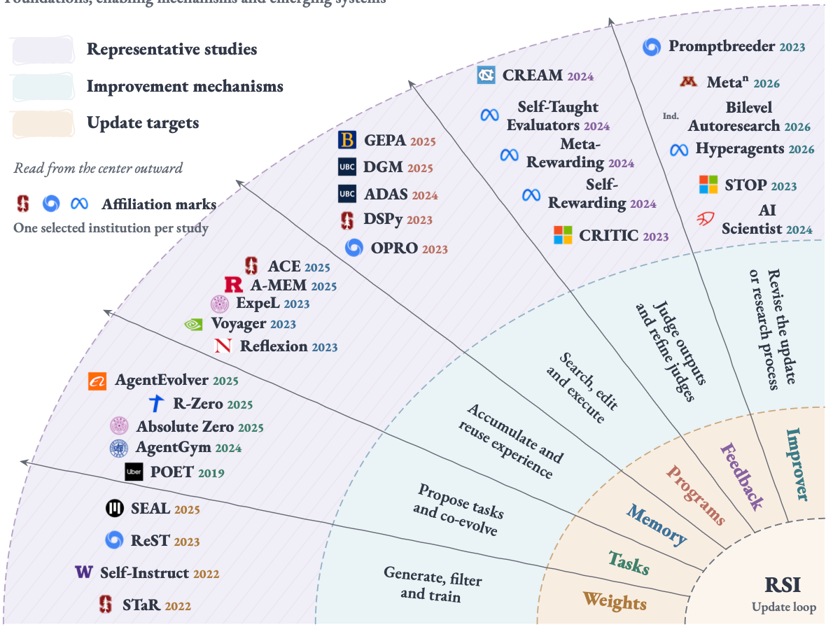
Contribution layers in Time-Series Agents
Paper cards record module-level contributions across the LLM, Harness, temporal, task, and evaluation layers.
LLM side
Time-Series Agent
Evaluation and ledger
Language capability
General Harness
Benchmark contract
tools · memory · control · planning · coordination
representation
alignment
temporal reasoning
ChatTS lineage
episodes
chronology
held-out tests
reproducible traces
General Time-Series Harness
temporal state · operations
provenance · validation
LLM component
Task-Specific Harness
module-level
counts
forecasting
augmentation
anomaly · decisions
Paper card fields
claim · evidence · BibTeX
Each paper can contribute
several modules
General Harness ⊃ General Time-Series Harness ⊃ Task-Specific Harness
Figure 3. The survey records contributions at the module level. The LLM side is parallel to the Harness hierarchy; temporal modules specialize the reusable runtime, and task contracts instantiate the finest layer.
Notes:
Time-Series Agent survey figure adapted from the user-supplied RSI visual template. The layout, typography, and visual hierarchy are retained while the content is rewritten for the LLM + General Harness + Time-Series Harness Module framework. Editable PowerPoint objects remain available for later grouping and revision.

Slide 4
Research routes in Time-Series Agent systems
Representative module contributions by first public year | LLM and Harness layers
LLM
side
General
Harness
General Time-Series
Harness
Task-Specific
Harness
Infrastructure
and benchmarks
Paper-card
database
Representation
Alignment
Tools and memory
Control and planning
Temporal state
Operations and grounding
Forecasting and prediction
Anomaly and diagnosis
Episodes, traces
TimeSeriesGym and ModernTSF
Claim, evidence
module-level counts
Augmentation
TS-Agent
Paper card
2026
Ledger
Module tags
ChatTS
TimeCAP
TimeClaw
TraceBench
Open tasks
2025
Time-LLM
Temporal grounding
Decision support
TimeART
Case studies
Forecasting
ModernTSF
AION
TimeMaster
Anomaly diagnosis
TSQBench
Calibration
TS-Agent
TimeCAP
Benchmark suite
2024
Evidence
LLM4TS
TimeART
TFRBench
Verifier
Surveys
AION
TimeSeriesGym
BibTeX
2023
TimeClaw
TFRBench
ModernTSF
Claims
TSQBench
TimeSeriesGym
Audit
Reflection
Reproducibility
2022
Memory Bank
◫ 2003 | Gödel Machine
◉ 2016 | Learned optimizers
▣ 2019 | POET
Marks: selected affiliations | Branches: research routes, not technical ancestry
Figure 4. Research routes toward recursive self-improvement. Forty-five representative method papers are grouped into six research routes, with three historical anchors shown separately.
Year bands use the first public dates in the checked source records; spacing within each band is adjusted for legibility. Branch lines denote research families.
Technical ancestry, cross-route transfer, and sustained recursive gains require separate evidence. The selection reflects the literature search through September 12, 2026.
Logos identify one selected author or work-done affiliation per study; “Ind.” denotes independent researchers. Affiliation and logo sources are documented separately.
Notes:
Time-Series Agent survey figure adapted from the user-supplied RSI visual template. The layout, typography, and visual hierarchy are retained while the content is rewritten for the LLM + General Harness + Time-Series Harness Module framework. Editable PowerPoint objects remain available for later grouping and revision.

Slide 5








Forecasting
Augmentation
Anomaly diagnosis
Decision support
origin, horizon,
calibration
fidelity, diversity,
utility
event, window,
cause
action, cost,
uncertainty
forecast y_t
forecast y_{t+h}
task contract
plan / verify
check → revise
H_t → H_{t+1}
task output
task-bound
retain
retain
cross-task reuse
same harness
Agent + temporal state
updated forecast
next task episode
new task
temporal memory
task output
new module record
(a) Forecasting
(b) Augmentation
(c) Anomaly diagnosis
(d) Decision support
Figure 5. Four task contracts instantiated by Time-Series Harness Modules. The same general runtime can support distinct temporal outputs when the interface, memory, tools, control, planning, optimization, and coordination obligations are specialized.
Forecasting binds origin, horizon, and calibration. Augmentation binds fidelity, diversity, and utility. Anomaly diagnosis binds event windows and causes. Decision support binds actions, costs, and uncertainty.
A paper may instantiate more than one contract. The paper-card ledger records each module independently so that a task-specific contribution does not occupy a coarser layer.
The dashed horizontal rule separates reusable harness mechanisms from task-bound contracts.
Colored arrows show the output contract carried by each task family.
The visual vocabulary is adapted from the supplied RSI template; the content follows our four task families.
Notes:
Time-Series Agent survey figure adapted from the user-supplied RSI visual template. The layout, typography, and visual hierarchy are retained while the content is rewritten for the LLM + General Harness + Time-Series Harness Module framework. Editable PowerPoint objects remain available for later grouping and revision.

